Slide 1
CSE 403
Lecture 4
Use Cases
Reading:
Writing Effective Use Cases, A. Cockburn
slides created by Marty Stepp
http://www.cs.washington.edu/403/

Slide 2
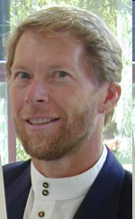
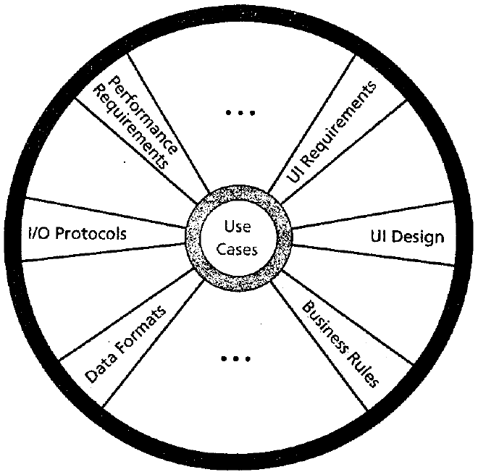
Cockburn's template
Alistair Cockburn's suggested outline for functional requirements:
purpose and scope
terms / glossary
use cases
technology used
other
  development process:
  participants, values (fast, good, cheap?),
  visibility, competition, dependencies
  business rules / constraints
  performance demands
  security (now a hot topic), documentation
  usability
  portability
  unresolved / deferred
human issues: legal, political, organizational, training
Cockburn says the central artifact of requirements is the use case.

Slide 3
Use cases
use case: a written description of the user's interaction with the software product to accomplish a goal
  interactions between an actor and the system
    3-9 clearly written steps lead to a "main success scenario"
    written from actor's point of view, not the system's
benefits of doing use cases?
  helps us discover and document functional requirements
  agreement as to the system's responsibilities
  provides executives a skeleton for planning project priorities
  helps provide a list of error cases to test

Slide 4

Use cases vs. internal features
consider the software to run a mobile phone:
Use Cases
call someone
receive a call
send a message
memorize a number
Point of view: user
Internal Functions
transmit / receive data
energy (battery)
user I/O (display, keys, ...)
phone-book mgmt.
Point of view: developer / designer

Slide 5
Use cases and requirements
Which of these requirements would probably be
represented or mentioned directly in a use case?
  Special deals may not run longer than 6 months.
  Customers only become preferred after 1 year.
  A customer has one and only one sales contact.
  Database response time is less than 2 seconds.
  Web site uptime requirement is 99.8%.
  Number of simultaneous users will be 200 max.
Answer: None!
  Most of these are non-functional requirements, so the use cases wouldn't mention them. The user doesn't see them directly.

Slide 6
Actors, stakeholders, goals
What are actors and stakeholders in a use case?
actor: anything with behavior (that "acts" on the system)
  primary actor: initiates interaction to achieve goal
  supporting actor: performs sub-goals in use case
stakeholder: anyone interested in the system
  supplier, stock agency, vendor
  stakeholder might not "act" in any scenario
goal: action that actor wants to accomplish
  summary (multi-sitting), user (one sitting), subfunction (partial)
Why?
What?
How?

Slide 7
Styles of use cases
Actor / goal list (or UML use case summary diagram)
  shows all use cases in system
Informal use case
Formal use case
Let's examine each of these in detail...

Slide 8
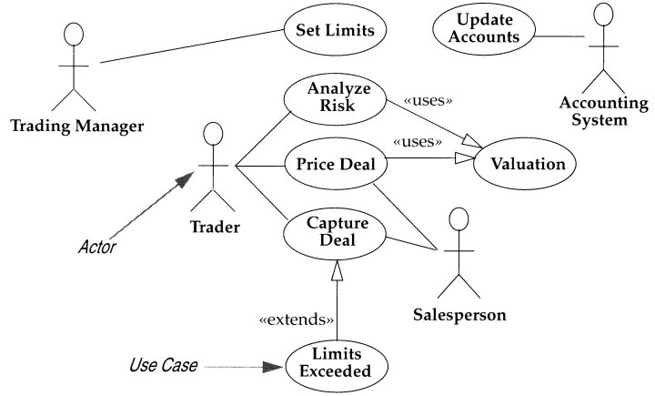
1. Actor / goal list
Often shown as a list or table of actors and their goals, or a diagram of actors connected to use cases:
ACTOR | USE CASES INITIATED
Club Member | Submit Promotion Order Submit Regular Order
Potential Member | Submit New Subscription
Past Member | Submit Subscription Renewal
Membership Dept. | Request Membership
Marketing Dept. | Create Monthly Promotion Create Seasonal Promotion Create Subscription Program Request Promotion Reports Request Sales Reports
Services System | Send Subscription Offer Send Club Promotion Send Subscription Renewal

Slide 9
Use case exercise
Consider a Netflix-like video rental web system.
  A customer with an account can use their membership and credit card in the web app to order a video for rental.
  The software can look up movies and actors by keywords.
  A customer can check out up to 3 movies, for 5 days each.
  Late fees can be paid at the time of return or at next checkout.
Exercise:
  Come up with 3-4 use case names for this software.
  Identify some of the actors and stakeholders in this system.

Slide 10
2. Informal use case
informal use case: a paragraph describing the scenario
Example (for a Netflix-style video rental system):
  Customer Loses a Disc
  The customer reports to the system that he has lost a disc. The clerk displays the customer's rental record and alerts the customer that this will incur a fee. The customer is asked to confirm the decision. After confirming the decision, the database will be updated to reflect the lost disc, and the customer's record is updated as well to remove the disc and add the fee. The inventory manager is notified of the event and may authorize purchase of a replacement disc.

Slide 11
Extensions
What is an "extension"? Why are they useful?
extension: A possible branch in a use case scenario, often triggered by an error or failure in the process.
  Useful for finding edge cases that need to be handled and tested.
  Do: Think about how every step of the use case could fail.
  Do: Give a plausible response to each extension from the system.
    Response should either jump to another step of the case, or end it.
  Don't: List things outside the use case ("User's power goes out").
  Don't: Make unreasonable assumptions ("DB will never fail").
  Don't: List a remedy that your system can't actually implement.

Slide 12
3. Formal use case
(goal of primary actor)
(level of goal [summary, user, subfunction])
(primary actor)
"Place an order" (User goal / Clerk)
Main scenario:
1. Clerk identifies customer, item and quantity.
2. System accepts and queues the order.
...
Extensions:
1a. Low credit & Customer is 'Preferred':
1a1. System gives them credit anyway.
1b. Low credit & not 'Preferred' customer:
1b1. Clerk performs Sign Up Preferred Customer scenario and accepts only prepayment.
2a. Low on stock: Customer accepts rain-check:
2a1. Clerk reduces order to available stock level.
(action steps:
full sentences showing
who takes the action!
3 - 9 steps long.)
(condition causing different actions)
(action step(s)
handling those conditions)
(calling another use case)
Notes:
Why was this important?
It clarified our vocabulary and
It included all the parts we needed to function
Discuss other ways to write use cases
narrative
formal scripts

Slide 13
Example formal use case
Use Case 12. Buy stocks over the web
Primary Actor: Purchaser (user) Level: user goal
Precondition: User already has PAF open and is logged in.
Minimal Guarantee: sufficient log information exists that PAF can detect what went wrong.
Success Guarantees: remote web site acknowledged purchase, user's portfolio updated.
Main success scenario:
1. User selects to buy stocks over the web.
2. PAF gets name of web site to use (E*Trade, Schwabb, etc.)
3. PAF opens web connection to the site, retaining control.
4. User browses and buys stock from the web site.
5. PAF intercepts responses from the web site, and updates the user's portfolio.
6. PAF shows the user the new portfolio standing.
Extensions:
2a. User wants a web site PAF does not support:
2a1. System gets new suggestion from user, with option to cancel use case.
3a. Web failure of any sort during setup:
3a1. System reports failure to purchaser with advice, backs up to previous step.
3a2. Purchaser either backs out of use case or tries again.

Slide 14
Cockburn's 4 use case steps
1. Identify actors and goals
  What computers, subsystems, people will drive our system?
  What does each actor need our system to do?
2. Write the main success scenario
  easiest to read; everything else is a complication on this
  capture each actor's intent and responsibility
3. List the failure extensions
  usually almost every step can fail (bad credit, out of stock...)
  note failure condition separately, after main success scenario
4. Describe failure-handling
  recoverable: back to main course (low stock + reduce quantity)
  non-recoverable: fails (out of stock, or not a valued customer)

Slide 15
Use case exercise
Recall our Netflix-like video rental web system example.
  A customer with an account can use their membership and credit card in the web app to order a video for rental.
  The software can look up movies and actors by keywords.
  A customer can check out up to 3 movies, for 5 days each.
  Late fees can be paid at the time of return or at next checkout.
Exercise:
  Write a formal use case for Customer Orders a Movie.

Slide 16
Agile "User Stories"
Instead of Use Cases, Agile project owners do "user stories"
  Who (user role) – Is this a customer, employee, admin, etc.?
  What (goal) – What functionality must be achieved/developed?
  Why (reason) – Why does user want to accomplish this goal?
As a [user role], I want to [goal], so I can [reason].
Example:
  "As a user, I want to log in, so I can access subscriber content."
story points: Rating of effort needed to implement this story
  common scales: 1-10, shirt sizes (XS, S, M, L, XL), etc.

