Slide 1
CSE 403
Lecture 5
Working in Teams
Reading:
Rapid Development Ch. 13,
Pragmatic Programmer Ch. 8.41
slides created by Marty Stepp
http://www.cs.washington.edu/403/

Slide 2
Big questions
How do you decide who should be project manager?
  What's the difference between project manager and tech lead?
How do you divide your team into subgroups?
Who will work on what, and with whom?
How will we make decisions about our project?
How will everyone communicate and stay in sync about important decisions and issues?
What will we do if someone is not doing their share?
  How can we motivate team members to prevent this?

Slide 3
Team pros and cons
Having more people has benefits
  Attack bigger problems in a short period of time
  Utilize the collective experience of everyone
Having more people has risks, too
  Communication issues
  Diffusion of responsibility
  Working by inertia; not planning ahead
  Conflict or mistrust between team members

Slide 4
Issues affecting team success
Presence of a shared mission and goals
Motivation and commitment of team members
Experience level and presence of experienced members
Team size, need for bounded yet adequate communication
Team organization
  and results-driven structure
Reward structure within the team
  incentives, enjoyment, empowerment (ownership, autonomy)

Slide 5
Common roles
Many software development teams include:
  designers (system design, documents, communication)
  developers ("devs")
  a head developer or tech lead
  testers
  a project manager a.k.a. "PM"
    functional and/or project management responsibilities
These could be all different team members,
or some members could span multiple roles.

Slide 6
Team leadership
Who makes the important big decisions in your team?
  One person?
  All, by unanimous consent?
  All, by majority vote?
  Other options?...
  Is this an unspoken or explicit agreement among team members?
Question: What are some good/bad ways to make decisions?

Slide 7
Making decisions
  let everyone give their input (even if some of it is off-track)
  write down pros/cons of alternatives in a grid or table (weighted?)
  think about cost/benefit, risk analysis of each proposed idea
    How long will it take? How much to learn? Do we have to do it?
  have a clear procedure for what to do for a tough disagreement
    strive for consensus, but if it cannot be achieved, ...
    majority vote, and PM decides on a tie, ... etc.
  stepladder technique: have 2 people decide, then 3, then 4, ...
  pareto analysis: find 20% of work that solves 80% of problem
  compromise, compromise, compromise

Slide 8
Once decisions are made
write down decisions and responsibilities clearly
  document by email
  post to a shared wiki or web page
come up with a set of steps to accomplish the decided goal
  list specific dates that progress should be made
  list several smaller milestones
  agree to communicate and/or meet after milestones are done
prioritize and order goals and TODOs
  list them by urgency, by due date (or milestone date)
  make sure to list group member(s) are responsible for which
  make sure every group member has a significant role

Slide 9
Kinds of teams
problem-resolution: a focused attack on specific issues
creativity: coming up with and exploring new ideas
tactical-execution: carries out a defined plan
Some team models
  business: tech lead and a bunch of equal devs
  chief programmer / surgical: lead dev does most of work
  skunk works: just turn the devs loose
  feature: divide work based on features of product
  search-and-rescue: focused on a specific problem
  SWAT: skilled with a particular advanced tool(s)
  athletic: carefully selected people w/ specialized roles
  theater: "director" assigns roles to others

Slide 10
Team structure models
Dominion model
  Pros
    clear chain of responsibility
    people are used to it
  Cons:
    single point of failure at the commander
    less or no sense of ownership by everyone
Communion model
  Pros
    a community of leaders, each in his/her own domain
    inherent sense of ownership
  Cons
    people aren't used to it (and this scares them)

Slide 11
Common positive factors
Clear roles and responsibilities
  Each person knows and is accountable for their work
Monitor individual performance
  Who is doing what, are we getting the work done?
Effective communication system
  Available, credible, tracking of issues, decisions
  Problems aren't allowed to fester ("boiled frogs")

Slide 12
Organizing by functionality
Who will do the ...
  scheduling? development? testing? documentation (spec, design, write-ups, presentations)? build/release preparation? inter-team communication? customer communication?
Pragmatic Programmer tip:
"Organize around functionality, not job functions."
Question: What are some benefits of organizing teams around functionality vs. around job functions/titles?

Slide 13
Achieving productivity
How can you get the most out of your team members?
  give them specific, small, attainable goals that they can visualize
  have frequent communication and updates
  meet in person to work as much as possible
  put people in small teams; minimize work done "solo"
  build good team camaraderie
What can block people or stop them from making progress?
  technical confusion: How do I start implementing that feature?
  unclear responsibilities: Oh, am I supposed to do that?
  unclear due dates: When was I supposed to have that done?
  lack of milestones: But it's not due until next Friday!
  laziness: Time to work on 403 ... Ooh look, World of Warcraft!

Slide 14
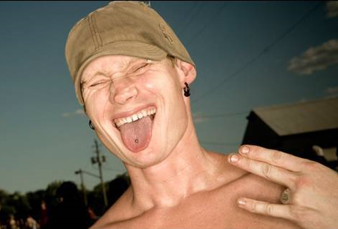
Dealing with slackers
What do you do if a group member is
slacking off instead of working?
  check up on them frequently
  give them less "solo" work;
  put them in a sub-team of 2-3
  have them meet more in person (harder to slack in front of you)
If the problem persists, then what?
  anonymous feedback
  have the PM send them a kind but firm email with concerns
  have an in-person meeting with PM and a few members
  contact primary customer to let them know about potential issue

Slide 15
Email question
What's wrong with this email?
  "Hey Jim, I was wondering if you finished the XYZ feature you were assigned yet? You were late on the ABC feature from the last phase so I thought I better email you. When you have time, please tell me when XYZ is done.
  -- Ralph"

Slide 16
Being quantitative
be quantitative and specific
  use specific, incremental goals, not just for things to be "done"
  list particular dates that results are expected
  give an expected date/time to reply to a communication
  don't be accusatory; offer support, help, gratitude as appropriate
  remind about upcoming deadlines, meetings, key points
possibly better email:
  "Hey Jim, how is your work on the XYZ going? It's due a week from Friday. Like we talked about at our last meeting, we are hoping to have the rough sketch of the first 2/3 of it by Sunday so we can go over it together. Please let me know by tomorrow night how much progress has been made. If you have any questions or need some assistance along the way, please let me know. We'll all meet Saturday in person and you can give us another update at that time. Thanks! -- Ralph"

Slide 17
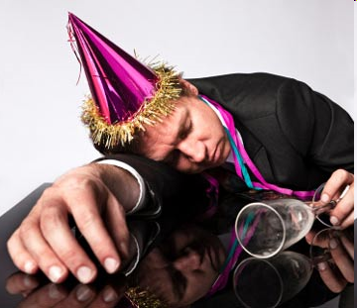
Slackers, continued
group relations must be handled with care
  "slacker" may feel singled out by
  rude or critical messages / meetings
  There are two sides to every story.
  goal: to improve problem and maintain positive group relations
  it is possible to be critical without being harsh, rude, mean
  it is often helpful to avoid the appearance of a 1-on-1 conflict
    PM can speak on behalf of other group members
      "We" are concerned about XYZ, not "I"
  depersonalize by making it about all group members, not one
    "We" are a little behind, so let's all meet in person in the lab today

Slide 18

Running a meeting
how to run an effective meeting:
  bring an agenda of topics to discuss
  (best to email this ahead of time)
  each member/subgroup reports its progress
  get an update on every current work item
  take notes on decisions made and post them to wiki, etc.
  have whiteboard/paper handy for sketching out ideas
  keep everyone's attention (maybe ban laptops / cell phones, etc)
  walk away with a clear plan of action, set of TODOs, etc.

Slide 19
Meeting gotchas
  don't tolerate people showing up late, not being on task, etc.
    punctuality is expected; PM should manage on-task discussion
  don't ignore a group member's input
    even if you don't go forward with their idea, at least listen to it
  don't let it run too long (people hate long meetings)
    if discussion is sidetracked, PM should steer group back to agenda
    if still running over, find a stopping point and save some for next time
    agree to discuss some issues over email if necessary
  don't "meet just to meet"
    if you have nothing to discuss, make it a "work meeting" in the lab or cancel the meeting altogether (no one will complain)
  don't use meetings for one-way flow of information (email)

