Slide 1
CSE 403
Lecture 6
User Interface Prototyping
Reading:
Paper Prototyping, C. Snyder
slides created by Marty Stepp
http://www.cs.washington.edu/403/

Slide 2
Big questions
What's the point of prototyping? Should I do it?
  If so, when in the overall process or "lifecycle" should I?
Should I make my prototype on paper or digitally?
How do I know whether my UI is good or bad?
  What are the ways in which a UI's "quality" can be quantified?
  What are some examples of software you use that have especially good/bad UIs? What do you think makes them good/bad?

Slide 3
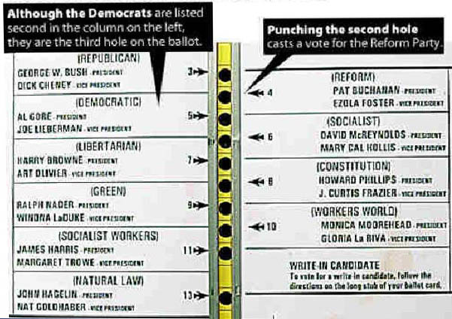
Usability and SW design
usability: The effectiveness with which users can achieve tasks in a software environment.
  studying and improving usability is part of
  Human-Computer Interaction (HCI)
  usability and good UI design are closely related
  a bad UI can have unfortunate results...

Slide 4
Achieving usability
some methods to achieve good usability:
  user testing / field studies
    having users use the product and gathering data
  evaluations and reviews by UI experts
  card sorting
    Show users various UI menus and ask them to group the ones that are similar, to see what UI tasks are seen as being related by users.
  prototyping
    paper prototyping
    code prototyping
Good UI design focuses on the user, not developer or system.

Slide 5
Prototyping
prototyping: Creating a scaled-down or incomplete version of a system to demonstrate or test aspects of it.
What are some possible benefits of prototyping?
  aids UI design
  help discover requirements
  help discover test cases and provide a basis for testing
  allows interaction with user and customer to ensure satisfaction
  team-building

Slide 6


Some prototyping methods
UI builders (Visual Studio, etc.)
  draw a GUI visually by dragging/dropping UI controls on screen
implementation by hand
  writing a "rough" version of your code
paper prototyping: a paper version of a UI
  Question: Why not just code up a working code prototype?
  much faster to create than code
  can change faster than code
  more visual bandwidth (can see more at once)
  more conducive to working in teams
  can be done by non-technical people

Slide 7
Where does it fit in?
At what point in the software lifecycle should we do (paper) prototyping? When would it be most useful to do it? Why?
We talk about requirements being about "what" and design being about "how." Which is paper prototyping?
  PP helps uncover requirements and also upcoming design issues
  do PP during or after requirements; before design
  "what" vs. "how": PP shows us "what" is in the UI, but it also shows us details of "how" the user can achieve goals in the UI

Slide 8
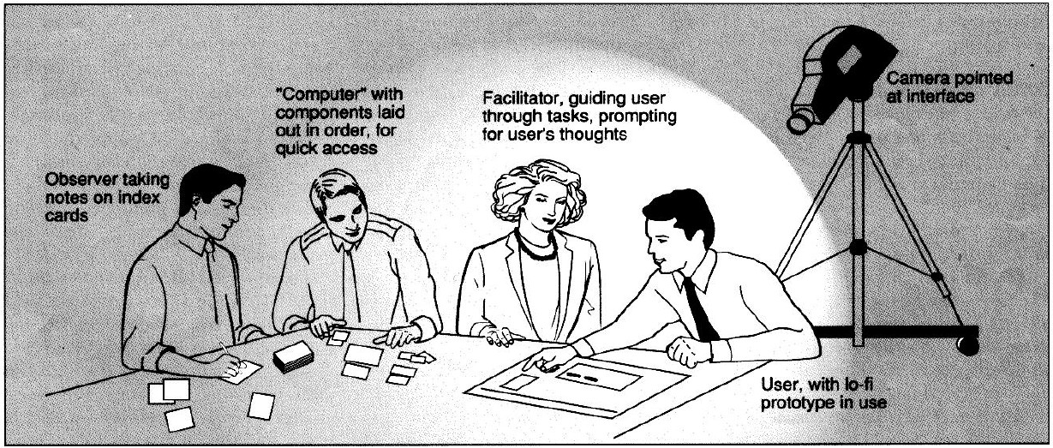
P.P. usability session
user is given tasks to perform using paper prototype
session can be observed by people or camera
one developer can "play computer"
“Computer”
Facilitator
Observer(s)
User

Slide 9
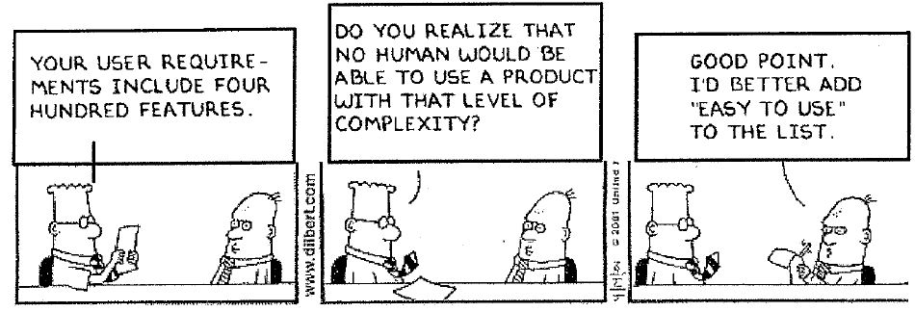
Schneiderman's 8 Golden Rules
Strive for consistency.
Give shortcuts to the user.
Offer informative feedback.
Make each interaction with the user yield a result.
Offer simple error handling.
Permit easy undo of actions.
Let the user be in control.
Reduce short-term memory load on the user.
(from Designing the User Interface, by Ben Schneiderman of UMD, HCI/UI expert)

Slide 10
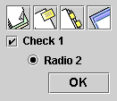
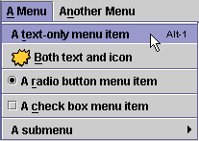
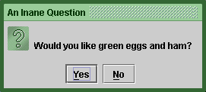

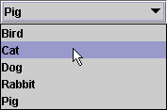


UI design and components
When should we use:
  A button?
  A check box?
  A radio button?
  A text field?
  A list?
  A combo box?
  A menu?
  A dialog box?
  Other..?

Slide 11
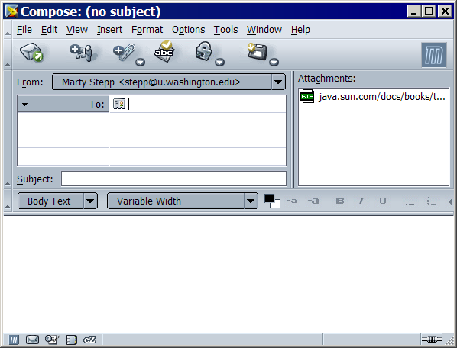
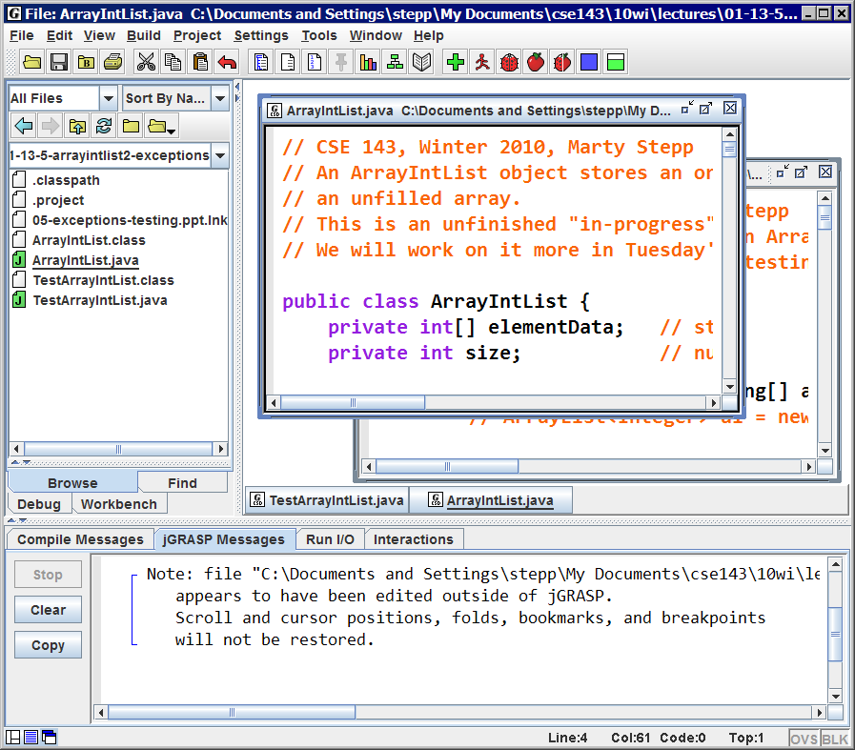
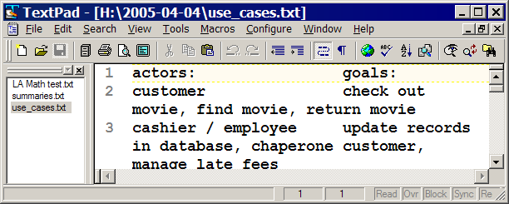
UI design examples

Slide 12
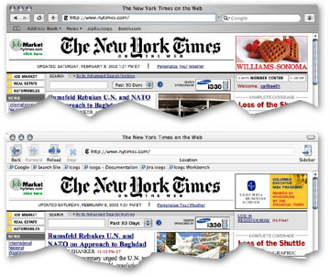
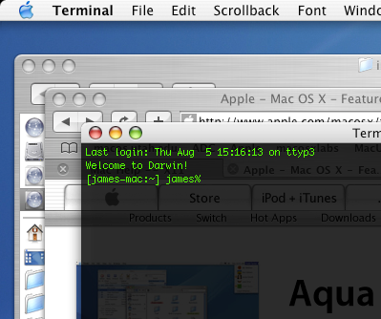
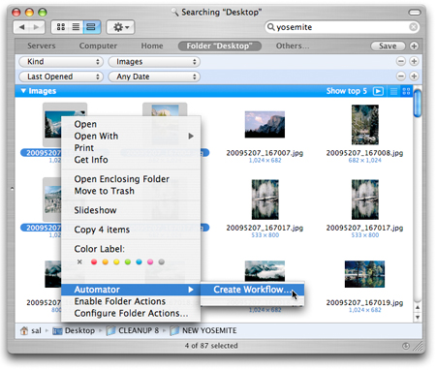
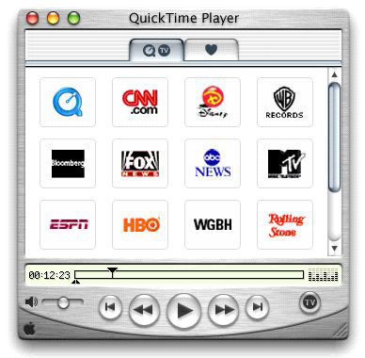
Apple Mac user interfaces

Slide 13
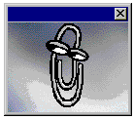
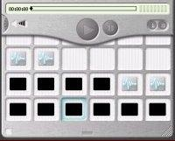

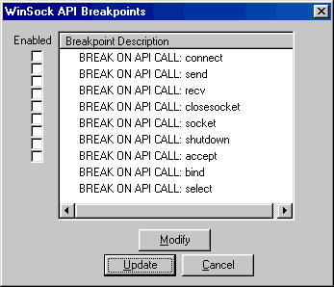
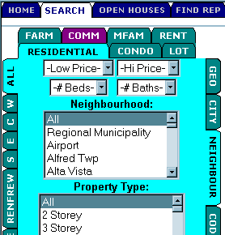

UI Hall of Shame
http://homepage.mac.com/bradster/iarchitect/shame.htm

Slide 14
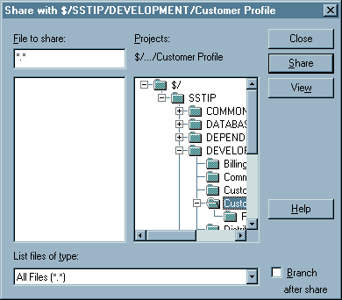
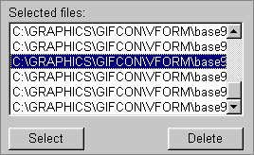

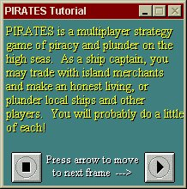


Layout and color

Slide 15
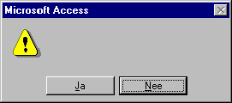
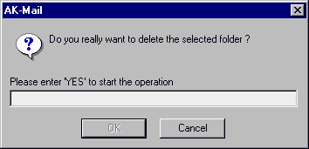
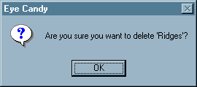
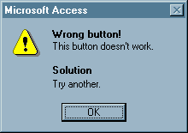
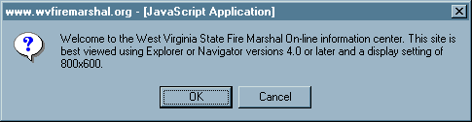
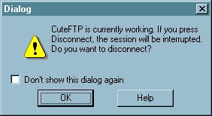
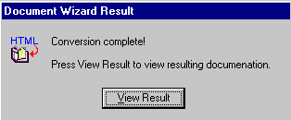
Bad error messages

Slide 16

UI design - buttons, menus
Use buttons for single independent actions that are relevant to the current screen.
  Try to use button text with verb phrases such as "Save" or "Cancel", not generic: "OK", "Yes", "No"
  use Mnemonics or Accelerators (Ctrl-S)
  tool tips are helpful, but don't rely on them
  (many users don't know to hover to find them)
Use toolbars for common actions.
Use menus for infrequent actions applicable to many screens.
  Users don't like menus! Try not to rely
  too much on menus. Provide
  another way to access the same
  functionality (toolbar, hotkey, etc)

Slide 17
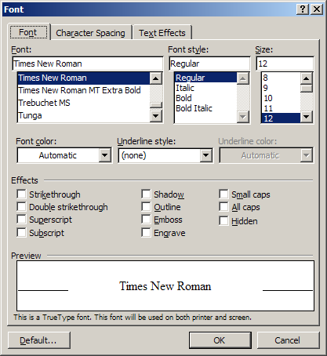
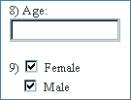
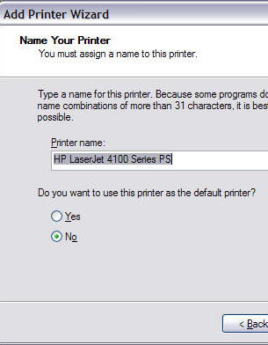
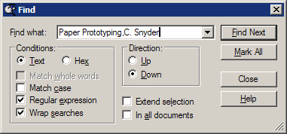
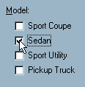
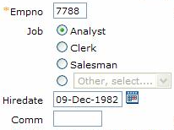
Checkboxes, radio buttons
Use check boxes for independent on/off switches (boolean)
Use radio buttons for a small number of related choices, when only one can be activated at a time (enum / constants)

Slide 18
Lists, combo boxes, etc.
use text fields (usually with a label) when the user may type in anything they want
  you will usually have to validate the input
use lists when there are many fixed choices (too many for radio buttons to be practical) and you want all choices visible at once
use combo boxes when there are many fixed choices, but you don't want to take up screen space by showing them all at once
use a slider or spinner for a
numeric value with fixed range

Slide 19
An example UI
Did the designer of this UI choose the right components?
  assume there are 30 collections and 3 ways to search
  (by title, author, relevancy)
LIBSYS: Search
Choose collection:
All
Phrase:
Search by:
T
itle
Adjacent words
Y
es
No
Default
Cancel
OK
Notes:
Answer:
UI should be set into columns.
The "search by" combo box is better as a list or radio buttons. The Adjacent Words should be a checkbox.
The button labels (especially "Default", which could be "Reset to Default") are poorly worded; they should be verb phrases. Also their order is non-standard.

Slide 20

UI design - multiple screens
you can use a tabbed pane when there are many screens that the user may want to switch between at any moment
  or multiple pages, if it's a web site
use dialog boxes or option panes to present temporary screens or options
  users hate popup dialogs; use them
  very rarely
  don't prompt for lots of user input by
  popping up dialogs
    instead, put the choices on the existing
    window as buttons, etc.

Slide 21
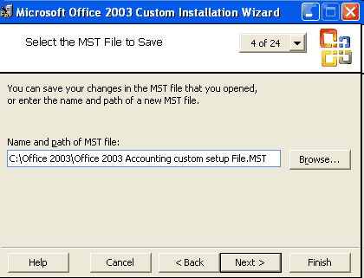
"Wizards"
wizard: series of dialog boxes to progress through a task
In the mid-1990s, Microsoft changed most of its Windows apps to use "wizards" for installation and settings.
  Why did they do this?
  What are the pros and cons of a "wizard" UI?

Slide 22

Creating a paper prototype
gather materials
  paper, pencils/pens
  tape, scissors
  highlighters, transparencies
identify the screens in your UI
  consider use cases, inputs and outputs to user
think about how to get from one screen to next
  this will help choose between tabs, dialogs, etc.

Slide 23
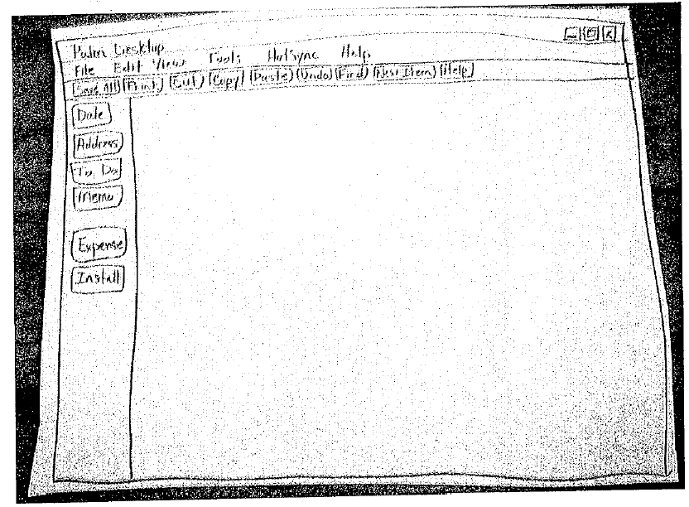
Application backgrounds
draw the app background (the parts that matter for the prototyping) on its own, then lay the various subscreens on top

Slide 24
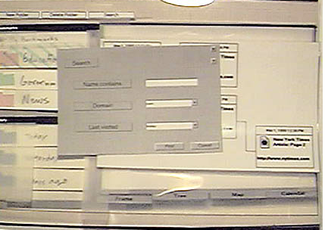
Representing a changing UI
layers of UI can be placed on top of background as user clicks various options

Slide 25
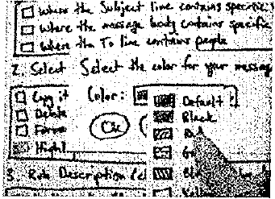
Interactive widgets
widget | how to simulate it
buttons or check boxes | tape
tabs and dialog boxes | index cards or small papers
text fields | removable tape
combo boxes | put the expanded choices on a separate paper / Post-It
selections | highlighted piece of tape
a disabled widget | cut out a separate gray version that can be placed on top of the normal one
Notes:
Simulate sounds yourself. When the computer beeps: say "beep" (hah!)

Slide 26
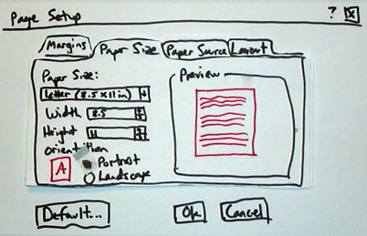
Example paper prot. screen

Slide 27
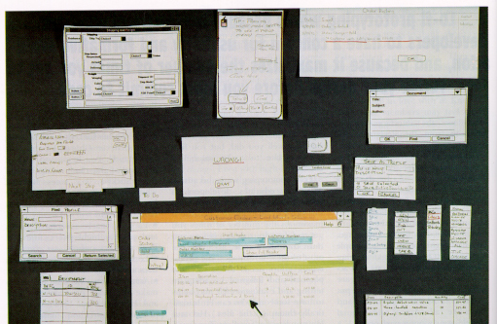
Example paper prototype

Slide 28
Prototyping exercise
Let's draw a prototype for a music player (e.g. iTunes).
  Assume that the program lets you store, organize, and play songs and music videos.
  Draw the main player UI and whatever widgets are required to do a search for a song or video.
  After the prototypes are done, we'll try walking through each UI.
Things to think about:
  How many clicks are needed? What controls to use?
  Could your parents figure it out without guidance?

