Slide 1
CSE 403
Lecture 10
Code Reviews
Reading:
Code Complete, Steve McConnell
slides created by Marty Stepp
http://www.cs.washington.edu/403/

Slide 2
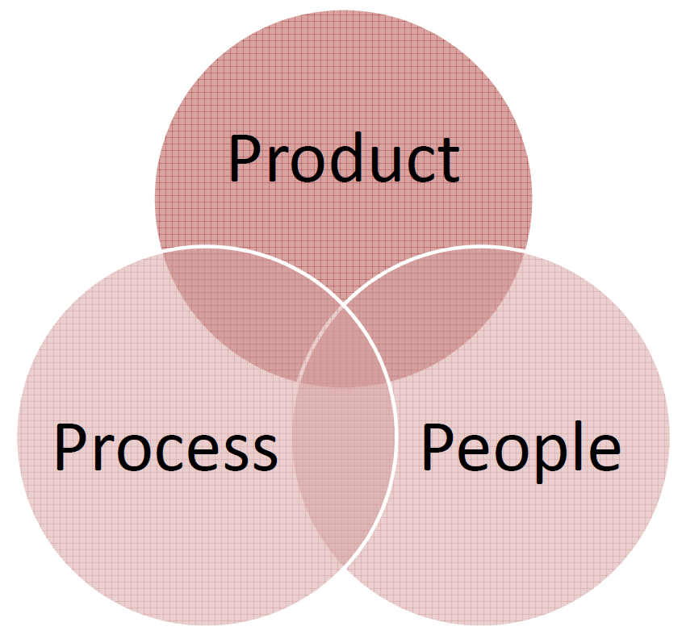
Software QA
It is difficult to assure the quality of a software product.
What are we assuring?
  Building the right system? Building the system right?
  Presence/absense of good/bad properties?
  Identifying errors? Confidence in the absence of errors?
  Robust? Safe? Secure? Available? Reliable?
  Understandable? Modifiable? Cost-effective? Usable? …
Why are we assuring it?
  Business/Economic reasons, Legal, Ethical,
  Social, Personal satisfaction, ...
How do we assure it?
  How do we know we have assured it?

Slide 3
Large code challenges
How to ensure…
  Maintainable code?
  DRY code?
  Readable code?
  Bug-free code?
Average defect detection rate for various testing
  Unit testing: 25%
  Function testing: 35%
  Integration testing:45%
  How can this be improved?

Slide 4
Code Reviews
code review: A constructive review of a fellow developer’s code. A required sign-off from another team member before a developer is permitted to check in changes or new code.
Analogy: writing articles for a newspaper
  What is the effectiveness of…
    Spell-check/grammar check?
    Author editing own article?
    Others editing others’ articles?

Slide 5
Mechanics
who: Original developer and reviewer, sometimes together in person, sometimes offline.
what: Reviewer gives suggestions for improvement on a logical and/or structural level, to conform to previously agreed upon set of quality standards.
  Feedback leads to refactoring, followed by a 2nd code review.
  Eventually reviewer approves code.
when: When code author has finished a coherent system change that is otherwise ready for checkin
  change shouldn't be too large or too small
  before committing the code to the repository or incorporating it into the new build

Slide 6
Why do code reviews?
> 1 person has seen every piece of code
  Prospect of someone reviewing your code raises quality threshold.
Forces code authors to articulate their decisions
Hands-on learning experience for rookies without hurting code quality
  Pairing them up with experienced developers
Team members involved in different parts of the system
  Reduces redundancy, enhances overall understanding
Author and reviewer both accountable for committing code

Slide 7
Actual Studies
Average defect detection rates
  Unit testing: 25%
  Function testing: 35%
  Integration testing:45%
  Design and code inspections: 55% and 60%.
11 programs developed by the same group of people
  First 5 without reviews: average 4.5 errors per 100 lines of code
  Next 6 with reviews: average 0.82 errors per 100 lines of code
  Errors reduced by > 80 percent.
    IBM's Orbit project: 500,000 lines, 11 levels of inspections. Delivered early and 1 % of the errors that would normally be expected.
    After AT&T introduced reviews, study with > 200 people reported a +14% productivity, -90% defects.
      (From Steve McConnell’s Code Complete)

Slide 8
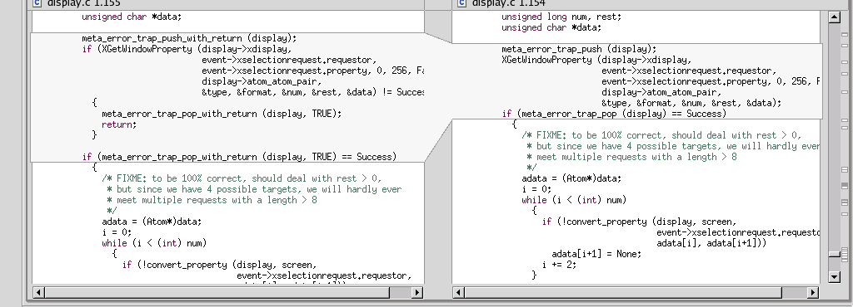
Code Reviews in Industry
Code reviews are a very common industry practice.
Made easier by advanced tools that:
  integrate with configuration management systems
  highlight changes (i.e., diff function)
  allow traversing back into history
  E.g.: Eclipse, Git/SVN tools

Slide 9
Variations
inspection: A more formalized code review with:
  roles (moderator, author, reviewer, scribe, etc.)
  several reviewers looking at the same piece of code
  a specific checklist of kinds of flaws to look for
    possibly focusing on flaws that have been seen previously
    possibly focusing on high-risk areas such as security
  specific expected outcomes (e.g. report, list of defects)
walkthrough: informal discussion of code between author and a single reviewer
code reading: Reviewers look at code by themselves (possibly with no actual meeting)

Slide 10
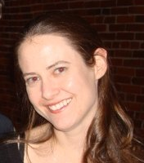
Code Reviews at Google
"All code that gets submitted needs to be reviewed by at least one other person, and either the code writer or the reviewer needs to have readability in that language."
"Most people use Mondrian to do code reviews, and obviously, we spend a good chunk of our time reviewing code."
  Amanda Camp, Software Engineer, Google

Slide 11

Code Reviews at Yelp
"At Yelp we use review-board. An engineer works on a branch and commits the code to their own branch. The reviewer then goes through the diff, adds inline comments on review board and sends them back."
"The reviews are meant to be a dialogue, so typically comment threads result from the feedback. Once the reviewer's questions and concerns are all addressed they'll click "Ship It!" and the author will merge it with the main branch for deployment the same day.”
  Alan Fineberg, Software Engineer, Yelp

Slide 12

Code Reviews at WotC
"At Wizards we use Perforce for SCM. I work with stuff that manages rules and content, so we try to commit changes at the granularity of one bug at a time or one card at a time. Our team is small enough that you can designate one other person on team as a code reviewer."
"Usually you look at code sometime that week, but it depends on priority. It’s impossible to write sufficient test harnesses for the bulk of our game code, so code reviews are absolutely critical."
  Jake Englund, Software Engineer, MtGO

Slide 13

Code Reviews at Facebook
"At Facebook, we have an internally-developed web-based tool to aid the code review process. Once an engineer has prepared a change, she submits it to this tool, which will notify the person or people she has asked to review the change, along with others that may be interested in the change -- such as people who have worked on a function that got changed. At this point, the reviewers can make comments, ask questions, request changes, or accept the changes. If changes are requested, the submitter must submit a new version of the change to be reviewed. All versions submitted are retained, so reviewers can compare the change to the original, or just changes from the last version they reviewed. Once a change has been submitted, the engineer can merge her change into the main source tree for deployment to the site during the next weekly push, or earlier if the change warrants quicker release."
  Ryan McElroy, Software Engineer, Facebook

Slide 14
Code Reviews in CSE 403
code reviews required for each code phase (Alpha, Beta, V1)
  Idea: 3 per week, one review per developer
  Not required to review before checkin
Need to document code review in some fashion
  Email thread, checklist, tools, etc.
Exact structure up to group: something between walkthrough and inspection
Don't review "trivial" code but "trivial" threshold is probably lower than you think
  example: exception tests added, good

Slide 15
Counter-argument 1
"I don't like doing a code review of every commit. It takes too long. I want to make lots of commits and it slows me down."
Responses?
  Maybe you are making too many commits.
  Commit coherent, complete changes to the code base, not incomplete work or tiny changes.
  If something was quick to write, or a small change, it will also be quick to code review.
  If you check in buggy code, you'll lose more time than it would have taken to code review it and (hopefully) find the bug.

Slide 16
Counter-argument 2
"We tried doing code reviews, but it was not useful. We never find any bugs or errors; the code is always approved."
Responses?
  Maybe the reviewer should be more thorough. Almost all reviews of non-trivial code uncover at least some issues to look into.
  Sometimes the point is not to find flaws and fix them, but also to make sure that another developer is familiar with that code.
  The fact that the original coder knew it would be reviewed increases the chance that they wrote better code to start with.

Slide 17
Code Review Example
What changes (if any) would you suggest?
  public class Account {
  double principal,rate; int daysActive,accountType;
  public static final int STANDARD = 0, BUDGET=1,
  PREMIUM=2, PREMIUM_PLUS = 3;
  } ...
  public static double calculateFee(Account[] accounts)
  {
  double totalFee = 0.0;
  Account account;
  for (int i=0;i<accounts.length;i++) {
  account=accounts[i];
  if ( account.accountType == Account.PREMIUM ||
  account.accountType == Account.PREMIUM_PLUS )
  totalFee += .0125 * ( // 1.25% broker's fee
  account.principal * Math.pow(account.rate,
  (account.daysActive/365.25))
  - account.principal); // interest-principal
  }
  return totalFee;
  }
  }

Slide 18
Possible Code Changes
Comment.
Make fields private.
Replace magic values (e.g. 365.25) with constants.
Use an enum for account types.
Use consistent whitespace, line breaks, etc.

Slide 19
Improved Code
  /** An individual account. Also see CorporateAccount. */
  public class Account {
  /** The varieties of account our bank offers. */
  public enum Type {STANDARD, BUDGET, PREMIUM, PREMIUM_PLUS}
  /** The portion of the interest that goes to the broker. */
  public static final double BROKER_FEE_PERCENT = 0.0125;
  private Type type;
  private double principal;
  /** The yearly, compounded rate (at 365.25 days per year). */
  private double rate;
  /** Days since last interest payout. */
  private int daysActive;
  /** Compute interest on this account. */
  public double interest() {
  double years = daysActive / 365.25;
  double compoundInterest = principal * Math.pow(rate, years);
  return compoundInterest – principal;
  }
  ...

Slide 20
Improved Code 2
  ...
  /** Return true if this is a premium account. */
  public boolean isPremium() {
  return accountType == Type.PREMIUM ||
  accountType == Type.PREMIUM_PLUS;
  }
  /** Return the sum of broker fees for all given accounts. */
  public static double calculateFee(Account[] accounts) {
  double totalFee = 0.0;
  for (Account account : accounts) {
  if (account.isPremium()) {
  totalFee += BROKER_FEE_PERCENT * account.interest();
  }
  }
  return totalFee;
  }
  }

Slide 21
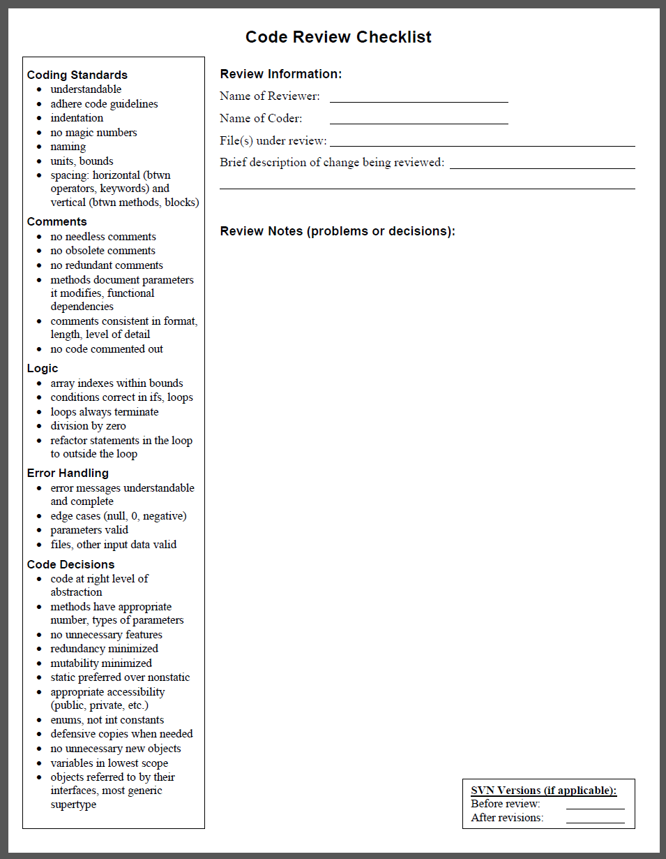
Code Review Checklist
(See course web site)
Useful to divide checks
into categories, such as:
  Coding Style Standards
  Comments
  Logic
  Error Handling
  Coding Decisions
Some tools (e.g. GitHub)
allow you to comment directly
on the code in the commit.

