Slide 1
CSE 403
Lecture 11
Static Code Analysis
Reading:
IEEE Xplore, "Using Static Analysis to Find Bugs"
slides created by Marty Stepp
http://www.cs.washington.edu/403/

Slide 2

FindBugs
FindBugs: Java static analysis tool
that focuses on bugs and usage
errors in code.
  null pointers
  useless/dead code
  unclosed I/O streams
  infinite loops
  infinite recursion
FindBugs has been run on the actual JDK 1.6 source, the Eclipse source, and many errors.
  What kind of bugs and problems were found?

Slide 3

Checkstyle
Checkstyle: A static analysis tool that focuses on
Java coding style and standards.
  whitespace and indentation
  variable names
  Javadoc commenting
  code complexity
    number of statements per method
    levels of nested ifs/loops
    lines, methods, fields, etc. per class
  proper usage
    import statements
    regular expressions
    exceptions
    I/O
    thread usage, ...

Slide 4
Automated Build Systems
Fairly essential, used on most large programming projects.
  Why? Why not Makefiles or shell scripts instead?
  What are these tools aiming to do?
  What other tools integrate well with them?
  What features would you want from an automated build tool?

Slide 5

Ant
Ant ("another neat tool"):
A Java build management tool.
  developed by Apache to help
  build their Tomcat web server
  expanded into a general tool
Ant is a commonly used build tool for Java programs giving many more build options than the old "Make" utility.
  built for Java, so it understands Java concepts like:
    classpath,
    javac, .class files,
    JARs,
    JUnit, etc.

Slide 6
An Ant Build File
Similar to Make, but Ant uses build.xml instead of Makefile:
  <project>
  <target name="name">
  tasks
  </target>
  <target name="name">
  tasks
  </target>
  </project>
A task can be a command such as:
  <javac … />
  <mkdir … />
  <delete … />
  More: http://ant.apache.org/manual/tasksoverview.html

Slide 7
Ant build.xml Example
  <project>
  <target name="clean">
  <delete dir="build"/>
  </target>
  <target name="compile">
  <mkdir dir="build/classes"/>
  <javac srcdir="src"
  destdir="build/classes"/>
  </target>
  </project>

Slide 8
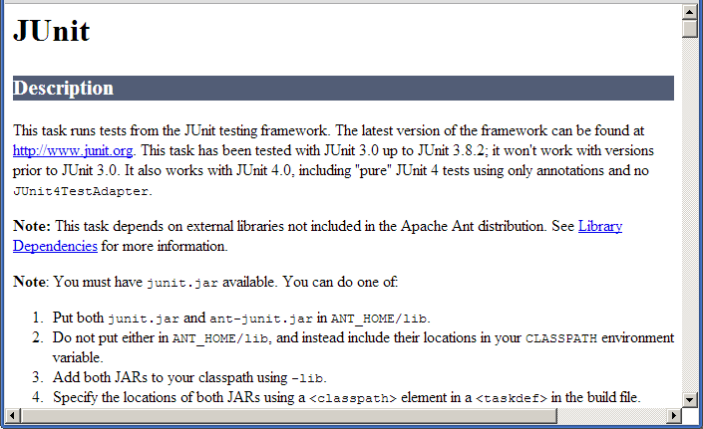
Ant Task Integration
To integrate other tools with Ant, download
custom Ant tasks for those tools.
  JUnit Ant task
  Checkstyle Ant task
  FindBugs Ant task
  ...
  Search for these,
  and instructions for adding them, on Google

Slide 9
JUnit Ant Task Example
  <project>
  <property name="src" value="./src" />
  <property name="lib" value="./lib" />
  <property name="classes" value="./classes" />
  <property name="test.class.name" value="com.xyz.MyTestSuite" />
  <path id="test.classpath">
  <pathelement location="${classes}" />
  <pathelement location="/path/to/junit.jar" />
  <fileset dir="${lib}">
  <include name="**/*.jar"/>
  </fileset>
  </path>
  <!-- Define the Ant task for running JUnit: -->
  <target name="test">
  <junit fork="yes" haltonfailure="yes">
  <test name="${test.class.name}" />
  <formatter type="plain" usefile="false" />
  <classpath refid="test.classpath" />
  </junit>
  </target>
  on command line: ant test

Slide 10
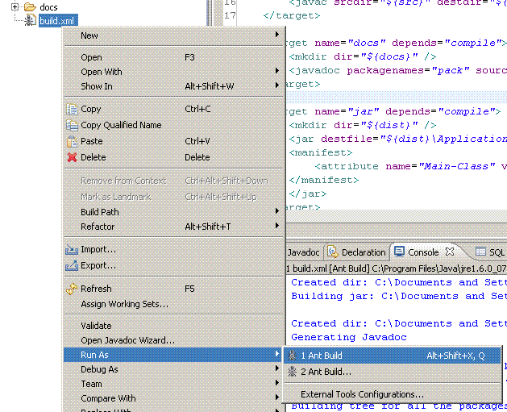
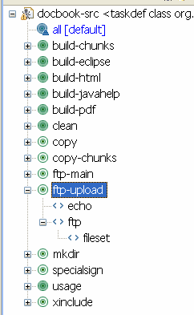
Ant and Eclipse
Ant integrates nicely with Eclipse.
  You can set up a "Build", "Run",
  or "Debug" task that uses Ant.
  Eclipse can create an Ant build
  file for you from an existing
  project that builds its code.
  Eclipse also has an Ant build
  file editor:

Slide 11

Maven
Maven: A project management,
comprehension, and build tool.
  A successor / replacement for Ant.
  Made by Apache, makers of Ant.
Differences from Ant:
  more powerful; higher level of abstraction
  great for generating reports and visualizations
  can run integration tests and continuous integration (seen later)
  can handle deployment of an app or site

Slide 12
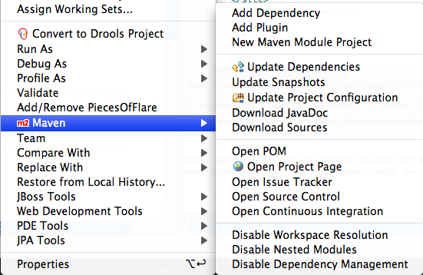
Maven and Eclipse
Since Maven is newer, tool support (e.g. Eclipse integration) was slower to arrive, but it is generally mature now

