Slide 1
CSE 403
Lecture 12
Effective Unit Testing
Reading:
The Art of Unit Testing, Ch. 7 (Osherove)
slides created by Marty Stepp
http://www.cs.washington.edu/403/

Slide 2
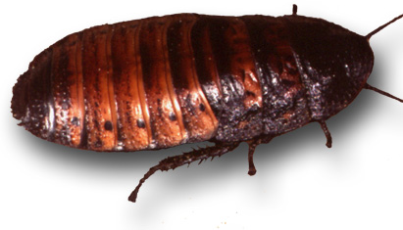
Bugs and testing
software reliability: Probability that a software system will not cause failure under specified conditions.
  measured by uptime, MTTF (mean time till failure), crash data
bugs are inevitable in any complex software system
  industry estimates: 10-50 bugs per 1000 lines of code
  a bug can be visible or can hide in your code until much later
testing: A systematic attempt to reveal errors.
  failed test: an error was demonstrated
  passed test: no error was found (for this particular situation)

Slide 3
Difficulties of testing
perception by some developers and managers
  testing is seen as a novice's job
  assigned to the least experienced team members
  done as an afterthought (if at all)
limitations of what testing can show you
  it is impossible to completely test a system
  testing does not always directly reveal the actual bugs in the code
  testing does not show absence of errors in software

Slide 4

Faults and errors
error: incorrect software behavior
  example: Message box said, "Welcome, null!"
fault: mechanical or algorithmic cause of error (bug)
  example: Account name field is not set properly.
  Requirements specify desired behavior;
  if the system deviates from that, it has a fault.

Slide 5
Quality control techniques
fault avoidance: Prevent errors before system is released.
  reviews, inspections, walkthroughs,
  development methodologies, configuration management
fault tolerance: When system can recover by itself.
  rollbacks, redundancy, mirroring
fault detection: Find faults without recovering from them.
  debugging, testing

Slide 6
Some kinds of testing
unit testing: Looks for errors in subsystems in isolation.
integration testing: find errors when connecting subsystems
  bottom-up: integrate upward into double, triple, quadruple test
  top-down: test UI first, then add layers to replace stubs
  stub/mock: an incomplete object/subsystem in masquerade
system testing: test entire system behavior as a whole, with respect to scenarios and requirements
  functional testing: test whether system meets requirements
  performance, load, stress testing
  acceptance, usability, installation, beta testing

Slide 7
Unit testing
unit testing: Looks for errors in subsystems in isolation.
  generally a "subsystem" means a class or object
benefits:
  1. reduces number of things to test
  2. easier to find faults when errors occur
  3. can test many components in parallel
In principle, test all objects.
  Because of time, test important ones involved in use cases.

Slide 8
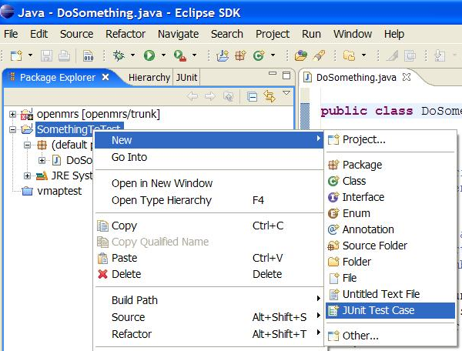
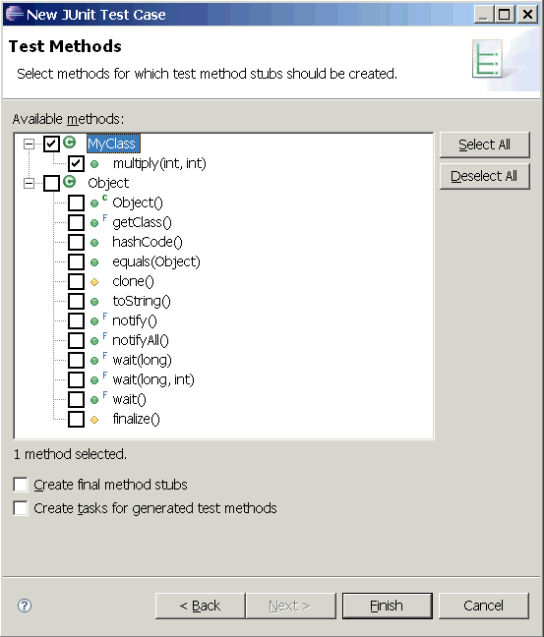
JUnit and Eclipse
Adding JUnit to an Eclipse project:
  click Project → Properties → Add External JARs... →
  eclipse folder / plugins / org.junit_x.x.x / junit.jar
Create a test case
  click File → New →
  JUnit Test Case
  or right-click a file and
  choose New Test
  Eclipse can create stubs
  of method tests for you

Slide 9
JUnit assertion methods
assertTrue (message, test) (italic = optional )
assertFalse (message, test)
assertEquals (message, expected, actual)
assertNotEquals (message, expected, actual)
assertSame (message, expected, actual)
assertNotSame (message, expected, actual)
  compares with ==
assertNull (message, obj)
assertNotNull (message, obj)
fail (message )
  causes the test to immediately fail (why no pass method?)

Slide 10
Ruby's Test::Unit
  require 'test/unit'
  class name < Test::Unit::TestCase
  def setup
  ...
  end
  def teardown
  ...
  end
  def name # a test case
  ...
  assert(condition, message )
  end
  end

Slide 11
Ruby assertions
assert(boolean, [msg]) - ensures the object/expression is true
assert_equal(obj1, obj2, [msg]) - ensures obj1 obj2 is true
assert_not_equal(obj1, obj2, [msg]) - ensures obj1 obj2 is false
assert_same(obj1, obj2, [msg]) - ensures obj1.equal?(obj2) is true
assert_not_same(obj1, obj2, [msg]) - ensures obj1.equal?(obj2) is false
assert_nil(obj, [msg]) - ensures obj.nil? is true
assert_not_nil(obj, [msg]) - ensures obj.nil? is false
assert_match(regexp, string, [msg]) - ensures a string matches the regular expression
assert_no_match(regexp, string, [msg]) - ensures string doesn't match regex
assert_in_delta(expecting, actual, delta, [msg]) - ensures numbers are within delta
assert_throws(symbol, [msg]) { block } - ensures a block throws the symbol
assert_raises(exceptions) { block } - ensures block raises an exception
assert_nothing_raised(exceptions) { block } - a block doesn’t raise the exceptions
assert_instance_of(class, obj, [msg]) - ensures obj is the class type
assert_kind_of(class, obj, [msg]) - ensures obj is or descends from class
assert_respond_to(obj, symbol, [msg]) - ensures obj has a method called symbol
assert_operator(obj1, operator, obj2, [msg]) - ensures obj1.operator(obj2) is true
assert_send(array, [msg]) - ensures that executing method listed in array[1] on the
object in array[0] with parameters of array[2+] is true
flunk([msg]) - Forcibly fails this test

Slide 12
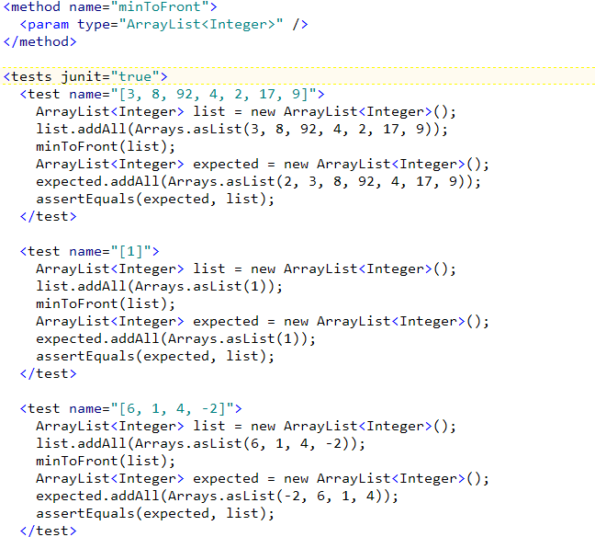
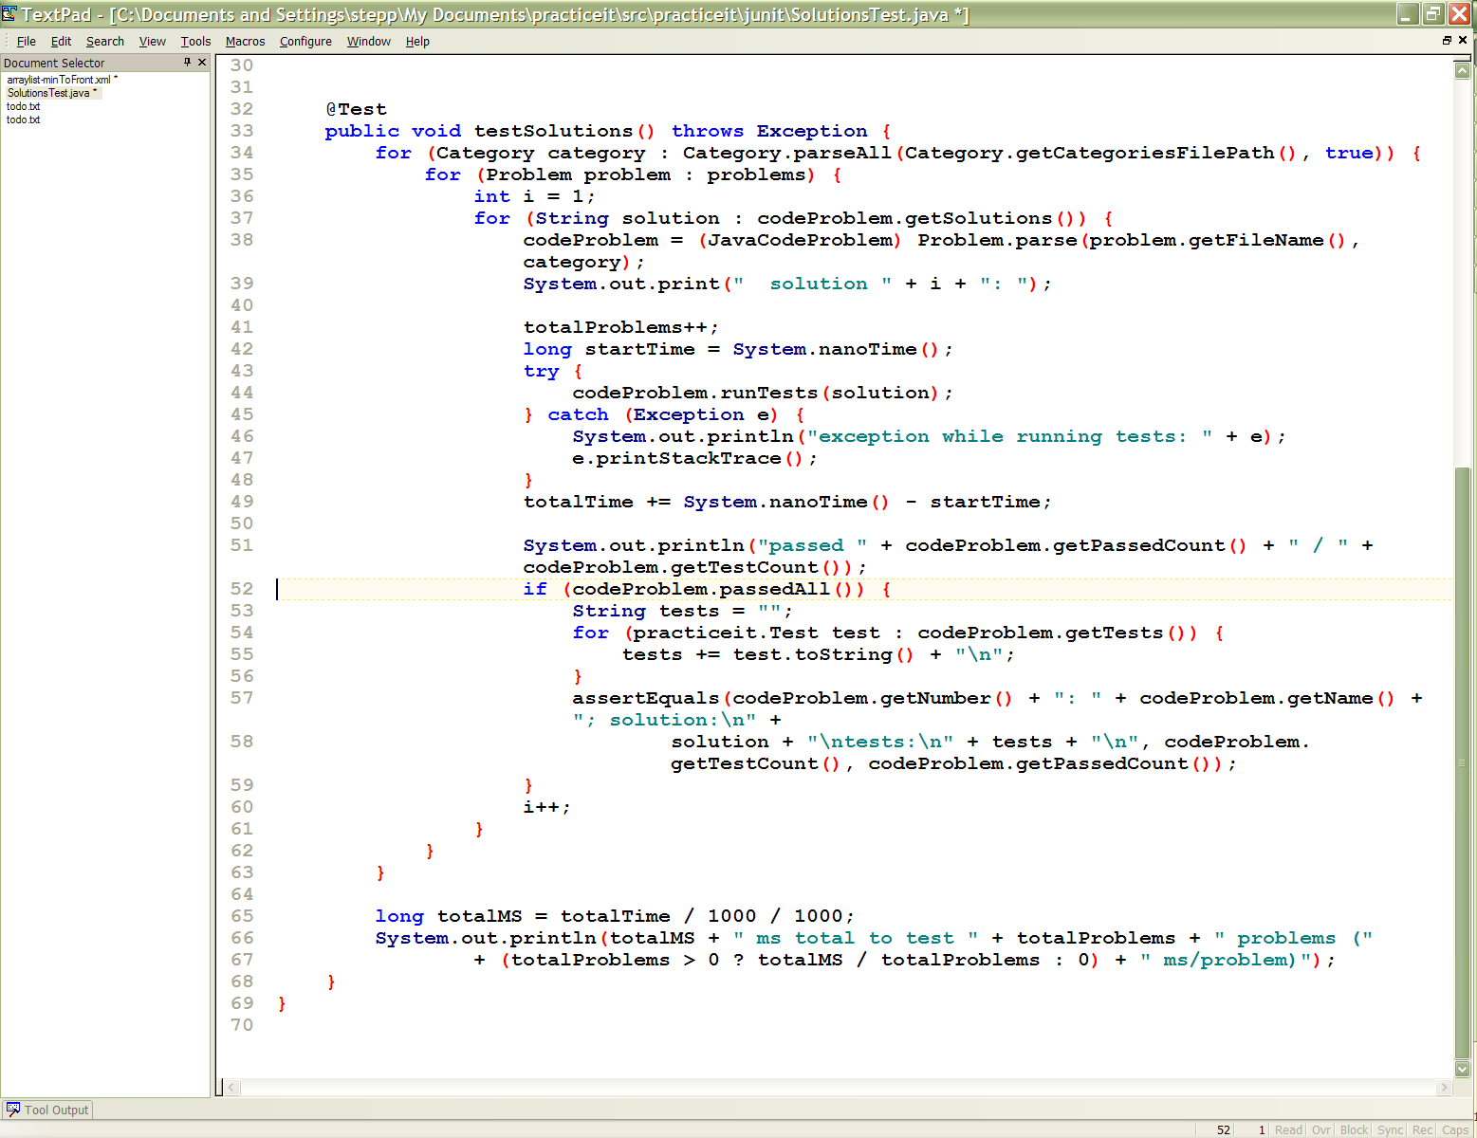
Unit tests in Practice-It
the system tests submitted student code using JUnit
the system (written in Java/JSP) also tests itself using JUnit

Slide 13
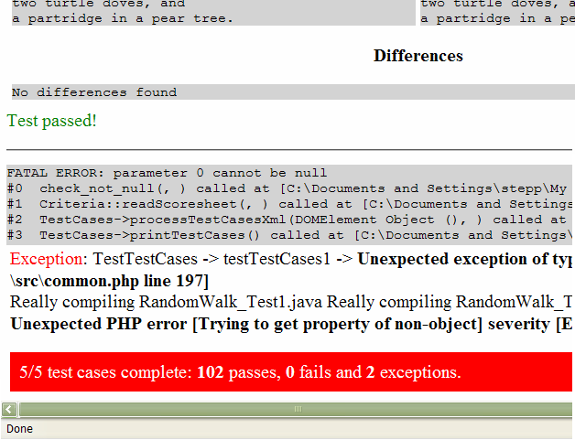
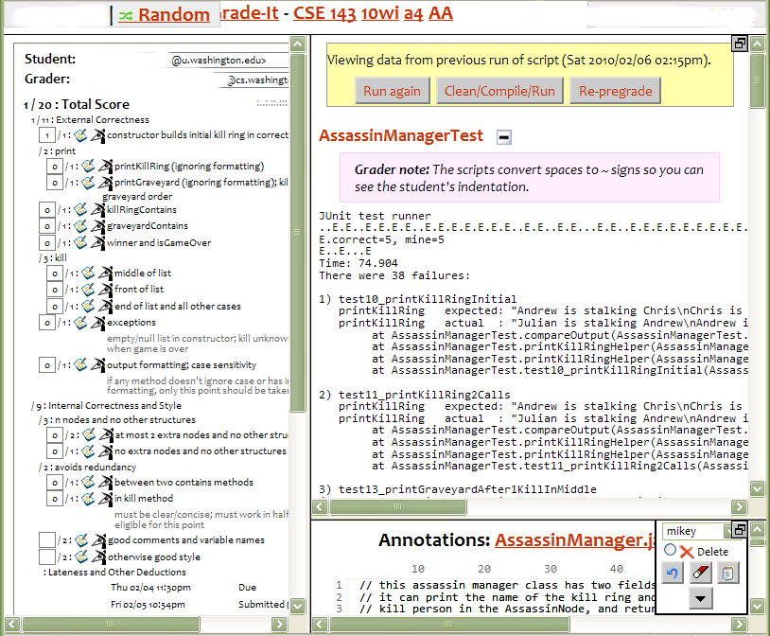
Unit tests in Grade-It
  grading scripts test student homework using JUnit test cases
  the web grading system tests itself using PHPunit/Simpletest

Slide 14
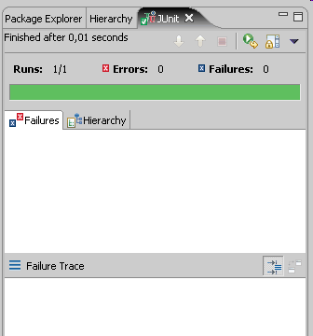

Qualities of good tests
test cases free of bugs
  a broken test isn't much help
readable test case code
easy to add/update tests
easy/fast to run
  unit tests are often run on
  each build or checkin, so fast = good

Slide 15
Bugs in tests
hard to find
  developers assume that tests are correct
manifest in odd ways
  sometimes test initially passes, then begins to fail much later
    code under test may have been altered in a subtle way
    test case may have relied on invalid assumptions
    API of code under test may have changed
often test wasn't written by developer
  bug assigned back and forth

Slide 16
What's wrong with this?
public class DateTest {
@Test
public void test1() {
Date d = new Date(2050, 2, 15);
d.addDays(4);
assertEquals(d.getYear(), 2050);
assertEquals(d.getMonth(), 2);
assertEquals(d.getDay(), 19);
}
@Test
public void test2() {
Date d = new Date(2050, 2, 15);
d.addDays(14);
assertEquals(d.getYear(), 2050);
assertEquals(d.getMonth(), 3);
assertEquals(d.getDay(), 1);
}
}

Slide 17
Well-structured assertions
public class DateTest {
@Test
public void test1() {
Date d = new Date(2050, 2, 15);
d.addDays(4);
assertEquals(2050, d.getYear()); // expected
assertEquals(2, d.getMonth()); // value should
assertEquals(19, d.getDay()); // be at LEFT
}
@Test
public void test2() {
Date d = new Date(2050, 2, 15);
d.addDays(14);
assertEquals("year after +14 days", 2050, d.getYear());
assertEquals("month after +14 days", 3, d.getMonth());
assertEquals("day after +14 days", 1, d.getDay());
} // test cases should usually have messages explaining
} // what is being checked, for better failure output

Slide 18
Expected answer objects
public class DateTest {
@Test
public void test1() {
Date d = new Date(2050, 2, 15);
d.addDays(4);
Date expected = new Date(2050, 2, 19);
assertEquals(expected, d); // use an expected answer
} // object to minimize tests
// (Date must have toString
@Test // and equals methods)
public void test2() {
Date d = new Date(2050, 2, 15);
d.addDays(14);
Date expected = new Date(2050, 3, 1);
assertEquals("date after +14 days", expected, d);
}
}

Slide 19
Pervasive timeouts
public class DateTest {
@Test(timeout = DEFAULT_TIMEOUT)
public void test1() {
Date d = new Date(2050, 2, 15);
d.addDays(4);
Date expected = new Date(2050, 2, 19);
assertEquals("date after +4 days", expected, d);
}
@Test(timeout = DEFAULT_TIMEOUT)
public void test2() {
Date d = new Date(2050, 2, 15);
d.addDays(14);
Date expected = new Date(2050, 3, 1);
assertEquals("date after +14 days", expected, d);
}
// almost every test should have a timeout so it can't
// lead to an infinite loop; good to set a default, too
private static final int DEFAULT_TIMEOUT = 2000;
}

Slide 20
Naming test cases
public class DateTest {
@Test(timeout = DEFAULT_TIMEOUT)
public void addDays_withinSameMonth_1() {
Date actual = new Date(2050, 2, 15);
actual.addDays(4);
Date expected = new Date(2050, 2, 19);
assertEquals("date after +4 days", expected, actual);
}
// give test case methods really long descriptive names
@Test(timeout = DEFAULT_TIMEOUT)
public void addDays_wrapToNextMonth_2() {
Date actual = new Date(2050, 2, 15);
actual.addDays(14);
Date expected = new Date(2050, 3, 1);
assertEquals("date after +14 days", expected, actual);
}
// give descriptive variable names to expected/actual values
private static final int DEFAULT_TIMEOUT = 2000;
}

Slide 21
Squashing redundancy
public class DateTest {
@Test(timeout = DEFAULT_TIMEOUT)
public void addDays_withinSameMonth_1() {
addHelper(2050, 2, 15, +4, 2050, 2, 19);
}
@Test(timeout = DEFAULT_TIMEOUT)
public void addDays_wrapToNextMonth_2() {
addHelper(2050, 2, 15, +14, 2050, 3, 1);
}
// use lots of helpers to make actual tests extremely short
private void addHelper(int y1, int m1, int d1, int add,
int y2, int m2, int d2) {
Date actual = new Date(y, m, d);
actual.addDays(add);
Date expect = new Date(y2, m2, d2);
assertEquals("after +" + add + " days", expect, actual);
}
// can also use "parameterized tests" in some frameworks
...

Slide 22
Flexible helpers
public class DateTest {
@Test(timeout = DEFAULT_TIMEOUT)
public void addDays_multipleCalls_wrapToNextMonth2x() {
Date d = addHelper(2050, 2, 15, +14, 2050, 3, 1);
addhelper(d, +32, 2050, 4, 2);
addhelper(d, +98, 2050, 7, 9);
}
// Helpers can box you in; hard to test many calls/combine.
// Create variations that allow better flexibility
private Date addHelper(int y1, int m1, int d1, int add,
int y2, int m2, int d2) {
Date date = new Date(y, m, d);
addHelper(date, add, y2, m2, d2);
return d;
}
private void addHelper(Date date, int add,
int y2, int m2, int d2) {
date.addDays(add);
Date expect = new Date(y2, m2, d2);
assertEquals("date after +" + add + " days", expect, d);
}
...

Slide 23
What's wrong with this?
public class DateTest {
@Test
public void test_addDays_addJustOneDay_1() {
Date actual = new Date(2050, 2, 15);
actual.addDays(1);
Date expected = new Date(2050, 2, 16);
assertEquals("after adding one day to 2050/2/15,\n" +
"should have gotten " + expected + "\n" +
" but instead got " + actual\n",
expected, actual);
}
...
}

Slide 24
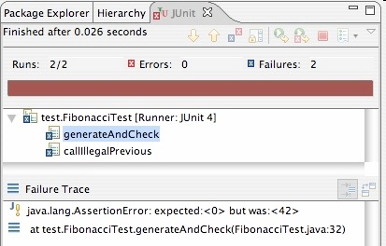
Good assertion messages
public class DateTest {
@Test
public void test_addDays_addJustOneDay_1() {
Date actual = new Date(2050, 2, 15);
actual.addDays(1);
Date expected = new Date(2050, 2, 16);
assertEquals("add one day to 2050/2/15",
expected, actual);
}
...
}
// JUnit will already show
// the expected and actual
// values in its output;
//
// don't need to repeat them
// in the assertion message

Slide 25
What's wrong with this?
public class DateTest {
// test every day of the year
@Test
public void tortureTest() {
Date date = new Date(2050, 1, 1);
int month = 1;
int day = 1;
for (int i = 1; i < 365; i++) {
date.addDays(1);
if (day < DAYS_PER_MONTH[month]) {day++;}
else {month++; day=1;}
assertEquals(new Date(2050, month, day), date);
}
}
private static final int[] DAYS_PER_MONTH = {
0, 31, 28, 31, 30, 31, 30, 31, 31, 30, 31, 30, 31
}; // Jan Feb Mar Apr May Jun Jul Aug Sep Oct Nov Dec
}

Slide 26
Trustworthy tests
Test one thing at a time per test method.
  10 small tests are much better than 1 test 10x as large.
Each test method should have few (likely 1) assert statements.
  If you assert many things, the first that fails stops the test.
  You won't know whether a later assertion would have failed.
Tests should avoid logic.
  minimize if/else, loops, switch, etc.
  avoid try/catch
    If it's supposed to throw, use expected=... if not, let JUnit catch it.
Torture tests are okay, but only in addition to simple tests.

Slide 27
What's wrong with this?
public class DateTest {
// shared Date object to test with (saves memory!!1)
private static Date DATE;
@Test(timeout = DEFAULT_TIMEOUT)
public void addDays_sameMonth() {
DATE = new Date(2050, 2, 15); // first test;
addhelper(DATE, +4, 2050, 2, 19); // DATE = 2/15 here
}
@Test(timeout = DEFAULT_TIMEOUT)
public void addDays_nextMonthWrap() { // second test;
addhelper(DATE, +10, 2050, 3, 1); // DATE = 2/19 here
}
@Test(timeout = DEFAULT_TIMEOUT)
public void addDays_multipleCalls() { // third test;
addDays_sameMonth(); // go back to 2/19;
addhelper(DATE, +1, 2050, 2, 20); // test two calls
addhelper(DATE, +1, 2050, 2, 21);
}
...
}

Slide 28

Isolation/order "smells"
Tests should be self-contained
and not care about each other.
"Smells" (bad things to avoid) in tests:
  Constrained test order : Test A must run before Test B.
  (usually a misguided attempt to test order/flow)
  Tests call each other : Test A calls Test B's method
  (calling a shared helper is OK, though)
  Mutable shared state : Tests A/B both use a shared object. If A breaks it, what happens to B?

Slide 29
Useful language features
Elegant tests use the expressive features of your language.
Java and many languages support variable numbers of params:
  public void depositAll(Account a, double... amounts) {
  for (double amount : amounts) {
  a.deposit(amount);
  }
  }
  ...
  Account a = new Account("Shirley", 10.00);
  a.depositAll(4.00, 5.67, 8.90);
  a.depositAll(100.50);

Slide 30
Tests and data structures
Need to pass lots of arrays? Use array literals
  public void exampleMethod(int[] values) { ... }
  ...
  exampleMethod(new int[] {1, 2, 3, 4});
  exampleMethod(new int[] {5, 6, 7});
Need a quick ArrayList? Try Arrays.asList
  List<Integer> list = Arrays.asList(7, 4, -2, 3, 9, 18);
Need a quick set, queue, etc.? Many collections can take a list
  Set<Integer> list = new HashSet<Integer>(
  Arrays.asList(7, 4, -2, 9));

Slide 31
More data structures
Need a quick Map or something else? Roll your own helper
  // pre-populates a map from given keys to given values
  public static <K, V> Map<K, V> asMap(List<K> keys,
  List<V> values) {
  Map<K, V> map = new HashMap<K, V>();
  for (int i = 0; i < keys.size(); i++) {
  map.put(keys.get(i), values.get(i));
  }
  return map;
  }
  ...
  Map<String, Integer> taAges = asMap(
  Arrays.asList("Marty", "Logan", "Kelly", "Marisa"),
  Arrays.asList(23, 14, 39, 25);
  );

