Slide 1
CSE 403
Lecture 13
Black/White-Box Testing
Reading:
Software Testing: Principles and Practices, Ch. 3-4 (Desikan, Ramesh)
slides created by Marty Stepp
http://www.cs.washington.edu/403/

Slide 2
Testing questions
Should I test my own code, or should somebody else?
Which code of my project should I test the most/least?
Can I test all possible inputs to see whether something works?
How do I know if I've tested well/enough?
What constitutes a good or bad test case method?
Is it good or bad if a test case fails?
What if a test case itself has a bug in it?

Slide 3
JUnit exercise
Given a Date class with the following methods:
  public Date(int year, int month, int day)
  public Date() // today
  public int getDay(), getMonth(), getYear()
  public void addDays(int days) // advances by days
  public int daysInMonth()
  public String dayOfWeek() // e.g. "Sunday"
  public boolean equals(Object o)
  public boolean isLeapYear()
  public void nextDay() // advances by 1 day
  public String toString()
Come up with unit tests to check the following:
  That no Date object can ever get into an invalid state.
  That the addDays method works properly.
    It should be efficient enough to add 1,000,000 days in a call.
Notes:
some ideas:
- write a too-big test for addDays with for loops and many calls
- develop a test-add-days-helper method that is called by many tests
- show the benefit of testing against a known "expected" object rather than 3 ints

Slide 4
Test-driven development
Imagine that we'd like to add a method subtractWeeks to our Date class, that shifts this Date backward in time by the given number of weeks.
Write code to test this method before it has been written.
  This way, once we do implement the method, we'll know whether it works.

Slide 5
Black and white box testing
What is the difference between black- and white-box testing?
black-box (procedural) test: Written without knowledge of how the class under test is implemented.
  focuses on input/output of each component or call
white-box (structural) test: Written with knowledge of the implementation of the code under test.
  focuses on internal states of objects and code
  focuses on trying to cover all code paths/statements
  requires internal knowledge of the component to craft input
    example: knowing that the internal data structure for a spreadsheet uses 256 rows/columns, test with 255 or 257
Notes:
(test case example: Microsoft Web Excel)

Slide 6
Black-box testing
black-box is based on requirements and functionality, not code
tester may have actually seen the code before ("gray box")
  but doesn't look at it while constructing the tests
often done from the end user or OO client's perspective
emphasis on parameters, inputs/outputs (and their validity)

Slide 7
Types of black-box
requirements based
positive/negative - checks both good/bad results
boundary value analysis
decision tables
equivalence partitioning - group related inputs/outputs
state-based - based on object state diagrams
compatibility testing
user documentation testing
domain testing

Slide 8
Boundary testing
boundary value analysis: Testing conditions on bounds between classes of inputs.
Why is it useful to test near boundaries?
  likely source of programmer errors (< vs. <=, etc.)
  language has many ways to implement boundary checking
  requirement specs may be fuzzy about behavior on boundaries
  often uncovers internal hidden limits in code
    example: array list must resize its internal array when it fills capacity

Slide 9
Boundary example
Imagine we are testing a Date class with a daysInMonth(month, year) method.
  What are some conditions and boundary tests for this method?
Possible answers:
  check for leap years (every 4th yr, no 100s, yes 400s)
  try years such as: even 100s, 101s, 4s, 5s
  try months such as: June, July, Feb, invalid values

Slide 10
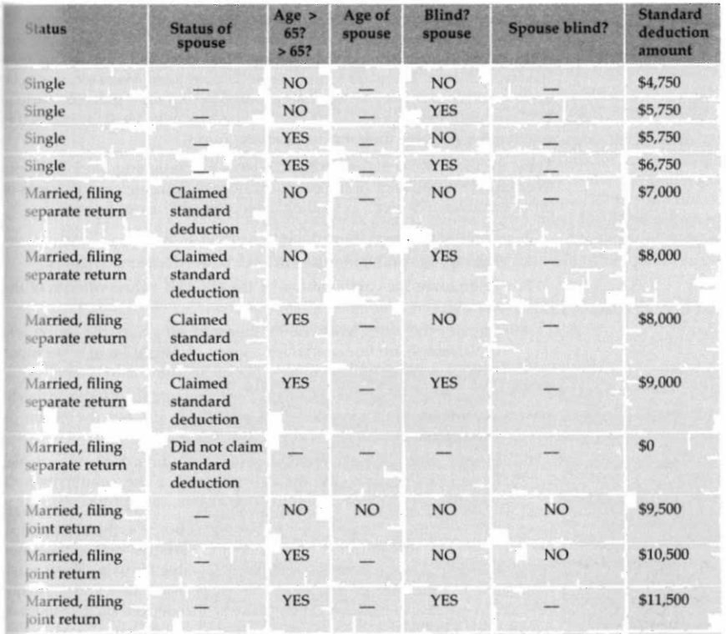
Decision tables

Slide 11
Equivalence testing
equivalence partitioning:
  A black-box test technique to reduce # of required test cases.
  What is it?
  steps in equivalence testing:
    identify classes of inputs with same behavior
    test on at least one member of each equivalence class
    assume behavior will be same for all members of class
  criteria for selecting equivalence classes:
    coverage : every input is in one class
    disjointedness : no input in more than one class
    representation : if error with 1 member of class, will occur with all

Slide 12
White-box testing
Some kinds of white box testing don't involve unit tests:
"static testing"
  code walkthroughs, inspections, code reviews
  static analysis tools
    Lint (and variants) JiveLint, JLint, PMD, CheckR, JSLint, php -l
    CheckStyle http://checkstyle.sourceforge.net/
    FindBugs http://findbugs.sourceforge.net/
  code complexity analysis tools
    PMD, CheckStyle, etc.

Slide 13
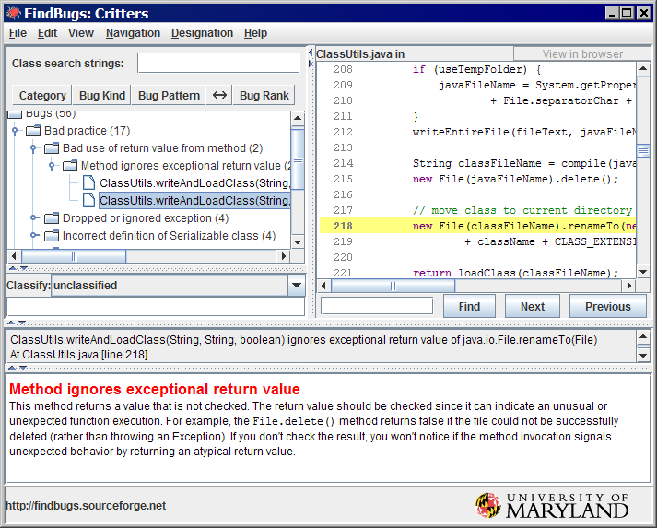
Static analysis example

Slide 14
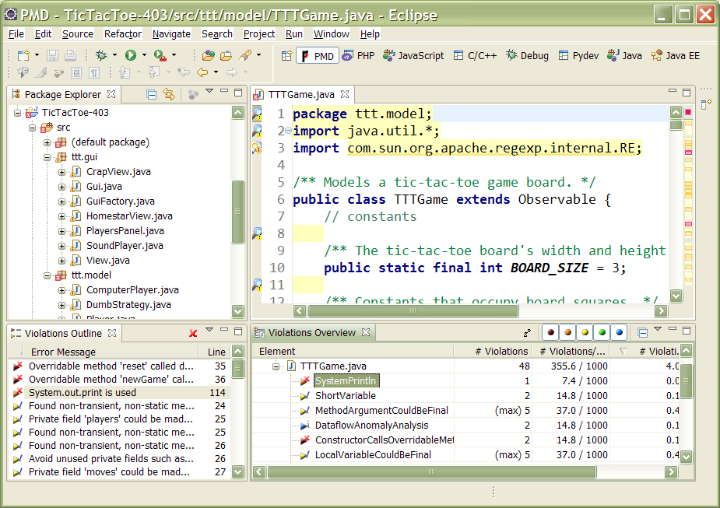
Complexity analysis

Slide 15
Path testing
path testing: an attempt to use test input that will pass once over each path in the code
  path testing is white box
  What would be path testing for daysInMonth(month, year)?
    some ideas:
    error input: year < 1, month < 1, month > 12
    one month from [1, 3, 5, 7, 10, 12]
    one month from [4, 6, 9, 11]
    month 2
      in a leap year, not in a leap year

Slide 16
Code coverage testing
code coverage testing: Examines what fraction of the code under test is reached by existing unit tests.
  statement coverage - tries to reach every line (impractical)
  path coverage - follow every distinct branch through code
  condition coverage - every condition that leads to a branch
  function coverage - treat every behavior / end goal separately
Several nice tools exist for checking code coverage
  EclEmma, Cobertura, Hansel, NoUnit, CoView ...

Slide 17
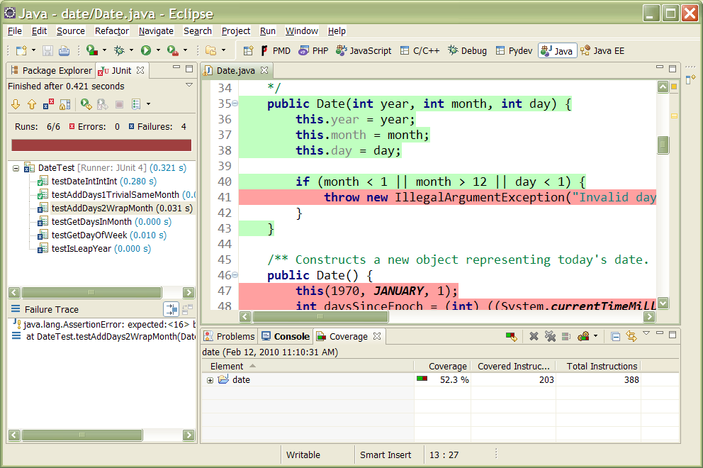
Code coverage example

Slide 18
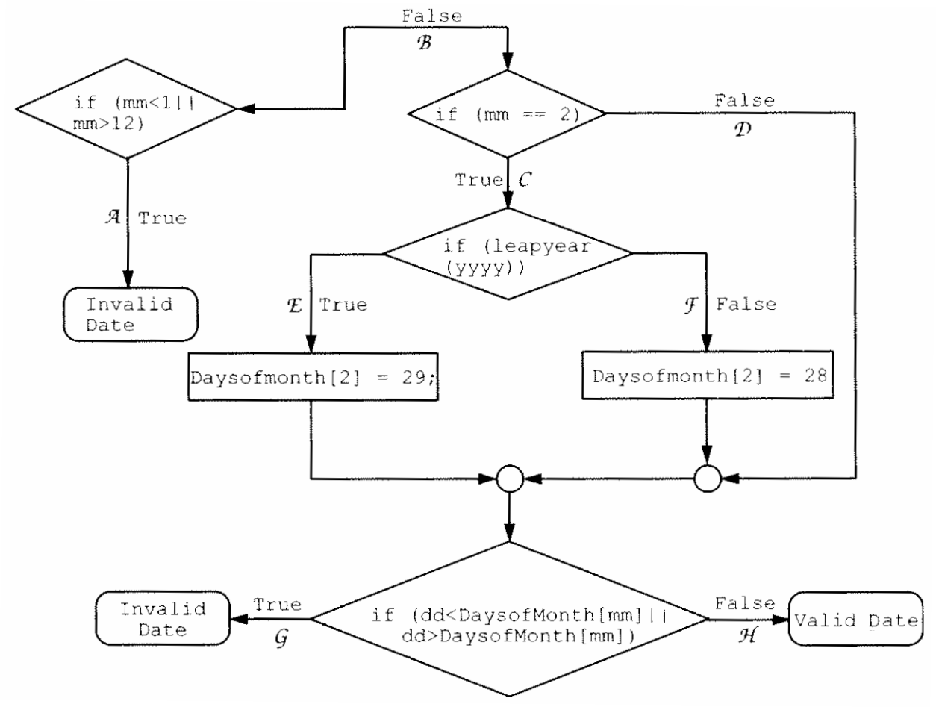
Path coverage example

Slide 19
White box testing is hard
Developers can't easily spot flaws in their own code.
Test cases that are too focused on code may not be thinking about how the class is actually going to be used.
Code coverage tools can give a false sense of security.
  Just because code is "covered" doesn't mean it is free of bugs.
Code complexity can be misleading.
  Complex code is not always bad code.
  Complexity analysis tools can be overly picky or cumbersome.

Slide 20
Testing exercise 1
Imagine that we have a Date class with working methods called isLeapYear(year) and daysInMonth(month, year).
  Question: What is the pseudo-code for the algorithm for an addDays(days) method that moves the current Date object forward in time by the given number of days. A negative value moves the Date backward in time.
  Question: Come up with a set of test values for your addDays method to test its correctness.

Slide 21
Testing exercise 2
Consider tests to determine whether a Scrabble move is legal:
  Are all tiles in a straight line?
  Are the tiles contiguous or separated only by existing old tiles?
  Are the tiles touching an existing old tile?
  On each of the words made:
    What is the score of this word?
    Is this word in the dictionary?
Question: What is/are some suitable Scrabble test board configuration(s) and moves that check each of these conditions?
  Make both passing and failing tests.

