Slide 1
CSE 403
Lecture 14
Integration Testing
Reading:
The Art of Unit Testing, Ch. 1, 3, 4-5 (Osherove)
Code Complete, Ch. 29 (McConnell)
slides created by Marty Stepp
http://www.cs.washington.edu/403/

Slide 2
Integration
integration: Combining 2 or more software units
  often a subset of the overall project (!= system testing)
Why do software engineers care about integration?
  new problems will inevitably surface
    many systems now together that have never been before
  if done poorly, all problems present themselves at once
    hard to diagnose, debug, fix
  cascade of interdependencies
    cannot find and solve problems one-at-a-time

Slide 3
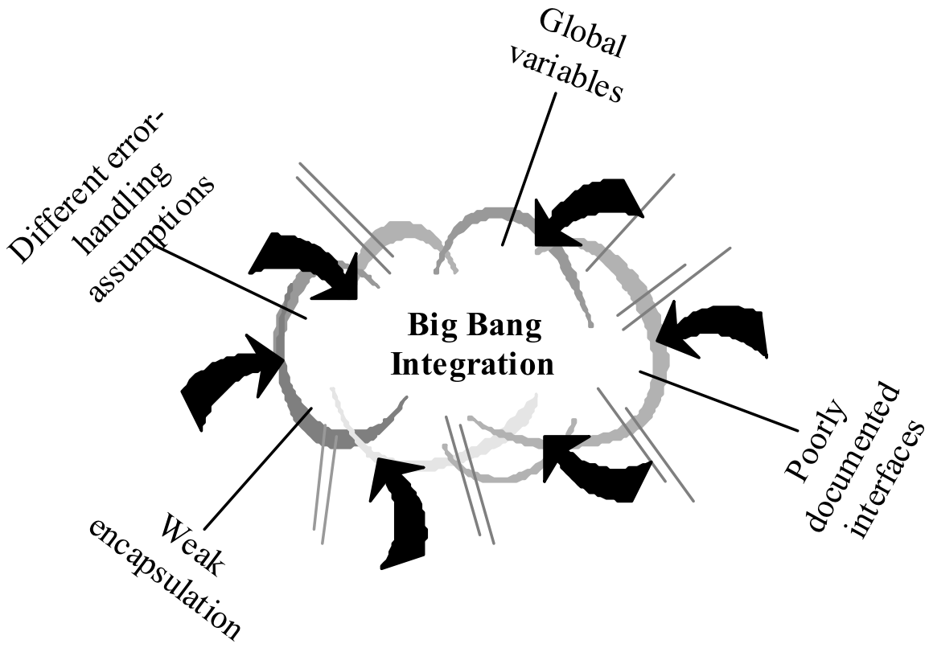
Phased integration
phased ("big-bang") integration:
  design, code, test, debug each class/unit/subsystem separately
  combine them all
  pray

Slide 4
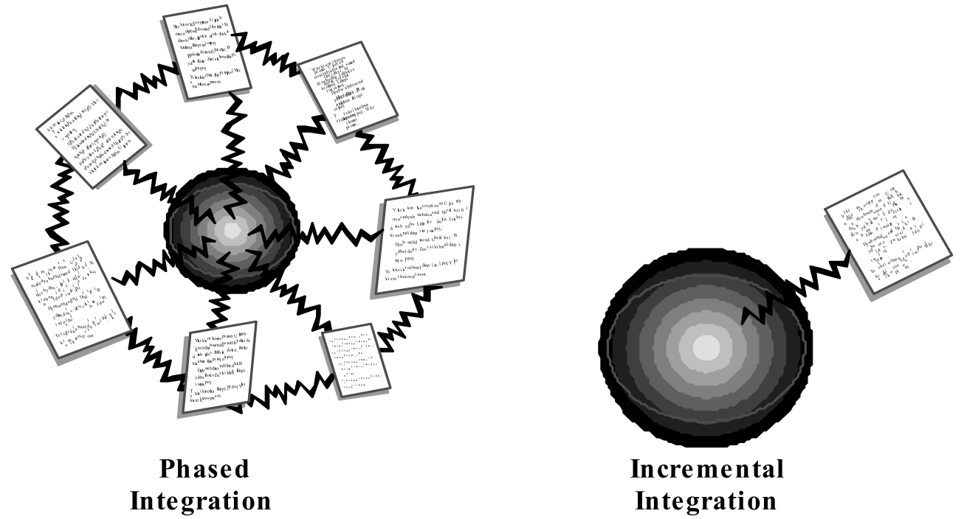
Incremental integration
incremental integration:
  develop a functional "skeleton" system (i.e. ZFR)
  design, code, test, debug a small new piece
  integrate this piece with the skeleton
    test/debug it before adding any other pieces

Slide 5
Benefits of incremental
Benefits:
  Errors easier to isolate, find, fix
    reduces developer bug-fixing load
  System is always in a (relatively) working state
    good for customer relations, developer morale
Drawbacks:
  May need to create "stub" versions of some features that have not yet been integrated

Slide 6
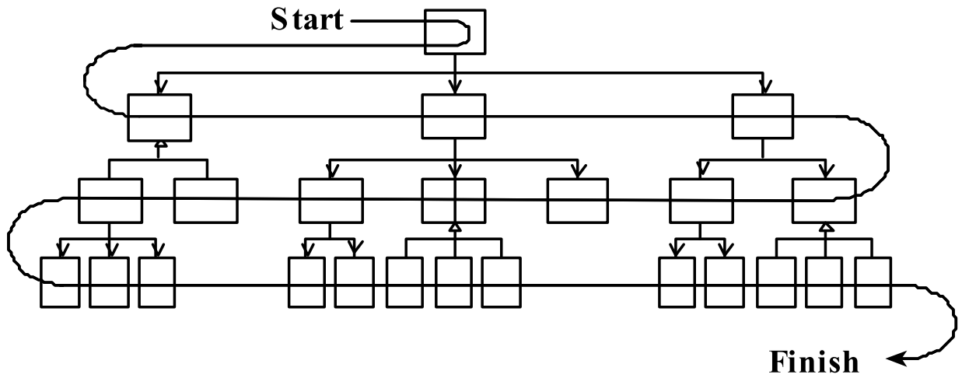
Top-down integration
top-down integration:
Start with outer UI layers and work inward
  must write (lots of) stub lower layers for UI to interact with
  allows postponing tough design/debugging decisions (bad?)

Slide 7
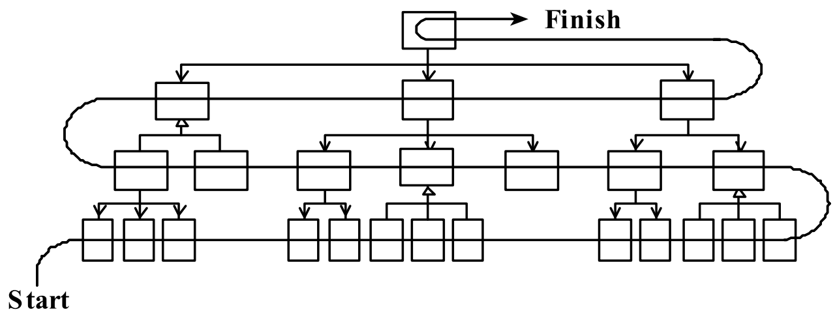
Bottom-up integration
bottom-up integration:
Start with low-level data/logic layers and work outward
  must write test drivers to run these layers
  won't discover high-level / UI design flaws until late

Slide 8
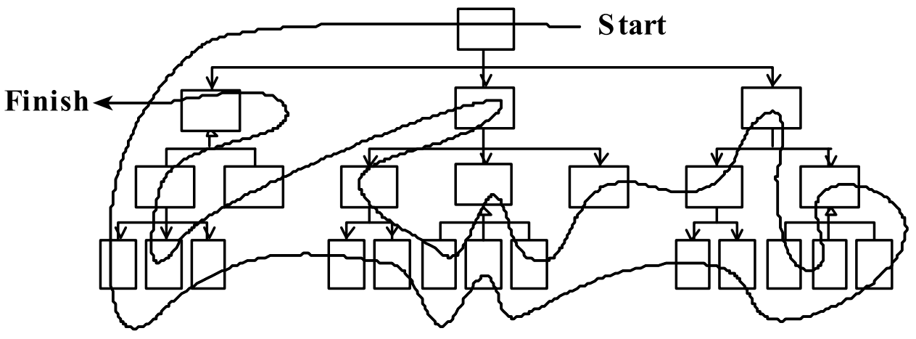
"Sandwich" integration
"sandwich" integration:
Connect top-level UI with crucial bottom-level classes
  add middle layers later as needed
  more practical than top-down or bottom-up?

Slide 9
Daily builds
daily build: Compile working executable on a daily basis
  allows you to test the quality of your integration so far
  helps morale; product "works every day"; visible progress
  best done automated or through an easy script
  quickly catches/exposes any bug that breaks the build
smoke test: A quick set of tests run on the daily build.
  NOT exhaustive; just sees whether code "smokes" (breaks)
  used (along with compilation) to make sure daily build runs
continuous integration:
Adding new units immediately as they are written.

Slide 10
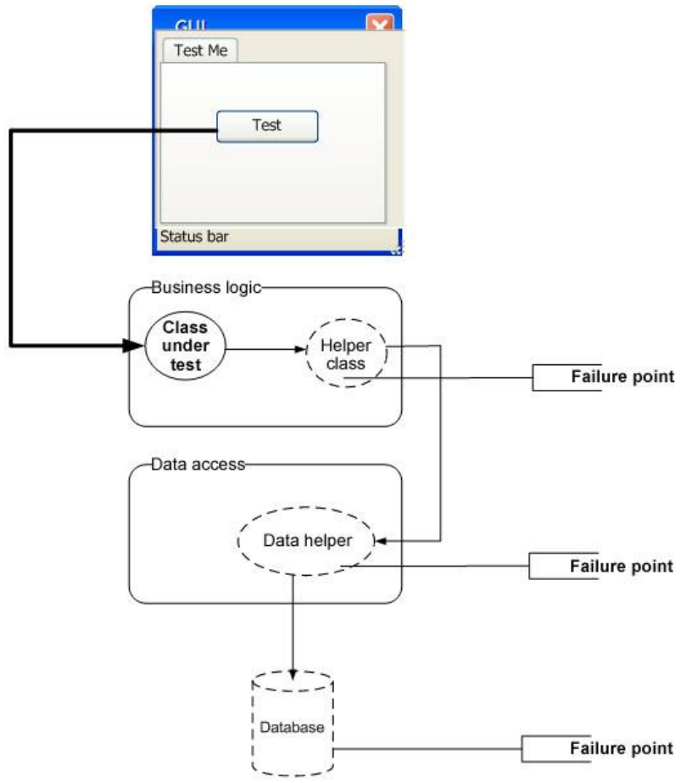
Integration testing
integration testing: Verifying software quality by testing two or more dependent software modules as a group.
challenges:
  Combined units can fail
  in more places and in more
  complicated ways.
  How to test a partial system
  where not all parts exist?
  How to "rig" the behavior of
  unit A so as to produce a
  given behavior from unit B?

Slide 11
Stubs
stub: A controllable replacement for an existing software unit to which your code under test has a dependency.
  useful for simulating difficult-to-control elements:
    network / internet
    database
    time/date-sensitive code
    files
    threads
    memory
  also useful when dealing with brittle legacy code/systems

Slide 12
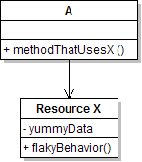
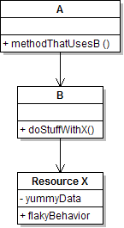
Create a stub, step 1
Identify the external dependency.
  This is either a resource or a class/object.
  If it isn't an object, wrap it up into one.
    (Suppose that Class A depends on troublesome Class B.)

Slide 13
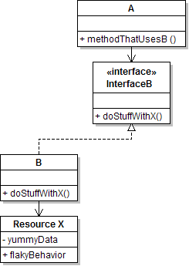
Create a stub, step 2
Extract the core functionality of the object into an interface.
  Create an InterfaceB based on B
  Change all of A's code to work with type InterfaceB, not B

Slide 14
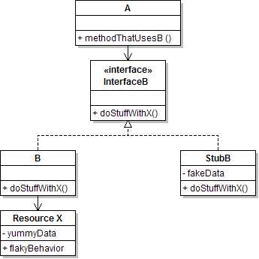
Create a stub, step 3
Write a second "stub" class that also implements the interface,
but returns pre-determined fake data.
  Now A's dependency on B is dodged and can be tested easily.
  Can focus on how well A integrates with B's external behavior.

Slide 15
Injecting a stub
seams: Places to inject the stub so Class A will talk to it.
  at construction (not ideal)
  A aardvark = new A(new StubB());
  through a getter/setter method (better)
  A apple = new A(...);
  aardvark.setResource(new StubB());
  just before usage, as a parameter (also better)
  aardvark.methodThatUsesB(new StubB());
    You should not have to change A's code everywhere (beyond using your interface) in order to use your Stub B. (a "testable design")

Slide 16
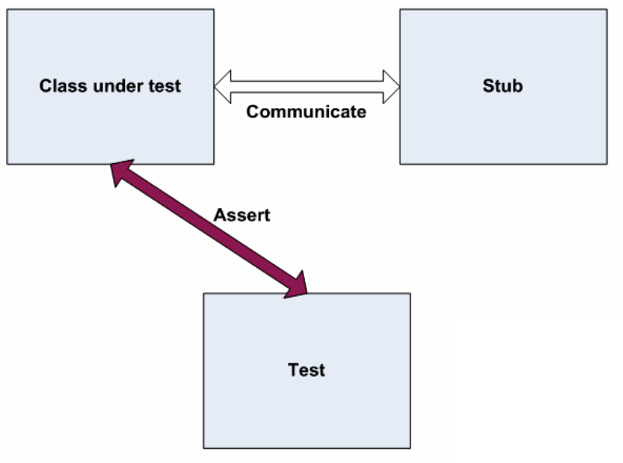
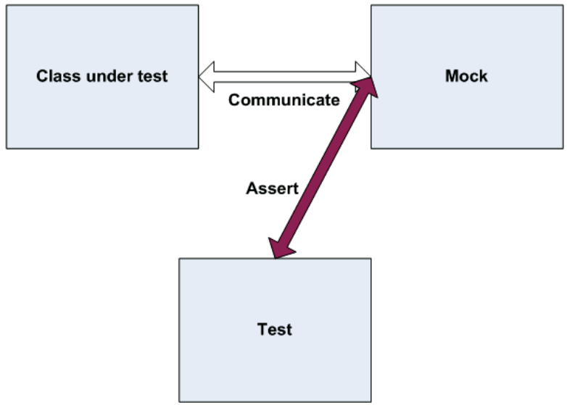
"Mock" objects
mock object: A fake object that decides whether a unit test has passed or failed by watching interactions between objects.
  useful for interaction testing (as opposed to state testing)

Slide 17
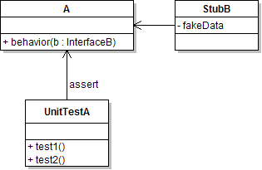
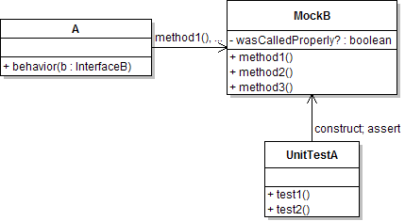
Stubs vs. mocks
  A stub gives out data that goes to
  the object/class under test.
  The unit test directly asserts against
  class under test, to make sure it gives
  the right result when fed this data.
  A mock waits to be called by
  the class under test (A).
    Maybe it has several methods
    it expects that A should call.
  It makes sure that it was contacted
  in exactly the right way.
    If A interacts with B the way it should, the test passes.
Notes:
Don't put assertion statements directly in the mock object, because we may want to re-use it.

Slide 18

Mock object frameworks
Stubs are often best created by hand/IDE.
Mocks are tedious to create manually.
Mock object frameworks help with the process.
  android-mock, EasyMock, jMock (Java)
  FlexMock / Mocha (Ruby)
  SimpleTest / PHPUnit (PHP)
  ...
Frameworks provide the following:
  auto-generation of mock objects that implement a given interface
  logging of what calls are performed on the mock objects
  methods/primitives for declaring and asserting your expectations

Slide 19
A jMock mock object
import org.jmock.integration.junit4.*; // Assumes that we are testing
import org.jmock.*; // class A's calls on B.
@RunWith(JMock.class)
public class ClassATest {
private Mockery mockery = new JUnit4Mockery(); // initialize jMock
@Test public void testACallsBProperly1() {
// create mock object to mock InterfaceB
final InterfaceB mockB = mockery.mock(InterfaceB.class);
// construct object from class under test; attach to mock
A aardvark = new A(...);
aardvark.setResource(mockB);
// declare expectations for how mock should be used
mockery.checking(new Expectations() {{
oneOf(mockB).method1("an expected parameter");
will(returnValue(0.0));
oneOf(mockB).method2();
}});
// execute code A under test; should lead to calls on mockB
aardvark.methodThatUsesB();
// assert that A behaved as expected
mockery.assertIsSatisfied();
}
}

Slide 20
jMock API
jMock has a strange API based on "Hamcrest" testing syntax.
Specifying objects and calls:
  oneOf(mock), exactly(count).of(mock),
  atLeast(count).of(mock), atMost(count).of(mock),
  between(min, max).of(mock)
  allowing(mock), never(mock)
    The above accept a mock object and return a descriptor that you can call methods on, as a way of saying that you demand that those methods be called by the class under test.
  atLeast(3).of(mockB).method1();
    "I expect that method1 will be called on mockB 3 times here."

Slide 21
Expected actions
.will(action)
  actions: returnValue(v), throwException(e)
values:
  equal(value), same(value), any(type), aNull(type), aNonNull(type), not(value), anyOf(value1, ..,valueN)
  oneOf(mockB).method1();
  will(returnValue(anyOf(1, 4, -3)));
    "I expect that method1 will be called on mockB once here, and that it will return either 1, 4, or -3."

Slide 22
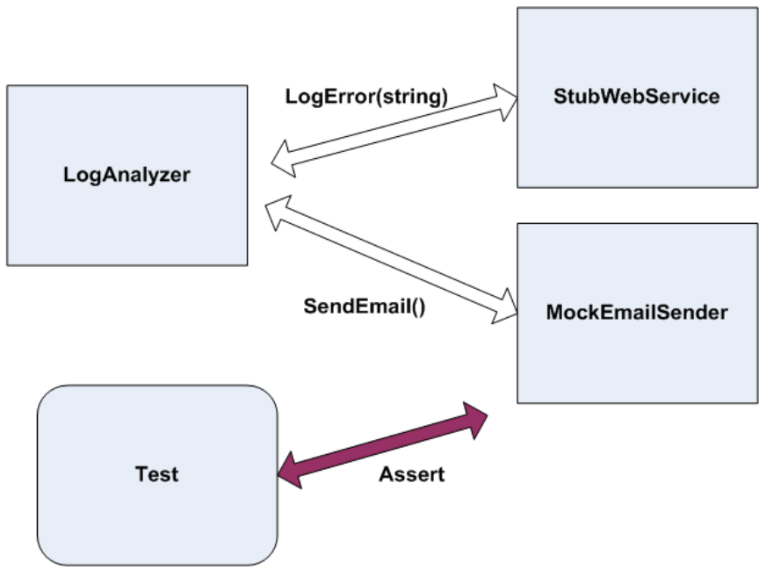
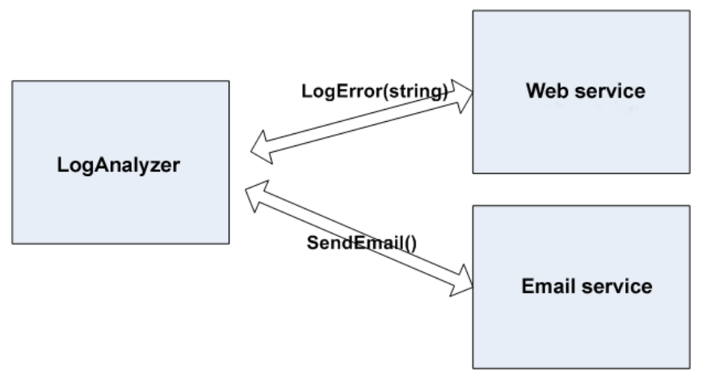
Using stubs/mocks together
Suppose a log analyzer reads from a web service.
If the web fails to log an error, the analyzer must send email.
  How to test to ensure that this behavior is occurring?
Set up a stub for the web service that intentionally fails.
Set up a mock for the email service that checks to see whether the analyzer contacts it to send an email message.

