Slide 1
CSE 403
Lecture 16
Continuous Integration; Integration Testing
Reading:
Continuous Integration (Fowler)
The Art of Unit Testing, Ch. 1, 3, 4-5 (Osherove)
Code Complete, Ch. 29 (McConnell)
slides created by Marty Stepp
http://www.cs.washington.edu/403/

Slide 2
Integration
integration: Combining 2 or more software units
  often a subset of the overall project (!= system testing)
Why do software engineers care about integration?
  new problems will inevitably surface
    many systems now together that have never been before
  if done poorly, all problems present themselves at once
    hard to diagnose, debug, fix
  cascade of interdependencies
    cannot find and solve problems one-at-a-time

Slide 3
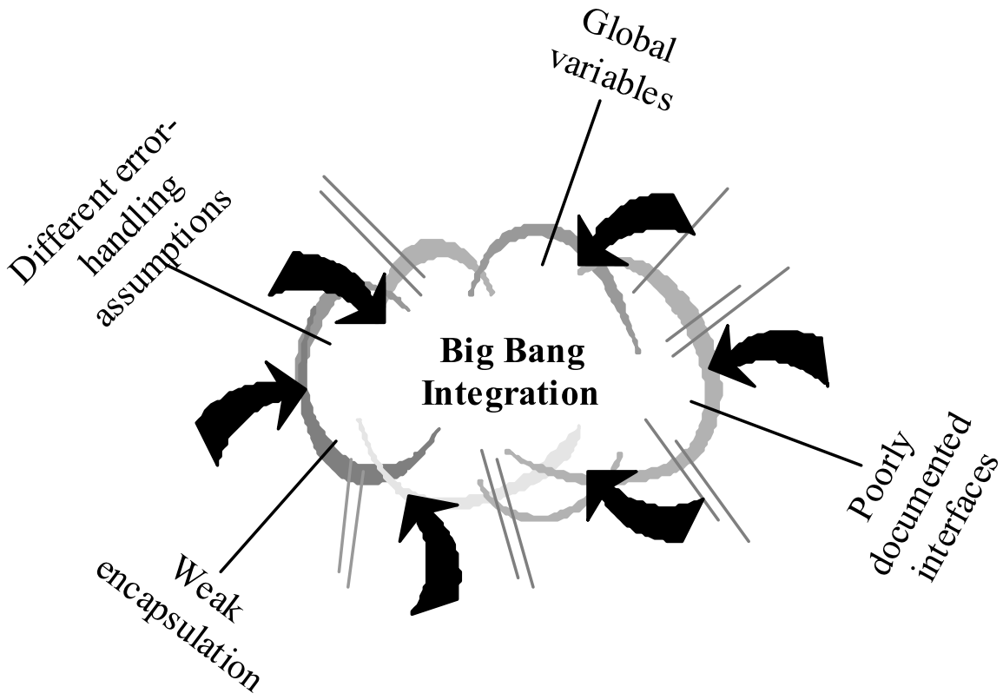
Phased integration
phased ("big-bang") integration:
  design, code, test, debug each class/unit/subsystem separately
  combine them all
  pray

Slide 4
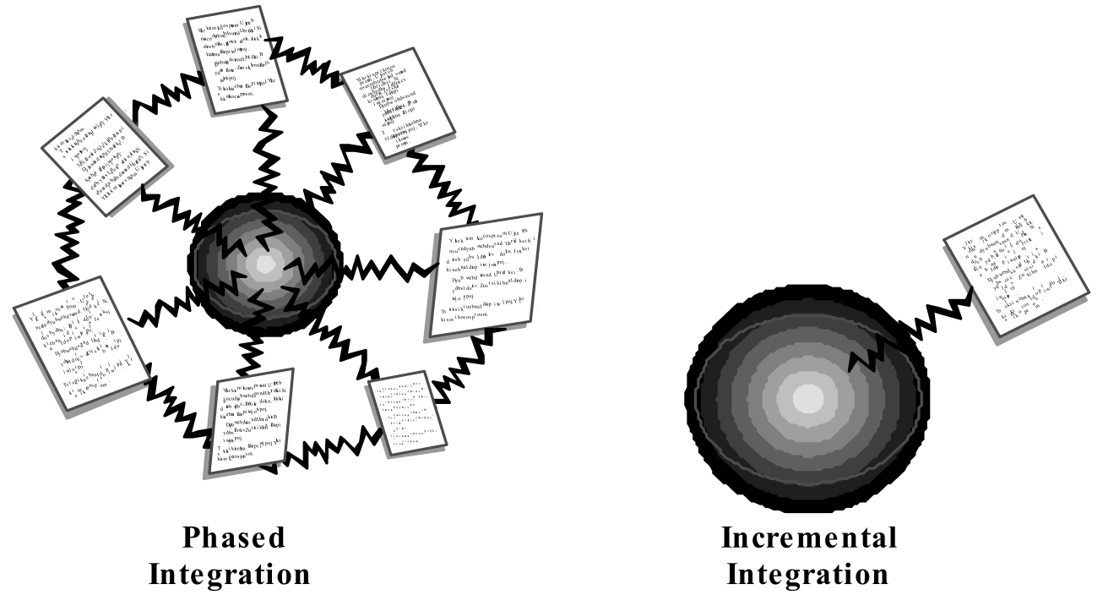
Incremental integration
incremental integration:
  develop a functional "skeleton" system (i.e. ZFR)
  design, code, test, debug a small new piece
  integrate this piece with the skeleton
    test/debug it before adding any other pieces

Slide 5
Benefits of incremental
Benefits:
  Errors easier to isolate, find, fix
    reduces developer bug-fixing load
  System is always in a (relatively) working state
    good for customer relations, developer morale
Drawbacks:
  May need to create "stub" versions of some features that have not yet been integrated

Slide 6
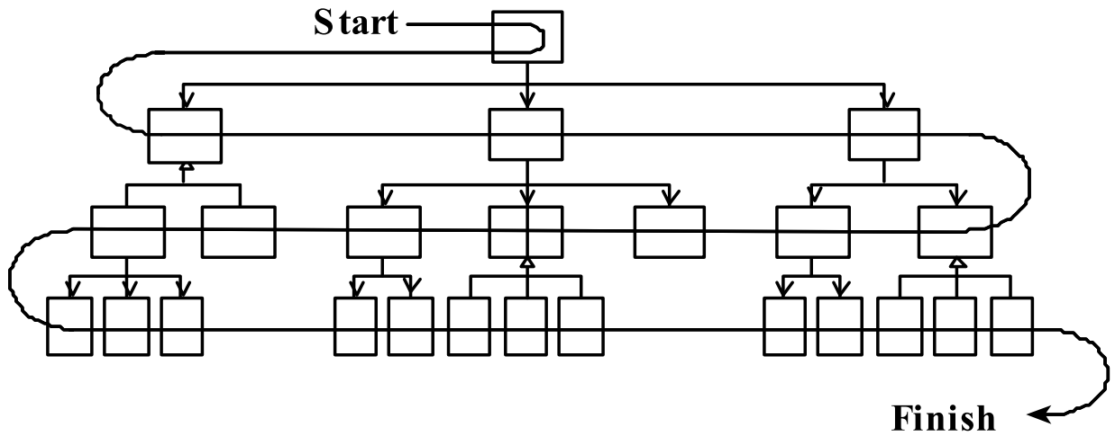
Top-down integration
top-down integration:
Start with outer UI layers and work inward
  must write (lots of) stub lower layers for UI to interact with
  allows postponing tough design/debugging decisions (bad?)

Slide 7
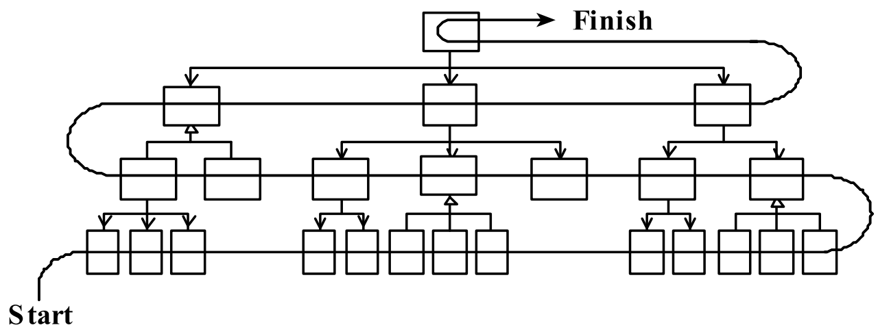
Bottom-up integration
bottom-up integration:
Start with low-level data/logic layers and work outward
  must write test drivers to run these layers
  won't discover high-level / UI design flaws until late

Slide 8
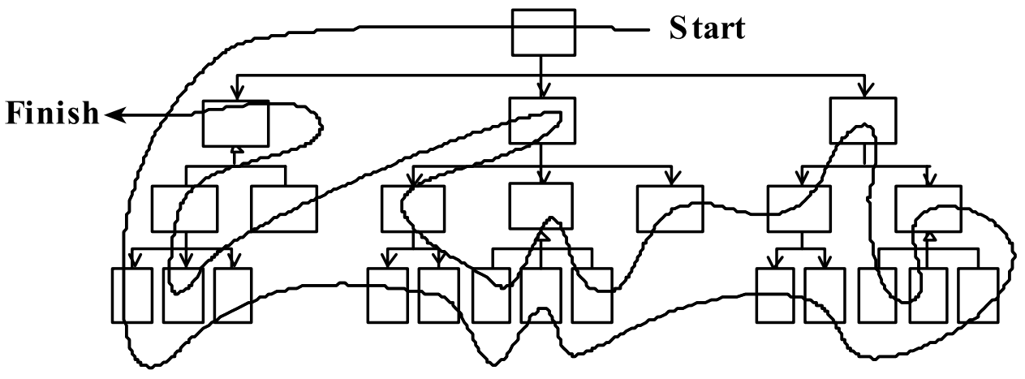
"Sandwich" integration
"sandwich" integration:
Connect top-level UI with crucial bottom-level classes
  add middle layers later as needed
  more practical than top-down or bottom-up?

Slide 9

Continuous Integration
Pioneered by Martin Fowler; part of Extreme Programming
Ten principles:
  maintain a single source repository
  automate the build
  make your build self-testing
  everyone commits to mainline every day
  every commit should build mainline on an integration machine
  keep the build fast
  test in a clone of the production environment
  make it easy for anyone to get the latest executable
  everyone can see what's happening
  automate deployment

Slide 10
Daily builds
"Automate the build."
daily build: Compile working executable on a daily basis
  allows you to test the quality of your integration so far
  helps morale; product "works every day"; visible progress
  best done automated or through an easy script
  quickly catches/exposes any bug that breaks the build
Continuous Integration (CI) server: An external machine that automatically pulls down your latest repo code and fully builds all resources.
  If anything fails, contacts your team (e.g. by email).
  Ensures that the build is never broken for long.

Slide 11
Build from command line
An Android project needs a build.xml to be used by Ant.
  This file allows your project to be compiled from the command line, making automated builds possible.
  <?xml version="1.0" encoding="UTF-8"?>
  <project name="MainActivity" default="help">
  <property file="ant.properties" />
  <import file="${sdk.dir}/tools/ant/build.xml" />
  <taskdef name="findbugs" classname="edu.umd.cs.findbugs.anttask.FindBugsTask"/>
  <target name="findbugs">
  <findbugs home="${findbugs.home}" output="xml" outputFile="findbugs.xml" excludeFilter="findbugs-exclude.xml">
  <auxClasspath path="${android.jar}" />
  <auxClasspath path="${rt.jar}" />
  <auxClasspath path="libs\android-support-v4.jar" />
  <class location="${out.dir}" />
  </findbugs>
  </target>
  <taskdef resource="checkstyletask.properties" classpath="${basedir}/libs/checkstyle-5.6-all.jar"/>
  <checkstyle config="sun_checks.xml" failonviolation="false">
  <fileset dir="src" includes="**/*.java"/>
  <formatter type="plain"/>
  <formatter type="xml" toFile="checkstyle-result.xml"/>
  </checkstyle>
  </project>

Slide 12
Automated tests
"Make your build self-testing."
automated tests: e.g. Tests that can be run from the command line on your project code at any time.
  can be unit tests, coverage, static analysis / style checking, ...
smoke test: A quick set of tests run on the daily build.
  NOT exhaustive; just sees whether code "smokes" (breaks)
  used (along with compilation) to make sure daily build runs

Slide 13
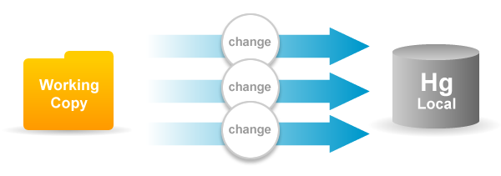
Daily commits
"Everyone commits to the mainline every day."
daily commit: Submit work to main repo at end of each day.
  Idea: Reduce merge conflicts; avoid later integration issues.
  This is the key to "continuous integration" of new code.
  Caution: Don't check in faulty code (does not compile, does not pass tests) just to maintain the daily commit practice.
  If your code is not ready to submit at end of day, either submit a coherent subset or be flexible about commit schedule.

Slide 14
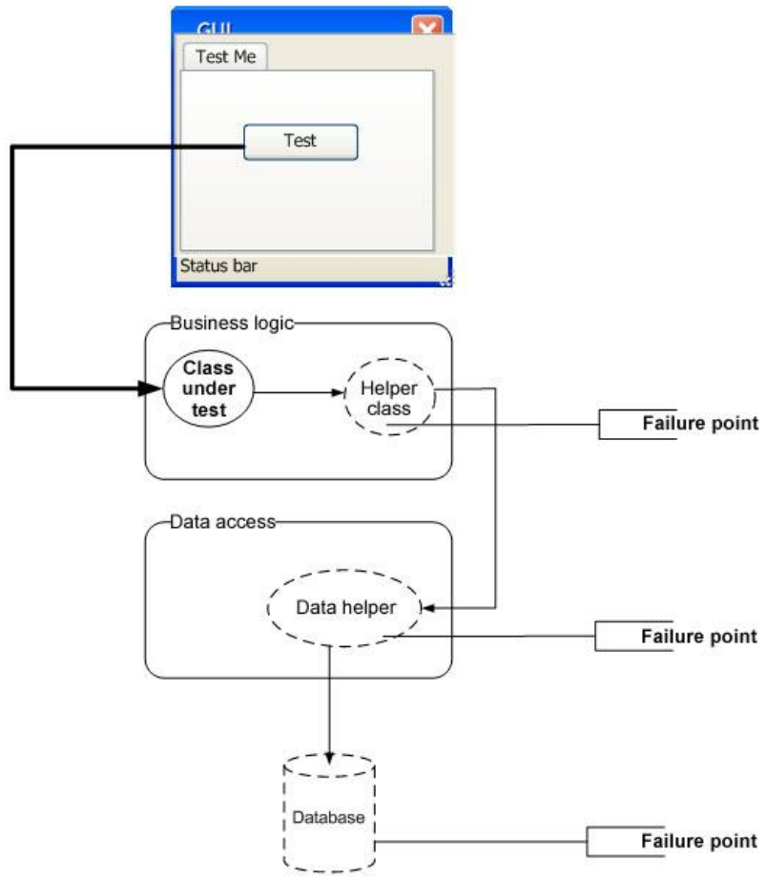
Integration testing
integration testing: Verifying software quality by testing two or more dependent software modules as a group.
challenges:
  Combined units can fail
  in more places and in more
  complicated ways.
  How to test a partial system
  where not all parts exist?
  How to "rig" the behavior of
  unit A so as to produce a
  given behavior from unit B?

Slide 15
Stubs
stub: A controllable replacement for an existing software unit to which your code under test has a dependency.
  useful for simulating difficult-to-control elements:
    network / internet
    database
    time/date-sensitive code
    files
    threads
    memory
  also useful when dealing with brittle legacy code/systems

Slide 16
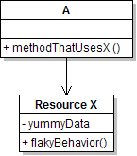
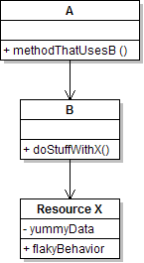
Create a stub, step 1
Identify the external dependency.
  This is either a resource or a class/object.
  If it isn't an object, wrap it up into one.
    (Suppose that Class A depends on troublesome Class B.)

Slide 17
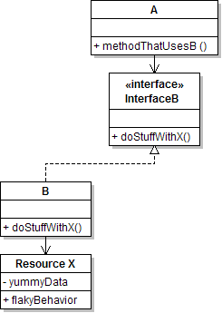
Create a stub, step 2
Extract the core functionality of the object into an interface.
  Create an InterfaceB based on B
  Change all of A's code to work with type InterfaceB, not B

Slide 18
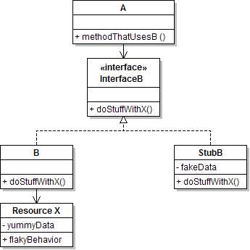
Create a stub, step 3
Write a second "stub" class that also implements the interface,
but returns pre-determined fake data.
  Now A's dependency on B is dodged and can be tested easily.
  Can focus on how well A integrates with B's external behavior.

Slide 19
Injecting a stub
seams: Places to inject the stub so Class A will talk to it.
  at construction (not ideal)
  A aardvark = new A(new StubB());
  through a getter/setter method (better)
  A apple = new A(...);
  aardvark.setResource(new StubB());
  just before usage, as a parameter (also better)
  aardvark.methodThatUsesB(new StubB());
    You should not have to change A's code everywhere (beyond using your interface) in order to use your Stub B. (a "testable design")

Slide 20
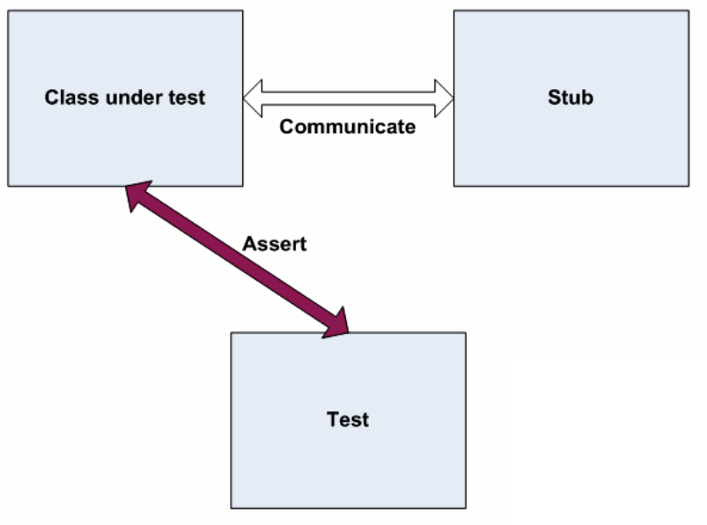
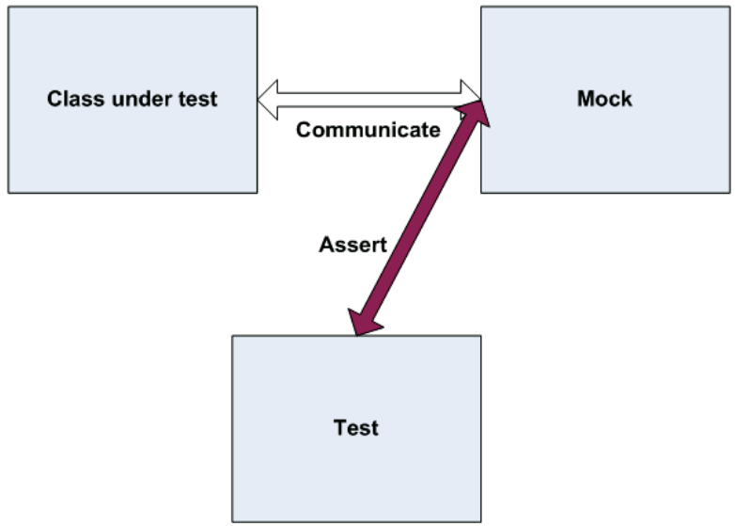
"Mock" objects
mock object: A fake object that decides whether a unit test has passed or failed by watching interactions between objects.
  useful for interaction testing (as opposed to state testing)

Slide 21
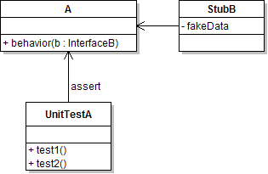
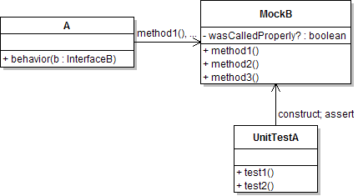
Stubs vs. mocks
  A stub gives out data that goes to
  the object/class under test.
  The unit test directly asserts against
  class under test, to make sure it gives
  the right result when fed this data.
  A mock waits to be called by
  the class under test (A).
    Maybe it has several methods
    it expects that A should call.
  It makes sure that it was contacted
  in exactly the right way.
    If A interacts with B the way it should, the test passes.
Notes:
Don't put assertion statements directly in the mock object, because we may want to re-use it.

Slide 22

Mock object frameworks
Stubs are often best created by hand/IDE.
Mocks are tedious to create manually.
Mock object frameworks help with the process.
  android-mock, EasyMock, jMock (Java)
  FlexMock / Mocha (Ruby)
  SimpleTest / PHPUnit (PHP)
  ...
Frameworks provide the following:
  auto-generation of mock objects that implement a given interface
  logging of what calls are performed on the mock objects
  methods/primitives for declaring and asserting your expectations

Slide 23
A jMock mock object
import org.jmock.integration.junit4.*; // Assumes that we are testing
import org.jmock.*; // class A's calls on B.
@RunWith(JMock.class)
public class ClassATest {
private Mockery mockery = new JUnit4Mockery(); // initialize jMock
@Test public void testACallsBProperly1() {
// create mock object to mock InterfaceB
final InterfaceB mockB = mockery.mock(InterfaceB.class);
// construct object from class under test; attach to mock
A aardvark = new A(...);
aardvark.setResource(mockB);
// declare expectations for how mock should be used
mockery.checking(new Expectations() {{
oneOf(mockB).method1("an expected parameter");
will(returnValue(0.0));
oneOf(mockB).method2();
}});
// execute code A under test; should lead to calls on mockB
aardvark.methodThatUsesB();
// assert that A behaved as expected
mockery.assertIsSatisfied();
}
}

Slide 24
jMock API
jMock has a strange API based on "Hamcrest" testing syntax.
Specifying objects and calls:
  oneOf(mock), exactly(count).of(mock),
  atLeast(count).of(mock), atMost(count).of(mock),
  between(min, max).of(mock)
  allowing(mock), never(mock)
    The above accept a mock object and return a descriptor that you can call methods on, as a way of saying that you demand that those methods be called by the class under test.
  atLeast(3).of(mockB).method1();
    "I expect that method1 will be called on mockB 3 times here."

Slide 25
Expected actions
.will(action)
  actions: returnValue(v), throwException(e)
values:
  equal(value), same(value), any(type), aNull(type), aNonNull(type), not(value), anyOf(value1, ..,valueN)
  oneOf(mockB).method1();
  will(returnValue(anyOf(1, 4, -3)));
    "I expect that method1 will be called on mockB once here, and that it will return either 1, 4, or -3."

Slide 26
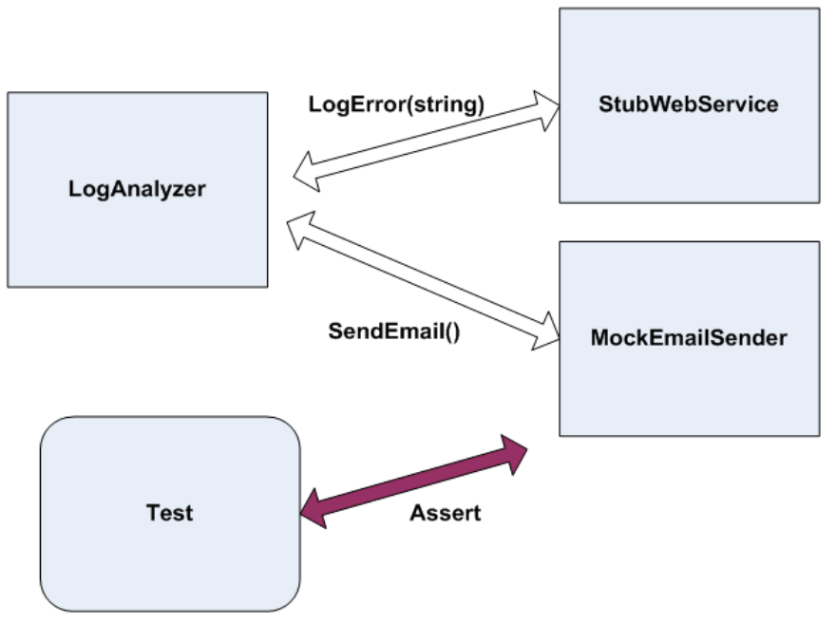
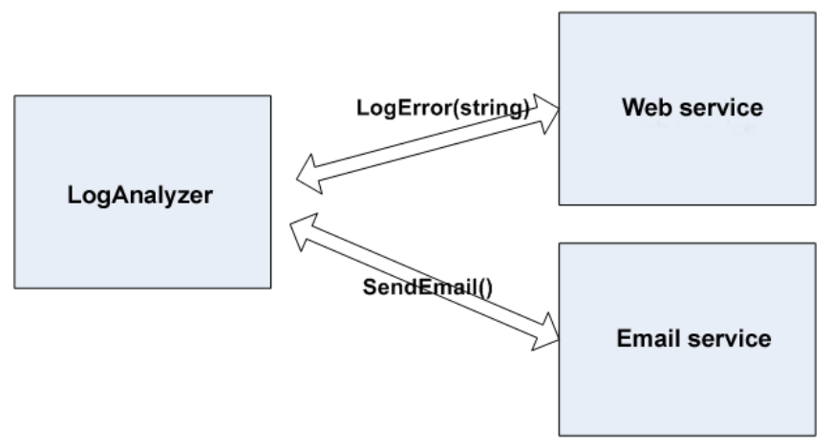
Using stubs/mocks together
Suppose a log analyzer reads from a web service.
If the web fails to log an error, the analyzer must send email.
  How to test to ensure that this behavior is occurring?
Set up a stub for the web service that intentionally fails.
Set up a mock for the email service that checks to see whether the analyzer contacts it to send an email message.

