Slide 1
CSE 403
Lecture 17
Usability Testing
Reading: Don't Make Me Think!
A Common Sense Approach to Web Usability
by S. Krug, Ch. 9-11
Handbook of Usability Testing, 2ed
by J. Rubin / D. Chisnell, Ch. 2-5
slides created by Marty Stepp
http://www.cs.washington.edu/403/

Slide 2
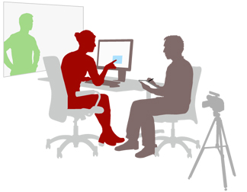
Usability testing
usability testing: Evaluating a product
by testing it on users.
  usability has become a distinguishing
  factor for products (Apple)
  focuses on individual usage, using
  the product to do something specific
focus group: A group of people are asked about their perceptions, opinions, beliefs and attitudes towards a product, service, concept, advertisement, idea, or packaging.
  focus group is a GROUP process; reactions; abstract; done early

Slide 3
Lack of usability testing
Many companies don't usability test, or do it very little.
  if done at all, often done with ~2 weeks left in development!
Reasons given not to usability test:
  not enough time
  not enough money
  no expertise in doing it
  no lab or location in which to perform it
  don't know how to interpret the results
How do the authors respond to these criticisms?
Notes:
no time
- take very little time; saves more than that later
no money
- doesn't really cost anything
no expertise
- it is very easy to do
no lab
- who cares; just needs to be quiet (see 200-level rooms in CSE)
don't know how to interpret the results
- see ch10

Slide 4
Countering criticisms
Why bother usability testing if we don't have time, money, or expertise to do very much of it?
Why can't the developers just test the product by using it themselves and seeing what does / doesn't work for them?
  developer knows product too well; can't see it like a newbie
  even limited testing is better than none
  few early tests are better than many late tests
  ideally, usability testing is iterative; done over and over

Slide 5
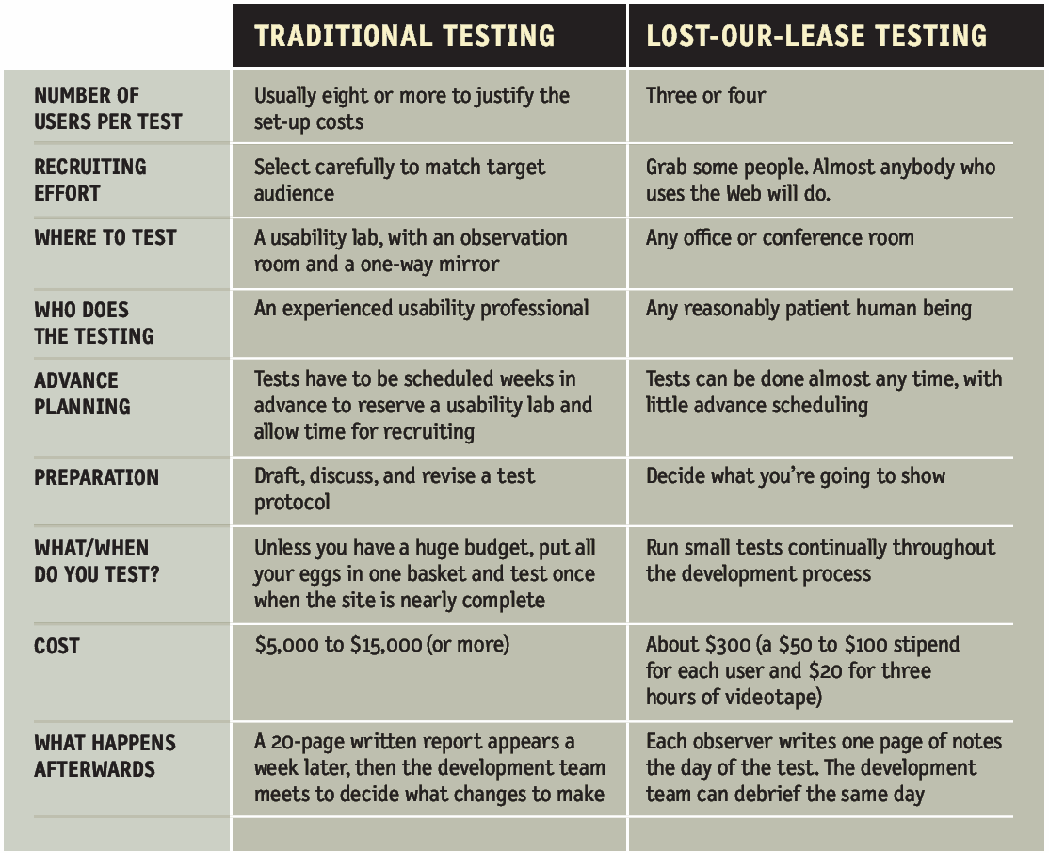
Inexpensive testing

Slide 6
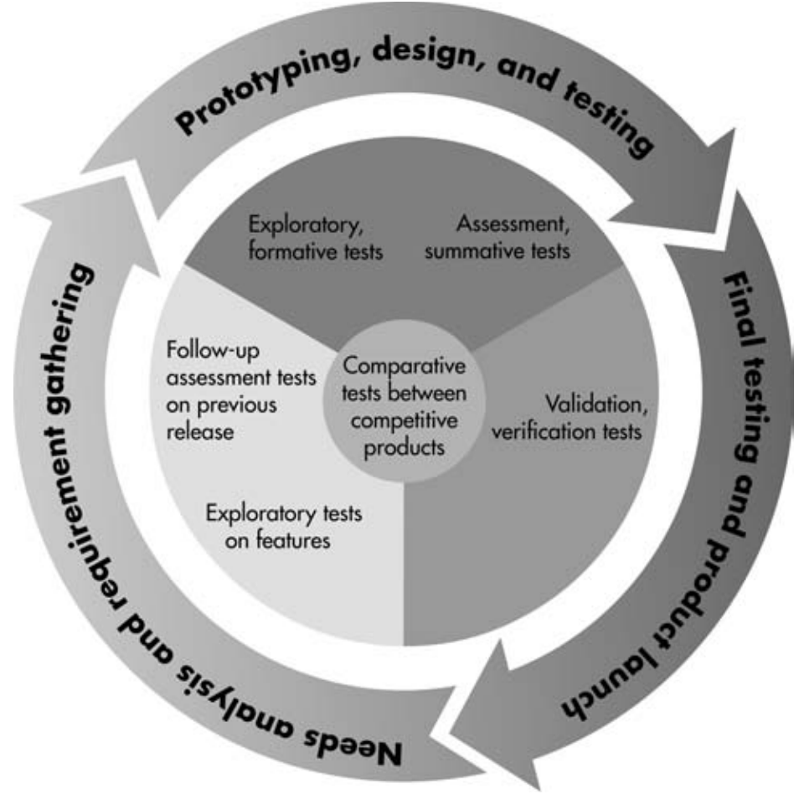
When to usability test?
When should a usability test be performed?
  best done early in the software lifecycle
  best done often / repeatedly
  type of test may vary
  depending on how far
  along the process you are
    early: paper prototype
    middle: compare UI designs
    later: verify UI's usability
  can keep a historical record
  of usability results for each test

Slide 7
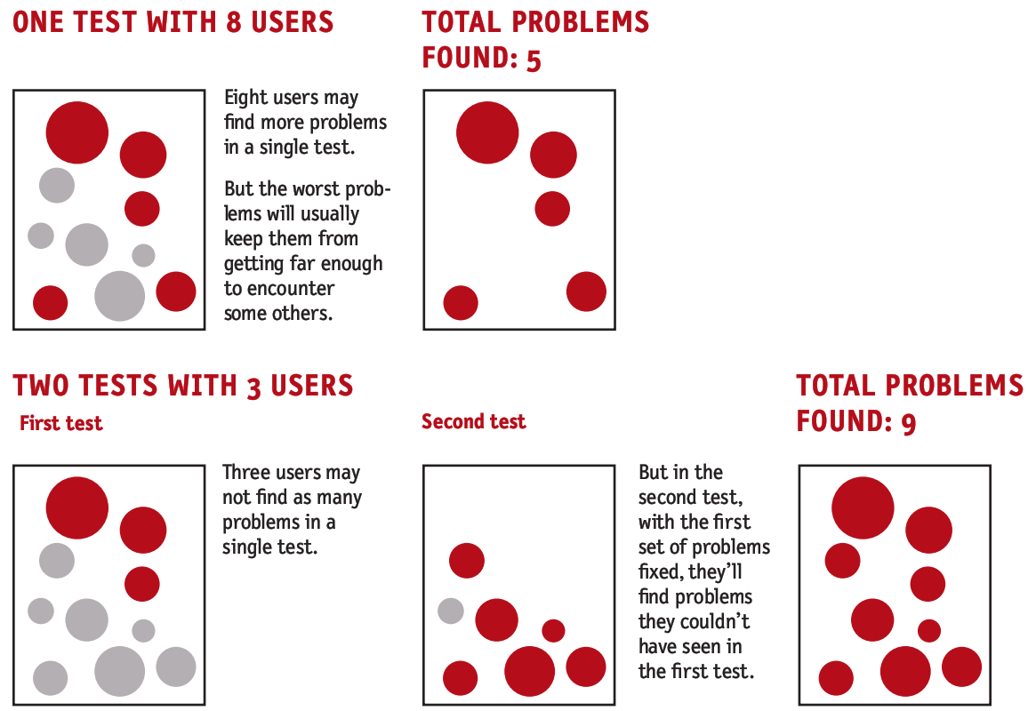
Benefits of multiple tests

Slide 8
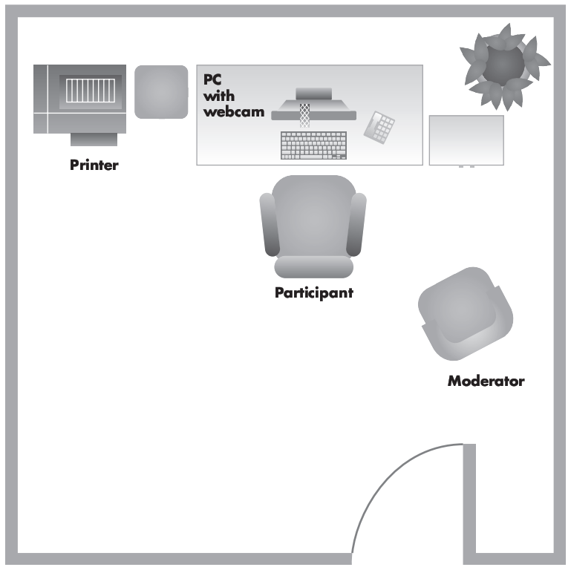

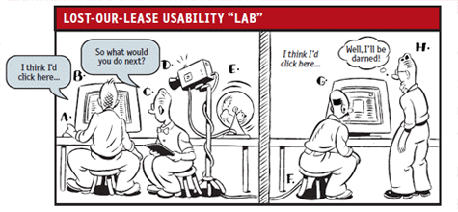
Usability study room setup
preferred: a quiet room with a computer and 2-3 chairs
  participant sits at computer and performs tasks w/ product
  moderator / facilitator guides the user through the process
  others on dev team observe
  user, either from the side
  or from another room (preferred)
    web cam, one-way mirror, etc.
    record the user and watch later

Slide 9
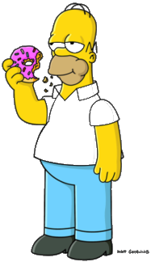
Identifying participants
Can I make my mother test our app?
Does it matter who the users are for a usability test?
  An ideal test has at least 3-4 users who have
  not been told much about the app beforehand.
  It doesn't matter much who you grab as your user;
  doesn't have to be just like a real user of the app.
  Everyone's a beginner in a way.
  It's bad to design a site that only experts can use.
  Experts don't mind something simple enough
  for beginners, so testing with beginners is not bad.
  UNLESS the app requires specific expert knowledge to use.

Slide 10

Facilitating a study
Who is qualified to be a study facilitator?
What things should / shouldn't a facilitator do?
  Anybody with decent people skills can do it.
  Be friendly.
  Tell them it's okay to make mistakes; they aren't being tested.
  Encourage them ask questions and to think out loud.
  Don't lead the user or give them hints about what to do.
  Probe; when they give feedback, ask for more details.
  Don't appear to be concerned with note-taking or data gathering.
  Don't be upset if the user fails or gets stuck.
  Ask user questions when they get stuck.
    "What are you thinking?" or "What are you trying to do now?"
  Tip: Try taking the test yourself first.

Slide 11

Types of tests
"get it" testing: Does user understand site's basic purpose?
  "What do you think this page/site/app is about?"
  "What do you think the ___ feature is for?"
  Let them just click around for a while and play with the app.
"key task" testing: Ask user to do a specific thing, and watch to see how they do.
  "Your goal is to purchase a book
  about sailing for under $15."
  "Change your buddy list
  preferences to block Amanda."

Slide 12
Another categorization
exploratory/formative - high-level design concepts
  Can user "walk up and use" it, and see value in the product?
assessment/summative - lower-level operations (later)
  user performs actual tasks, not vague goals; less moderated
comparison test - match up different prototypes or designs
  perf data are gathered for each design and compared
  idea: test a competitor's site, see what they do/don't like
  "best" design may turn out to be a hybrid of the available choices
verification test - verifies that UI is okay or that a fix works
  done with an actual product, not just a paper prototype
  performance expectations are decided and measured

Slide 13
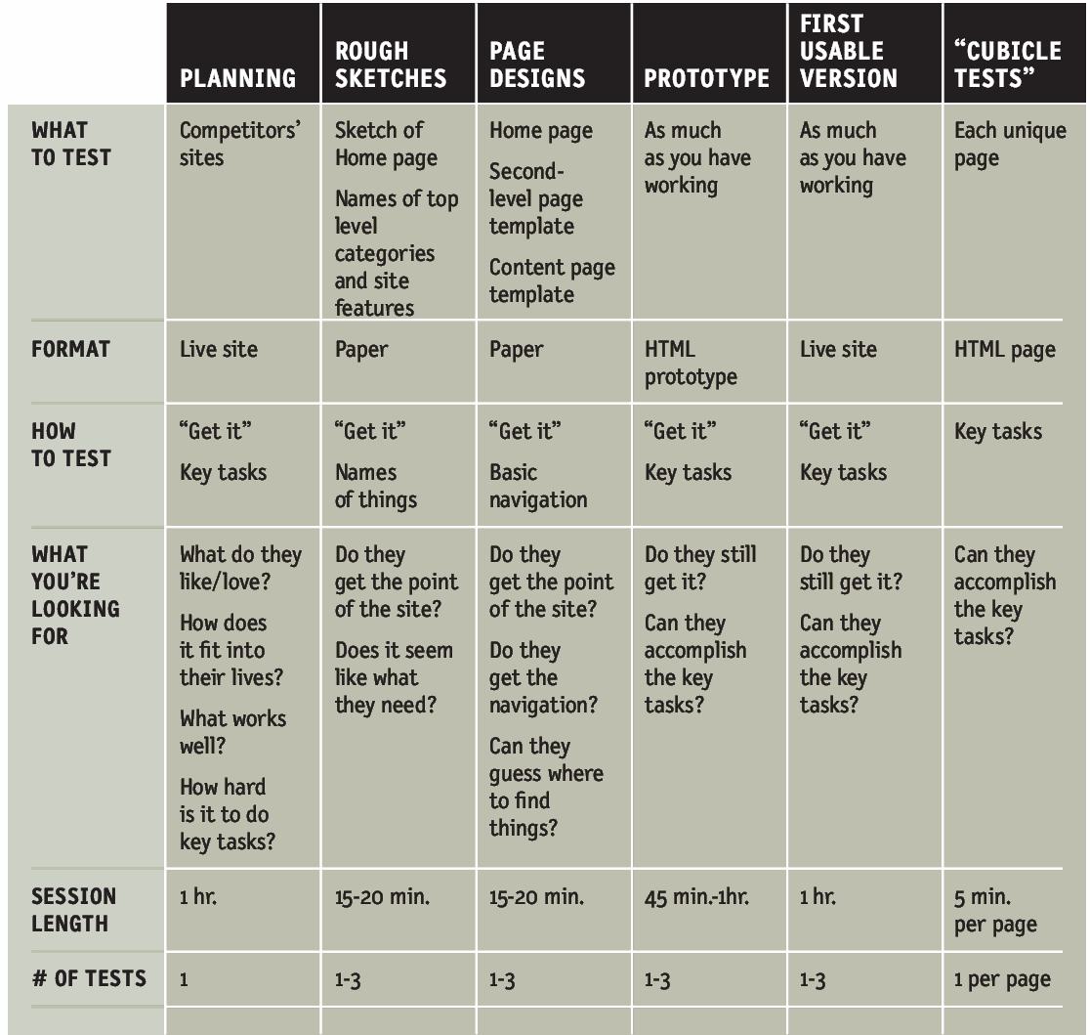
A usability test plan

Slide 14

Another usability test plan
type of test
purpose/goals/objectives
participant characteristics
task list
  (possibly have users try same tasks in different orders)
test environment / equipment
moderator's role
evaluation metrics and data to be collected
report

Slide 15
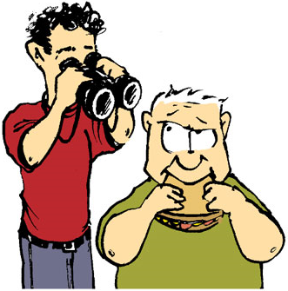
Observing a test
Should be out of view/room if possible.
What should observers look for?
  Does the user "get it"?
  Can they find their way around the site?
  How long (time, number of clicks) does it take them?
  Do they do any "head-slapping" or shocking things?
  What do the users like and dislike most about the experience?
  Watch what users do when they get stuck.
    Do they look for help?
    Do they re-read the page carefully?
    Do they go back?
    Do they just stop and look at the moderator?
    Do they start wandering the app looking for the feature?

Slide 16
Gather and interpret data
Observers write down usability test notes.
  Team looks over notes and decides what to change.
  Tip: Value the user's actions and explanations over opinions.
  Tip: Don't always listen to user suggestions for new features.
  It can be hard to figure out HOW to fix problems.
Small changes (tweaks) are often better than huge changes.
  Often removing or simplifying is better than adding.
  First fix things that are easy or get the most bang for the buck.

Slide 17
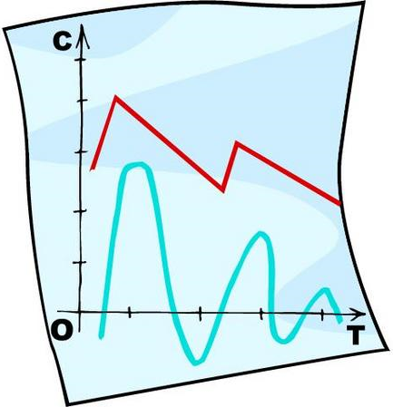
Possible data to collect
Number/percentage of:
  tasks completed correctly with/without prompts or assistance
  tasks completed incorrectly
Count of:
  incorrect selections (errors)
  errors of omission
  incorrect menu choices
  incorrect icons selected
  visits to the help file, index, table of contents, etc.
  negative comments or mannerisms
Time required to:
  access information in online help
  recover from error(s)
  complete each task

Slide 18
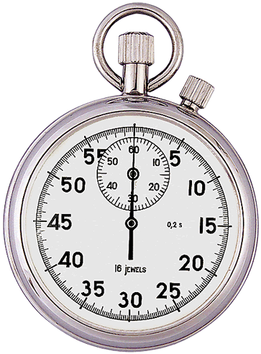
Performance goals
Some tests have specific performance goals.
  Decide specific goals you want users to achieve.
    "At least 2/3 of users will be able to find and
    change their Network Settings in < 5 minutes."
    "Every user will be able to find/use the navigation bar."
  In these tests, moderator offers less guidance and fewer hints
  Less emphasis on "thinking out loud"
    Thinking out loud slows users down; they may not finish in time.
  Alternatives to thinking out loud:
    Replay steps with user after the test is over.
    Get them to talk about what they did and why they did it.
    Hook up electrodes to their brain and measure the current. (no)

Slide 19
Goals and objectives
bad goals:
  Is the product usable? (too vague / nebulous)
  Is it ready for release? (users can't determine that)
  Is this a good product? (too subjective)
better goals:
  Can users tell what is / isn't clickable?
  Where do users go to search the site?
  How easily do users find new products on the site to purchase?
  Do users use the toolbar at the top of the screen?
  What do users click to find help when they are stuck?

Slide 20
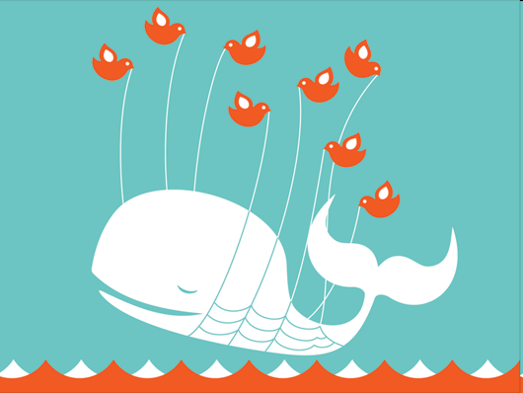
Users fail
Typical ways users fail in usability tests:
  Don't understand the point of the site.
  They use different vocabulary than you, so
  they can't find a word for the action to do.
  Their notion of how to categorize is different.
  Site is too busy / cluttered.
  Not clear what the options are on the screen.
If user momentarily gets stuck or goes astray,
that CAN be okay.
  A "kayak" problem; the boat can right itself.
  Give them a chance to temporary fail and then recover.
Notes:
grade-it, groups by assignment -> section -> student

Slide 21
Limitations of usability tests
Somewhat artificial
Test results don't prove that a product/design/UI "works"
Testing may not be the best use of your time.
  Maybe have a usability expert look at it, to find gross violations.
It's possible that a UI has an initial learning curve, but is then very powerful/usable. A usability test doesn't measure that.
Doesn't tell you if the market wants/needs a product like yours.
  A focus group or survey would be better for that.

