Slide 1
CSE 403
Lecture 18
Performance Testing
Reading:
Code Complete, Ch. 25-26 (McConnell)
slides created by Marty Stepp
http://www.cs.washington.edu/403/

Slide 2
Acceptance, performance
acceptance testing: System is shown to the user / client / customer to make sure that it meets their needs.
  A form of black-box system testing
Performance is important.
  Performance is a major aspect of program acceptance by users.
  Your intuition about what's slow is often wrong.

Slide 3
What's wrong with this? (1)
  public class BuildBigString {
  public final static int REPS = 80000;
  // Builds/returns a big, important string.
  public static String makeString() {
  String str = "";
  for (int n = 0; n < REPS; n++) {
  str += "more";
  }
  return str;
  }
  public static void main(String[] args) {
  System.out.println(makeString());
  }
  }

Slide 4
What's wrong with this? (2)
  public class Fibonacci {
  public static void main(String[] args) {
  // print the first 10000 Fibonacci numbers
  for (int i = 1; i <= 10000; i++) {
  System.out.println(fib(i));
  }
  }
  // pre: n >= 1
  public static long fib(int n) {
  if (n <= 2) {
  return 1;
  } else {
  return fib(n - 2) + fib(n - 1);
  }
  }
  }

Slide 5
What's wrong with this? (3)
  public class WordDictionary {
  // The set of words in our game.
  List<String> words = new ArrayList<String>();
  public void add(String word) {
  words.add(word.toLowerCase());
  }
  public boolean contains(String word) {
  for (String s : words) {
  if (s.toLowerCase().equals(word)) {
  return true;
  }
  }
  return false;
  }
  }

Slide 6
What's wrong with this? (4)
  public class BankManager {
  public static void main(String[] args) {
  Account[] a = Account.getAll();
  for (int i = 0; i < Math.sqrt(895732); i++) {
  a[i].loadTaxData();
  if (a.meetsComplexTaxCode(2020)) {
  a[i].fileTaxes(4 * 4096 * 17);
  }
  }
  Account[] a2 = Account.getAll();
  for (int i = 0; i < Math.sqrt(895732); i++) {
  if (a.meetsComplexTaxCode(2020)) {
  a2[i].setTaxRule(4 * 4096 * 17);
  a2[i].save(new File(a2.getName()));
  }
  } } }

Slide 7
The correct answers
Who cares?
Who cares?
Who cares?
Who cares?
"We should forget about small efficiencies, say about 97% of the time: premature optimization is the root of all evil."
-- Donald Knuth
"We follow two rules in the matter of optimization:
  1. Don't do it.
  2. (for experts only) Don't do it yet."
-- M. A. Jackson

Slide 8
Thinking about performance
The app is only too slow if it doesn't meet your project's
stated performance requirements.
  If it meets them, DON'T optimize it!
Which is more important, fast code or correct code?
What are reasonable performance requirements?
  What are the user's expectations? How slow is "acceptable" for this portion of the application?
  How long do users wait for a web page to load?
  Some tasks (admin updates database) can take longer

Slide 9
Optimization myths
Myth: You should optimize your code as you write it.
  No; makes code ugly, possibly incorrect, and not always faster.
  Optimize later, only as needed.
Myth: Having a fast program is as important as a correct one.
  If it doesn't work, it doesn't matter how fast it's running!
Myth: Certain operations are inherently faster than others.
  x << 1 is faster to compute than x * 2 ?
  This depends on many factors, such as language used.
  Don't write ugly code on the assumption that it will be faster.
Myth: A program with fewer lines of code is faster.

Slide 10
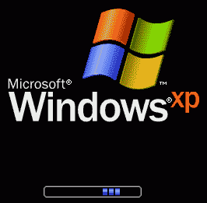
Perceived performance
"My app feels too slow. What should I do?"
  possibly optimize it
  And/or improve the app's perceived performance
perceived performance:
User's perception of your app's responsiveness.
factors affecting perceived performance:
  loading screens
  multi-threaded UIs (GUI doesn't stall while
  something is happening in the background)
Notes:
Examples:
Grade-It
Catalyst

Slide 11
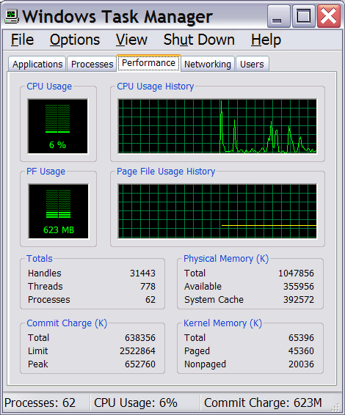
Optimization metrics
runtime / CPU usage
  what lines of code the program is spending the most time in
  what call/invocation paths were used to get to these lines
    naturally represented as tree structures
memory usage
  what kinds of objects are on the heap
  where were they allocated
  who is pointing to them now
  "memory leaks" (does Java have these?)
web page load times,
requests/minute, etc.

Slide 12
Benchmarking, optimization
benchmarking: Measuring the absolute performance of your app on a particular platform (coarse-grained measurement).
optimization: Refactoring and enhancing to speed up code.
  I/O routines
    accessing the console (print statements)
    files, network access, database queries
    exec() / system calls
  Lazy evaluation saves you from computing/loading
    don't read / compute things until you need them
  Hashing, caching save you from reloading resources
    combine multiple database queries into one query
    save I/O / query results in memory for later

Slide 13
Optimizing memory access
Non-contiguous memory access (bad):
  for (int col = 0; col < NUM_COLS; col++) {
  for (int row = 0; row < NUM_ROWS; row++) {
  table[row][column] = bulkyMethodCall();
  }
  }
Contiguous memory access (good):
  for (int row = 0; row < NUM_ROWS; row++) {
  for (int col = 0; col < NUM_COLS; col++) {
  table[row][column] = bulkyMethodCall();
  }
  }
  switches rows NUM_ROWS times, not NUM_ROWS * NUM_COLS

Slide 14
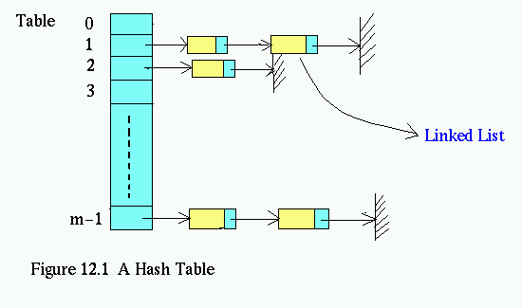
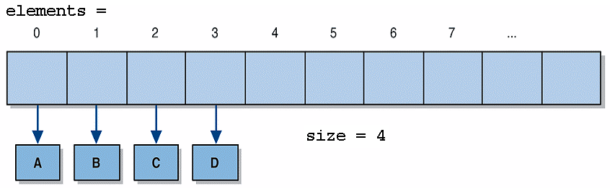
Optimizing data structures
Take advantage of hash-based data structures
  searching an ArrayList (contains, indexOf) is O(N)
  searching a HashMap/HashSet is O(1)
Getting around limitations of hash data structures
  need to keep elements in sorted order? Use TreeMap/TreeSet
  need to keep elements in insertion order? Use LinkedHashSet

Slide 15
Avoiding computations
Stop computing when you know the answer:
  found = false;
  for (i = 0; i < reallyBigNumber; i++) {
  if (inputs[i].isTheOneIWant()) {
  found = true;
  break;
  }
  }
Hoist expensive loop-invariant code outside the loop:
  double taxThreshold = reallySlowTaxFunction();
  for (i = 0; i < reallyBigNumber; i++) {
  accounts[i].applyTax(taxThreshold);
  }

Slide 16
Lookup tables
Figuring out the number of days in a month:
  if (m == 9 || m == 4 || m == 6 || m == 11) {
  return 30;
  } else if (month == 2) {
  return 28;
  } else {
  return 31;
  }
Days in a month, using a lookup table:
  DAYS_PER_MONTH = {-1, 31, 28, 31, 30, 31, 30, ..., 31};
  ...
  return DAYS_PER_MONTH[month];
  Probably not worth the speedup with this particular example...

Slide 17
Optimization is deceptive
  int sum = 0;
  for (int row = 0; row < NUM_ROWS; row++) {
  for (int col = 0; col < NUM_COLS; col++) {
  sum += matrix[row][column];
  }
  }
Optimized code:
  int sum = 0;
  Cell* p = matrix;
  Cell* end = &matrix[NUM_ROWS - 1][NUM_COLS - 1];
  while (p != end) {
  sum += *p++;
  }
Speed-up observed: NONE.
  Compiler was already optimizing the original into the second!

Slide 18
Dynamic programming
  public static boolean isPrime(int n) {
  double sqrt = Math.sqrt(n);
  for (int i = 2; i <= sqrt; i++)
  if (n % i == 0) { return false; }
  return true;
  }
dynamic programming: Caching previous results.
  private static Map<Integer, Boolean> PRIME = ...;
  public static boolean isPrime2(int n) {
  if (!PRIME.containsKey(n))
  PRIME.put(n, isPrime(n));
  return PRIME.get(n);
  }

Slide 19
Optimization tips
Pareto Principle, aka the "80-20 Rule"
  80% of a program's execution occurs within 20% of its code.
  You can get 80% results with 20% of the work.
"The best is the enemy of the good."
  You don't need to optimize all your app's code.
  Find the worst bottlenecks and fix them. Leave the rest.

Slide 20
Profiling
profiling: Measuring relative system statistics (fine-grained).
  Where is the most time being spent? ("classical" profiling)
    Which method takes the most time?
    Which method is called the most?
  How is memory being used?
    What kind of objects are being created?
    This in especially applicable in OO, GCed environments.
  Profiling is not the same as benchmarking or optimizing.

Slide 21
Types of profiling
insertion: placing special profiling code into your program (manually or automatically)
  pros: can be used across a variety of platforms; accurate
  cons: requires recompiling; profiling code may affect performance
sampling: monitoring CPU or VM at regular intervals and saving a snapshot of CPU and/or memory state
  pros: no modification of app is necessary
  cons: less accurate; varying sample interval leads to a time/accuracy trade-off; small methods may be missed;
  cannot easily monitor memory usage

Slide 22
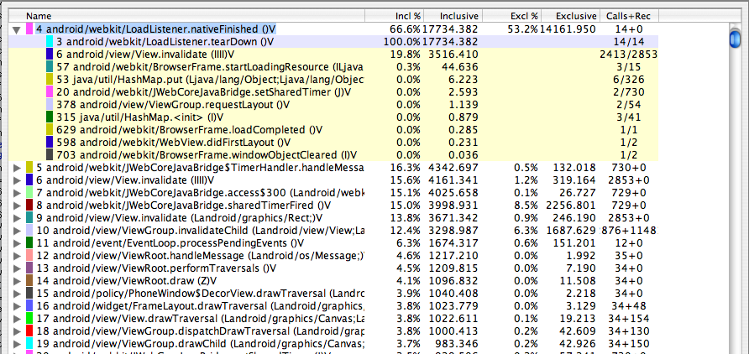
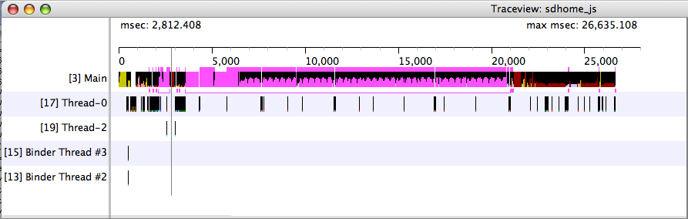
Android Traceview
Traceview:
  http://developer.android.com/tools/debugging/debugging-tracing.html
  Debug class generates *.trace files to be viewed
    Debug.startMethodTracing(); ... Debug.stopMethodTracing();
  timeline panel: describes when each thread/method start/stops
  profile panel: summary of what happened inside a method

Slide 23
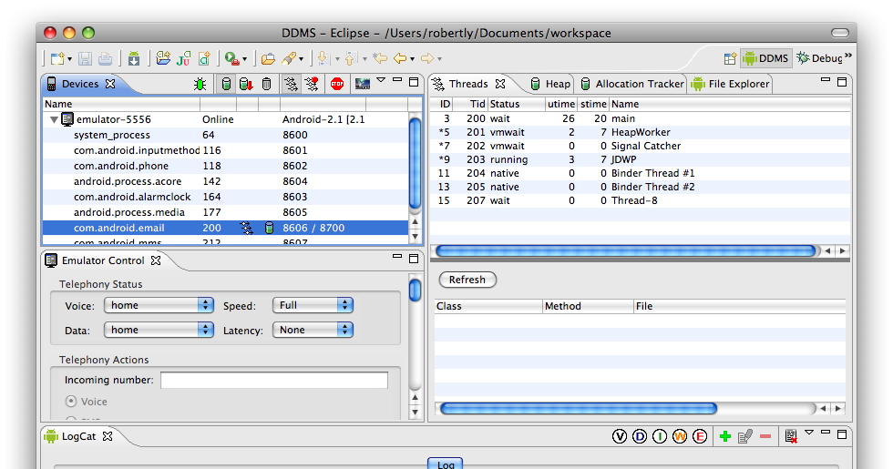
Android profiling DDMS
Dalvik Debug Monitor Server (DDMS):
  http://developer.android.com/tools/debugging/ddms.html
    Eclipse: Window → Open Perspective → Other... → DDMS
    console: run ddms from tools/ directory
  On Devices tab, select process that you want to profile
    Click Start Method Profiling
    Interact with application to run and profile its code.

Slide 24
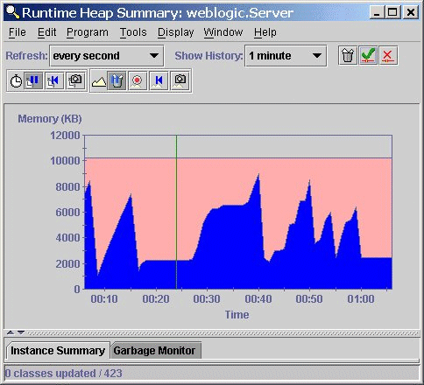
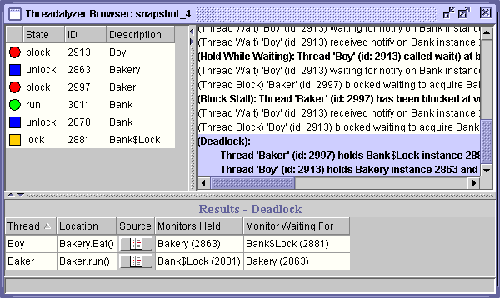
Java profiling tools
Many free Java profiling/optimization tools available:
  TPTP profiler extension for Eclipse
  Extensible Java Profiler (EJP) - open source, CPU tracing only
  Eclipse Profiler plugin
  Java Memory Profiler (JMP)
  Mike's Java Profiler (MJP)
  JProbe Profiler - uses an instrumented VM
hprof (java -Xrunhprof)
  comes with JDK from Sun, free
  good enough for anything I've ever needed

Slide 25
Using hprof
  usage: java -Xrunhprof:[help]|[<option>=<value>, ...]
  Option Name and Value Description Default
  --------------------- ----------- -------
  heap=dump|sites|all heap profiling all
  cpu=samples|times|old CPU usage off
  monitor=y|n monitor contention n
  format=a|b text(txt) or binary output a
  file=<file> write data to file off
  depth=<size> stack trace depth 4
  interval=<ms> sample interval in ms 10
  cutoff=<value> output cutoff point 0.0001
  lineno=y|n line number in traces? Y
  thread=y|n thread in traces? N
  doe=y|n dump on exit? Y
  msa=y|n Solaris micro state accounting n
  force=y|n force output to <file> y
  verbose=y|n print messages about dumps y

Slide 26
Sample hprof usage
  java -Xrunhprof:cpu=samples,depth=6,heap=sites
  or
  java -Xrunhprof:cpu=old,thread=y,depth=10,cutoff=0,format=a ClassName
  Takes samples of CPU execution
  Record call traces that include the last 6/10 levels on the stack
  Only record "sites" used on heap (to keep output file small)
  java -Xrunhprof ClassName
  Takes samples of memory/object usage
After execution, open the text file java.hprof.txt in the current directory with a text editor

Slide 27
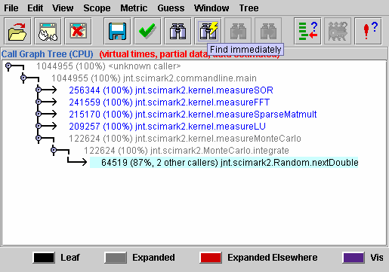
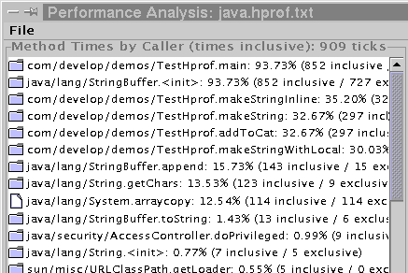
hprof visualization tools
CPU samples
  critical to see traces to modify code
  hard to read - far from the traces in the file
  HPjmeter analyzes java.hprof.txt visually
    http://software.hp.com/portal/swdepot/displayProductInfo.do?productNumber=HPJMETER
  another good tool called PerfAnal builds
  and navigates the invocation tree
  download PerfAnal.jar, and:
  java -jar PerfAnal.jar ./java.hprof.txt
Heap dump
  critical to see what objects are there, and who points to them
  HPjmeter or HAT: https://hat.dev.java.net/

Slide 28
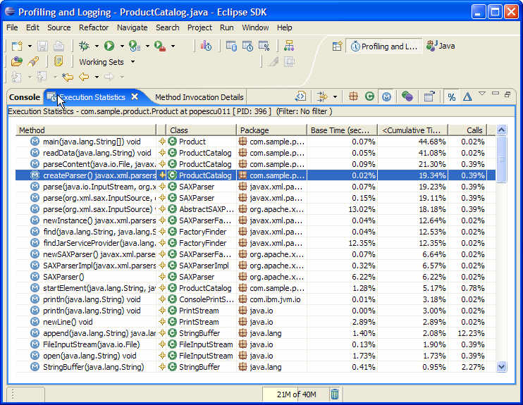
TPTP
a free extension to Eclipse for Java profiling
  easier to interpret than raw hprof results
  has add-ons for profiling web applications (J2EE)

Slide 29
Profiler results
What to do with profiler results:
  observe which methods are being called the most
    These may not necessarily be the "slowest" methods!
  observe which methods are taking most time relative to others
Warnings
  CPU profiling slows down your code (a lot)
    design your profiling tests to be very short
  CPU samples don't measure everything
    doesn't record object creation and garbage collection time
  Output files are very large, esp. if there is a heap dump

Slide 30
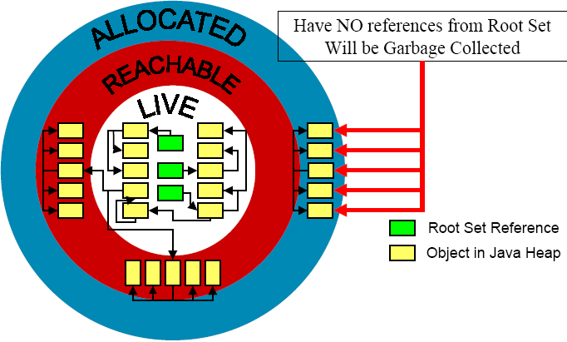
Garbage collection
garbage collector: A memory manager that reclaims objects that are not reachable from a root-set
root set: all objects with an immediate reference
  all reference variables in each frame of every thread's stack
  all static reference fields in all loaded classes
Size
Heap Size
GC
GC
GC
GC
GC
Total size of reachable objects
Total size of allocated objects
Time

Slide 31
Profiling Web languages
HTML/CSS
  YSlow: http://developer.yahoo.com/yslow/
JavaScript
  Firebug: http://getfirebug.com/
Ruby on Rails
  ruby-prof: http://ruby-prof.rubyforge.org/
  ruby-prof --printer=graph_html --file=myoutput.html myscript.rb
JSP
  x.Link: http://sourceforge.net/projects/xlink/
PHP
  Xdebug: http://xdebug.org/

Slide 32
JavaScript optimization
JavaScript is ~1000x slower than C code.
Modifying a page using the DOM can be expensive.
  var ul = document.getElementById("myUL");
  for (var i = 0; i < 2000; i++) {
  ul.appendChild(document.createElement("li"));
  }
  Faster code that modifies DOM objects "offline":
  var ul = document.getElementById("myUL");
  var li = document.createElement("li");
  var parent = ul.parentNode;
  parent.removeChild(ul);
  for (var i = 0; i < 2000; i++) {
  ul.appendChild(li.cloneNode(true));
  }
  parent.appendChild(ul);

