Slide 1
CSE 403
Lecture 19
Reliability Testing
slides created by Marty Stepp
http://www.cs.washington.edu/403/

Slide 2
Load testing
load testing: Measuring system's behavior and performance when subjected to particular heavy tasks.
  often tested at ~1.5x the expected SWL (safe working load)
    testing a word processor by loading large documents
    testing a printer by sending it many large print jobs
    testing a web app by having several users connect at once
Differences between performance and load testing
  performance testing looks for code bottlenecks
  (which are often the same at any level of load) and fixes them
  in load testing, level of load remains fixed
  load testing measures performance at a given level of activity so that you can make decisions about allocating resources

Slide 3
Goals of load tests
Expose bugs that don't show up during normal usage
  memory leaks / memory management problems
  buffer overflows
  concurrency problems / race conditions
Ensure that system meets performance requirements
  load tests can be done repeatedly as regression tests to make sure system retains required performance

Slide 4
Stress testing
stress testing: An extreme load test where the system is subjected to much higher than usual load.
  often an error (timeout, etc.) is the expected result
Goals of stress testing
  see how gracefully the system handles unreasonable conditions
  discover any data loss or corruption problems when under load
  test recoverability and recovery time
Difference between load and stress testing
  stress testing often runs at a level of load far beyond load tests
  stress tests are meant to break things
  there's no clear boundary between a load test and stress test

Slide 5
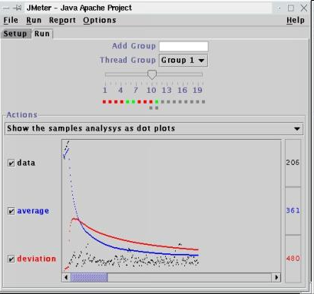
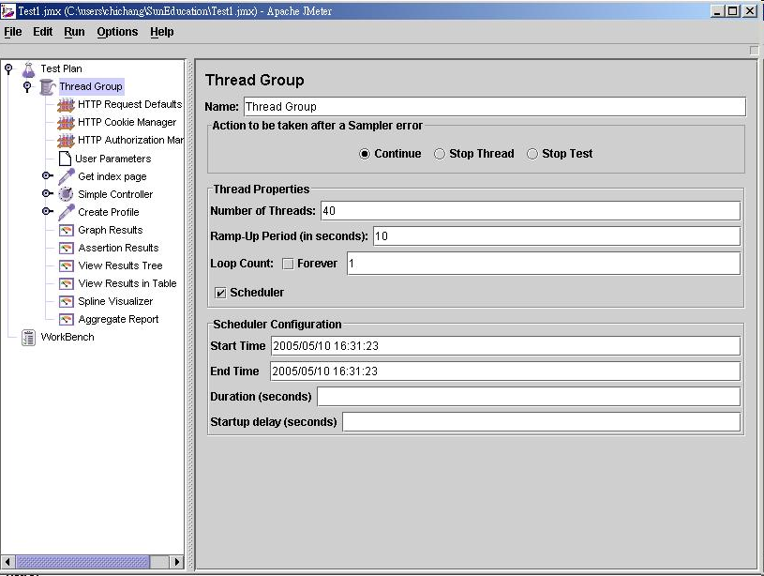
JMeter
Apache's JMeter software performs load tests on a web server
  Youtube Video: Getting Started with JMeter

Slide 6

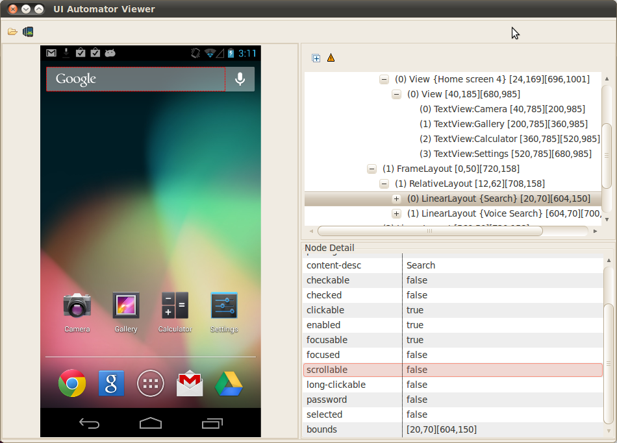
Android Monkey
Android UI/Application Exerciser Monkey: Simulates lots of random clicks / UI interactions on your app.
  adb shell monkey [options] <event-count>
  e.g. adb shell monkey -p your.package.name -s 42 -v 500
  random, but can be seeded (-s 42) so results are repeatable
  runs until:
    given number of events are done
    emulator exits your app
    app crashes / throws exception
    app-not-responding state
  http://developer.android.com/_x000b_tools/help/monkey.html

Slide 7
System reliability
reliability testing: Measuring how well the system can remain available and functional over time.
Common goals:
  "two nines": 99% uptime (down 3.65 days/year)
  "three nines": 99.9% uptime (down 9 hours/year)
  "four nines": 99.99% uptime (down 52 minutes/year)
  "five nines": 99.999% uptime (down 5 minutes/year)
What causes a system to "fail" or become unavailable?
  software failures/bugs
  hardware failures (broken HD, fan, etc.)
  network failures
  incorrect system configuration
Notes:
Google's App Engine promises "three 9s" of uptime (99.9%).

Slide 8
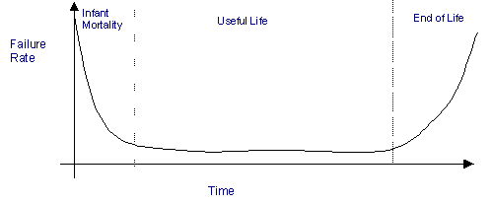
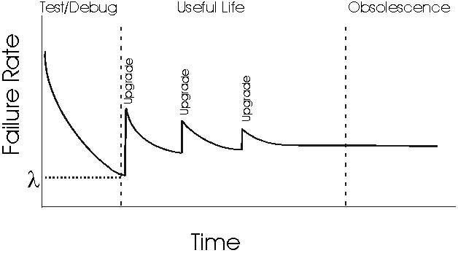
Estimating failures
Most hardware fails very early or late
  mean time between failures (MTBF)
  FITS: failures per billion hours
Software failure depends on:
  quality of design and process
  complexity and size of system
  experience of development team
  percentage of reused code
  depth of testing performed
  "bathtub curve" (see right)
  Software failures are often measured per 1000 lines of code.

Slide 9
Things to test
What does the product do when subsystems go down?
  database, file system, network connection, etc.
What does the product do when subsystems degrade?
  slow network/database, etc.
What does the product do when it receives corrupted data?
  garbage data through network, file system, etc.
Does the site go down?
Does the system display an error? If so, is it a good one?
Does the site hang? How much does user experience suffer?

Slide 10
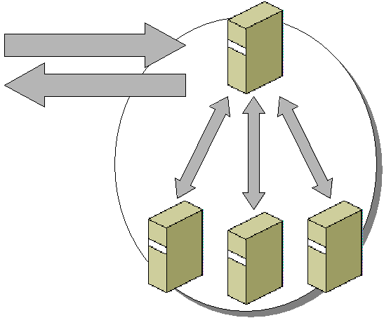
Improving reliability
Replicate crucial system components
  example: three web servers, two database servers, etc.
Benefits of replication
  system is only considered unavailable if BOTH are down
  2 replicas * 99% reliability => 99.99% reliability
massive replication (e.g. Google)
  If we have 20k machines and
  each has 99% reliability, how
  often will a machine fail?

Slide 11
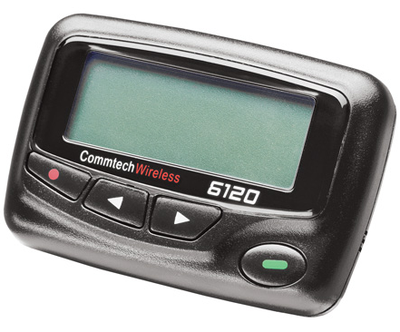
Repairing failures
Some failure recovery can be automated:
  roll back transaction / fall back to another database
  shift the load to another machine(s)
  redirect to another site
  reboot (Windows!)
Some failure recovery requires a human component:
  on-site support staff
  on-call developers or QA engineers
Estimating failure recovery time
  MTTR (mean time to repair)
    < 10 minutes if problem/fix are known
    1 hour to 2 weeks if not
    availability = MTBF / (MTBF + MTTR)

Slide 12
Logging
logging: Writing state information to files or databases as your application runs.
Reasons to do logging:
  logging is the println-debugging of web apps
  notice patterns of repeated errors
  a minimal guarantee on use cases: the error will be logged
Why not just output error messages to the page?
  the wrong person sees the message (user, not developer)
  user shouldn't be told detailed information about the system or about the causes of errors
  message is not permanent (shows on page, but then is lost)

Slide 13
Logging in Android
Class android.util.Log has these static methods:
Example:
  Log.i("MyActivity", "getView item #" + i);
d(tag, message[, ex]) | writes a "debug" message to the log file
e(tag, message[, ex]) | writes an "error" message to the log file
i(tag, message[, ex]) | writes an "info" message to the log file
v(tag, message[, ex]) | writes a "verbose" message to the log file
w(tag, message[, ex]) | writes a "warning" message to the log file
wtf(tag, message[, ex]) | writes a "what the F" message to log file
Notes:
Logging exercise: Go to Marty's J2EE "Practice-It" app, disable the database, and see what happens. Add a better error message, then add logging so Marty can find/fix the problem. Then add a line to email Marty when it is broken.

Slide 14
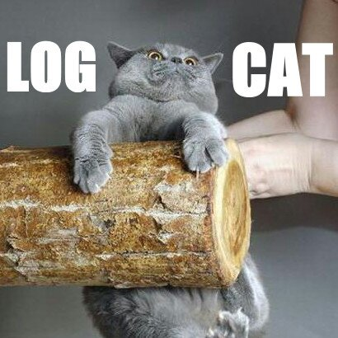
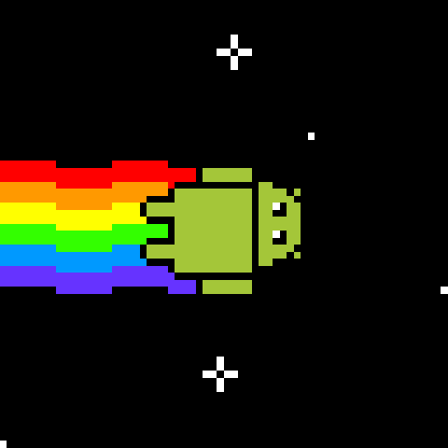
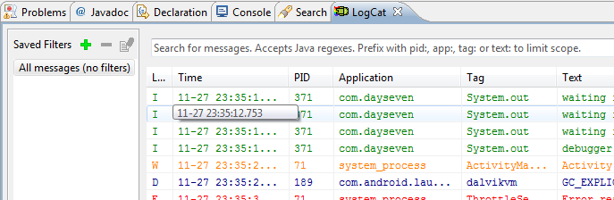
LogCat
logcat: A tool for viewing Android logs.
  viewable in Eclipse
  runnable as a stand-alone tool
    adb logcat -v format
    e.g. adb logcat -v long

Slide 15
What to log
log mostly errors, not success cases (don't flood the log file)
log enough detail that you can understand it later
  What page was the error on?
  What method or command was called?
  What parameters were passed?
  What was the current date/time?
  Who was the current user or IP (if known)?
  What was the complete stack trace of any exception/error?
Suggestion: switch log files daily
  (many web frameworks do this for you automatically)

Slide 16
Properties of Java logging
It is easy to suppress all log records or just those below a certain level, and just as easy to turn them back on.
Minimal penalty for leaving logging code in your application.
Log records can be directed to different handlers, for display in the console, for storage in a file, and so on.
Logs can be formatted in different ways, e.g. text or XML.
By default, logging configuration is controlled by a config file.

Slide 17
Logging in J2EE
JSP pages can call a global log method to log errors:
Example:
  try {
  double avg = currentUser.getAverageScore();
  out.println(avg);
  } catch (ArithmeticException e) {
  log("failed to get average score", e);
  }
  There is also a more advanced Apache log4j package (not shown)
log(message) | writes the given message string to the log file
log(message, ex) | writes the given message string to the log file, along with a stack trace of the given exception
Notes:
Logging exercise: Go to Marty's J2EE "Practice-It" app, disable the database, and see what happens. Add a better error message, then add logging so Marty can find/fix the problem. Then add a line to email Marty when it is broken.

Slide 18
java.util.logging
log levels: Partition different kinds/severities of log messages.
  Java's: SEVERE, WARNING, INFO, CONFIG, FINE, FINER, FINEST
Using the global logger:
  Logger.global.info("File->Open menu selected");
  Logger.global.setLevel(Level.FINE);
  logger.warning(message);
  logger.fine(message);
  logger.log(Level.FINEST, message);
A specific logger for one part of your application:
  Logger myLog = Logger.getLogger("com.uw.myapp");

Slide 19
Logging in Ruby on Rails
Rails built-in logger lets you log errors, warnings, etc.:
  require 'logger'
  def add_to_cart
  product = Product.find(params[:id])
  @cart = find_cart
  @cart.add_product(product)
  rescue ActiveRecord::RecordNotFound
  logger.error("invalid product #{params[:id]}" )
  flash[:notice] = "Invalid product"
  redirect_to :action => 'index'
  end
logger methods:
  logger.error, logger.fatal, logger.warn, logger.info

Slide 20
Log file contents
Web server software has its own request/error logs
  A typical Apache log file /var/log/apache2/error.log :
  [Tue Nov 20 12:07:37 2007] [notice] Apache/2.2.6 (Win32) mod_ssl/2.2.6 OpenSSL/0.9.8e PHP/5.2.5 configured -- resuming normal operations
  [Tue Nov 20 12:07:37 2007] [notice] Server built: Sep 5 2007 08:58:56
  [Tue Nov 20 12:07:37 2007] [notice] Parent: Created child process 8872
  PHP Notice: Constant XML_ELEMENT_NODE already defined in Unknown on line 0
  [Sun Nov 04 18:29:19 2007] [error] [client 24.17.240.98] File does not exist: D:/www/gradeit/courses/142/07au/a5/files/BL/BEIROUTY_0726779/output_3_2.png, referer: http://pascal.cs.washington.edu:8080/gradeit/testcases_view.php?course=142&quarter=07au&assignment=a5&section=BL&student=BEIROUTY_0726779&small=1
  [Sun Nov 04 18:29:19 2007] [error] [client 24.17.240.98] File does not exist: D:/www/gradeit/courses/142/07au/a5/files/BL/BEIROUTY_0726779/output_3_3.png, referer: http://pascal.cs.washington.edu:8080/gradeit/testcases_view.php?course=142&quarter=07au&assignment=a5&section=BL&student=BEIROUTY_0726779&small=1
  [Tue Oct 30 17:22:06 2007] [error] [client 128.95.141.49] PHP Warning: Invalid argument supplied for foreach() in D:\\www\\gradeit\\Section.php on line 43, referer: http://pascal.cs.washington.edu:8080/gradeit/assignment_view.php?course=142&quarter=07au&assignment=a5
  [Tue Oct 30 17:22:06 2007] [error] [client 128.95.141.49] PHP Warning: Invalid argument supplied for foreach() in D:\\www\\gradeit\\Section.php on line 43, referer: http://pascal.cs.washington.edu:8080/gradeit/assignment_view.php?course=142&quarter=07au&assignment=a5

Slide 21
Viewing Rails logs
  $ gem install production_log_analyzer \
  --include-dependencies
Then, to identify potential performance bottlenecks in our application, use pl_analyze command to generate a report:
  $ pl_analyze log/production.log
  Request Times Summary: Count Avg Std Dev Min Max
  ALL REQUESTS: 8 0.011 0.014 0.002 0.045
  PeopleController#index: 2 0.013 0.010 0.003 0.023
  PeopleController#show: 2 0.002 0.000 0.002 0.003
  PeopleController#create: 1 0.005 0.000 0.005 0.005
  PeopleController#new: 1 0.045 0.000 0.045 0.045
  Slowest Request Times:
  PeopleController#new took 0.045s
  PeopleController#index took 0.023s
  PeopleController#create took 0.005s
  PeopleController#index took 0.003s
  PeopleController#show took 0.003s

Slide 22
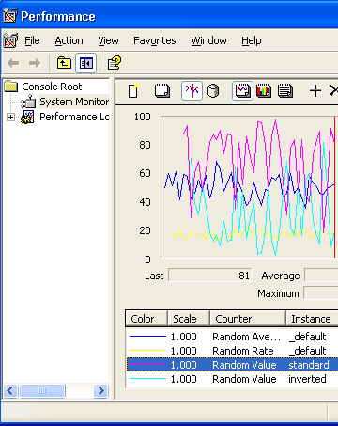
Performance counters
performance counter: A piece of hardware or software inserted to aid in measuring the efficiency of a system.
  hardware perf counters are often special registers in a chip
  software perf counters are timing code inserted and logged
software (e.g. perfmon) can be installed to aid perf. counters
programmers can add their own monitoring code
  grab system time before and after a task; log it
  ask for system info (RAM, HD, CPU %, etc.); log it
  counters increase continuously
    e.g. hit counter, DB query counter, error counter
  gauges report an absolute value at a given time
    e.g. RAM free; CPU usage

Slide 23
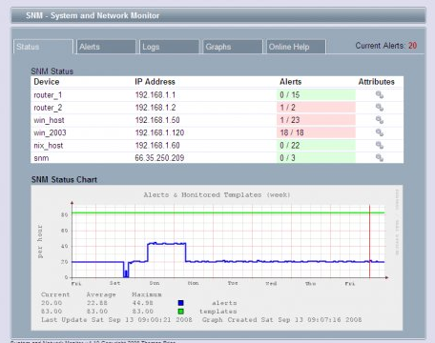
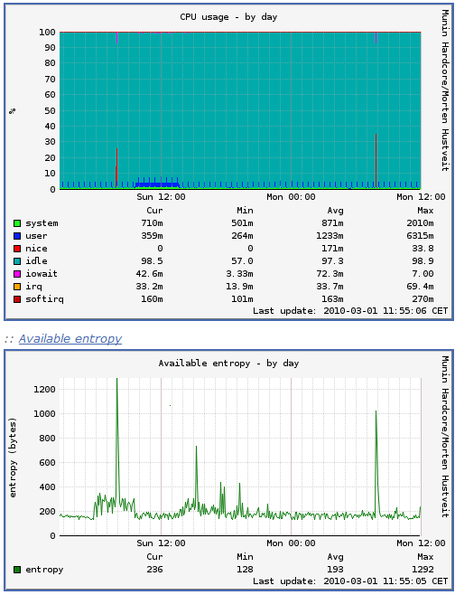
Web site monitoring
web site monitoring: A program or third-party machine "pings" your server periodically to make sure it is live.
  downloadable scripts/apps (ZABBIX, Spong, CheckWebSite)
    many based on SNMP (simple network monitoring protocol)
    JMX (Java Management Extensions) for J2EE web apps
  paid services (ExternalTest, SiteUpTime)
  internal: installed on your own server, as root
  external: runs on another server, connects remotely

Slide 24
Reliability Engineer (SRE)
software reliability engineer (SRE): Responsible for making sure network services stay running.
  a job description recently popularized by Google
  a mix of coding, sw. engineering, testing, system administration
some SRE responsibilities:
  review specs/design to point out vulnerabilities and problems
  make sure that sites and products can tolerate growth/scaling
  help deploy hardware and servers for new products/sites
  write scripts to automate reliability tests, monitoring, sys. config
  carry pager that goes off if site goes down or subsystems fail
  analyze logs and data to discover potential issues
goal: Heavily automate diagnosis and repair of major issues.

Slide 25
Quotes from an SRE
"Much of (SRE) is just encouraging people to add proper instrumentation to software, especially performance counters, and then graphing the output. Code coverage doesn't hurt, but that's more of a safety measure for engineers. They're less likely to have problems and be woken up at 3am to resolve an issue if the code is tested first, especially test cases where their dependencies are slow or broken."
"Performance counters are a big help. Logging is an even bigger help if you can replay logs to do load/performance tests in the future. Degrading gracefully under heavy load or subcomponent failure is a good approach that gets insufficient attention. In some cases, latency may be more important than correctness."
"Monitoring is a little simpler. There are black box tests that can be run on the outside to see if the service is responding correctly or not. With the right performance counters you can start to do white box monitoring. e.g. if the ms of CPU needed per request step outside some bound of "normal" that may need some investigation. Is a limited resource being starved? Is it one particularly complicated query that is coming in repeatedly? Is that query malicious?"
-- Andy Carrel, SRE, Google

Slide 26
SRE interview questions
What is the difference between a hard and soft link?
What is an inode, and what is inside it?
What is RAID, and how does it work?
What is a "zombie process"?
What happens when a process is forked?
Describe how a ping and a traceroute work.
When user types "google.com" in the browser, what happens?
Describe the TCP/IP 3-way handshake: Syn, Syn/Ack, Ack.
What is the difference between a network switch and a hub?
Write a shell script to rename *.html to *.htm and vice versa.
Write a program to remove all userids matching a pattern.
Notes:
for a in `find . -type f -name “*.html”`; do mv $a ${a/html/htm}; done

