Slide 1
CSE 403
Lecture 20
Security Testing for Mobile and Web Apps
Reading:
Android Apps Security, Ch. 2-3 (Gunasekara)
How to Break Web Software, Ch. 2-5 (Andrews/Whittaker)
slides created by Marty Stepp
http://www.cs.washington.edu/403/

Slide 2

Android security risks
What are some security risks you can think
of that can affect an Android phone?
  What are actions a malicious app could take?
Examples:
  uses a bug or security vulnerability to gain ungranted permissions
  shows the user unsolicited messages (especially commercial)
  resists (or attempts to resist) the user's effort to uninstall it
  attempts to automatically spread itself to other devices
  hides its files and/or processes
  discloses the user's private information to a third party w/o consent
  destroys the user's data (or the device itself) without w/o consent
  impersonates the user (such as by sending email or buying things)
  drains the phone's battery, data bytes/minutes, SMS/MMS remaining
  otherwise degrades the user's experience with the device

Slide 3
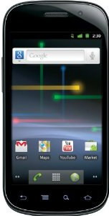
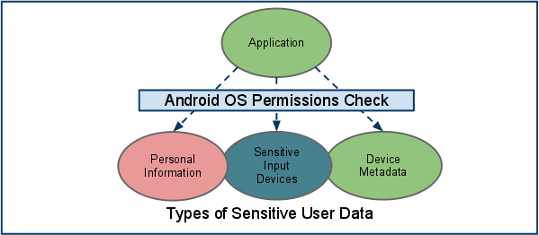
Android OS security
The Android operating system provides security:
  Unix-based file/directory permission model
  process memory isolation and memory protection
  filesystem encryption
  per-app access to hardware devices
  per-app restrictions on memory/CPU usage, other resources
    network/data connection
    camera
    location (GPS) data
    bluetooth
    SMS/MMS
    ...
  DRM framework

Slide 4

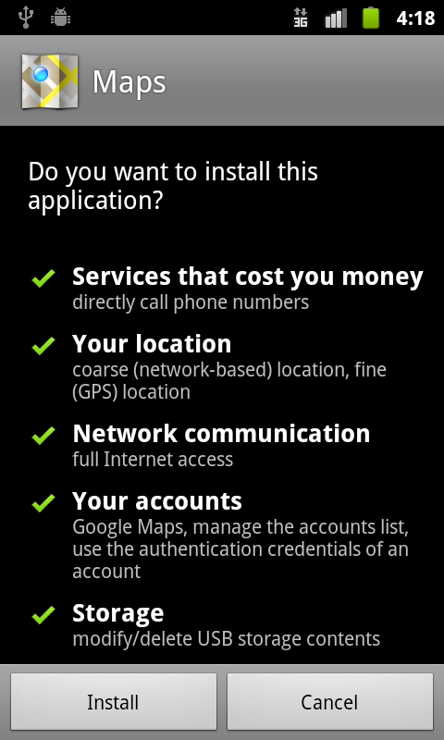
Mobile app permissions
Apps must declare which permissions they need
  e.g. use internet; write to local files; look at contacts;
  use Bluetooth; access GPS location; send SMS
  user must manually give permission for actions
Fine-grained access control in Manifest XML file
  File/URL-specific permissions
<manifest xmlns:android="http://schemas.android.com/apk/res/android"
package="com.android.app.myapp" >
<uses-permission android:name="android.permission.RECEIVE_SMS" />
...
</manifest>

Slide 5


Signed apps/stores
signed apps: Coded with a private developer key
  On Android / iPhone, apps must be signed in market
  manual approval reduces chance of rogue apps
  any app bought in official App Store / Market is
  generally thought of as having being audited
    Is this true for Apple store apps?
    Is this true for Google Play Market apps?
    App store users can rate the apps and comment
  Do you feel that an app is more likely to be secure:
    If it is from a publisher/company you already know?
    If a friend of yours has it installed?
    If it costs money?

Slide 6
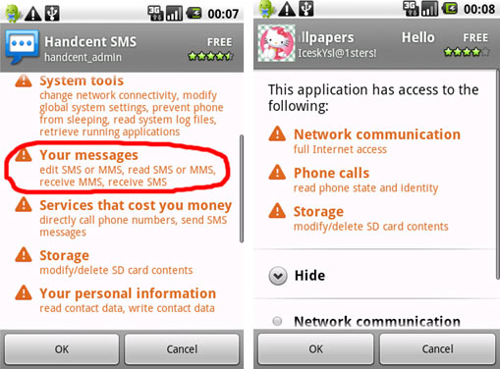
Problems with Android
Apps can ask for too many permissions.
  Users don't really understand permissions.
  Users are overwhelmed and just click "Yes"
  Now the app can do almost anything.
Updates to an app can change its permissions.
  example: recent Facebook app update
  Users often click "Yes" if they already trust the app.
  "privilege escalation"
Spammy apps
  resist attempts to uninstall
  show ads that are like system/OS UI
  disclose or damage the user's personal information data
  impersonates the user

Slide 7
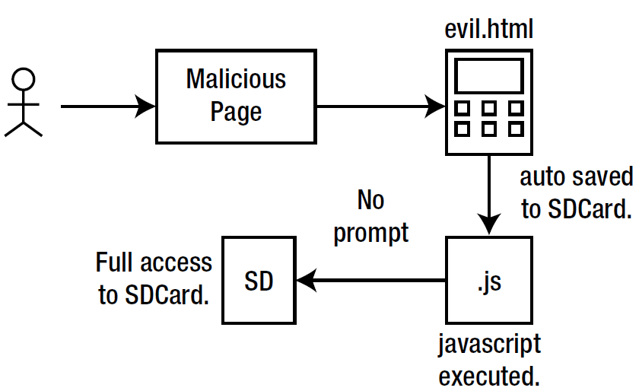
Example attack
Android 2.2 / 2.3 had vulnerabilities.
  Browser could download a HTML page.
  The page contains JS code.
  The JS code can self-execute later
  in a "local" context.
  This has higher permissions and can
  modify the local file system.
App ABC stores sensitive data on the local file system.
  The data is financially important.
  It is saved as a file in plain-text.
  The above malicious browser JS code can read and access it.

Slide 8
Designing for security

Slide 9
Methods of security
Security through obscurity: Relying on the fact that attackers don't know something needed to harm you.
  Example: "If an attacker pointed their browser to http://foo.com/passwords.txt, they'd get our passwords. But nobody knows that file is there, so we are safe."
  Example: "Our app saves its sensitive user data using SQLite which ends up as a file on the local file system."
  Example: "Our authentication database goes down for 2 minutes every night at 4am. During that time any user can log in without restrictions. But no one knows this, and the odds of a login at that time are miniscule."

Slide 10

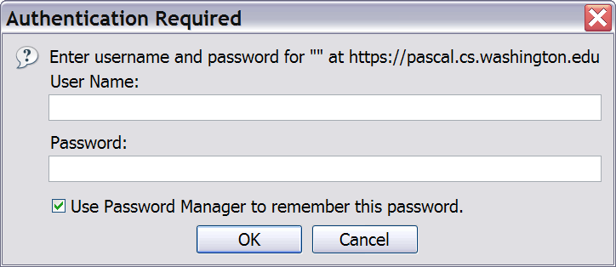
Secure authentication
Force users to log in to your system before performing sensitive operations
Use secure protocols (https, etc.) to prevent sniffing
  Some sites use HTTPS only for login page, then switch back to regular HTTP for future page views. Is this bad?
Force users to use strong passwords
  not "password", or "abc", or same as their user name, etc.

Slide 11

Principle of least privilege
principle of least privilege:
Granting just enough authority to get the job done (no more!).
  Examples:
    Code should not "run as root" or as a highly privileged user unless absolutely necessary.
    A web server should only be given access to the set of HTML files that the web server is supposed to serve.
  Turn off unnecessary services on your server
    disable SSH, VNC, sendmail, etc.
    close all ports except 80, and any
    others needed for web traffic

Slide 12
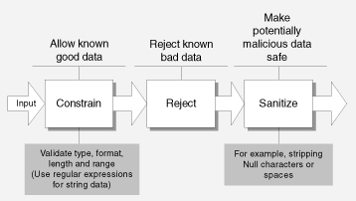
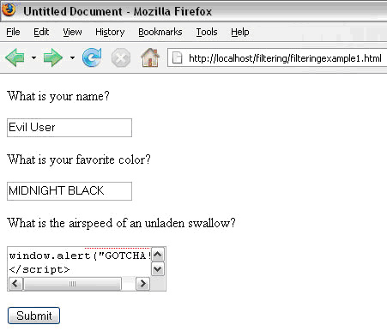
Sanitizing inputs
sanitizing inputs: Encoding and filtering untrusted user input before accepting it into a trusted system.
  Ensure that accepted data is the right type, format, length...
  Disallow entry of bad data into a graphical form.
  Remove any SQL code from submitted user names.
  Encode/sanitize input text that is displayed back to the user.

Slide 13
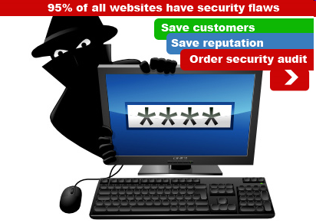
Verifying that code is secure
Before code is written:
  considering security in the design process
As code is being written:
  code reviews
  code security audits
  pair programming
After code has been written:
  walkthroughs
  system security audits
  system/functional security testing
  penetration tests

Slide 14
Security audits
security audit: A series of checks and questions to assess the security of your system.
  can be done by an internal or external auditor
  best if done as a process, not an individual event
penetration test: Targeted white-hat attempt to compromise your system's security.
risk analysis: Assessment of relative risks of what can go wrong when security is compromised.

Slide 15
Security audit questions
Does your system require secure authentication with passwords?
Are passwords difficult to crack?
Are there access control lists (ACLs) in place on network devices?
Are there audit logs to record who accesses data?
Are the audit logs reviewed?
Are your OS security settings up to accepted industry levels?
Have all unnecessary applications and services been eliminated?
Are all operating systems and applications patched to current levels?
How is backup media stored? Who has access to it? Is it up-to-date?
Is there a disaster recovery plan? Has it ever been rehearsed?
Are there good cryptographic tools in place to govern data encryption?
Have custom-built applications been written with security in mind?
How have these custom applications been tested for security flaws?
How are configuration and code changes documented at every level? How are these records reviewed and who conducts the review?

Slide 16
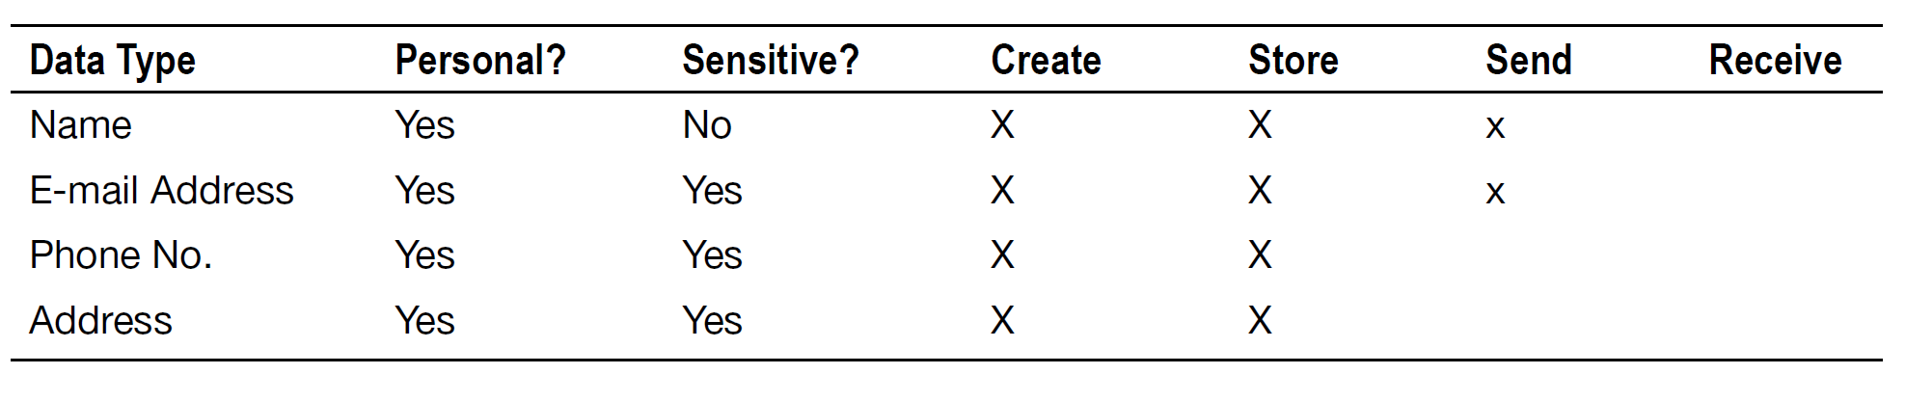
Data classification
data classification table: For each kind of data your app saves/uses, ask yourself:
  Is this information personal or sensitive in nature?
  What does my app do with this information?
  Where and in what format is it saved?
  Is it sent over the network?
  (for all above) Does it need to be? Can I reduce my use?

Slide 17
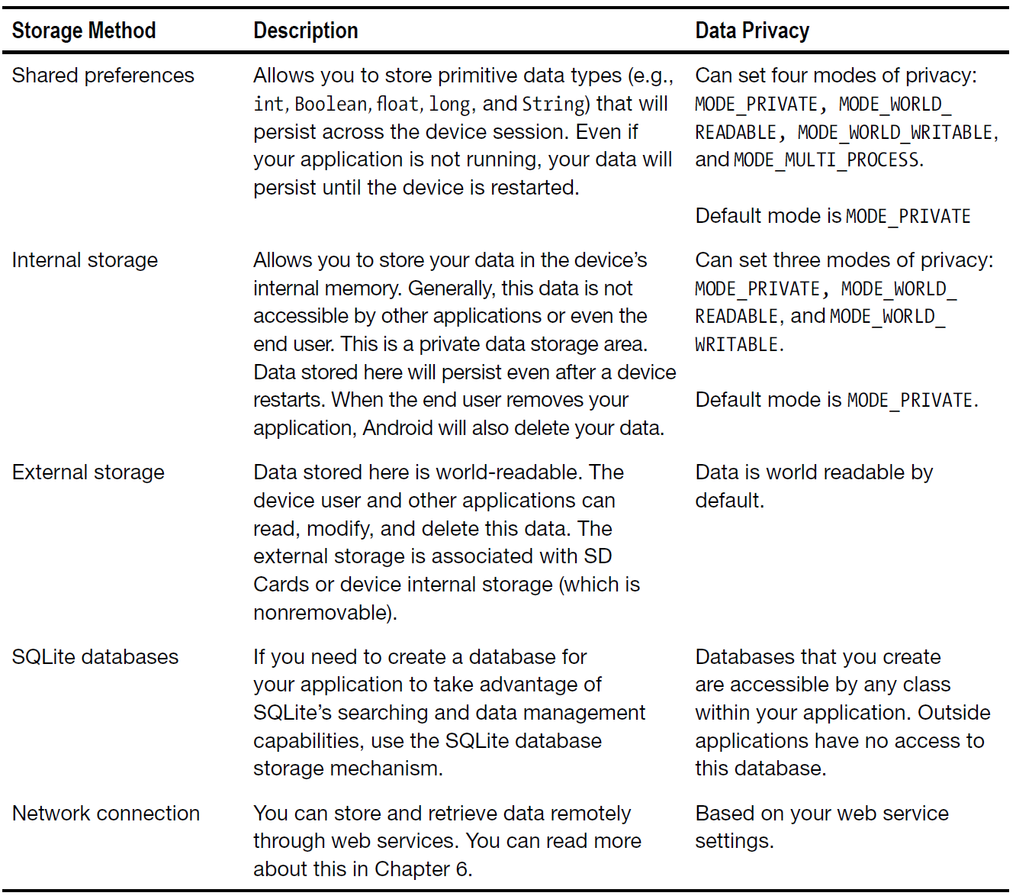
Data storage location
Where is your app storing its data, and why? Is it secure?

Slide 18
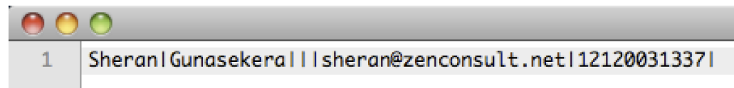
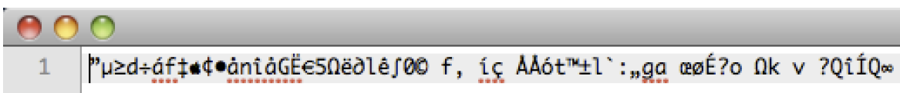
Encryption
You can easily encrypt data in Android just before/after saving it to the device's SD card or local database.
  private static byte[] encrypt(byte[] key, byte[] data) {
  SecretKeySpec sKeySpec = new SecretKeySpec(key, "AES");
  Cipher cipher;
  byte[] ciphertext = null;
  try {
  cipher = Cipher.getInstance("AES");
  cipher.init(Cipher.ENCRYPT_MODE, sKeySpec);
  ciphertext = cipher.doFinal(data);
  } catch (NoSuchAlgorithmException e) {
  Log.e(TAG, "NoSuchAlgorithmException");
  } catch (InvalidKeyException e) {
  Log.e(TAG, "InvalidKeyException");
  } catch (Exception e) {
  Log.e(TAG, "Exception");
  }
  return ciphertext;
  }

Slide 19

Mobile+web apps
OWASP Top 10 issues for mobile
apps that talk to web apps:
  Identify and protect sensitive data on the mobile device.
  Handle password credentials securely on the device.
  Ensure that sensitive data is protected in transit.
  Implement user authentication and session management correctly.
  Keep the back-end APIs (services) and the platform (server) secure.
  Perform data integration with third party services/apps securely.
  Pay specific attention to the collection and storage of consent for the collection and use of the user’s data.
  Implement controls to prevent unauthorized access to paid-for resources (e.g., wallet, SMS, and phone calls).
  Ensure secure distribution/provisioning of mobile applications.
  Carefully check any runtime interpretation of code for errors.

Slide 20
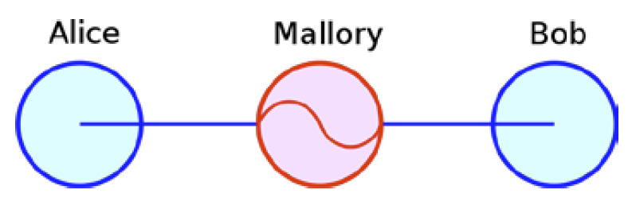
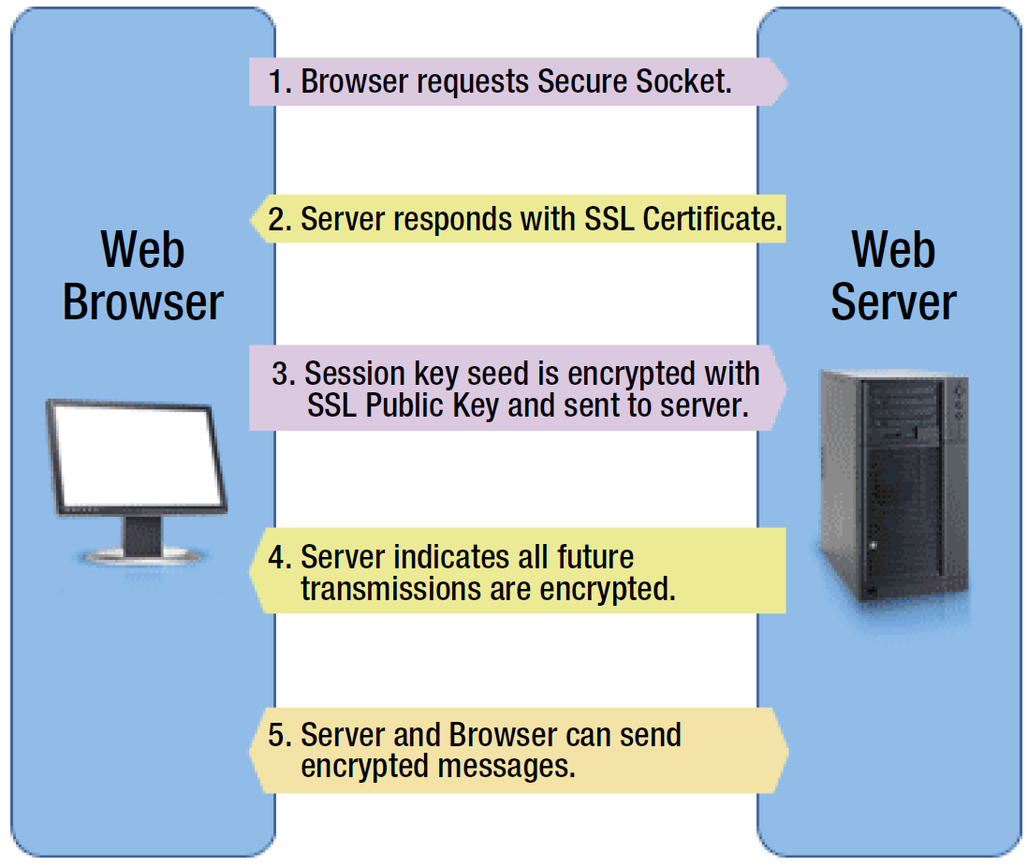
Secure web (HTTPS)
man-in-the-middle attack:
  unauthorized third party
  can hear web traffic
  on its hops between
  client and server
For security, all web traffic
in your app should use
HTTPS secure protocol.
  built on Secure Socket Layer (SSL)

Slide 21
Web security

Slide 22
Denial-of-Service (DoS)
Denial of Service (DoS) attack:
Attacker causes web server to be unavailable.
How attack is performed:
  Attacker frequently requests many pages from your web site.
    distributed DoS (DDoS): DoS using lots of computers
  Your server cannot handle this many requests at a time, so it turns into a smoldering pile of goo (or just becomes very slow).
Problems that this attack can cause:
  Users cannot get to your site.
  Online store's server crashes -> store loses potential revenue.
  Server may crash and lose or corrupt important data.
  All the bandwidth used by the DoSers may cost you $$$.

Slide 23
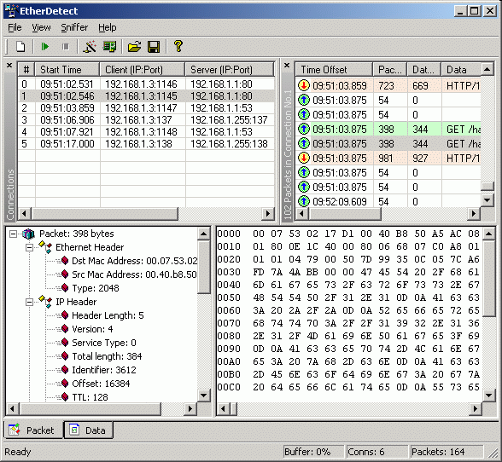
Packet sniffing
packet sniffing: Listening to traffic sent on a network.
  Many internet protocols (http, aim, email) are unsecure.
  If an attacker is on the same local network (LAN) as you, he can:
    read your email/IMs as you send them
    see what web sites you are viewing
    grab your password as it's being sent to the server
solutions:
  Use secure protocols (ssh, https)
  Encryption
  Don't let creeps on your LAN/wifi

Slide 24
Password cracking
password cracking:
Guessing the passwords of privileged users of your system.
How attack is performed:
  brute force attack: Attacker uses software that sequentially tries every possible password.
  dictionary attack: Attacker uses software that sequentially tries passwords based on words in a dictionary.
    every word in the dictionary
    combinations of words, numbers, etc.
What you can do about it:
  Force users to have secure passwords.
  Block an IP address from logging in after N failed attempts.

Slide 25
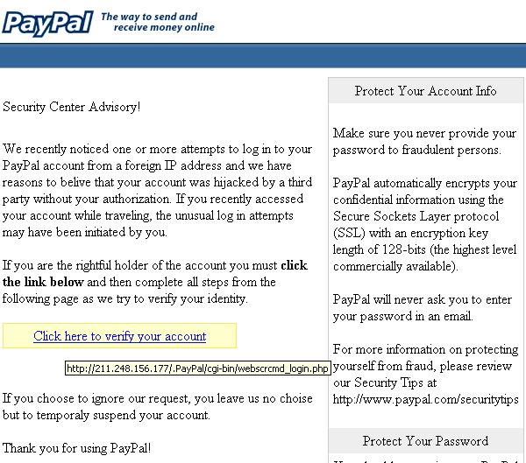
Phishing/social engineering
phishing: Masqueraded mails or web sites.
  social engineering: Attempts to manipulate users, such as fraudulently acquiring passwords or credit card numbers.
Problems:
  If trusted users of your
  system are tricked into
  giving out their personal
  information, attackers
  can use this to log in as
  those users and
  compromise your system.

Slide 26
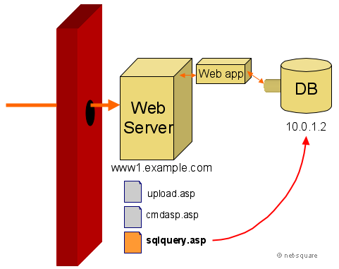
Privilege escalation
privilege escalation: Attacker becomes able to run code on your server as a privileged user.
  Example: Perhaps normal users aren't able to directly query your database. But an attacker may find a flaw in your security letting him run as an administrator and perform the query.
  Once you're running as root,
  You own the server.
  You can do anything you want!

Slide 27
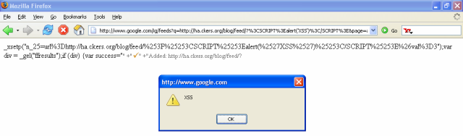
Cross-site scripting (XSS)
cross-site scripting: Causing one person's script code to be executed when a user browses to another site.
  Example: Visit google.com, but evil.com's JavaScript runs.
How attack is performed:
  Attacker finds unsecure code on target site.
  Attacker uses hole to inject JavaScript into the page.
  User visits page, sees malicious script code.

Slide 28
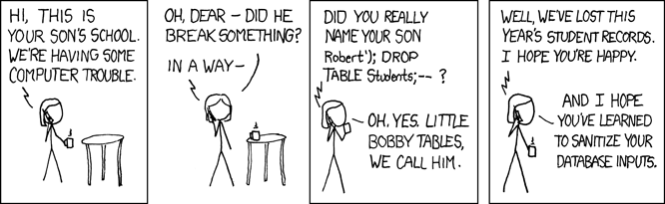
SQL Injection
SQL injection:
Causing undesired SQL queries to be run on your database.
  Often caused when untrusted input is pasted into a SQL query
  PHP: "SELECT * FROM Users WHERE name='$name';";
  specify a user name of: x' OR 'a'='a
  SELECT * FROM Users WHERE name='x' OR 'a'='a';

Slide 29
Thinking like an attacker:
Finding vulnerabilities

Slide 30
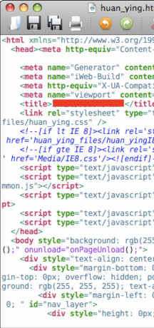
Panning for gold
View Source, and look for:
  HTML comments
  script code
  other sensitive information in code:
  IP/email addresses, SQL queries, hidden fields,...
  watch HTTP requests/responses
    look for hidden pages, files, parameters to target
  error messages sent to your browser by app
    200: OK 400: Invalid request
    403: Forbidden 404: File not found
    500: Internal server error

Slide 31
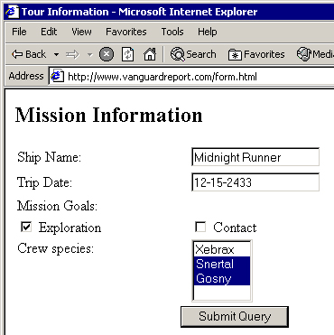
Input forms
Forms let users pass parameters to the web server.
Parameters are passed using GET or POST requests.
  GET: parameters are contained in the request URL.
  http://www.google.com?q=Stephen+Colbert&lang=en
  POST: parameters are contained in the HTTP packet header.
    harder for the user to see, but no more secure than GET
Forms provide a rich attack ground...

Slide 32
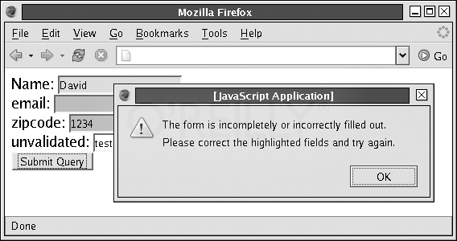
Form validation
validation: Examining form parameters to make sure they are acceptable before/as they are submitted.
  nonempty, alphabetical, numeric, length, ...
  client-side: HTML/JS checks values before request is sent.
  server-side: JSP/Ruby/PHP/etc. checks values received.
Some validation is performed by restricting the user's choices.
  select boxes
  input text boxes with
  maxlength attribute
  key event listeners that
  erase certain key presses

Slide 33
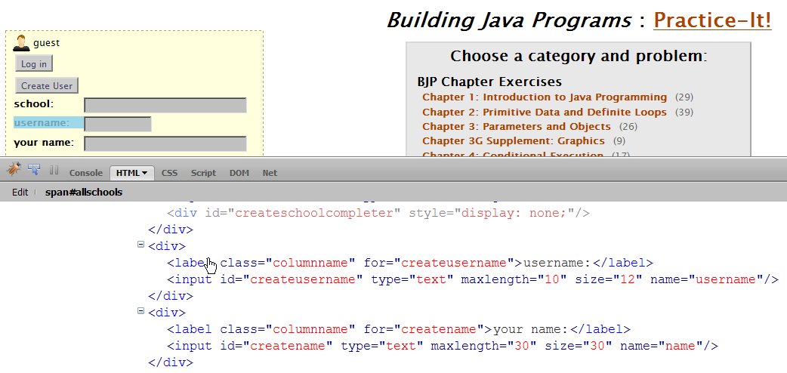
User input attacks
Bypassing client-side input restrictions and validation
  maxlength limits on an input text field
  choices not listed in a select box
  hidden input fields
  modifying or disabling client-side JavaScript validation code

Slide 34
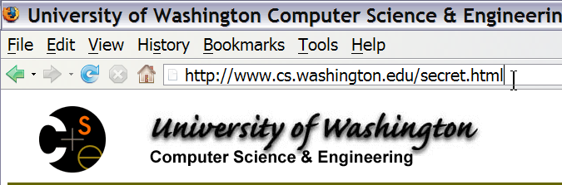
Guessing files/directories
security through obscurity: Many reachable files/resources are hidden only by the fact that there is no link to them.
Try common file/folder/commands to see what happens:
  /etc/passwd , /etc/shadow , cat, ls, grep
  guess file names based on others
    page11.php --> page12.php
    loginfailure.jsp --> loginsuccess.jsp
    accounts/fred.html --> accounts/sue.html
  brute force / web spiders
  port scanners

Slide 35

Other attacks
Attacking GET parameters
Attacking hidden input fields
Attacking cookies
Cross-site request forgery (CSRF)
...

Slide 36
Web attack exercise
We are taking CSE 144, which uses an online turnin system.
  We want to hack it because we are evil.
Our goals:
  We want to cheat on Homework Assignment 7, Song.java. We want to find a way to submit a perfect working solution without doing any real work.
  We got a low grade on a past assignment, so if possible, we want to set our past grades to be higher than they are now.
  Our enemy is fellow classmate Felix Chu. We want to find out his personal information (password, email, student ID, grade, etc.).
  We don't like the course instructor, Marty Stepp. We want to make the turnin page print an embarrassing message about him.

