Slide 1
CSE 403
Lecture 21
Refactoring and Code Maintenance
Reading:
Code Complete, Ch. 24, by S. McConnell
Refactoring, by Fowler/Beck/Brant/Opdyke
slides created by Marty Stepp
http://www.cs.washington.edu/403/

Slide 2
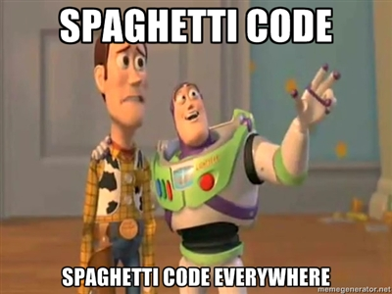
Problem: "Bit rot"
After several months and new versions, many codebases reach one of the following states:
  rewritten : Nothing remains from the original code.
  abandoned : Original code is thrown out, rewritten from scratch.
Why?
  Systems evolve to meet new
  needs and add new features
  If the code's structure does
  not also evolve, it will "rot"
  This can happen even if the code was initially reviewed and well-designed at the time of checkin

Slide 3
Code maintenance
maintenance: Modification or repair of a software product after it has been delivered.
  Purposes:
  fix bugs
  improve performance
  improve design
  add features
  Studies have shown that ~80% of maintenance is for non-bug-fix-related activities such as adding functionality (Pigosky 1997).

Slide 4
Maintenance is hard
It's harder to maintain code than write your own new code.
  "house of cards" phenomenon (don't touch it!)
  must understand code written by another developer,
  or code you wrote at a different time with a different mindset
  most developers dislike code maintenance
Maintenance is how developers spend much of their time.
It pays to design software well and plan ahead so that later maintenance will be less painful.
  Capacity for future change must be anticipated

Slide 5

Refactoring
refactoring: Improving a piece of software's internal structure without altering its external behavior.
  Incurs a short-term time/work cost to reap long-term benefits
  A long-term investment in the overall quality of your system.
refactoring is not the same thing as:
  adding features
  debugging code
  rewriting code

Slide 6
Why refactor?
Why fix a part of your system that isn't broken?
Each part of your system's code has 3 purposes:
  1. to execute its functionality,
  2. to allow change,
  3. to communicate well to developers who read it.
  If the code does not do one or more of these, it is "broken."
Refactoring:
  improves software's design
  makes it easier to understand

Slide 7
When to refactor?
When is it best for a team to refactor their code?
  best done continuously (like testing) as part of the process
  hard to do well late in a project (like testing)
Refactor when you identify an area of your system that:
  isn't well designed
  isn't thoroughly tested, but seems to work so far
  now needs new features to be added

Slide 8
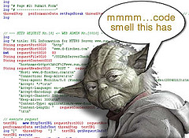
Signs you should refactor
code is duplicated
a routine is too long
a loop is too long or deeply nested
a class has poor cohesion
a class uses too much coupling
inconsistent level of abstraction
too many parameters
to compartmentalize changes (change one place → must change others)
to modify an inheritance hierarchy in parallel
to group related data into a class
a "middle man" object doesn't do much
poor encapsulation of data that should be private
a weak subclass doesn't use its inherited functionality
a class contains unused code

Slide 9
Code "smells"
Duplicated Code
Long Method
Large Class
Long Parameter List
Divergent Change
Shotgun Surgery
  (change one place → must change others)
Feature Envy
Data Clumps
Primitive Obsession
Switch Statements
Parallel Inheritance Hierarchies
Lazy Class
Speculative Generality
Temporary Field
Message Chains
Middle Man
Inappropriate Intimacy
Alternative Classes with Different Interfaces
Incomplete Library Class
Data Class
Refused Bequest
  (subclass doesn't use inherited members much)
Comments

Slide 10
Some types of refactoring
refactoring to fit design patterns
renaming (methods, variables)
extracting code into a method or module
splitting one method into several to improve cohesion and readability
changing method signatures
performance optimization
moving statements that semantically belong together near each other
naming (extracting) "magic" constants
exchanging idioms that are risky with safer alternatives
clarifying a statement that has evolved over time or is unclear
  See also http://www.refactoring.org/catalog/

Slide 11
Refactoring patterns
Composing Methods
  Extract Method
  Inline Method; Inline Temp
  Replace Temp with Query
  Introduce Explaining Variable
  Split Temporary Variable
  Remove Assignments to Parameters
  Replace Method with Method Object
  Substitute Algorithm
Moving Features Between Objects
  Move Method; Move Field
  Extract Class
  Inline Class
  Hide Delegate
  Remove Middleman
  Introduce Foreign Method
  Introduce Local Extension
Organizing Data
  Self-encapsulate Field
  Replace Data Value with Object
  Change Value to Reference; Change Reference to Value
  Replace Array with Object
  Duplicate Observed Data
  Change Unidirectional Association to Bidirectional
  Change Bidirectional Association to to Unidirectional
Simplifying Conditional Expressions
  Decompose Conditional
  Consolidate Conditional Expression
  Consolidate Duplicate Conditional Fragments
  Remove Control Flag
  Replace Nested Conditional with Guard Clauses
  Replace Conditional with Polymorphism
  Introduce Null Object
  Introduce Assertion
Making Method Calls Simpler
  Rename Method
  Add/Remove Parameter
  Separate Query from Modifier
  Parameterize Method
  Replace Parameter with Explicit Methods
  Preserve Whole Object
  Replace Parameter with Method
  Introduce Parameter Object
  Remove Setting Method
  Hide Method
  Replace Constructor with Factory Method
  Encapsulate Downcast
  Replace Error Code with Exception
  Replace Exception with Test
Dealing with Generalization
  Pull Up Field; Method; Constructor Body
  Push Down Method; Push Down Field
  Extract Subclass; Extract Superclass; Interface
  Collapse Hierarchy
  Form Template Method
  Replace Inheritance with Delegation (or vice versa)
Big Refactorings
  Nature of the Game
  Tease Apart Inheritance
  Convert Procedural Design to Objects
  Separate Domain from Presentation
  Extract Hierarchy

Slide 12
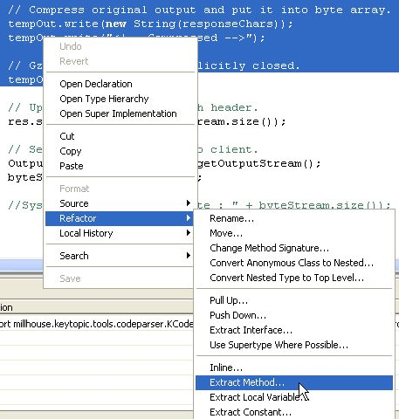

IDE support for refactoring
Eclipse and Visual Studio support:
  variable / method / class renaming
  method or constant extraction
  extraction of redundant code snippets
  method signature change
  extraction of an interface from a type
  method inlining
  providing warnings about method
  invocations with inconsistent parameters
  help with self-documenting code
  through auto-completion

Slide 13
Refactoring plan, pt 1
Save / backup / checkin the code before you mess with it.
  If you use a well-managed version control repo, this is done.
Write unit tests that verify the code's external correctness.
  They should pass on the current poorly designed code.
  Having unit tests helps make sure any refactor doesn't break existing behavior (regressions).
Analyze the code to decide the risk and benefit of refactoring.
  If it is too risky, not enough time remains, or the refactor will not produce enough benefit to the project, don't do it.

Slide 14
Refactoring plan, pt 2
(after completing steps on the previous slide)
Refactor the code.
  Some unit tests may break. Fix the bugs.
  Perform functional and/or integration testing. Fix any issues.
Code review the changes.
Check in your refactored code.
  Keep each refactoring small; refactor one issue / unit at a time.
    helps isolate new bugs and regressions
  Your checkin should contain only your refactor.
    NOT other changes such as adding features, fixing unrelated bugs.
    Do those in a separate checkin.
      (Resist temptation to fix small bugs or other tweaks; this is dangerous.)

Slide 15
"I don't have time!"
Refactoring incurs an up-front cost.
  many developers don't want to do it
  management don't like it; they lose time and gain "nothing"
  (no new features)
But...
  well-written code is more conducive to rapid development
  (some estimates put ROI at 500% or more for well-done code)
  refactoring is good for programmer morale
    developers prefer working in a "clean house"

Slide 16
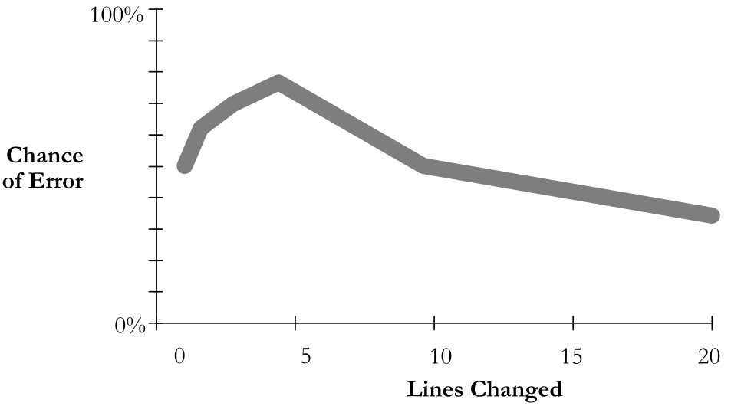
Dangers of refactoring
code that used to be ...
  well commented, now (maybe) isn't
  fully tested, now (maybe) isn't
  fully code reviewed, now (maybe) isn't
easy to insert a bug into previously working code (regression!)
  a small initial change can have a large chance of error

Slide 17
Regressions
What if refactoring introduces new bugs in previously working functionality ("regressions")? How can this be avoided?
Code being refactored should have good unit test coverage, and other tests (system, integration) over it, before the refactor.
  If such code is not tested, add tests first before refactoring.
  If the refactor makes a unit test not compile, port it.
  If the method being tested goes away, the underlying functionality of that method should still be somewhere. So move the unit test to cover that new place in the code.

Slide 18

Company/team culture
Organizational barriers to refactoring:
  Many small companies and startups don't do it.
    "We're too small to need it!" ... or, "We can't afford it!"
  Many larger companies don't adequately reward it.
    Not as flashy as adding features/apps; ignored at promotion time
Reality:
  Refactoring is an investment in quality of the company's product and code base, often their prime assets.
  Many web startups are using the most cutting-edge technologies, which evolve rapidly. So should the code.
  If a team member leaves or joins (common in startups), ...
  Some companies (e.g. Google) actively reward refactoring.

Slide 19

Refactoring and teams
Amount of overhead/communication needed depends on size of refactor.
  small refactor: Just do it, check it in, get it code reviewed.
  medium refactor: Possibly loop in tech lead or another dev.
  large refactor: Meet with team, flush out ideas, do a design doc or design review, get approval before beginning.
Avoids possible bad scenarios:
  Two devs refactor same code simultaneously.
  Refactor breaks another dev's new feature they are adding.
  Refactor actually is not a very good design; doesn't help.
  Refactor ignores future use cases, needs of code/app.
  Tons of merge conflicts and pain for other devs.

Slide 20
Phased refactoring
Sometimes a refactor is too big to do all at once.
  Example: An entire large subsystem needs redesigning.
  We don't think we have time to redo all of it at once.
phased refactoring:
Adding a layer of abstraction on top of legacy code.
  New well-made System 2 on top of poorly made old System 1.
  System 1 remains; Direct access to it is deprecated.
  For now, System 2 still forwards some calls down to System 1 to achieve feature parity.
  Over time, calls to System 1 code are replaced by new System 2 code providing the same functionality with a better design.

Slide 21
Refactoring at Google
"At Google, refactoring is very important and necessary/inevitable for any code base. If you're writing a new app quickly and adding lots of features, your initial design will not be perfect. Ideally, do small refactoring tasks early and often, as soon as there is a sign of a problem."
"Refactoring is unglamorous because it does not add features. At many companies, people don't refactor because you don't get promoted for it, and their code turns into hacky beasts."
"Google feels refactoring is so important that there are company-wide initiatives to make sure it is encouraged and rewarded."
"Common reasons not to do it are incorrect:
  a) 'Don't have time; features more important' -- You will pay more cost, time in adding features (because it's painful in current design), fixing bugs (because bad code is easy to add bugs into), ramping up others on code base (because bad code is hard to read), and adding tests (because bad code is hard to test), etc.
  b) 'We might break something' -- Sign of a poor design from the beginning, where you didn't have good tests. For same reasons as above, you should fix your testing situation and code.
  c) 'I want to get promoted and companies don't recognize refactoring work' -- This is a common problem. Solution varies depending on company. Seek buy-in from your team, gather data about regressions and flaws in the design, and encourage them to buy-in to code quality."
"An important line of defense against introducing new bugs in a refactor is having solid unit tests (before the refactor)."
-- Victoria Kirst,
Software Engineer, Google

