Slide 1
CSE 403
Lecture 22
Localization
Reading: Core Java, Volume II: Advanced Features, 8ed
by Cay Horstmann, Ch. 5
Agile Web Development with Rails, 3ed
by Ruby/Thomas/Hansson, Ch. 13
slides created by Marty Stepp
http://www.cs.washington.edu/403/

Slide 2


i18n and L10n
internationalization ("i18n"): Process of designing software so that it can be adapted to various languages and regions.
  done once per product (ideally); updated as code is added
localization ("L10n"): Process of adapting/translating internationalized software for a specific region or language.
  done once per locale; each locale is updated as text is added
globalization ("g11n"): i18n + L10n
  Less commonly used term,
  but many companies use it.

Slide 3

Who cares?
Why should a team want to internationalize / localize its app?
  reach a wider audience
  make more $$$
Is it worth it to localize?
  May need to evaluate cost/benefit:
    What fraction of our users speak that language?
    Are they also fluent in English?
    Are they already able to use the site now?
open-source software is often translated for free by community
  Maybe you can post your code and let them do it ...

Slide 4

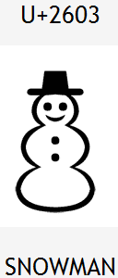
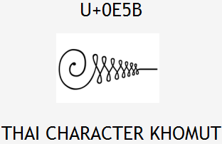
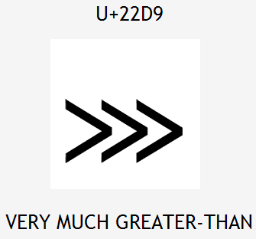



Unicode
Unicode: Standard for storing, encoding, numbering over 107,000 chars from > 90 languages.
  created in 1991 by non-profit Unicode Consortium
  standard character ⇔ integer mappings
  Translation Formats (UTF-*) to store chars as bytes
  supported by languages (Java,.NET,Python), browsers
  important for localization because it defines int'l chars and encodings we will use to present localized text

Slide 5
Character encodings
ISO-8859-1: ANSI, 8-bit (extended ASCII)
  backward-compatible; simple; mostly English-only
UTF-8: 1 byte for all ANSI chars, which have the same code values as in standard ASCII; up to 4 bytes for other chars
UTF-16: uses 2 bytes for almost all characters, and 4 bytes to encode certain special characters
Code files, web pages may specify or be saved with encoding:
  <html>
  <head>
  <title>CSE 403, Winter 2048</title>
  <meta charset="utf-8" />

Slide 6
Locales
locale: A geographic/cultural location targeted for localization.
  A locale consists of:
  a language (e.g. English)
    often expressed as an ISO-639-1 code: de, en, fr, ja
  a location or variant (e.g. United States, UK)
    often expressed as an ISO-3166-1 code: CA, US, GB, DE, ES, JP
Why isn't it enough to specify just the language?
  different locations may use different conventions, spelling, etc.
    "color" (US) vs. "colour" (UK)
    "localize" (US) vs. "localise" (UK)
  some locations use dialects of a given language
  other differences (dates, currency, numbers, time zone, etc.)

Slide 7
Differences between locales
language English vs. German
spelling "color" vs. "colour"
slang "line" vs. "queue"
number formatting
  telephone number format (206) 949-0504 vs. +1.206.949.0504
  decimal separator, digit groups
currency units/formatting $123.45 vs. 123,45€
date formatting 3/14/10 vs. 2010/Mar/14
keyboard shortcuts
text direction hello vs. שָׁלוֹם
  left-to-right ("LTR") vs. right-to-left ("RTL"), AKA "bidi" issues
multimedia: spoken audio; video subtitles

Slide 8
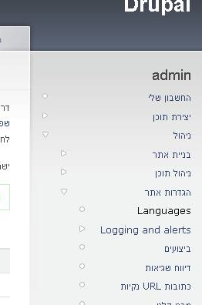
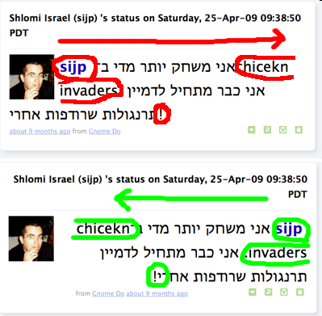

Right-to-Left (RTL)
some languages begin lines on the right side and go left
  Arabic, Farsi/Persian, Hebrew, Kurdish, Punjabi, Somali, ...
  hello vs. שָׁלוֹם
often handled by supplying separate .css files for RTL locales
can lead to lots of subtle UI bugs
based on coders' LTR assumptions

Slide 9
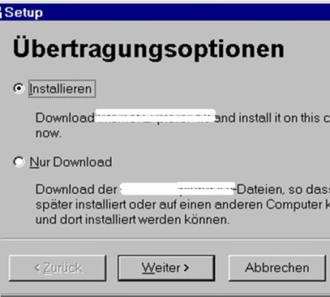
Localization gotchas
Some languages (e.g. German) use long words
  buttons/labels get too wide for space provided
Some Unicode characters look like ASCII ones
  U+00A0 "non-breaking space" character
  "-" vs. U+2014 "em-dash" —, U+2013 "en-dash" –
some fonts don't have all characters
  but a smart OS can use font substitution
regular expressions / text searches may not match i18n input
  ex. \w "word boundary" doesn't match Unicode word delimiters
web server might return text that has not been localized (Ajax)
Notes:
"Ubertragungsoptionen" ~= "Options about transmissions"

Slide 10
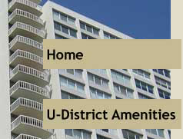


Things to avoid for i18n
Don't hard-code widths/heights in CSS or GUI
Avoid images that look like text.
Avoid using symbols that have no meaning in other locales.
  USA "STOP sign"
  Hand up for "Wait"
(if localizing to RTL locales) Avoid hard-coding the notion that "left" means "start" and "right" means "end".
  example: Left for "Back", right for "Forward"
  example: Left for "less", right for "more"

Slide 11
How are i18n/L10n done?
developers internationalize the app's code
  pull all strings out of code and into separate resource files
  call methods that localize/format strings, numbers before printing
  use libraries (e.g. gettext) to help localize messages
localizers (maybe not programmers) localize the app's text
  often hired to localize an app for a particular locale at a time
  desktop apps: possibly compile a different binary for each locale
  web app: look up localized strings when generating each page
model-view separation is very important for i18n/L10n

Slide 12
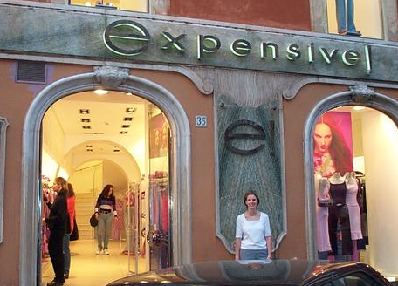
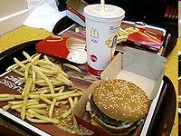
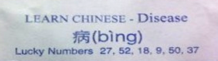
Perils of poor localization
word "Okay" could be translated as "so-so" or "mediocre"
<< and >> , when used as "arrows", can confuse some users whose languages use << and >> as quotation marks
product's name or ad could translate poorly
  Microsoft's "Bing" can translate to "disease" in Chinese
  McDonald's pictures-only billboard in Saudi Arabia
product could offend users from other countries
  an online dating site that allows users under 16 to register?
  an online auction site that has bidding end on a holy day?

Slide 13
Poorly localized messages
"Drop your pants here for best results." - dry cleaning, Tokyo
"We take your bags and send them in all directions." - Scandinavian airport
"Ladies may have a fit upstairs." - dry cleaning, Bangkok
"Teeth extracted by latest methodists." - dentist, Hong Kong
"Please leave your values at the front desk." - hotel, Paris
"No smoothen the lion." - zoo, Czech
"If you consider our help impolite, you should see the manager." - hotel, Athens
"Our wines leave you nothing to hope for." - Swiss restaurant
"It is forbidden to enter a woman, even if dressed as a man." - Bangkok temple
"Fur coats made for ladies from their own skin." - Swedish furrier
"Specialist in women and other diseases." - doctor, Rome
"Ladies, leave clothes here and spend afternoon having good time." - laundry, Rome
"We regret that you will be unbearable." - hotel, Bucharest
"When passenger of foot heave in sight, tootle the horn. Trumpet him melodiously at first, but if he still obstacles you then tootle him with vigor." - car rental, Tokyo

Slide 14
Automated translation
Why hire localizers when automated translators exist,
such as Google Translate and BabelFish?
  From course syllabus:
  "There is no textbook, but there will be reading assignments throughout the quarter that will be posted to the course web site to print or read online. For many of the reading assignments, we will assign questions posted online for you to answer about the reading. You will submit your answers to these questions online. These will be part of your course grade and will not be accepted late."
  Translated to Chinese by BabelFish, then back to English:
  "Without the textbook, but will have will be posted to the route website, in on-line printing or reads in quarter reading assignment. For many reading assignments, we the assignment problem on-line will post, for you can reply that about studies. You on-line will submit your answer to give these questions. These will be a your route rank part, and after them, will not be accepted."

Slide 15
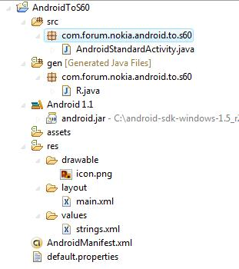
Android localization
Android apps store resources in res/ folder
  text strings go in strings.xml files:
    res/values/strings.xml (defaults)
    res/values-en/strings.xml (English)
    res/values-fr/strings.xml (French)
  testing locales:
    (on a real Android device)
    Home → Menu → Settings → Locale & text → Select locale
    (on the emulator using adb)
    adb -e shell
    # setprop persist.sys.language [language code];setprop
    persist.sys.country [country code];stop;sleep 5;start

Slide 16
strings.xml example
  <!-- res/values/strings.xml -->
  <?xml version="1.0" encoding="utf-8"?>
  <resources>
  <string name="greeting">Hello!</string>
  <string name="login">User %1 logged in.</string>
  </resources>
  <!-- layout XML file that uses string in View -->
  <TextView
  android:layout_width="fill_parent"
  android:layout_height="wrap_content"
  android:text="@string/greeting" />
  // in-app Java code that grabs a resource string
  Resources res = getResources();
  String greet = res.getString(R.string.greeting);
  String msg = String.format(
  res.getString(R.string.login), userName);

Slide 17


Other resources
Images are in res/drawable
  res/drawable/company-logo.png (English)
  res/drawable-fr/company-logo.png (French)
  <!-- layout XML file that uses image in View -->
  <ImageView
  android:layout_height="wrap_content"
  android:layout_width="wrap_content"
  android:src="@drawable/company-logo" />
Layouts are in res/layout
Menus are in res/menu
Colors are in res/values/colors.xml

Slide 18
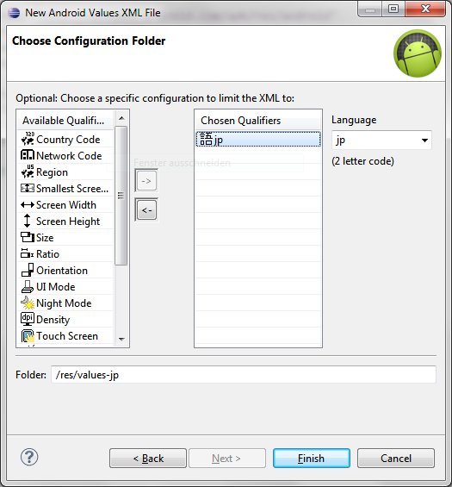
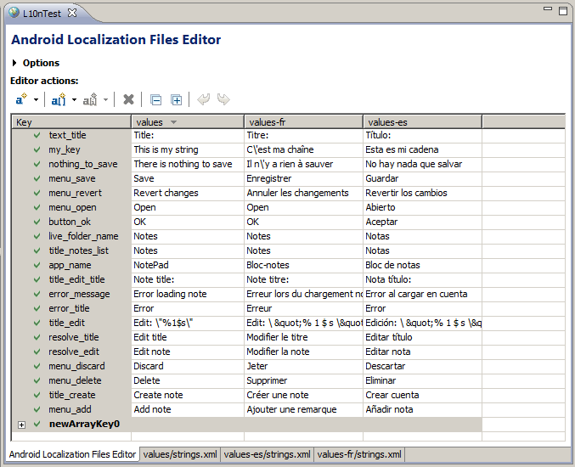
IDE resource support
Many IDEs (Eclipse) help you graphically create/edit resources

Slide 19
Locales in standard Java
java.util.Locale class represents a locale on the system
  Locale here = Locale.getDefault();
  Locale swiss = new Locale("de", "CH");
  System.out.println(swiss.getDisplayName());
  System.out.println(swiss.getDisplayName(Locale.GERMAN));
  Locale.setDefault(Locale.ITALIAN);
many other classes have methods to get supported Locales
  Locale[] locs = DateFormat.getAvailableLocales();
many other classes have methods that accept a Locale
  NumberFormat euro =
  NumberFormat.getCurrencyInstance(Locale.US);
Notes:
choosing a locale at the command-line: -Duser.language=de -Duser.region=CH

Slide 20
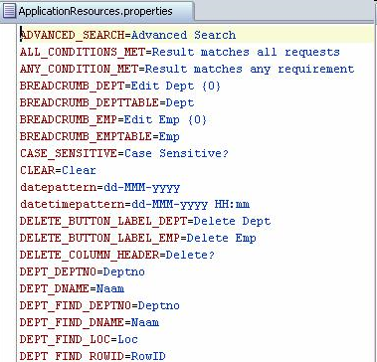
Resource files
resource: An external file (not code) containing a list of text messages localized for a particular locale.
  benefits:
  putting messages together makes sure you don't forget any
  easier to add another language later
  no locale-based logic in program code
  non-programmers can work on localization
given file names that contain locale info
  e.g. PracticeIt_de_DE.properties

Slide 21
Resource bundles in Java
standard (non-Android) Java's resource file format:
  a "properties file", full of name =value pairs
  named something like MyProgram_de_CH.properties
  computeButton=Rechnen
  colorName=black
  defaultPaperSize=210x297
java.util.ResourceBundle class reads resource files
  ResourceBundle bundle =
  ResourceBundle.getBundle(bundleName, locale);
  String buttonText = bundle.getString("computeButton");
  can bundle objects by extending ResourceBundle, but don't

Slide 22
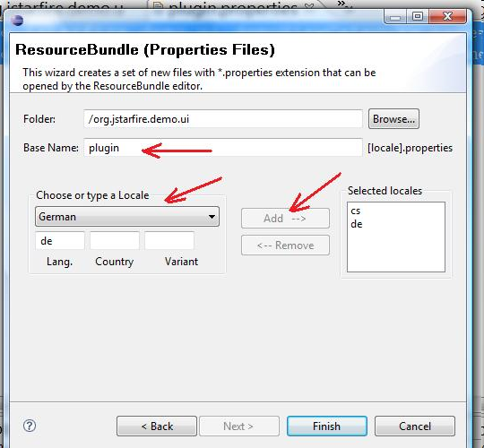
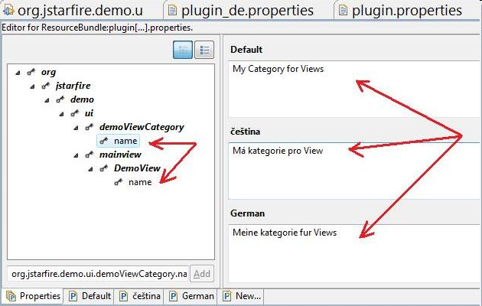
IDE resource support
Many IDEs (Eclipse) help you graphically create/edit resources

Slide 23
Formatting numbers
java.text.NumberFormat formats numbers for a locale
  Locale loc = Locale.getDefault();
  NumberFormat currFmt =
  NumberFormat.getCurrencyInstance(loc);
  String result = currFmt.format(1234.56); // 1.234,56€
  // don't use Double.parseDouble, etc.
  String line = scanner.nextLine(); // user input
  Number input = fmt.parse(line.trim());
  throws ParseException if text is in invalid format (need to trim)

Slide 24
Formatting dates
Differences in how to display dates across locales:
  names of the months/days (Monday vs. Lundi)
  ordering of days (what day does a week start/end)
  relative order of y/m/d (3/14/2010 vs. 2010/Mar/14)
  time zone (usually offset from UTC/GMT)
  12 vs. 24 hour time (5:00 PM vs. 17:00)
java.text.DateFormat formats dates
  styles: DateFormat.DEFAULT, FULL, LONG, MEDIUM, SHORT
  DateFormat fmt = DateFormat.getDateTimeInstance(
  DateFormat.LONG, DateFormat.SHORT, locale);
  String s = fmt.format(new Date());
  Date d = fmt.parse(dateText.trim()); // parse a date

Slide 25
Formatting currencies
currencies are represented by ISO-4217 currency identifiers
  examples: USD, GBP, EUR, JPY, CNY, INR, RUB
  programming languages don't know exchange rates between currencies (can't tell you how many Euros equals $100.00)
  but facilities exist for displaying a variable as a currency amount
java.text.NumberFormat has currency objects (instances)
  NumberFormat dollar =
  NumberFormat.getCurrencyInstance(Locale.US);
  NumberFormat euro =
  NumberFormat.getCurrencyInstance(Locale.GERMANY);
  euro.setCurrency(Currency.getInstance("EUR"));
  String s = euro.format(123456.78);

Slide 26
String collation
collation: Locale-dependent relative ordering of strings.
  String's compareTo method just goes by ASCII/Unicode value
  doesn't work well for special characters: é, Å, æ, ß, ™
    one locale might want Å to come between A and B
    another might want Å to come after Z...
  normalization/decomposition: turning ™ into "TM", é into "e´"
java.text.Collator class collates strings for a given locale
  implements Comparator interface
  collation strengths: PRIMARY, SECONDARY, TERTIARY
  Collator coll = Collator.getInstance(locale);
  coll.setStrength(Collator.TERTIARY);
  if (coll.compare(a, b) < 0) { ... // a comes before b

Slide 27
String/text formatting
When dealing with strings that insert variables' values, it is best practice to make them use printf / String.format / etc.
  This gives one complete sentence/string for the localizers.
  Easier to understand context and translate properly.
java.text.MessageFormat formats localized strings
  String format = "On {2}, a {0} caused {1} damage."
  String msg = MessageFormat.format(message,
  "hurricane", 10.0E8,
  new GregorianCalendar(1999, 0, 1).getTime());
  // On 1/1/99 12:00 AM, a hurricane caused 100,000,000 damage.
  format = "On {2,date,medium}, a {0} caused
  {1,number,currency} damage.";
  // On Jan 1 1999, a hurricane caused $100,000,000 damage.
  // can specify placeholder format: number, time, date, ...

Slide 28
Localization in Ruby/Rails
I18n module has transate (t) and localize (l) methods
  t 'store.title' # translate the given string id
  l Time.now # localize the current time
  you can also get/set the following I18n properties as necessary:
    load_path, locale, default_locale, exception_handler, ...
  setting locale based on URL subdomain:
  # de.myapp.com -> set I18n.locale to "de"
  I18n.locale = request.subdomains.first
  setting locale based on HTTP request
  # request is "de" -> set I18n.locale to "de"
  I18n.locale = request.env['HTTP_ACCEPT_LANGUAGE']
  .scan(/^[a-z]{2}/).first

Slide 29
Localization resource files
each language gets a .yml file of hierarchical key/value pairs:
  en:
  hello: "Hello, world!"
  store:
  title: "Jim's Meat Market"
  es:
  hello: "Hola, mundo!"
  store:
  title: "Mercado carne de Jim"
views can refer to a key from the resource file:
  # app/views/home/index.html.erb
  <h1><%= t :hello %></h1>
  <p><%= flash[:store.title] %></p>
  <h2><%= l Time.now %></h2>

