Slide 1
CSE 403
Lecture 23
Intellectual Property Issues in Software
Reading:
What Intellectual Property Law Should Learn from Software,
by J. Boyle
slides created by Marty Stepp, Gail Alverson, David Notkin
http://www.cs.washington.edu/403/

Slide 2
Intellectual property
intellectual property (IP): Any intangible asset that consists of human knowledge and ideas.
  patents, copyrights, trade secrets, trademarks, contracts
  intent: to encourage ingenuity and protect creative ventures
  "value" of an intellectual asset:
    Most such assets cannot be recognized on a balance sheet when internally generated, since it is very difficult to objectively value intellectual property assets.
    They can be included in a balance sheet if acquired, which allows more accurate valuation for the asset (the acquisition cost).

Slide 3





IP at Cray
Internal Cray IP
  Hardware management patents
  Proprietary cluster management software
  Apprentice2 performance tool
External IP, with fees
  Catamount OS, Sandia National Lab
  C, Fortran compiler, PGI
  Totalview parallel debugger, Etnus
  PBS Pro batch management tool, Veritas
External IP, without fees
  Linux, PAPI, gcc, gdb
  source: Gail Alverson

Slide 4

Patent
Protects: inventions and innovations
(processes, machines, products, phrases, algorithms…)
Protects against: others making, using, selling innovation, even if they independently came up with it
Requirements: novel, useful, non-obvious
Term: 20 years from filing; typically must file within a year of being publicly disclosed
Cost: relatively high, in time and cost

Slide 5
USPTO on patents
"A patent for an invention is the grant of a property right to the inventor, issued by the United States Patent and Trademark Office. … The right conferred by the patent grant is … 'the right to exclude others from making, using, offering for sale, or selling' the invention in the United States or 'importing' the invention into the United States."
"Utility patents may be granted to anyone who invents or discovers any new and useful process, machine, article of manufacture, or composition of matter, or any new and useful improvement thereof."

Slide 6
Patent "war chests"
Companies build up collections of patents to avoid lawsuits
  Apple's iPhone patents (e.g. vs. Samsung)
  Google buys Motorola, largely for mobile phone patents
  Microsoft vs. Google (Android); Microsoft / SCO vs. Linux
  Kodak vs. digital camera companies
  Verizon vs. Vonage (VoIP technology)
Results of patent lawsuits:
  may need to settle (e.g. cash payout)
  may need to license the patents (Google pays MS $5-10 for every Android device sold)
  suit may be thrown out for lack of merit (SCO vs. Linux)

Slide 7

Patent trolls
patent troll: An entity granted a patent that uses that patent largely to hold large corporations "hostage" by legal threats
  currently account for 30% of all patent litigation
MercExchange company holds patent on "Buy it Now" sales feature, also used by eBay
  MercExchange sued eBay for patent infringement
Supreme Court pushed back to lower court, but until decision, allows eBay to continue using the phrase
Other trolls: Intellectual Ventures ($5b!), Polaris IP (email apps), WebEx (wifi), Eolas (browser plugins), Amazon (1-click)

Slide 8


Patent lawsuit 1
Court ruled that Microsoft infringed on 15 patents owned by Alcatel-Lucent relating the MP3 music format (MP3 playback) in Windows Media Player
Alcatel-Lucent had argued it co-developed the technology with Germany's Fraunhofer Institute (FI)
  MS licensed through FI (for $16M) but not also Alcatel-Lucent
Damages: $1.52 BILLION (Microsoft appeals)
Bad news for Apple?
  iTunes to iPod have dependency on MP3 technology

Slide 9

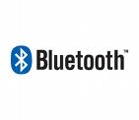
Patent lawsuit 2
UW ugrad (!) has 4 patents on technology used by cell phone manufacturers in "Bluetooth" technology
  Bluetooth is used in wireless devices; exchange info w/o wires
Washington Research Foundation (WRF) working on behalf of UW reached licensing agreement with Broadcom
CSR (cell phone maker) did not want to license the technology
  WRF filed a suite against CSR for patent infringement
April 2007, CSR settled with WRF for $15M
  CSR believes the suit was without merit

Slide 10
Other patent headlines
Kim Dotcom wants money from Google, Twitter for 2-Factor authentication
Microsoft's most profitable mobile operating system: Android
  (MS collects license fees on Android devices from its patents)
Google acquires Motorola Mobility (largely for their patents)
Patent war looming over Google VP8, WebM video codecs
Apple v. Samsung, Round 2
Will patents threaten 3-D printing?
New Sony patent blocks second-hand games on PS4 system

Slide 11
Trademarks
Protects: any word, name, symbol, or device, or any combination thereof used to distinguish goods from others
Protects against: others using the mark, likelihood of confusion and dilution
Excluded: use in other industries / geographic areas
Requirements: use mark in commerce or register with intent to do so in future; must maintain quality control over goods
Term: 10 year renewable (no upper limit)
Is your project's name trademarked?
http://tess2.uspto.gov/

Slide 12
USPTO on trademarks
"A trademark is a word, name, symbol, or device that is used in trade with goods to indicate the source of the goods and to distinguish them from the goods of others. A servicemark is the same as a trademark except that it identifies and distinguishes the source of a service rather than a product."
"Trademark rights may be used to prevent others from using a confusingly similar mark, but not to prevent others from making the same goods or from selling the same goods or services under a clearly different mark."

Slide 13
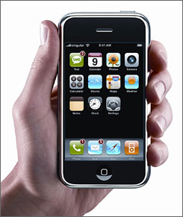
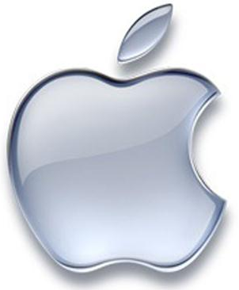
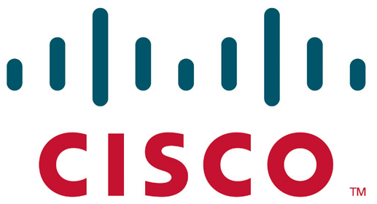
Trademark suit example
Cisco owns the trademark "iPhone"
  Apple started negotiations with Cisco to share the TM
  Cisco wanted an open approach to allow Apple iPhone to be compatible with other companies' products
Apple announced its iPhone before an agreement was made
  Cisco sued Apple for trademark infringement
Cisco and Apple reached a settlement (2/21/07)
  two companies pledged to "explore
  opportunities for interoperability in the areas
  of security, and consumer and communications."
  Other terms were confidential

Slide 14

Copyright
Protects: expression of ideas in a medium, but not the ideas
Protects against: reproduction, copy distribution, derivative work creation (NOT independent creation of same/similar work)
Requirements: original work, fixed in tangible form
Term: author's life + 70 years
Cost: simple, no registration

Slide 15
USPTO on copyright
"Copyright is a form of protection provided to the authors of 'original works of authorship' including literary, dramatic, musical, artistic, and other intellectual works, published and unpublished. The 1976 Copyright Act generally gives the owner of copyright the exclusive right to reproduce the copyrighted work, to prepare derivative works, to distribute copies ..."
"The copyright protects the form of expression rather than the subject matter of the writing. For example, a description of a machine could be copyrighted, but this would only prevent others from copying the description; it would not prevent others from writing a description of their own or from making and using the machine. Copyrights are registered by the Copyright Office of the Library of Congress.”

Slide 16

Asserting copyright
Almost all things are copyrighted the moment they are written.
  Can provide an explicit copyright notice or license in the work
  e.g. email signature: "The information in this email and subsequent attachments may contain confidential information that is intended solely for the attention and use of the named addressee(s). This message or any part thereof must not be disclosed, copied, distributed or retained by any person without authorization from the sender."
  e.g. license notice/link in a software product or source code
  e.g. a copyright watermark logo on an image
Copyrighting software:
  contracts/licenses can give the user
  permission to use copyrighted material
  in various ways

Slide 17
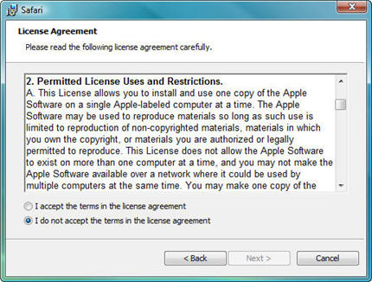
Proprietary licenses
most proprietary ($) software is licensed, not sold
  publisher grants you a "license" to use a copy of the software
  ownership of those copies stays with the software publisher
    reserves for the owner almost all rights
    grants only a limited set of rights to the end-user
Without accepting the license, the end-user may generally not use the software at all
Are EULAs enforceable?
  never fully challenged in court
  (without a settlement)

Slide 18
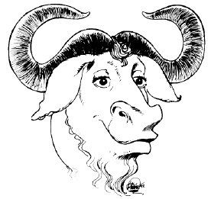
Open source / free licenses
generally consistent with the GNU GPL and similar licenses
owner retains ownership
license grants all rights except the right
to sell or license it on different terms ("copyleft")
  Commercial licensing for a profit is also prohibited
intent: encourage perpetuation of free use of software
end-user may use the software without accepting the license
  only when additional rights are desired must the end-user accept and be bound to the license terms

Slide 19
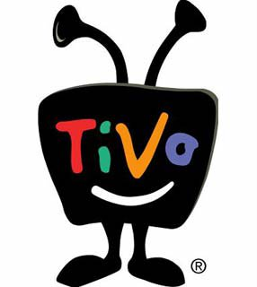
Fair use
fair use: limitation and exception to copyright to allow duplication and usage for purposes of commentary, criticism, research, education, archiving, scholarship, etc.
  examples: Tivo, VHS, CD ripping/burning, Xeroxing
  USPTO: "The fair use of a copyrighted work … is not an infringement of copyright. In determining whether the use made of a work in any particular case is a fair use, the factors to be considered shall include:
    purpose and character of the use, including whether such use is of a commercial nature or is for nonprofit educational purposes;
    nature of the copyrighted work;
    amount and substantiality of the portion used in relation to the copyrighted work as a whole; and
    effect of use upon the market for or value of the copyrighted work."

Slide 20
Reverse engineering
reverse engineer: take something apart to see how it works
  In software, this usually means decompilation (converting from object code to source code)
As reverse engineering is based on a copy of a piece of software, it is almost always in violation of copyright unless the right to do so is explicitly granted
  However, if decompilation is needed to attain interoperability, US and European copyright laws permit it in some cases
One US example allowed a company to decompile to get around a software locking mechanism for a Sega game console

Slide 21
Trade secret
Protects: concept, idea, info, or innovation
Protects against: misappropriation (NOT independent creation of same work)
Requirements:
  info not generally known or available
  must spend reasonable effort to maintain secrecy
  company derives some (economic) value from secrecy
Term: no predefined limit
Cost: no registration or examination

Slide 22


Trade secret examples
Symantec said Veritas shared trade secrets and even trained Microsoft engineers as the companies began working together
  Microsoft used trade secrets to start developing products [Vista] that directly competed with their offerings, the lawsuit said.
Microsoft said that in 2004 it bought from Veritas the rights to the technologies in question
other examples:
  Mac "rumor" sites leaking secrets
  Eric Schmidt, Sun → Google

Slide 23
Who owns UW projects?
In the US, inventors traditionally own their inventions.
  Universities most often share monetary returns from commercialization.
CSE commercialization committee
  http://www.cs.washington.edu/commercialization/
UW office of technology transfer
  http://depts.washington.edu/techtran/
Key question: "Who is funding the work?"

Slide 24
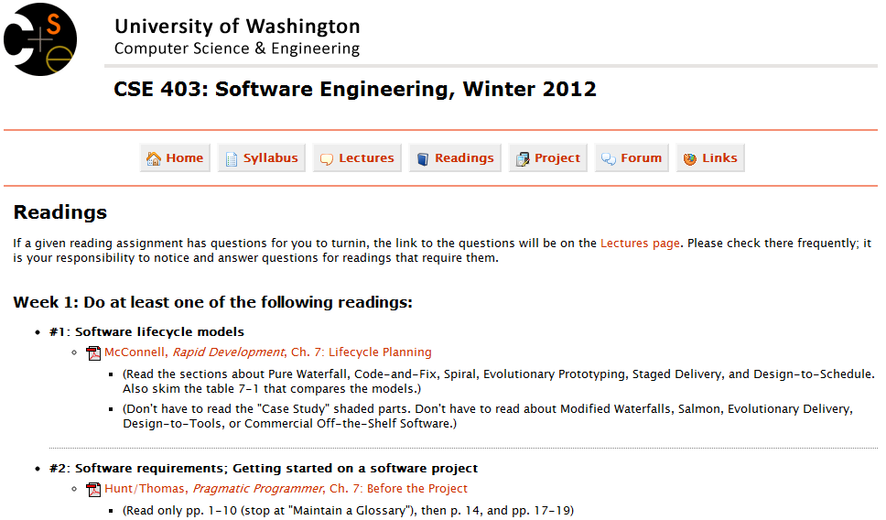
Find the IP violations!

