Slide 1
CSE 403
Lecture 25
Scheduling and Planning a Large Project
Reading:
The Mythical Man-Month, Ch. 2, by F. Brooks
slides created by Marty Stepp
http://www.cs.washington.edu/403/

Slide 2
Revisited: Software is hard
Historically, ~ 85% of software projects "fail." Why?
  management sets unrealistic expectations; devs don't correct them
  overestimating the positive impact of shiny new tools and hardware
  hired developers based on availability despite warning signs
  personality conflicts between developers
  changes in rate structure requirements in middle of work
  one delay causes another (dev delay leads to test delay, etc.)
  hacks and shortcuts
  developers end up working "death marches" (6-day, 10-hour weeks)
  overestimating how nearly done you are ("I'm 90% there!")
  software written doesn't match the spec
  developer time taken away by other tasks
  tons of bugs come out in testing
  developers don't listen to testers; ignore severity of bugs reported
  management breaking promises (bonuses, time off, etc.)

Slide 3
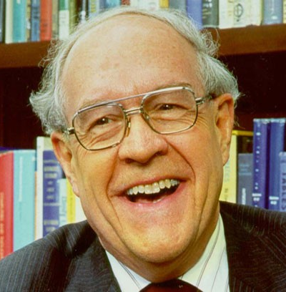
Why do projects fail?
Fred Brooks: Turing Award-winning Harvard
professor; expert on software engineering.
  managed development of IBM System/360
  author of The Mythical Man-Month
Brooks: "More programming projects have gone awry for lack of calendar time than for all other causes combined."
But why do projects finish late?
  How can we foresee/predict this happening?
  What (if anything) can we do about it?

Slide 4
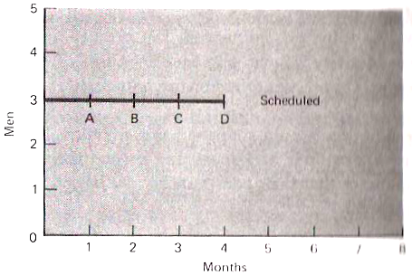
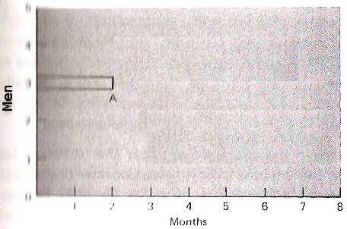
A late software project
In the graphs, the project was supposed to reach milestone A in 1 month (left), but in fact it took 2 months (right).
  How should this delay be interpreted?
  What are the options facing the project's manager?
  Should the manager add extra people to the development team to make up for the delay? If so, how many and why?

Slide 5
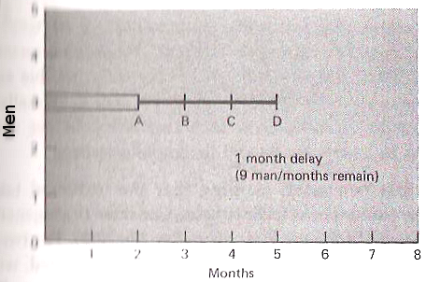
Interpretation #1
Only Part A was misestimated.
So the overall project will be 1 month late. (at right)
  If the assumption is valid:
    9 man-months of work remain
    / 2 actual months remain in which to do it
    = 4.5 people will need to work each month
    so add 2 workers to the existing 3.

Slide 6
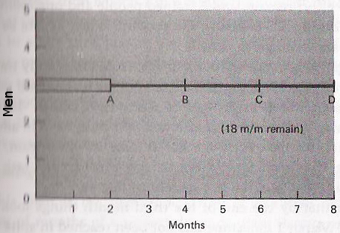
Interpretation #2
The whole project estimate was low.
So the project will take twice as long as expected. (at right)
  If the assumption is valid:
    18 man-months of work remain
    / 2 actual months remain in which to do it
    = 9 people will need to work each month
    so add 6 workers to the existing 3.

Slide 7
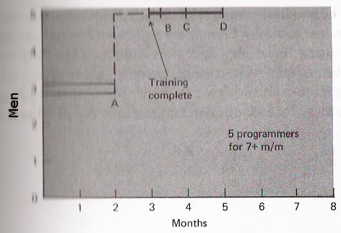
The Mythical Man-Month
If we assume the interpretation #1 was correct:
  We must account for delays in training the new workers
  We must partition the job into 5 pieces, to be integrated later
  What is "Brooks' Law"?
  "Adding manpower to a late software project makes it later."
  -- The Mythical Man-Month

Slide 8
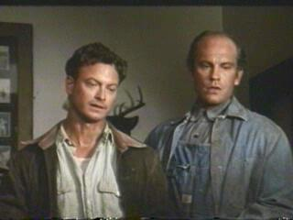
Of Months and Men
Men/women and months are not interchangeable!
When you add workers, the following costs occur:
  must repartition the work
  must train the new workers
  must increase intercommunication
What is Brooks' suggested schedule?
  1/3 for design
  1/6 for coding
  1/4 for unit/component testing
  1/4 for system testing

Slide 9
LOC per day
Pro developers often write 50-100 lines of code per day.
  How can it be so low?
  Does it change based on the programming language used?
Factors to consider:
  Should say, 100 lines of correct code per day.
    Are we counting comments? Blank lines? Modified old lines?
  The code must be...
    designed
    tested
    code reviewed
    checked in
    maintained / updated

Slide 10

Productivity
Factors that eat up developer time:
  learning new systems, languages, and code
  documentation
  testing
  debugging (getting stuck!)
  meetings
  interpersonal communication
  code reviews
  design reviews
  illness
  real life (family, pets, flat tire, etc.)
  distraction (Facebook, etc.)

Slide 11
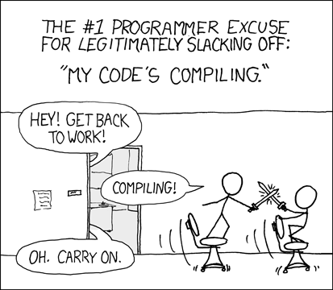
Measuring productivity
Ways LoC can be useful:
  when measured in the same language
  with the same developer
  over a long period of time
Variations
  Include comments / blank lines in LoC?
Other ways to measure productivity, besides LoC:
  LoC per month
  "function points"
  "eLoC" - substantive lines
  check-ins

Slide 12
Why is estimating hard?
Why are we so bad at estimating how long a project will take?
Programmers are optimists: "All will go well."
  Programming = creative; building with "thought-stuff"
  therefore, we do not usually imagine that things will go wrong
We lack practice at measuring how long tasks will take
  lose track of time while coding; forget how long it took
  tend to focus on the time needed to finish "rough" untested code
We fail to account ahead of time for:
  bugs; sticking points (sometimes NO progress will be made)
  design / redesign / refactoring
  testing and debugging (both our code and others')

Slide 13
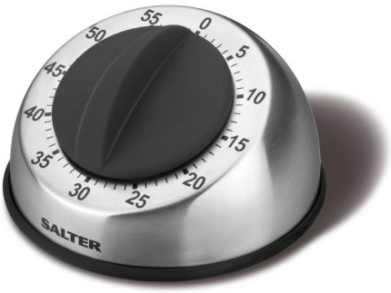
Some estimating tips
Guess how long you think you'll actually need...
  Then double (or triple) it.
  Use a coarse granularity; days/weeks, not hours.
Add time to your estimate if:
  It involves learning any new technologies or systems.
  It involves collaborating with others.
  It is user-facing and therefore needs to be very robust/secure.
  It is concurrent, network-enabled, or long-running.
  It involves "messy" data or combining data from multiple sources.

Slide 14
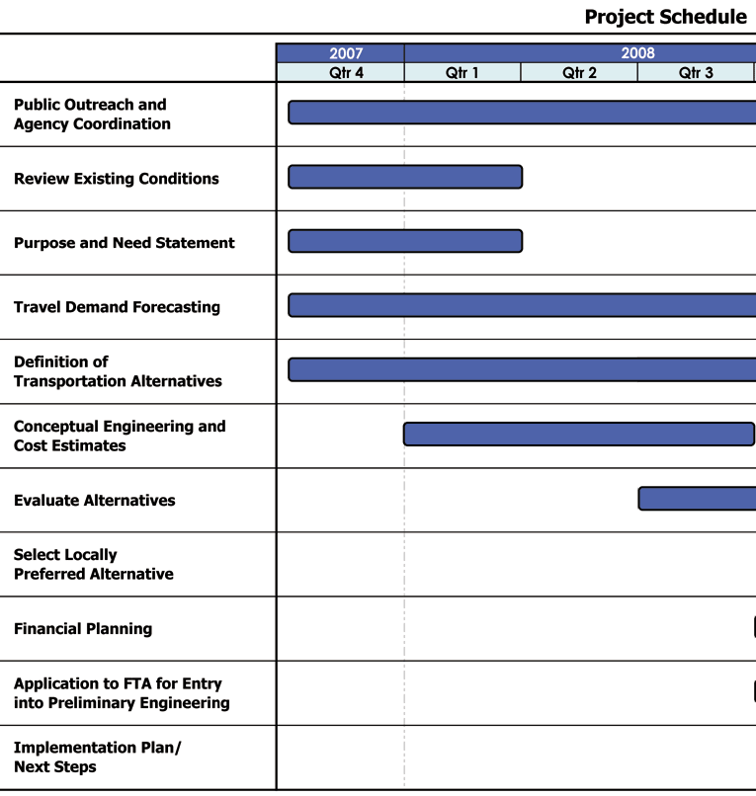
Your project schedules
Looking back on your initial estimated project schedules:
  How accurate were your initial ideas?
  In what way are they the most
  "off" from what you have actually
  spent your time doing?
  Do you know something now that
  would help you to more effectively
  schedule a large project in the
  future? If so, what?

Slide 15

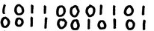
Code maintenance
maintenance: Modification or repair of a
software product after it has been delivered.
  fix bugs, performance, improve design, add features
Maintenance is how developers
spend much of their time.
It's harder to maintain code than write your own new code.
  "house of cards" phenomenon (don't touch it!)
  must understand code written by another developer,
  or code you wrote at a different time with a different mindset
  most developers dislike code maintenance...

Slide 16
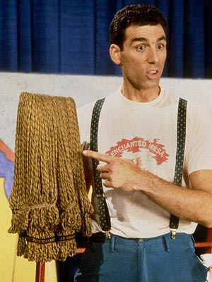
Performing maintenance
Maintenance comprises all phases of the software lifecycle.
  gather requirements
  design
  implement (code)
  test/debug
  integrate
  ...
New versions of your software are subject to all constraints that were placed on the old version, and possibly more.
  backwards compatibility is often expected / required

Slide 17
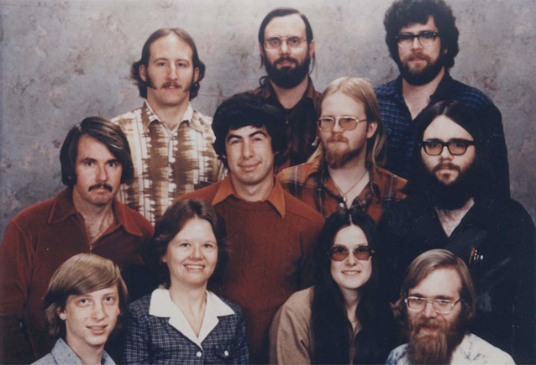
Maintenance + new devs
It is often done as an afterthought.
  Not enough time allocated in schedule
  You must think ahead of time how you
  (or someone) will maintain code later
Maintenance is often given to junior developers.
  "This way they'll learn the guts of the system better."
  Senior developers don't want to work on maintenance.
  But junior devs don't know the system or how to maintain it.
Result: brittle code with little conceptual or design integrity; even more maintenance headaches to come.

