Slide 1
CSE 403
Lecture 26
Tech Startups
slides created by Marty Stepp
http://www.cs.washington.edu/403/
some ideas and content taken from slides by Wayne Yamamoto, Wikipedia

Slide 2

Startups
startup company ("startup"): A company, partnership, or temporary organization designed to search for a repeatable and scalable business model.
  became very popular during dot-com bubble
  often a company poised for rapid growth
    must be able to reach many people, and make money from them
  a new/small company != a startup, ... but most are
  often based on technology
    low cost to enter market
    easy to reach many people
    high risk, high reward
  ... Could you make a startup??

Slide 3
Your idea
Are you sure your idea is even any good?
  Many successful ideas are "disruptive" to an existing market, or create a new market that was not seen before
    example: Tivo disrupts TV market / creates DVR market
    example: Facebook, Twitter disrupt online social networking
    example: FourSquare creates location-based "check in" ad market
  You may need to do market research to validate your idea.
    assess / develop business ideas and concepts (what is it?)
    assess revenue potential (can it make money?)
    identify potential for growth (what is the future of the idea?)

Slide 4
Do you own it?
You might not "own" your idea if:
  the idea came from a course or project
  you built it in a group (group may collectively own it)
  it uses any university resources (servers, libraries, etc.)
  it uses any university intellectual property
Many startups must acquire IP protection of their ideas.
  Often close to 100% of the value of a startup is in its IP.

Slide 5



A minimal startup team
A hacker
  (developer, writes most of the code)
A hustler
  (manager, handles business side)
A hipster
  (designer)
Some teams have a few hackers instead of just one
  but ignoring the other categories is perilous

Slide 6
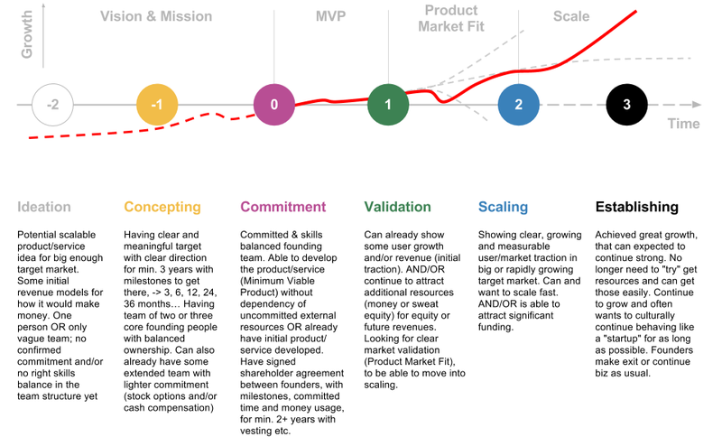
A startup timeline

Slide 7
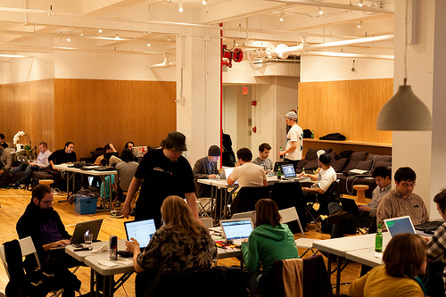
Prototypes
Hack out a prototype.
  spend 2-10 weeks max
  Investors are much more likely to
  fund you if you can show them some
  minimal initial version of your idea.
one source: hack-a-thons
  Some universities run 24-hour hack-a-thons where groups build prototype apps to win prizes.
  Sometimes investors or other groups watch these events and contact promising groups about turning these into startups.

Slide 8
Iterating on a prototype
Even if started as a prototype/hack, software engineering principles are still important for a project
  back-create a spec and requirements, rough feature list
  set up version control repo
  code review it, refactor poorly designed code
  add unit tests and some system tests
  daily builds and automated tests
  speak to potential users, do UI/usability testing
  re-examine code for security, performance, reliability, etc.

Slide 9

Money
Do you need funding to build your prototype?
  Growing a company typically requires money.
  Can you afford to "bleed" till your demo hits?
Reasons you might need money:
  pay core employees (devs, manager, designers)
  purchase equipment (computers, servers, software, services...)
  pay for licenses to use intellectual property
  rent office space

Slide 10


Angel investors
angel investor: An affluent individual who
provides initial capital for a business start-up.
  amount is generally smallish (~$10-30k)
  gets company off the ground to prototype stage
  often decided quickly and on a fairly informal proposal
  angels are accredited investors to comply with SEC regulations
  in US, many angels (≥40%) are in Silicon Valley
    other sources: NYC, Seattle, Austin, Boston, NC Research Triangle
angels are compensated with:
  ownership equity (a percentage of ownership of the company)
    implies company's value (e.g. $10k for 5% stock => $200k value)
  convertible debt (options to buy stock in the company later)

Slide 11

Venture capital
venture capital ("VC"): Financial
resources given to early-stage companies.
  given to startups by VC firms (groups)
  VC firm gets % of profits or equity (stock)
  different from bank loans; does not need to be paid back
stages of VC financing:
  seed funding: initial minimal funds; often given by angels
  start-up: early funds from VC firm for marketing/dev
  growth ("series A"): large investment ($1-2M) for preferred stock
  second round: company is successful, but not profiting
  expansion ("mezzanine"): $ given to a newly profitable company
  exit/bridge: VC firm sells stock once company matures

Slide 12


Getting VC
VCs won't fund just anyone.
You must convince them.
  have a means of contacting/meeting a VC firm
  pitch your product
  convince the firm that:
    you have a good idea
    people want it
    that you have addressed a problem or need and will solve it
    it is profitable
    it has growth potential
    you have assembled a good team to execute it
    you can beat any (potential) competitors
    you have legal right to produce the product (own relevant IP, etc.)
    you are open to suggestions, partnership with the VC firm

Slide 13
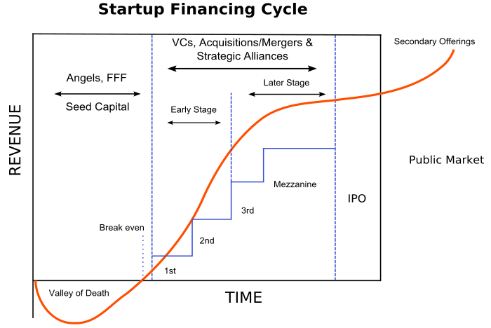
Funding timeline

Slide 14
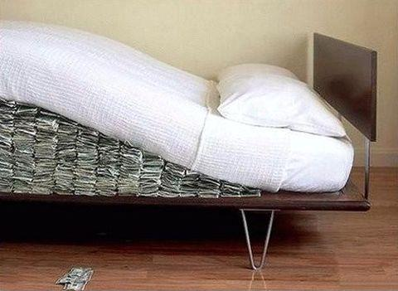
Other funding sources
friends and family funding ("fff"):
asking friends to borrow/donate money
grants or government funding
bank loans: taking out a standard business loan to be repaid
public equity: Selling stock in the company
  IPO (initial public offering) often comes after VC funding
crowd funding: Asking the public for donations
  e.g. Kickstarter

Slide 15


Startup incubators
incubator: Program designed to support successful development of startups by providing business resources.
  business, marketing, and networking advice
  computing resources (computers, net access, servers)
  financial advisors
  management teams
  access to loans and banks
  access to angel investors and/or venture capitalists
  legal advisors (such as for intellectual property rights)
  Examples: Ycombinator, Techstars

Slide 16
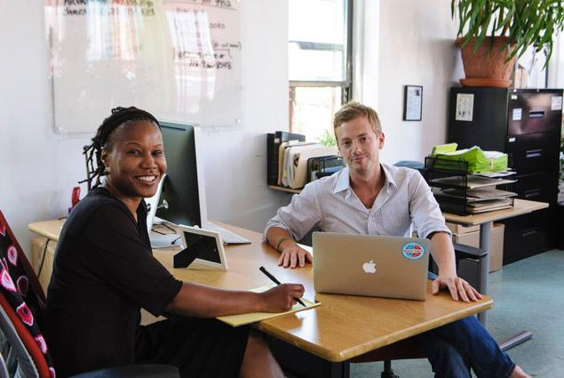
Working at startup - pros
motivation
  work on something you believe in
autonomy
  smaller team; you get to make decisions
ownership
  you may be given stock in the company
compensation (long-term)
  chance to get rich if company becomes a hit
casual workplace atmosphere

Slide 17

Working at startup - cons
compensation (short-term)
  somewhat lower pay than at big company
fewer perks
  less free food, games, toys
job security
  company might fail
long hours
  entire company's fate rests on short-term milestones;
  may have to work long days and/or weekends to meet them

Slide 18

Startup failure
Up to 75% of startups fail. Why?
  can't raise enough initial angel/VC funding
  wasting too much money at early stages
  company doesn't begin with the best people
  doesn't produce something people want
  hires too many people too quickly
  hires the wrong people, or people with the wrong skills
  doesn't produce a working product in a timely manner
  not able to successfully monetize the idea
  beaten out by a competitor

Slide 19
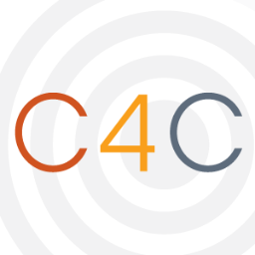



UW/Seattle resources
UW Center for Commercialization (depts.washington.edu/uwc4c/)
  helps develop idea, find w/ VC firms, advisors, interns
UW Startup Weekend (uw.startupweekend.org/)
  event where coders, hustlers get together
  to network, develop, pitch ideas, meet mentors
UW CSE Startup Recruiting Fair
UW CSE Startup Office Hours
Startup Seattle: city-wide initiative and resources
Started in Seattle: a list of Seattle startup companies
Seattle VC firms: Madrona, Arch, WRF, Voyager, Vulcan, OVP, Ignition, Frazier

