Slide 1
CSE 403
Lecture 27
Course Wrap-up Discussion
slides created by Marty Stepp
http://www.cs.washington.edu/403/

Slide 2
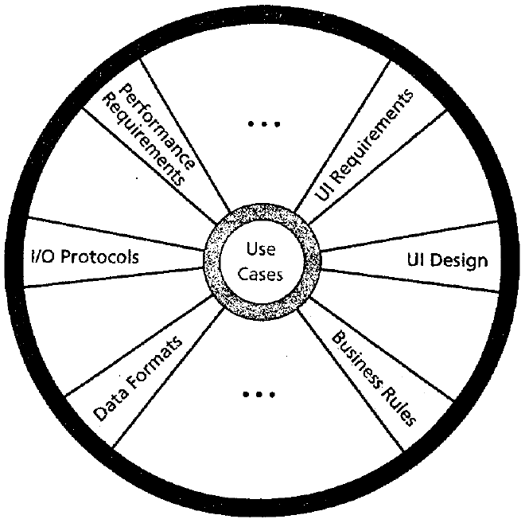
Requirements
How does the product you built differ
from what you intended/expected to build?
  What are some features you had to cut?
  What are some implementation challenges you didn't anticipate?
  Did you end up implementing all of your original use cases as planned? If not, what was cut/changed and why?
  What phases, features, aspects took longer to complete than you thought? How does your initial estimation of your project's schedule compare to what really took place?

Slide 3

Teams and groups
What are some of the challenges that came
from working in a large team on a big project?
  What were the roles of your team's members?
    Did everyone work on individual tasks, or were there sub-groups?
  How did the PM manage and collaborate with others?
  What was the communication like between group members?
    Was it as good as it should have been?
  When, where, and how often did you meet in person to work?
  How did you resolve conflicts?

Slide 4

Tools and technologies
While building this project, you had to learn about
new languages, tools, services, and technologies.
  (Git/Github; Android; Heroku; testing tools; Jenkins)
  How difficult was this for you and for your group?
  What were some unforeseen challenges related to these technologies that hit your group during the project?
  If you had to do a project like this again, would you choose the same tools and technologies or switch, and why?
  Should we have done more to prepare you for using these tools?

Slide 5
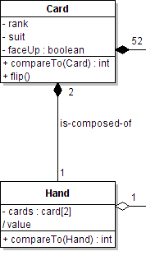
Design
This was (probably) your first time designing
such a large-scale team project.
  How difficult was it to come up with an initial design?
  Does your final code look anything like your UML?
  What design aspects were hard to anticipate, or
  came out very differently from your initial idea?
  Was UML useful as a tool to talk about your design?
    What about related techniques like CRC cards?
  Do you feel like you could design a similar app well now?

Slide 6
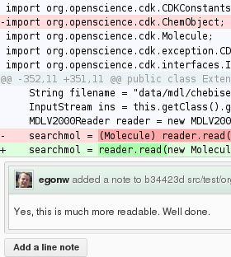
GitHub, code reviews
We forced you to use a central GitHub repo
and to do extensive code reviewing.
  Was it helpful to use a central Github repo?
  Did you feel like you knew Git/Github well?
    Do you feel like you know it well now?
  Did your group have any challenges related to the repo/Github?
  What were the pros and cons of doing the code reviews?
  How useful do you think code reviewing was on your project?
    Did you learn any coding skills or good/bad practices from it?
    Did it help your team to avoid any problems, bugs, bad code, etc.?

Slide 7
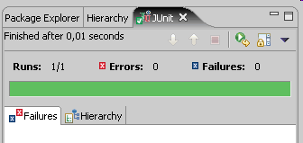
Testing
We did a lot of unit testing, including coverage
analysis, and also integration/system testing.
  Did unit tests help you find any bugs or regressions?
  How hard was it to get to the expected coverage percentage?
  What kind(s) of testing were most interesting or useful?
    integration, UI, usability, performance, reliability, security, ...
  What kind of testing scheme would you use if a future large team project were entirely under your control?
    Would you require unit testing? A minimum coverage?
    What kind(s) of system testing, if any, would you use and why?

Slide 8
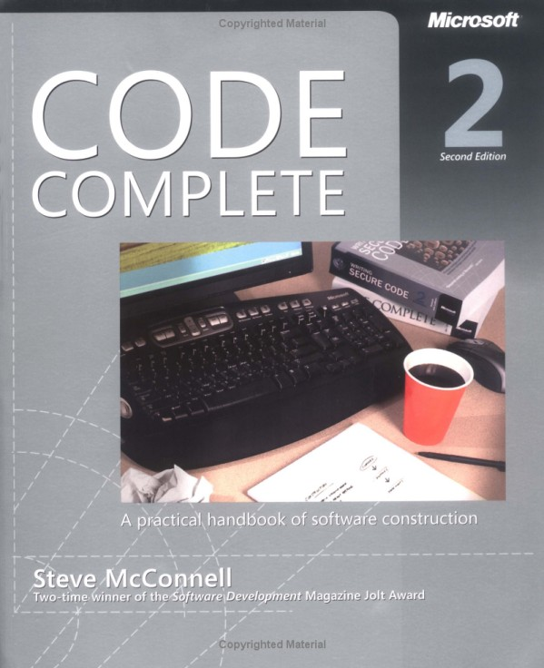
Readings
Throughout the quarter we read articles, chapters,
and sections about SW engineering topics.
  What topics were interesting to read about?
  What topics were tougher or less interesting?
  Is there a topic we didn't read about but should have?
  What do you think about the reading in the course overall?
    Would the course be better with less/different expectations?

Slide 9











Further reading
Code Complete, by Steve McConnell
The Pragmatic Programmer, by Andrew Hunt / David Thomas
The Art of Unit Testing, by Roy Osherove
Don't Make Me Think!, by Steve Krug (usability)
How to Break [Web] Software, by James Whittaker (testing)
The Mythical Man-Month, by Fred Brooks
Programming Pearls, by Jon Bentley
Refactoring, by Martin Fowler
UML Distilled, by Martin Fowler
Rapid Development, by Steve McConnell
Design Patterns: Elements of Reusable ..., by "Gang of Four"
Object-Oriented Design and Patterns, by Cay Horstmann
  web sites: Joel on Software; Paul Graham; Hacker News; reddit

Slide 10
Advice from past students
Here is some advice given from students in past quarters:
  "Work together (in the same place) as much as possible."
  "Well-run and consistently scheduled meetings help a lot."
  "We often underestimated tasks. If we had spent more time analyzing each task and breaking it down into smaller chunks, our estimated times would have been more accurate."
  "Don't underestimate the difficulty of learning new languages, frameworks and tools."
  "Make small, frequent updates and commits to your source repo. Not doing this leads to merges that can be a nightmare."
What advice do you have for future CSE 403 students?

