Slide 1
CSE 403
Personality Types
Slides by Valentin Razmov
http://www.cs.washington.edu/403/

Slide 2
Resources
Myers-Briggs Personality Type (MBTI) test
Handouts (distributed during and after class)
MBTI workshop, at Leadership Institute for Tomorrow (LIFT), by Chris Loving
Guest lecture in CSE403 Sp’04, by Prof. Ginorio

Slide 3
Motivation
Humans tend to assume that others are like themselves.
  … and so others’ preferences “must be” like their own.
  The stronger one’s preferences are, the harder it is to imagine that something very different may be just as valid!
Personality tests (e.g., MBTI) have demonstrated that people’s preferences differ along many axes.
Hence, there is a need for conversations – to discover how to communicate effectively with each individual.
  Crucial in a team setting where common goals are pursued
MBTI provides a language to talk about our differences.
  … without marginalizing anyone.

Slide 4
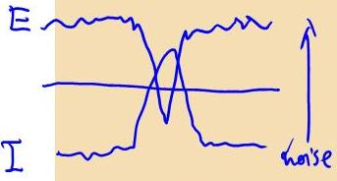
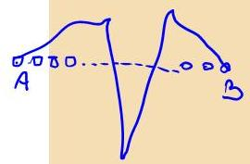
Personality traits
Introvert vs. Extrovert
  Where do you get your energy from?
INtuitive vs. Sensory
  How do you get information?
Thinking vs. Feeling
  How do you process information?
Judging vs. Perceiving
  What is your lifestyle?

Slide 5
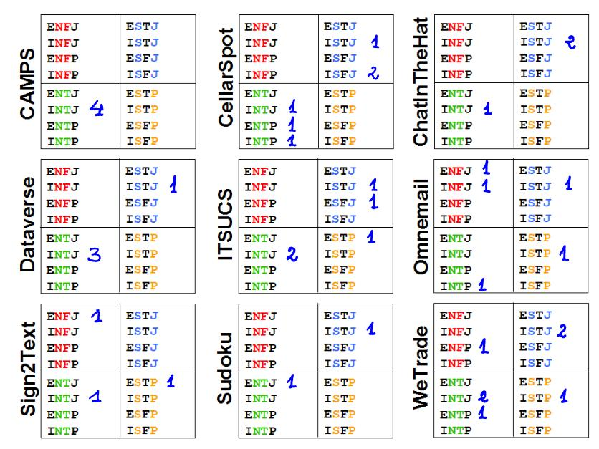

Slide 6
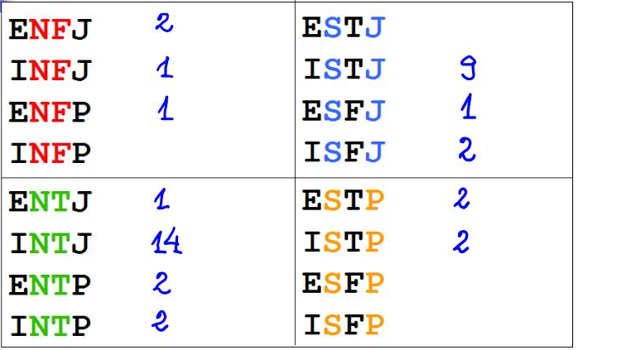
Results Aggregated
ENFJ
INFJ
ENFP
INFP
ESTJ
ISTJ
ESFJ
ISFJ
ENTJ
INTJ
ENTP
INTP
ESTP
ISTP
ESFP
ISFP

Slide 7
Results across quarters
 | Su’02 | Su’03 | Wi’04 | Wi’05 | Sp’05 | Su’05 | Su’06 | Wi’07
I : E | 14 : 6 | 16 : 9 | 11 : 10 | 23 : 8 | 12 : 9 | 7 : 3 | 5 : 3 | 30 : 9
N : S | 12 : 8 | 17 : 8 | 13 : 8 | 23 : 8 | 10 : 11 | 9 : 1 | 5 : 3 | 23 : 16
T : F | 13 : 7 | 15 : 10 | 14 : 7 | 23 : 8 | 14 : 7 | 6 : 4 | 6 : 2 | 32 : 7
J : P | 15 : 5 | 17 : 8 | 18 : 3 | 23 : 8 | 18 : 3 | 8 : 2 | 7 : 1 | 30 : 9
Overall:
I: 67.4%
N: 64.0%
T: 70.3%
J: 77.7%

Slide 8
Comparisons
UW CSE
(undergrad, 403)
UW Engineering
(grad, workshop)
USA population
(normalized)
ENFJ 13
INFJ 15
ENFP 2
INFP 2
ESTJ 3
ISTJ 31
ESFJ 5
ISFJ 9
ENFJ 14
INFJ 15
ENFP 11
INFP 16
ESTJ 6
ISTJ 5
ESFJ 3
ISFJ 5
ENFJ 4
INFJ 2
ENFP 12
INFP 7
ESTJ 13
ISTJ 17
ESFJ 18
ISFJ 21
ENTJ 19
INTJ 41
ENTP 9
INTP 11
ESTP 4
ISTP 5
ESFP 2
ISFP 4
ENTJ 12
INTJ 16
ENTP 6
INTP 9
ESTP 0
ISTP 0
ESFP 2
ISFP 0
ENTJ 3
INTJ 3
ENTP 5
INTP 5
ESTP 6
ISTP 8
ESFP 13
ISFP 13
UW CSE: I: 67.4%; N: 64.0%; T: 70.3%; J: 77.7%
UW Engr: I: 55.0%; N: 82.5%; T: 45.0%; J: 63.3%
USA gen.: I: 50.9%; N: 26.6%; T: 40.4%; J: 54.3%

Slide 9
Personality Types/Teams
Effective teams usually have members of different types, contributing strengths toward common goals.
“A-ha” moments when one realizes what their teammates’ strongest “muscles” are and correlates this with their behavior
  “quiet” may indicate an introvert person, not an incompetent or unengaged one.
  More than one “field marshal” (ENFJ) on a team may be a cause for (and explanation for) power struggles.
Is it a good idea to team up people based on personality types, in addition to (technical) aptitude?

Slide 10
Disclaimer
A personality type is not a definition of who you will be tomorrow, much less who you will always be.
  It differs between situations (interpretations) and across times.
The personality type indicates which your currently strong “muscles” are.
  … but those strengths can be changed at will.

Slide 11
Stereotypes
Large body of research shows:
Implicit Assumptions Impact Evaluation
Gender Bias and Research Papers
  Paludi and Bauer (Sex Roles, 1983)
Gender Bias and Performance Evaluation
  Orchestra try-outs behind curtains
  Stereotype threat on exam performance
Reviewer (1-5, 1 top) | John T. McKay | Joan T. McKay | J. T. McKay
Male
Female
1.9 | 3.0 | 2.7
2.3 | 3.0 | 2.6

Slide 12
Stereotyping/Trends in CS
Shifted focus of Computer Science in recent years
  Before: fundamental and theoretical discipline
  Now: (increasingly) application-oriented, practical engineering discipline that serves many other fields
“Geeky” stereotype of computer scientists persists
  … despite mounting evidence to the contrary
  Hurdle toward increased participation of underrepresented groups as key constituencies with their unique and equally valuable perspectives.

Slide 13
Take-away points
There are many people who are very different from you in the way they approach the world
  … but they are still perfectly reasonable.
  Working with such people requires mutual respect and care in understanding. Effective communication is a prerequisite for this.
Stereotyping is counterproductive: it closes doors and eliminates desirable possibilities.
  “When you label me, you negate me.”

