Slide 1
CSE 403
Pitching a Project Idea
Reading:
Pragmatic Programming Ch. 1, 10
slides created by Valentin Rasmov and Marty Stepp
http://www.cs.washington.edu/403/

Slide 2
Lifecycle Objectives
Operational Concepts
  What is it? (High-level scope and objectives)
System Requirements
  What does it do for us? (Lower-level actual planned deliverables)
System and Software Architecture
  How? (Technically)
Lifecycle Plan
  Who wants it? Who’ll support it? (Resources needed)
Feasibility Rationale
  Given the constraints, is this realistic (can it be built)?

Slide 3
1. Operational concepts
Top-level system objectives and scope
  What problem are you trying to solve? Why? For whom?
  User community, environment, major benefits?
  Goals and non-goals
    To set realistic expectations in the audience
  Tip: This is what you should be able to explain in a 1-minute pitch (if you didn’t have more time) – a.k.a. “an elevator pitch.”
  Tip: It takes practice to refine this, so start early.

Slide 4
2. System requirements
Essential features of the system
  What does the customer want from this system?
    Look from the user’s perspective
    Tip: Avoid details at the start; there’s time to evolve.
  Discuss main capabilities, outcomes, reliability and performance needs, appearance
  Customer involvement is important and beneficial
    They know best what their interests and needs are, including what fits in their daily work and life patterns
      … even if they may not always express it very well
    They understand the domain better than developers do.
    Working jointly and openly with customers helps build trust, so any necessary changes are more acceptable.

Slide 5
2: System Requirements
Essential features of the system
  This will be your initial written specification
    Customers can review and sign off or complain early.
    Putting it in writing is less ambiguous than saying it.
    Forces you to think of major functional areas and seek architectural defects early
    “Failing to write a spec is the single biggest unnecessary risk you take in a software project” -- Joel Spolsky
  Be concise yet complete
    People get attached to work even if no longer of value.
  Tip: A picture / diagram is (often) worth 1000 words.
  Tip: Scenarios and stories help, but avoid being verbose.

Slide 6
3: System/SW Architecture
High-level technical description but with enough detail to allow feasibility analysis
  Unlike the previous two elements, this is technical.
  Architectural flaws will only deepen as you go forward, so look for alternatives while it’s still early.
  Tip: Try to come up with several (at least 3) alternative architectural designs.
  Tip: Identify clients, servers, major software components, external 3rd party software, and the interactions between them.
  Tip: Pictures say 1000 words.

Slide 7
4: Life Cycle Plan
Identify stakeholders and their roles
  Users, architects, developers, testers, managers, etc.
WWWWWHH:
Why / What / When / Who / Where / How / How
  Objectives: Why is the system being developed?
  Schedules: What will be done, When?
  Responsibilities: Who will do it? Where are they?
  Approach: How will the job be done?
  Resources: How much of each resource?
Tip: Make your best (educated) guess. Some of this will necessarily change. This is not a contract.

Slide 8
5: Feasibility Rationale
Conceptual integrity and compatibility
  Can this really be built with the available resources?
  Identify project risks
  What are the assumptions? Any unwarranted ones?
    “If you make one or two ridiculous assumptions, you’ll find everything I say or do totally justified.”
    -- Ashleigh Brilliant, 1671
Tip: Keep asking “why” until the assumptions emerge.
  E.g., “Why do we need this?”, “Why is this good?”

Slide 9
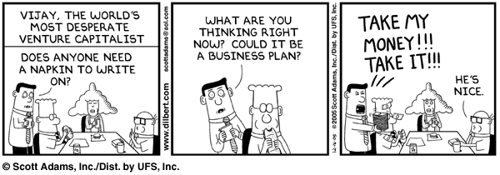
When do we make pitches?
To colleagues: to argue for a technical direction
To management:
  to convince that your idea/project/approach is of value
To customers:
  to purchase/fund product, to change requirements, etc.

Slide 10
Will project be approved?
Money is rarely the (real) issue...
The trick is to convince yourself and others
  that you will deliver a large positive payoff
  that you can manage the risks while building it
The different stakeholders (customers, management, developers, etc.) define success differently and you must satisfy (nearly) all of them at once.
Payoffs: money, market share, credibility, capability, satisfaction
Risks: wasted money/time, loss of credibility, opportunity cost

Slide 11
Questions audience will ask
Q1: Will this project make a positive difference for us
(our company)?
Q2: Do I want to hire this team (to work for us)?
The answers to both are independent, but you’d like both to be “Yes.”

Slide 12
Project won't be funded
"... because I think this will be fun to work on."
"... because it’s clearly better technically than the brain-dead solution proposed by those marketing folks who talked to our uninformed managers."

Slide 13
What makes a successful pitch
Presented at a level appropriate for your audience
  Customers, marketing people, VPs of Engineering, and developers all have rather different mindsets and measures of success
  Do you know who your audience will be next week?
Answering the audience's (unspoken) questions
  What questions do you anticipate they/we will have?
Focused and succinct statement of the value you propose and how specifically you intend to provide it
Credibility of the team
  If you've successfully completed other similar projects, tell them that, but don’t brag.

Slide 14
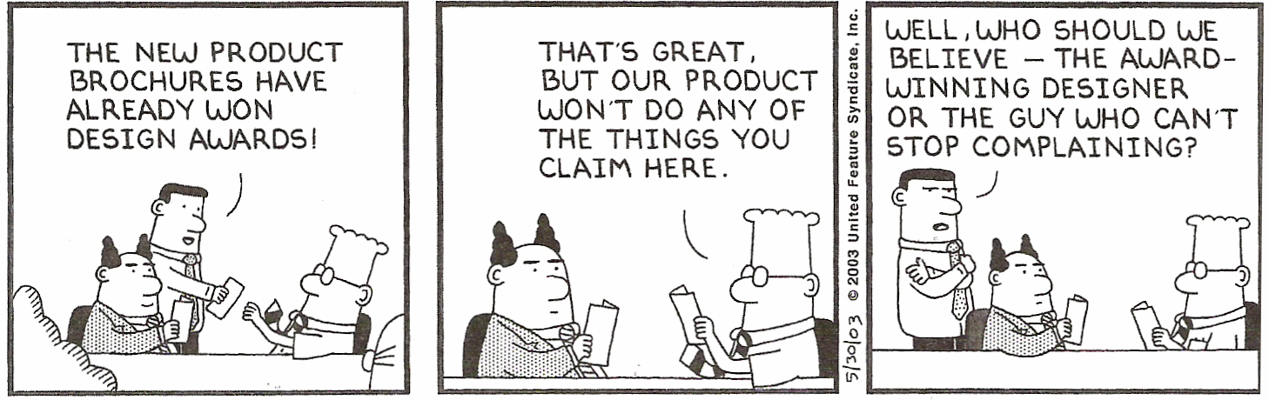
What makes a successful pitch
It helps to have something tangible to show briefly (a sketch)
Distinguish yourself from other same (or similar) products
  Convince your audience that they shouldn’t go to your competition that has already built this product!
Leave audience with something positive they can remember
Advice: Keep all of this in mind when applying for jobs and talking to potential employers!

Slide 15
Investment process
create and refine a pitch
get lots of advice and feedback; refine
be prepared for detailed diligence
  market models
  technical papers and analysis
  financials
  customer feedback
partner meeting
term sheet
legal work to close deal

Slide 16

"Elevator pitches"
30 seconds to 1 minute in length
  "Tell me what you’ve been working on."
Covers the most essential parts from the
point of view of your listener
  No one cares about details and no one will remember them anyway.
Use your time wisely
  You are not marketing something that’s already been made.
  You are trying to figure out if there is a need for what is being proposed.
A memorable concept to associate with your idea helps tremendously.

Slide 17
Common mistakes
Not ensuring that everyone can comfortably hear/see you
Misjudging audience (interests, background, requirements, etc.)
  E.g., assuming that their understanding prior to the presentation is similar to yours in level of depth
Not addressing the “why” question to motivate your idea
Not helping the audience understand the “big picture” of the area in which your product fits
Not covering alternatives and what novelty you are offering
Not presenting a picture of how project cost justifies value

Slide 18
Value proposition statement
Your audience, after listening to your pitch, must be able to at least fill out the following template reasonably accurately.
From “Crossing the Chasm” by Geoffrey Moore
For (target customer)
who (statement of need or opportunity)
the (product or company name)
is a (product or company category)
that (statement of key benefit / compelling reason to buy).
Unlike (primary “competitive” alternative),
our product (statement of primary differentiation).

Slide 19
Value proposition example
For users of the “pine” email client software on Unix
who need to easily find content in their past email correspondence
the “pine+” product
is an email client software
that is backwards compatible with “pine” and also free.
Unlike “pine” or other similar Unix-based email clients,
our product provides an intuitive way to annotate email messages with keywords of the user’s choice in order to facilitate subsequent searching by using one or more keywords in addition to the search functionality that “pine” offers.

Slide 20
Value proposition example
For (target customer)
who (statement of need or opportunity)
the (product or company name)
is a (product or company category)
that (statement of key benefit / compelling reason to buy).
Unlike (primary “competitive” alternative),
our product (statement of primary differentiation).
This format works for a personal value proposition, as well as for a product value
An excellent way to distinguish yourself
  “Unlike the other candidates, I …”

Slide 21
From "20 Questions for Startup Success"
1. What problem does this product/proposal solve?
2. How does your product/proposal solve the problem?
3. Who are the end users of the product? Is there an addressable market of actual users?
4. Who is your revenue-supplying customer? Are there enough of these paying customers to make a huge business?
5. Does the product solve a problem that end-users/revenue supplying customers actually have?
6. Are you sure that what you’re building a product and not just a “feature”?
7. Does your stuff easily fit into the way that people work?
8. Are you too involved in how you're building your product rather than WHAT you’re building?
9. Who are the potential partners? Who are the required partners?
10. What is the go-to-market strategy?

Slide 22
From "20 Questions for Startup Success"
11. What is your sustainable competitive advantage? In other words, will you soon be overtaken by others who do something similar?
12. Do you have a time-to-market / first-mover advantage?
13. Can you be #1 or #2 in the space? Who is your competition?
14. Is there a team formed/identified with a record of successful ventures? Have they done something like this before?
15. Is there a “soul” of the team that knows where this product AND business is going for the next few years?
16. Is anyone on the team insane? Also, are the members of the team totally passionate and aligned on this business?
17. Are there product/technology/operations barriers to success? If yes, can they be overcome?
18. Are there marketing/sales barriers to success? If yes, can they be overcome?
19. Are there legal barriers to success? If yes, can they be overcome?
20. Is there an exit strategy?

