Slide 1

Software Quality Assurance and Test Automation
Track Overview
Software Quality Assurance
Telerik Software Academy
http://academy.telerik.com

Slide 2
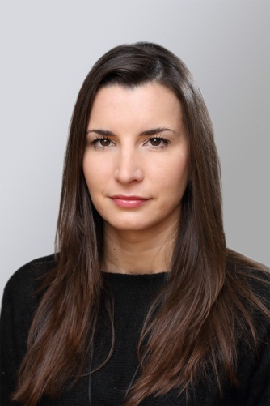
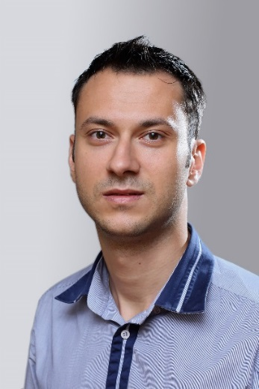
The Lectors
Snejina Lazarova
Product Manager
Talent Management System
Dimo Mitev
QA Architect
Backend Services Team

Slide 3

Table of Contents
Course Objectives
Trainers Team
Course Curriculum and Exams
Course Schedule
Assessment
Recommended Resources
Notes:
Results from the course?

Slide 4

Course Objectives
Why Do We Teach This Course?

Slide 5
Course Objectives
“Software Quality Assurance” course:
Give the trainees the fundamental knowledge and skills required in Quality Assurance
Establish the logical and critical thinking
Development of problems solving skills
Learn basic test design techniques
Study the most popular test automation tools

Slide 6
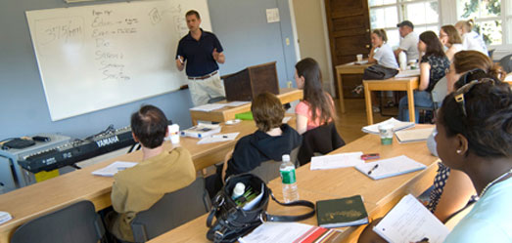
Trainers Team

Slide 7
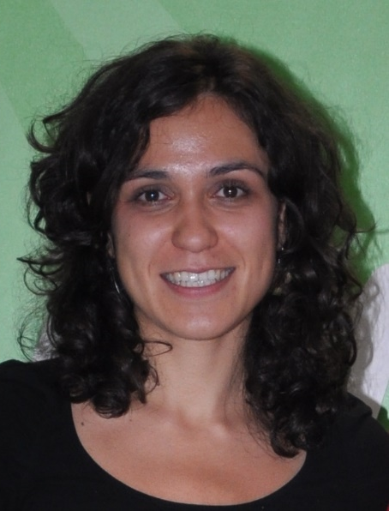
Trainers Team
Asya Georgieva
The main organizer of QA Track 2014
Junior QA Engineer @ Telerik Academy & AppBuilder Team
Experienced in functional testing and interest in Exploratory approach
ISTQB foundation level certified
E-mail: asya.georgieva[at]telerik.com

Slide 8
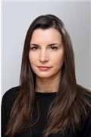
Trainers Team (2)
Snejina Lazarova
Product Manager @ Talent Management System
Over 7 years experience in QA
Experienced in automation, functional, performance and web service testing
ISTQB foundation and advanced level certified
E-mail: snejina.lazarova[at]telerik.com

Slide 9

Trainers Team (3)
Dimo Mitev
QA Architect @ Backend Services Team
9 years QA experience in 4 companies
Experienced in automation, functional and web service testing
ISTQB foundation and advanced level certified
1 publication in Quality Matters magazine
E-mail: dimo.mitev[at]telerik.com

Slide 10
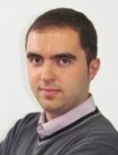
Trainers Team (4)
Angel Tsvetkov
Senior QA Engineer @ DevCloud Core Team
6 years QA experience
Experienced in automotive software testing, web, stand alone and mobile apps testing
E-mail: angel.tsvetkov[at]telerik.com

Slide 11
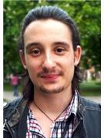
Trainers Team (5)
Anton Angelov
Senior QA Engineer @ Licensing Team
Experienced performance, automation, web service and data base testing
ISTQB foundation and advanced level certified
E-mail: anton.angelov[at]telerik.com

Slide 12
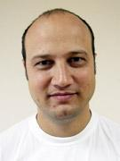
Trainers Team (6)
Daniel Djambov
QA Architect @ DevCloud Testing & Test Studio Quality Assurance Team
15 years QA experience
Experienced quality manager, improving product quality and performance, training and people management
E-mail: daniel.djambov[at]telerik.com

Slide 13
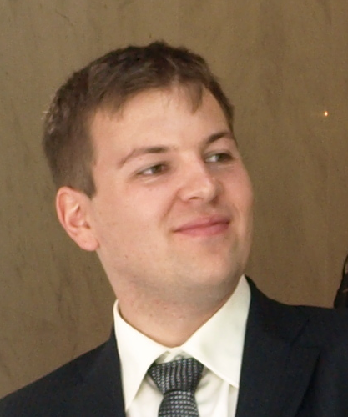
Trainers Team (7)
Dimitar Topuzov
Senior QA Engineer @ Foundation Services Team
Over 8 years experience in QA
Experience in various domains, including
Dev Tools (Telerik WPF and Silverlight Controls)
Test Automation Tools (Borland’s Silk products)
Data warehouse and BI solutions
E-mail: dimitar.topuzov[at]telerik.com

Slide 14

Trainers Team (8)
Iliyan Panchev
Senior QA Engineer@ DevCloud Testing & Test Studio Quality Assurance Team
Experienced in automation, functional and mobile apps testing
E-mail: iliyan.panchev[at]telerik.com

Slide 15
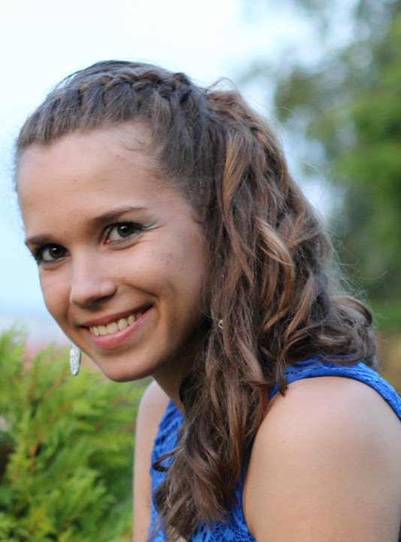
Trainers Team (9)
Joana Ivanova
QA Engineer@ @ ASP .NET AJAX Team
2 years QA experience
Experienced in automation using various tools especially Telerik Testing Framework, functional, security and performance testing
ISTQB foundation level certified
E-mail: joana.ivanova[at]telerik.com

Slide 16
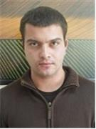
Trainers Team (10)
Mihail Parvanov
Senior QA Engineer, Team Lead @ ASP .NET AJAX Team
7+ years QA experience
Experienced in automation, functional and performance testing
ISTQB foundation level certified
E-mail: mihail.parvanov[at]telerik.com

Slide 17
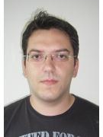
Trainers Team (11)
Miroslav Shtilianov
Senior QA Engineer @ DevCloud Testing & Test Studio Quality Assurance Team
Experienced in automation, functional and mobile apps testing
E-mail: miroslav.shtilianov[at]telerik.com

Slide 18

Trainers Team (12)
Neven Dinev
QA Architect @ AppBuilder Team
Quality manager with experienced in automation, functional and performance testing
E-mail: neven.dinev[at]telerik.com

Slide 19
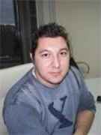
Trainers Team (13)
Nikolay Nedyalkov
QA Architect @ XAML Division
Experienced in Silverlight and WPF automation testing
E-mail: nikolay.nedyalkov[at]telerik.com

Slide 20
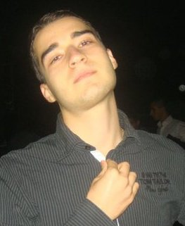
Trainers Team (14)
Nikolay Kostov
Team Lead, Senior Developer and Trainer @ Telerik Academy
Student at Sofia University
Computer Science
IT and Informatics competitions contestant
Graduate from the second season of Telerik Software Academy
Email: nikolay.kostov[at]telerik.com
Blog: http://nikolay.it

Slide 21
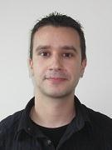
Trainers Team (15)
Petar Horozov
Senior QA Engineer @ XAML Team2
6+ years experience in software testing and QA
Experienced in Silverlight and WPF automation testing
E-mail: petar.horozov[at]telerik.com

Slide 22

Track Curriculum and Exams

Slide 23

Curriculum
Fundamentals of Testing
Fundamental Test Process
Test Levels and Types
Quality Attributes for
Domain Testing
Technical Testing
Software Development Models
Risk and Testing

Slide 24

Curriculum (2)
Test Organization
Test Planning and Estimation
Test Progress Monitoring and Control
Tools for Management of Testing and Tests
Test Automation
Web Testing
Selenium
Selenium WebDriver

Slide 25
Curriculum (3)
Telerik Test Studio
Telerik Testing Framework, BDD & SpecFlow
Test Design Techniques
Deriving Manual & Automated test cases based on
Equivalence Partitioning
Boundary Value Analysis
Intermediate Exam – 6.10

Slide 26
Curriculum (4)
Deriving Automated test cases using WebAii Framework based on
Decision Table Testing
State Transition Testing
Use Case Testing
Pairwise Testing
Classification Trees

Slide 27

Curriculum (5)
Defect Taxonomies, Error Guessing, Checklist Testing and Exploratory Testing
Static Techniques
Mobile testing
Sikuli
Intermediate Exam – 3.11

Slide 28

Curriculum (6)
Performance, Load Testing and Stress Testing
Web Service Testing
Security Vulnerability Testing
Set up QA process
Intermediate Exam – 24.11

Slide 29

Course Schedule

Slide 30

Training Duration
Lectures: ~ 90 hours
Practical exercises: ~ 60 hours
Exams: ~ 20 hours
Homework and Teamwork: ~ 200 hours

Slide 31

Schedule
Time allocation
3 months * 3 days weekly, 4 hours / day
Mondays and Wednesdays from 4 to 8 PM
lectures + work in class with the trainer
Fridays from 3 to 7 PM
work in class
check homework, advanced topics, teamwork and other activities

Slide 32

Assessment
Quality
Assurance
How, What, When?

Slide 33
The Exams
Assessment for the course is based on multiple intermediate exams
There is no comprehensive final exam
Each intermediate exam covers the preceding topics
The final score is cumulative
Exams measure individual performance
Serve as filter for skillful people
Exams are not the only filter!

Slide 34

Homework
Most topics include homework assignments
Homeworks are obligatory
Students who do not fulfill their homeworks fall off the program
Homework assignments are due to in a week after each lecture
Submission will be accepted through the student's system: telerikacademy.com

Slide 35
Homework Peer Reviews
Everyone will get feedback for their homework
Everyone will give feedback for few random homework submissions
Students submit homework anonymously
Please exclude your name from the submissions!
For each homework submitted
Students evaluate 3 random homeworks
From the same topic, after the deadline
Give written feedback, at least 200 characters
Low-quality feedback → report for punishment

Slide 36
Evaluation for onsite participants
Formal Criteria
Criterion | Weight
Exams (*3) | 55%
Team works | 30%
Homework | 10%
Homework evaluation | 5%
Informal Criteria
Forum activity – bonus up to 5%
Attendance – send e-mail notifications
Participation – ask questions, give ideas, express your thoughts

Slide 37

Recommended Resources

Slide 38
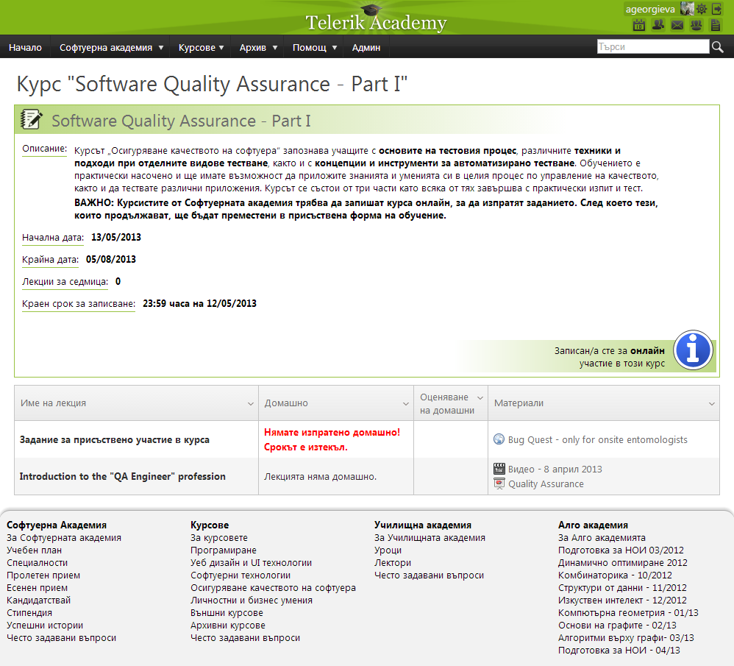
Telerik Integrated Learning System (TILS)
The Telerik Integrated Learning System (TILS)
www.telerikacademy.com
Important resource for all students
Homework submissions
Homework peer reviews
Presence cards with barcode
Reports about your results
https://telerikacademy.com/Courses/Courses/Details/183

Slide 39
Course Web Site & Forums
The QA Track official web site:
Register for the "Telerik Academy Forums":
Discuss the course exercises with your colleagues
Share ideas
http://academy.telerik.com/student-courses/software-technologies/software-quality-assurance/about
http://forums.academy.telerik.com/qa-academy

Slide 40



Use the Same Email!
Please use the same email address in:
http://telerikacademy.com
http://forums.academy.telerik.com
Otherwise your score could be incorrectly calculated!

Slide 41
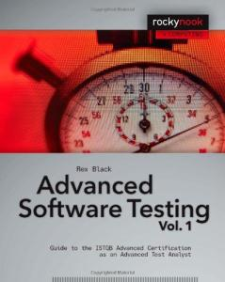

Recommended Books
Advanced Software Testing Vol. 1: Guide to the ISTQB Advanced Certification as an Advanced Test Analyst, Rex Black ISBN: 978-1-933952-19-2
Advanced Software Testing Vol. 2: Guide to the ISTQB Advanced Certification as an Advanced Test Manager, Rex Black ISBN: 978-1-933952-36-9

Slide 42
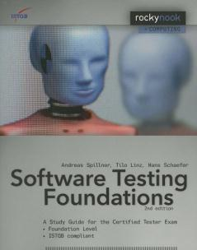
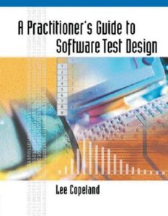
Recommended Books (2)
Software Testing Foundations: A Study Guide for the Certified Tester Exam, Andreas Spillner, Tilo Linz, Hans Schaefer ISBN: 978-1-933952-08-6
A Practitioner's Guide to Software Test Design, Lee Copeland ISBN: 978-1580537919

Slide 43
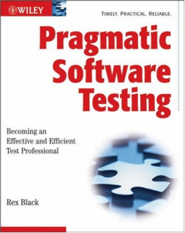
Recommended Books (3)
Pragmatic Software Testing: Becoming an Effective and Efficient Test Professional, Rex Black ISBN: 9780470127902 http://www.wiley.com/WileyCDA/WileyTitle/productCd-0470127902.html

Slide 44

Web Resources
ISTQB (International Software Testing Qualifications Board) syllabus
http://istqb.org/

Slide 45
Software Quality Assurance
?
?
?
?
?
Questions?
?
?
?
?
?
?

Slide 46
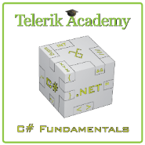



Free Trainings @ Telerik Academy
C# Programming @ Telerik Academy
csharpfundamentals.telerik.com
Telerik Software Academy
academy.telerik.com
Telerik Academy @ Facebook
facebook.com/TelerikAcademy
Telerik Software Academy Forums
forums.academy.telerik.com

