Slide 1


Test Design Techniques
Introduction
Software Quality Assurance
Telerik Software Academy
http://academy.telerik.com
Notes:
M

Slide 2


The Lectors
Joana Ivanova QA Engineer ASP .NET AJAX Team
Mihail Parvanov Senior QA Engineer, Team Lead ASP .NET AJAX Team

Slide 3

Table of Contents
The Test Development Process
Categories of Test Design Techniques
Static Techniques
Reviews
Static Analysis
Dynamic Techniques
Specification-based (Black-box) Techniques
White-box techniques
Choosing Test Techniques

Slide 4

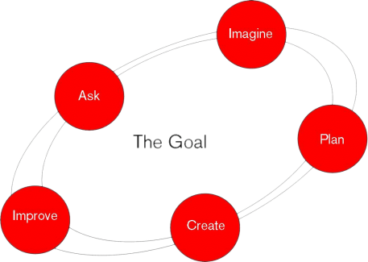
The Test Development Process
Some Basic Concepts

Slide 5
Overview
Test development process represents a sequence of events for developing a test that varies for different programs.
However, most of the tests follow these general procedures:
Determine the purpose of testing
Build test specification
Create test items
Review the test items
Evaluate the quality of the items

Slide 6
Terminology
Test Condition – an item or event that could be verified by one or more test cases
Test Case – developed to cover a certain test objective(s) or test condition(s). Consists of:
Input values
Execution preconditions
Expected results
Execution postconditions
Test Procedure Specification – Specifies the sequence of actions for the execution of a test

Slide 7
Terminology (1)
Test script – the sequence of actions when tests are run using a test execution tool
Test execution schedule – consists of various test procedures and automated test scripts
Defines the order in which tests are executed
Takes into account factors like:
Regression tests
Prioritization
Technical and logical dependencies

Slide 8
Test Bases vs. Test Oracle
The term test oracle is similar and related but not the same as the test basis
The test oracle is anything we can use to determine expected results
Which we can compare with the actual results of the component or system under test
Anything that can serve as a test basis can also be a test oracle
An oracle can also be an existing system or someone's specialized knowledge

Slide 9
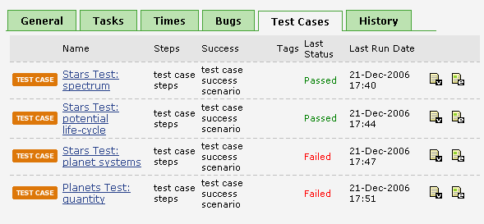
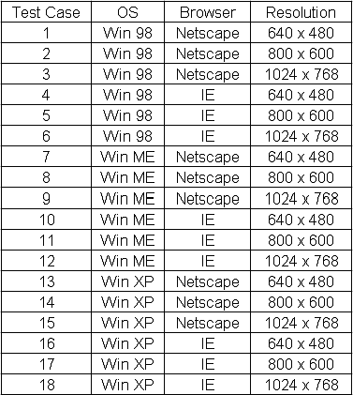
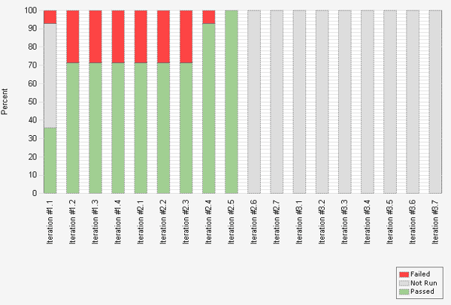
Test Case Examples
Quick Demo

Slide 10
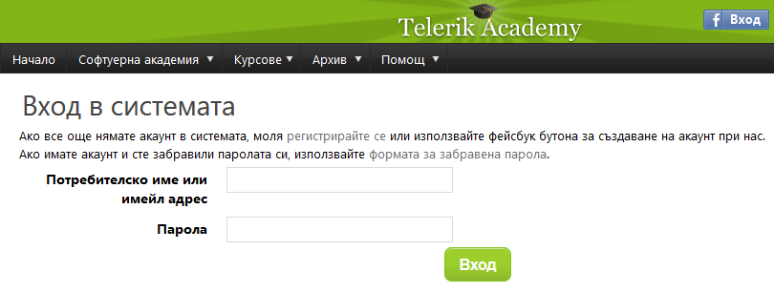
Test Case Example
Login/Logout test case
Test Step | Description | Expected Result | Pass/Fail
Step 1 | Login using a valid Username/Password | The user is logged successfully. | Pass
Step 2 | Press the Logout button. | The user is logged out. | Pass
Step 3 | Login using a valid Username and invalid Password. | The user is not logged in. A warning message is displayed. | Pass
Step 4 | Login using a valid Password and invalid Username. | The user is not logged in. A warning message is displayed. | Pass

Slide 11

Categories of Test Design Techniques

Slide 12
Testing Techniques Chart
Testing
Static
Dynamic
Dynamic analysis
Review
Static Analysis
Black-box
White-box
Experience-based
Defect-based
Functional
Non-functional

Slide 13


Static vs. Dynamic Tests
Static tests
Do not involve running (executing) the test object
Dynamic tests
Involve running (executing) the test object

Slide 14

Static Techniques
Testing Without Executing the Program

Slide 15
Testing Techniques Chart
Testing
Static
Dynamic
Dynamic analysis
Review
Static Analysis
Black-box
White-box
Experience-based
Defect-based
Functional
Non-functional

Slide 16
Static Techniques
Static tests are usually considered as divided into two parts:
Reviews
Any method where the human being is the primary defect finder and scrutinizer of the item under test
Static analysis
Relies on a tool as the primary defect finder and scrutinizer

Slide 17
Testing Techniques Chart
Testing
Static
Dynamic
Dynamic analysis
Review
Static Analysis
Black-box
White-box
Experience-based
Defect-based
Functional
Non-functional

Slide 18
What is Review?
An evaluation of a product or project status to ascertain discrepancies from planned results and to recommend improvements
Reviews usually precede dynamic tests. Because the cost of a defect increases as that defect remains in the system, reviews should happen as soon as possible. However, because not all defects are easy to find in reviews, dynamic tests should still occur

Slide 19
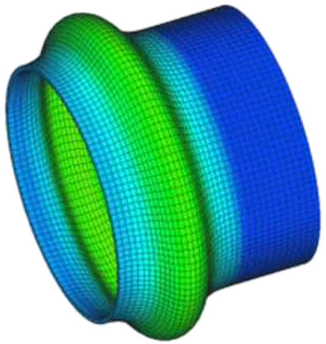
Static Analysis

Slide 20
Testing Techniques Chart
Testing
Static
Dynamic
Dynamic analysis
Review
Static Analysis
Black-box
White-box
Experience-based
Defect-based
Functional
Non-functional

Slide 21

What is Static Analysis?
Analyzing software artifacts in order to gain information about the software
Source code
Binaries
Configuration files
Analyzing software “at rest”
Performed by an automated tool

Slide 22


Dynamic Techniques

Slide 23
Testing Techniques Chart
Testing
Static
Dynamic
Dynamic analysis
Review
Static Analysis
Black-box
White-box
Experience-based
Defect-based
Functional
Non-functional

Slide 24
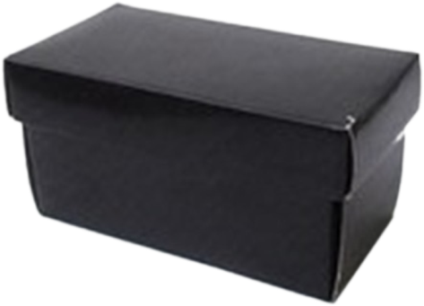

Specification-based (Black-box) Techniques
Tests Blind for The Code

Slide 25
Testing Techniques Chart
Testing
Static
Dynamic
Dynamic analysis
Review
Static Analysis
Black-box
White-box
Experience-based
Defect-based
Functional
Non-functional

Slide 26
Black-box Techniques
Black-box techniques are a way to derive and select test conditions, test cases, or test data
Based on an analysis of the test basis documentation
Also called specification-based or behavioral techniques
Tests are based on the way the system is supposed to work

Slide 27

Blind for the Code
Black-box Techniques (1)
Black-box testing does not use any information regarding the internal structure of the component or system to be tested
The code of the tested object is not considered
Sometimes it is not accessible

Slide 28
Black-box Techniques (2)
Black-box techniques are divided into two main subtypes
Functional
What the system does?
(e.g. Unit, Sanity, Integration, Regression)
Non functional
How the system does what it does?
(e.g. Load, Performance, Stress, Security, Installation, Recovery)

Slide 29

Black-box Techniques (3)
Equivalence Partitioning
Boundary Value Analysis
Use Case Testing
Decision Table Testing
State Transition Testing
Pairwise Testing
Classification Trees Testing

Slide 30

White-box techniques

Slide 31
White-box techniques
White-box techniques are a way to derive test cases based on analysis of the code if it works as expected
Design test cases that
Exercise independent paths within a module or unit
Exercise logical decision //both true and false side
Execute loops at their boundaries
Exercise internal data structures
Also called structural or glass box testing

Slide 32
White-box techniques (1)
White-box testing uses the internal structure of the component or system
The code of the tested object is considered
Testing can be commenced at an earlier stage. It’s applicable to:
Unit testing
Integration testing
System testing

Slide 33

Choosing Test Techniques

Slide 34
Choosing Test Techniques
Some techniques are more applicable to certain situations and test levels
Others are applicable to all test levels
Combination of test techniques
Testers usually use a combination of test techniques
Process, rule and data-driven techniques
Ensures adequate coverage of the object under test

Slide 35
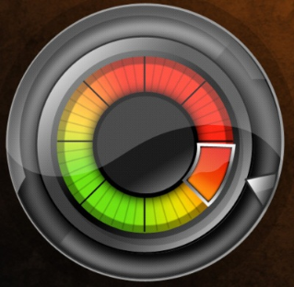
Factors for Choosing Test Techniques
The choice of test techniques to be used depends on a number of factors:
Type of the system
Regulatory standards
Customer or contractual requirements
Level of risk
Type of risk
Test objective

Slide 36

Factors for Choosing Test Techniques (1)
The choice of test techniques to be used depends on a number of factors:
Documentation available
Knowledge of the testers
Time and budget
Development lifecycle
Use case models
Previous experience with types of defects found

Slide 37
Test Design Techniques - Introduction
?
?
?
?
?
Questions?
?
?
?
?
?
?

