Slide 1


Boundary Value Analysis
Testing on the Edge
Software Quality Assurance
Telerik Software Academy
http://academy.telerik.com

Slide 2


The Lectors
Joana Ivanova QA Engineer ASP .NET AJAX Team
Mihail Parvanov Senior QA Engineer, Team Lead ASP .NET AJAX Team

Slide 3

Table of Contents
Boundary Value Analysis – Main Concepts
Boundary Values and Conditions
Ordered Sets
How many Boundary Values?
BVA With Floating Point Data
Examples of Boundary Conditions
Deriving Test Cases With BVA

Slide 4


What is BVA?
Boundary value analysis (BVA) is a black-box test design technique in which test cases are designed based on boundary values
Conceptually, boundary value analysis is about testing the edges of equivalence classes

Slide 5
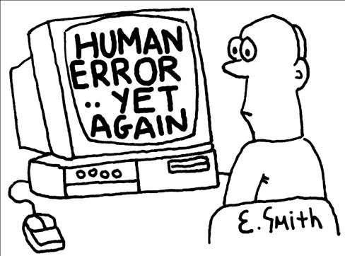
Why Test the Boundaries?
If an operation is performed on a range of numbers:
Odds are the programmer got it right for the vast majority of the numbers in the middle,
But maybe made a mistake at the edges

Slide 6
Common Mistake Example
This is an example of a simple, but very common mistake:
Many bugs occur due to careless usage of indexes, operators ( for example < instead of <= ), etc.
int[] arr = new int[10];
for(i = 1; i < 10; i++)
{
arr[i] = 1;
}
Console.WriteLine(arr[0]); // 0
The value at index [0] is not changed to 1.

Slide 7

Why Should This Work?
If a software can operate on the edge of its capabilities, it will almost certainly operate well under normal conditions

Slide 8
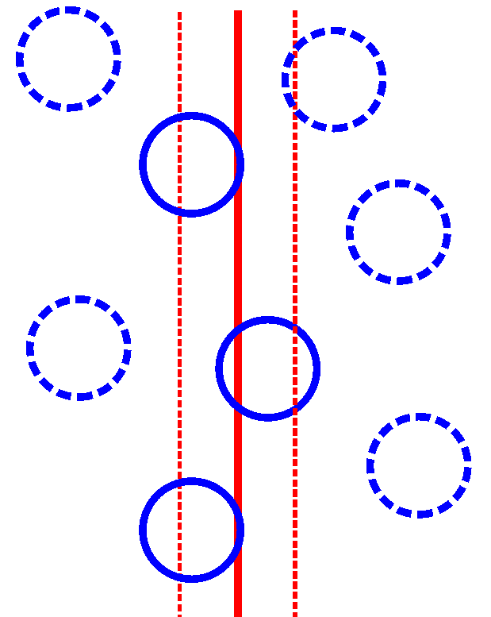

What is a Boundary Value?
An input value or output value that is on the edge of an equivalence partition
Or at the smallest incremental distance on either side of an edge
E.g., the minimum or maximum value of a range

Slide 9

What is a Boundary Value? (1)
The point where the expected behavior of the system changes
The values could be either input or output ranges of a software component

Slide 10


Valid / Invalid Values
If the boundary values are members of a valid equivalence class, they are valid
If they are members of an invalid equivalence class, they are invalid
invalid
valid
invalid
1
31
…-2-1 0
2 3 4 ….
…28 29 30
32 33 …
Days of a month

Slide 11

Boundary Conditions
Boundary conditions are the situations at the edge of the planned operational limits of the software
Types of data with boundary conditions:
Numeric
Character
Position
Quantity
Speed
Location
Size
Etc.

Slide 12

Ordered Sets Only
An ordered set is one where we can say that one member is greater than or less than some other member
If those two members are not the same

Slide 13

Ordered Sets Only (1)
Not all equivalence classes have boundary values!
Boundary value analysis is an extension of equivalence partitioning
Applies only when the members of an equivalence class are ordered

Slide 14
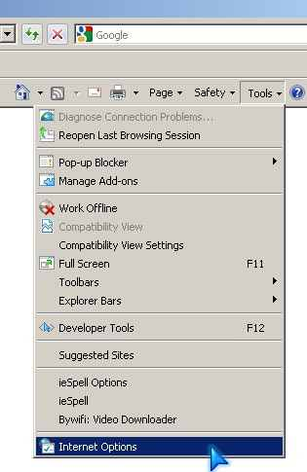
Ordered Sets Only (2)
Just because some item is right above or below some other item on a pull-down menu does not mean that, within the program, the two items have a greater-than/less-than relationship

Slide 15

Ordered Sets Examples
Ranges of numbers
How many times something is done
Size of a number to enter (number of digits)
Size of a character string
Size of a file
Size of a file name
Amount of available memory
Speed of data entry (time between keystrokes, menus, etc.)
Etc.

Slide 16

How Many Boundary Values Exist At A Boundary?

Slide 17
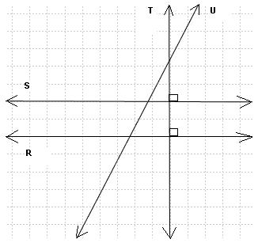
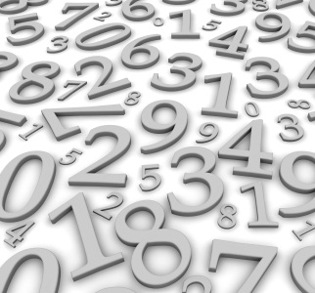
Number Of Boundary Values
How many boundary values should be considered at the edge of a partition?
There are two main approaches
The difference mainly occurs due to difference in the way the data is being presented: graphical or mathematical

Slide 18
Graphical Representation
Graphical representation
The boundary lies between the largest member of one equivalence class and the smallest member of the equivalence class above it
The boundary itself doesn't correspond to any member of any class and
Only two boundary values are considered at each edge of a partition class
invalid
valid
invalid
0
1
x
99
100

Slide 19
Mathematical Representation
The mathematical analysis sets three values at each edge:
The value corresponding to the boundary itself;
The closest value inside the partition;
The closest value outside the partition.
0 < = x < = 100
-1
1
99
101
0
100

Slide 20
Boundary Values With Floating Point Data
Be careful when you set boundary values for floating point data!
Floating point numbers, like integers, are also ordered sets. However, while integers do not have decimal points, floating point numbers do
0.0000001
0
0
-0.0000001

Slide 21
Boundary Values With Floating Point Data (1)
How many decimal points? That is a question of the particular field's precision
This is sometimes referred to as epsilon or the smallest recognizable difference
We can't figure out what the boundary values are without knowing the answer to this question
Problems with precision, and particularly ambiguity about it, are fertile ground for bugs

Slide 22

Examples Of Boundary Conditions

Slide 23
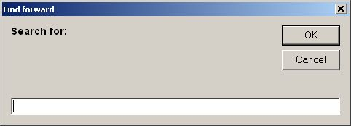
Text Entry Field
If a text entry field allows 1 to 255 characters:
Try entering 1 character and 255 characters as the valid partition
You might also try 2 and 254 characters as a valid choice
Enter 0 and 256 characters as the invalid partitions

Slide 24

CD-R Writing / Reading
If a program reads and writes to a CD-R:
Try saving a file that's very small, maybe with one entry
Save a file that's very large just at the limit for what the disc holds
Try saving an empty file and a file that's too large to fit on the disc

Slide 25

Printing
If a program allows you to print multiple pages onto a single page:
Try printing just one (the standard case)
Try printing the most pages that it allows
If you can, try printing zero pages and one more than it allows

Slide 26

Flight Simulator
If you're testing a flight simulator - try flying:
Right at ground level
At the maximum allowed height for your plane
Below ground level
below sea level
Into outer space

Slide 27
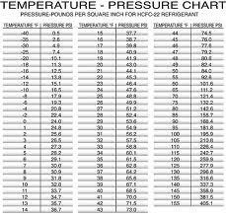
Output BVA
Testing boundary conditions of an output data
Adjust the input to produce particular output results
E.g., assume that a temperature vs. pressure table is required as output from a program
Test cases should be designed to create an output report that produces the maximum (and minimum) allowable number of table entries

Slide 28

Deriving Test Cases With BVA

Slide 29

Deriving Test Cases With BVA
Deriving test cases with BVA
Similar to deriving tests with equivalence partitioning
We test valid boundary values together
Then combine one invalid boundary value with other valid boundary values

Slide 30


The Coverage Criterion
Each boundary value must be represented in at least one test case
Both – valid and invalid test cases

Slide 31

Types of Improper Handling
Deriving test cases we are testing for situations where some equivalence class is handled improperly
Improper hanlding could mean:
Acceptance of values that should be rejected
Rejection of values that should be accepted
Proper acceptance or rejection, but improper handling subsequently

Slide 32
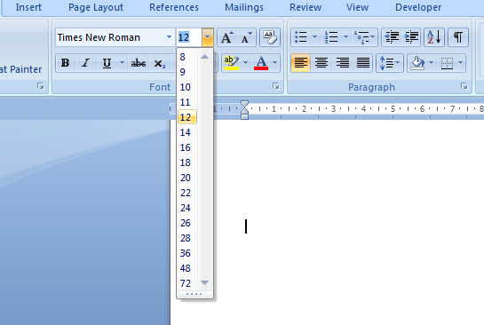
MS Word Font Size Menu
Live Demo

Slide 33
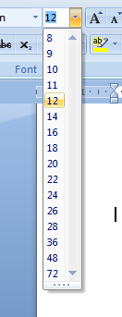
Font Size Menu BVA
Applying Equivalence Partitioning and BVA:
Invalid (low)
Invalid (high)
Menu entry
BVA
Valid
8
72
EP
Not integer
EP
{ letters, decimal, null .. }
Direct entry
EP
Integer
BVA
Invalid (neg.)
Invalid (high)
Valid
min
-1
0
1
1638
1639
max

Slide 34

Limitations of BVA
Boolean and logical variables present a problem for Boundary Value Analysis
BVA assumes the variables to be truly independent
This is not always possible
BVA test cases have been found to be rudimentary
Obtained with very little insight and imagination

Slide 35

Keep Looking
It's vitally important that you continually look for boundaries in every piece of software you work with
The more you look, the more boundaries you'll discover, and the more bugs you'll find
Usually there are a few obvious ones
If you dig deeper you'll find the more obscure, interesting, and often bug-prone boundaries

Slide 36
Boundary Value Analysis
?
?
?
?
?
Questions?
?
?
?
?
?
?

Slide 37
Exercises
Why does the boundary value analysis provide good test cases?
Because it is an industry standard
Because errors are frequently made during programming of the different cases near the ‘edges’ of the range of values
Because only equivalence classes that are equal from a functional point of view are considered in the test cases
Because the test object is tested under maximal load up to its performance limits

Slide 38
Exercises (2)
Boundary value testing:
Is the same as equivalence partitioning tests
Test boundary conditions on, below and above the edges of input and output equivalence classes
Tests combinations of input circumstances
Is used in white box testing strategy

Slide 39
Exercises (3)
In a flight reservation system, the number of available seats in each plane model is an input. A plane may have any positive number of available seats, up to the given capacity of the plane. Using Boundary Value analysis, a list of available – seat values were generated. Which of the following lists is correct?
1, 2, capacity -1, capacity, capacity plus 1
0, 1, capacity, capacity plus 1
0, 1, 2, capacity plus 1, a very large number
0, 1, 10, 100, capacity, capacity plus one

Slide 40
Exercises (4)
A thermometer measures temperature in whole degrees only. If the temperature falls below 18 degrees, the heating is switched on. It is switched off again when the temperature reaches 21 degrees. What are the best values in degrees to cover all equivalence partitions?

Slide 41
Exercises (5)
A wholesaler sells printer cartridges. The minimum order quantity is 5. There is a 20% discount for orders of 100 or more printer cartridges. You have been asked to prepare test cases using various values for the number of printer cartridges ordered. Generate test inputs using Boundary Values Analysis.

Slide 42
Exercises (6)
An input field takes data on a person age, which should be between 1 to 99. Which are the appropriate boundary values for testing the field?
An input field takes the year of birth between 1900 and 2011. Which are the appropriate boundary values for testing the field?

Slide 43
Exercises (7)
In a system designed to work out the tax to be paid: An employee has $4000 of salary tax free. The next $1500 is taxed at 10% The next $28000 is taxed at 22% Any further amount is taxed at 40%. Define the boundary values for testing the system.

Slide 44
Exercises (8)
Implement BVA for the following examples:
Text entry field with allowed limits from 1 to 100 symbols
Integer number entry field with value limit from 0 to 150
Number entry field of type float with limits from 0.0 to 10.0
Size of a file name from 1 up to 40 symbols

Slide 45
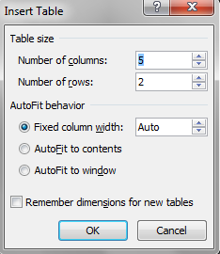
Exercises (9)
Implement BVA for the MS Word Insert Table dialog box. Look for information about the minimum and maximum values allowed.

Slide 46
Exercises (10)
Define the boundaries, and suitable boundary value test cases for the following:
ZIP Code - five numeric digits
First consider ZIP Code just in terms of digits. Then, determine the lowest and highest legitimate ZIP Codes in the United States
Last Name - one through fifteen characters (including alphabetic characters, periods, hyphens, apostrophes, spaces, and numbers). Try to create a few very complex Last Names. Can you determine the "rules" for legitimate Last Names?

Slide 47
Exercises (11)
User ID - eight characters at least two of which are not alphabetic (numeric, special, nonprinting)
University Course ID - three alpha characters representing the department followed by a six-digit integer which is the unique course identification number. The possible departments are:
PHY - Physics
EGR - Engineering
ENG - English
LAN - Foreign languages
CHM - Chemistry
MAT - Mathematics
PED - Physical education
SOC - Sociology

