Slide 1

Equivalence Partitioning
Testing by Splitting Data Into Equivalence Classes
Software Quality Assurance
Telerik Software Academy
http://academy.telerik.com

Slide 2


The Lectors
Joana Ivanova QA Engineer ASP .NET AJAX Team
Mihail Parvanov Senior QA Engineer, Team Lead ASP .NET AJAX Team

Slide 3

Table of Contents
Equivalence Partitioning – Basic Principles
Equivalence Partitioning Examples
Some Useful Hints
Deriving Test Cases With Equivalence Partitioning
The Coverage Criteria
Avoiding Equivalence Partitioning Errors

Slide 4
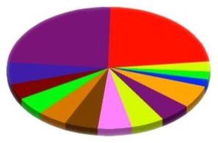


Equivalence Partitioning
Basic Principles

Slide 5

What is Equivalence Partitioning?
Equivalence partitioning:
A basic black-box test design technique
in which test cases are designed to execute representatives from equivalence partitions

Slide 6

What is Equivalence Partitioning? (1)
Equivalence partitioning is about testing various groups that we expect the system to handle the same way
Exhibiting similar behavior for every single member of an equivalence partition
Test cases are designed to cover each partition at least once

Slide 7

Why Equivalence Partitioning?
Equivalence partitioning aims reducing the total number of test cases to a feasible count
Excessive testing of all possible input / output values (or conditions) is usually impossible

Slide 8

Input / Output Domains
The input / output domain (also called set of interest) is the total set of data, subject to equivalence partitioning
A domain can be formed of:
Input field
Output field
Test precondition or postcondition
Configuration

Slide 9
Equivalent Classes
Equivalent classes (partitions) are portions of an input or output domain
The behavior of a component or system is assumed to be the same for every member of a partition class, based on the specification
A
b
23
M
4
8
9
t
C
j
56
w
2

Slide 10

Splitting Domains Into Partitions
The operation of equivalence partitioning is performed by splitting a set (domain) into two or more disjoint sets
All the members of each subset share some trait in common
This trait is not shared with the members of the other subsets

Slide 11
Visualizing Equivalence Partitioning
Subset A
Set
Equivalence partitioning
Subset B
Choosing a member of each partition

Slide 12
Subpartitioning
Equivalence partitioning can be iteratively applied to subsets
We no longer have to choose members from parent sets
Subset A 1
Subset A
EP
Subset A 2
Set
EP
Subset A 3
Subset B

Slide 13
A Simple Example
In a simple drawing program that can fill figures in with red, green, or blue, you can split the set of fill colors into three disjoint sets:
red
Fill colors
Equivalence partitioning
green
blue

Slide 14

Valid vs. Invalid Classes
Valid equivalence classes
Describe valid situations
The system should handle them normally
Invalid equivalence classes
Describe invalid situations
The system should reject them
Or at least escalate to the user for correction or exception handling

Slide 15
Using The Requirements Specification
Requirements specifications can be very useful for equivalence partitioning
For input domains (e.g., an input field)
We can refer to the specification to understand how the system should handle each subset
For output domains
The specification can be useful for deriving inputs that should cause the specific output to occur

Slide 16
Types of Improper Handling
There are two common ways an equivalence class can be handled improperly:
A value is accepted when it should have been rejected (or vice versa)
A value is properly accepted or rejected but handled in a way appropriate to another equivalence class
(Not the class to which it actually belongs)

Slide 17

Equivalence Partitioning Examples
Source: http://glitter-graphics-scraps-gifs.blogspot.com

Slide 18
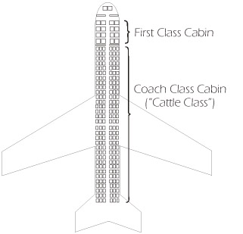
EP for Airplane Seats – Example
Imagine a program for assigning passenger seats in an airplane:
If the only meaningful factor is the class of seats – then there will be two partitions:
First Class
Coach Class

Slide 19
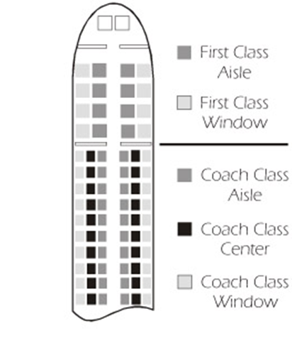
EP for Airplane Seats – Example
In real life people also have preferences where the sit is in a row: aisle, middle or window
That causes dividing the partitions to subpartitions:
First Class Aisle
First Class Window
Coach Aisle
Coach Window
Coach Middle

Slide 20

EP for a Bonus Calculation Program – Example
Let's take another example:
A program calculates Christmas bonuses for employees depending on the affiliation to the company:
More than 3 years = 50% bonus
More than 5 years = 80% bonus
More than 8 years = 100% bonus

Slide 21
EP for a Bonus Calculation Program – Example (1)
Distributing valid equivalence classes:
Parameter | Equivalence classes | Representative values | Expected results
Duration of employment in years (x) | 0 <= x <= 3 | 2 | 0%
 | 3 < x <= 5 | 4 | 50%
 | 5 < x <= 8 | 7 | 80%
 | X > 8 | 12 | 100%

Slide 22
EP for a Bonus Calculation Program – Example (2)
Distributing invalid equivalence classes:
Parameter | Equivalence classes | Representative values | Expected results
Duration of employment in years (x) | x < 0 | -6 | rejected
 | 0 <= x <= 3 | 2 | 0%
 | 3 < x <= 5 | 4 | 50%
 | 5 < x <= 8 | 7 | 80%
 | x > 8 | 12 | 100%
 | x > 70 | 72 | rejected
 | NaN | abc | rejected
 | blanc field |  | rejected

Slide 23

Some Useful Hints
For Deriving Test Cases With EP

Slide 24
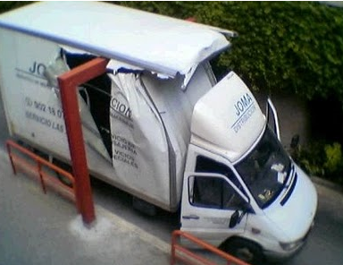

Some Hints for Deriving Equivalence Classes
Identify the restrictions and conditions for inputs and outputs according to the specification

Slide 25
Some Hints for Deriving Equivalence Classes (1)
For every restriction or condition, partition into equivalence classes:
Continuous numerical domains
Create one valid and two invalid equivalence classes
Number of values to be entered
Create one valid (with all possible correct values)
Create two invalid equivalence classes (less and more than the correct number)

Slide 26
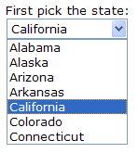
Some Hints for Deriving Equivalence Classes (2)
For every restriction or condition, partition into equivalence classes:
Set of values – each one treated differently
Create one valid equivalence class for each value of the set (containing exactly this one value)
Create one additional invalid equivalence class (containing all possible other values)

Slide 27

Some Hints for Deriving Equivalence Classes (3)
For every restriction or condition, partition into equivalence classes:
Condition that must be fulfilled
Create one valid and one invalid to test the condition fulfilled and not fulfilled

Slide 28

Can Something Go Wrong?
If the tester chooses the right partitions, the testing will be accurate and efficient
If the tester mistakenly thinks of two partitions as equivalent and they are not
A test situation will be missed
If the tester thinks two objects are different and they are not,
The tests will be redundant

Slide 29

Are You Sure That's All?
If there is any doubt that the values of one equivalence class might not be treated equally
The equivalence class should be further divided into subclasses

Slide 30

Deriving Test Cases With Equivalence Partitioning

Slide 31
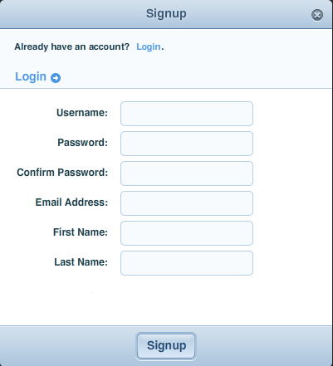
Deriving Tests With Equivalence Partitioning
Deriving tests we are usually working with more than one set of equivalence classes at one time
E.g., one GUI screen usually has multiple input / output fields
Each input / output field on a screen has its own set of valid and invalid equivalence classes

Slide 32

Deriving Tests With Equivalence Partitioning (1)
Equivalence partitioning ends with at least two equivalence classes for each domain
One valid and one invalid
Therefore at least two representative values must be used as test input for each parameter

Slide 33


Rules for Test Case Determination

Slide 34

Creating Valid Tests
Valid test cases are formed by selecting one valid member from each equivalence partition
This process is continued until each valid partition for each input/output domain is represented in at least one valid test

Slide 35
Creating Invalid Tests
For each invalid test case we select:
One member of an invalid partition
Members of valid partitions for every other domain
Multiple invalids should not be combined in a single test
The presence of one invalid value might mask the incorrect handling of another invalid value

Slide 36
Combining Invalid Values
Sometimes after testing invalid values separately – a combination of them seems required
If the risk presented is sufficient – this can be performed
Be cautious - combinatorial testing can easily lead to spending a lot of time testing things that aren't terribly important

Slide 37
Restriction of the Number of Test Cases
The number of "valid" test cases is the product of the number of valid equivalence classes per parameter
Even a few parameters can generate hundreds of "valid test cases"
Using that many test cases is hardly possible
More rules are necessary to reduce the number of "valid" test cases

Slide 38
EP Test Case Example
If you are testing for an input box accepting numbers from 1 to 1000 then there is no use in writing thousand test cases for all 1000 valid input numbers plus other test cases for invalid data. Test cases can be divided into three equivalence classes of some valid and invalid inputs:
One input data class with all valid inputs. Pick a single value from range 1 to 1000
Input data class with all values below lower limit
Input data with any value greater than 1000

Slide 39



The Coverage Criteria
Defining the Level of Test Completion

Slide 40

The Coverage Criteria
Deriving test cases follows the basic coverage criteria:
Every class member, both valid and invalid, must be represented in at least one test case

Slide 41
Test Comprehensiveness
Degree of coverage defines test comprehensiveness
The more thoroughly a test object is planned to be tested, the higher the intended coverage
Before test execution,
The predefined coverage serves as a criterion for deciding when the testing is sufficient
After test execution
It serves as verification if the required test intensity has been reached

Slide 42




Avoiding Equivalence Partitioning Errors

Slide 43
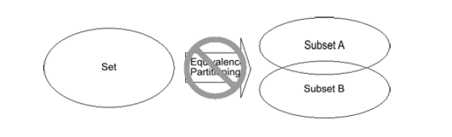
Equivalence Partitions Must Be Disjoint
No two of the subsets can have one or more members in common
Repeating members

Slide 44
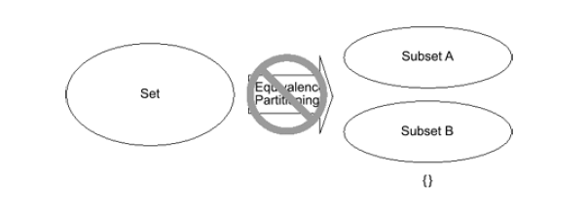
Equivalence Partitions May Not Be Empty
Subsets with no members are not useful for testing
Empty set

Slide 45
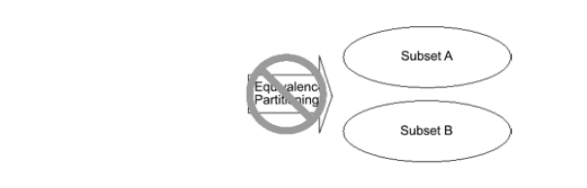

Divide, Do Not Subtract
Equivalence partitioning process does not subtract - it divides
The union of the subsets produced by equivalence partitioning must be the same as the original set
No "spare" subsets should be generated

Slide 46
Equivalence Partitioning
?
?
?
?
?
Questions?
?
?
?
?
?
?

Slide 47
Exercises
What is an equivalence partition (also known as an equivalence class)?
A set of test cases for testing classes of objects
An input or output range of values such that only one value in the range becomes a test case
An input or output range of values such that each value in the range becomes a test case
An input or output range of values such that every tenth value in the range becomes a test case

Slide 48
Exercises (2)
Equivalence partitioning is:
A black box testing technique used only by developers
A black box testing technique than can only be used during system testing
A black box testing technique appropriate to all levels of testing
A white box testing technique appropriate for component testing

Slide 49
Exercises (3)
Equivalence partitioning consists of various activities:
Ensure that test cases test each input and output equivalence class at least once
Identify all inputs and all outputs
Identify equivalence classes for each input
All of the above

Slide 50
Exercises (4)
A switch is switched on once the temperature falls below 18 degrees and then it is turned off when the temperature is more than 21. Identify the equivalence values for testing the switch.
In an examination a candidate has to score minimum of 24 marks in order to clear the exam. The maximum that he can score is 40 marks. Identify the Valid equivalence values if the student clears the exam.

Slide 51
Exercises (5)
One of the fields on a form contains a text box which accepts numeric values in the range of 18 to 25. Define the equivalence classes.
In a system designed to work out the tax to be paid: An employee has £4000 of salary tax free. The next £1500 is taxed at 10%. The next £28000 is taxed at 22%. Any further amount is taxed at 40%. Define the equivalence classes.

Slide 52
Exercises (6)
A program validates a numeric field as follows: Values less than 10 are rejected, values between 10 and 21 are accepted, values greater than or equal to 22 are rejected. Define the equivalence classes.

Slide 53
Exercises (7)
Define the equivalence classes and suitable test cases for the following:
ZIP Code—five numeric digits
State—the standard Post Office two-character abbreviation for the states, districts, territories, etc. of the United States
Last Name—one through fifteen characters (including alphabetic characters, periods, hyphens, apostrophes, spaces, and numbers)

Slide 54
Exercises (8)
Define the equivalence classes and suitable test cases for the following:
ZIP User ID—eight characters at least two of which are not alphabetic (numeric, special, nonprinting)
Student ID—eight characters. The first two represent the student's home campus while the last six are a unique six-digit number. Valid home campus abbreviations are: AN, Annandale; LC, Las Cruces; RW, Riverside West; SM, San Mateo; TA, Talbot; WE, Weber; and WN, Wenatchee

Slide 55
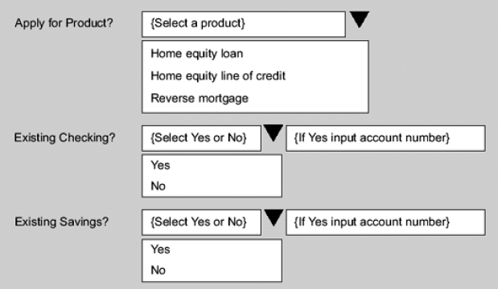
Exercises (9)
A screen prototype for a bank loan system is given:
Continues …

Slide 56
Exercises (10)
The screen asks for three pieces of information:
The product being applied for, which is one of the following:
Home equity loan
Home equity line of credit
Reverse mortgage
Whether someone has an existing checking account, which is either Yes or No
Whether someone has an existing savings account, which is either Yes or No
Continues …

Slide 57
Exercises (11)
If the user indicates an existing account, then the user must enter the corresponding account number . This number is validated against the bank's central database upon entry. If the user indicates no such account, the user must leave the corresponding account number field blank.
If the fields are valid, including the account number fields, then the screen will be accepted. If one or more fields are invalid, an error message is displayed.
Continues …

Slide 58
Exercises (12)
The exercise consists of two parts:
Show the equivalence partitions for each of the three pieces of information, indicating valid and invalid members.
Create test cases to cover these partitions, keeping in mind the rules about combinations of valid and invalid members.

