Slide 1


Sikuli
Software Quality Assurance
Telerik Software Academy
http://academy.telerik.com

Slide 2

The Lector
Neven Dinev QA Architect AppBuilder Team

Slide 3
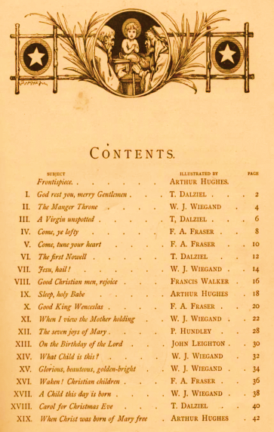


Table of Contents
What is Capture/Replay tool
Issues to solve
Introducing Sikuli
The Structure of Test Folder
Platform Independence
What we need
How Sikuli Works
Using Sikuli IDE

Slide 4

Table of Contents (1)
Advantages
Limitation
Using Advanced Sikuli Functions
Main parts of Automation Test
Testing Framework
UI Test Framework Architecture
HTMLTestRunner
Reading results

Slide 5

What is Capture/Replay tool
The test developer interacts with an application under test, typically through the graphical user interface (GUI), while some capture tool simultaneously generates an automated test script
Tests are difficult to maintenance as the application changes
ex. screens will get added, buttons will get removed, column names will get modified

Slide 6
Issues to solve
GUIs are difficult to test directly in code
Need of a reliable consistent regression test execution approach
Need of easy-to-read test execution results
Too many repeatable test steps
No suitable tools for specific applications (e.g. mobile app simulators)
Notes:
Different ways to locate elements

Slide 7

Introducing Sikuli
Images driven – it is a visual technology to search and automate GUI using images
Intuitive open-source visual scripting tool
Scripts are written in Jython
Jython is an implementation of the high-level, dynamic, object-oriented language Python seamlessly integrated with the Java platform

Slide 8


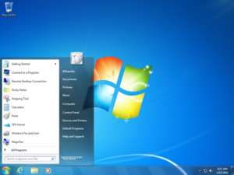
Sikuli Script
Sikuli Script is a Jython and Java library that automates GUI interaction using image patterns to direct keyboard/mouse events

Slide 9

The Structure of Test Folder
Sikuli source/executable script directory (.sikuli)
Python source file (.py)
Images files (.png)
While saving a script using Sikuli IDE, an HTML file is created

Slide 10
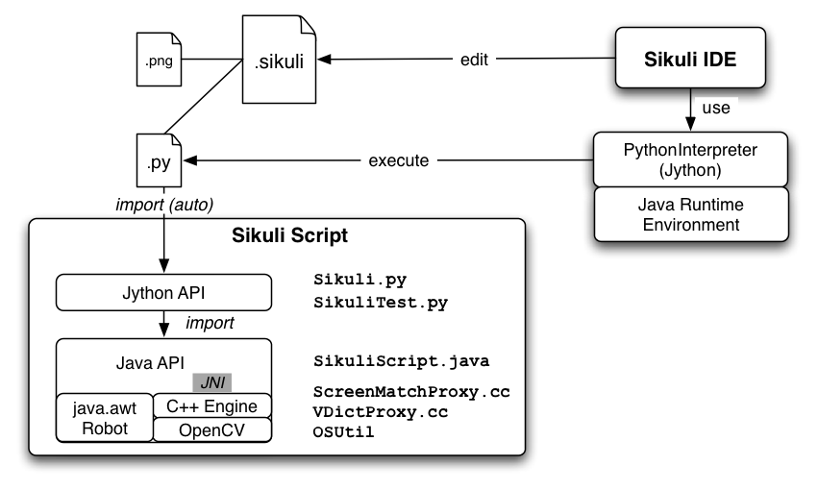
System Design

Slide 11



Platform Independence
Works on any GUI can be displayed on Windows/Linux/Mac
Virtual machines
Remote desktop
Mobile simulators: Android, iPhone
Web: Flash, HTML + Javascript

Slide 12


What we need
Prerequisites for the lecture
Windows OS
Sun Java 7 JRE 32-bit version
Download and install Sikuli
site: http://www.sikuli.org/download.html

Slide 13
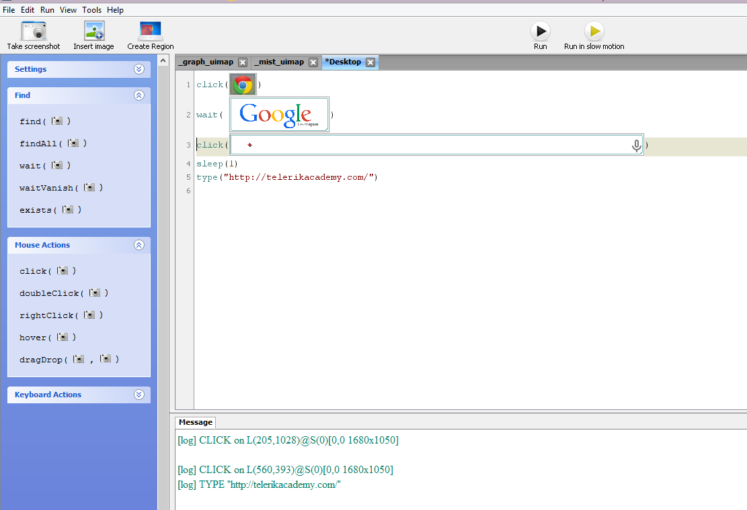
How Sikuli Works
Combination of GUI & Traditional coding
Jython coding that can use images as parameters and variables
Screen Capture utilized for image selection instead of object IDs
Can upload image files

Slide 14
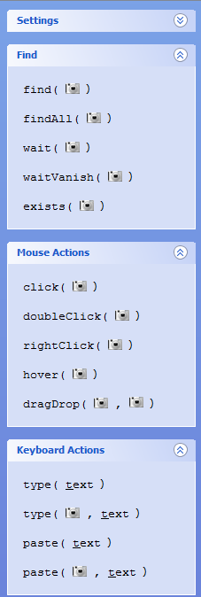
Using Sikuli IDE
Basic Sikuli functions
IDE Command List –
exists, find, findAll, wait, click, doubleClick, dragDrop, type
switchApp("App Name")

Slide 15
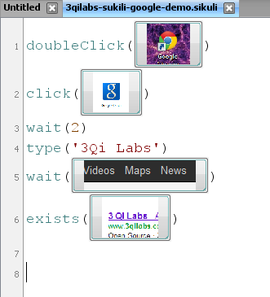
Using Sikuli IDE (2)
Editor for writing Sikuli scripts in Jython

Slide 16
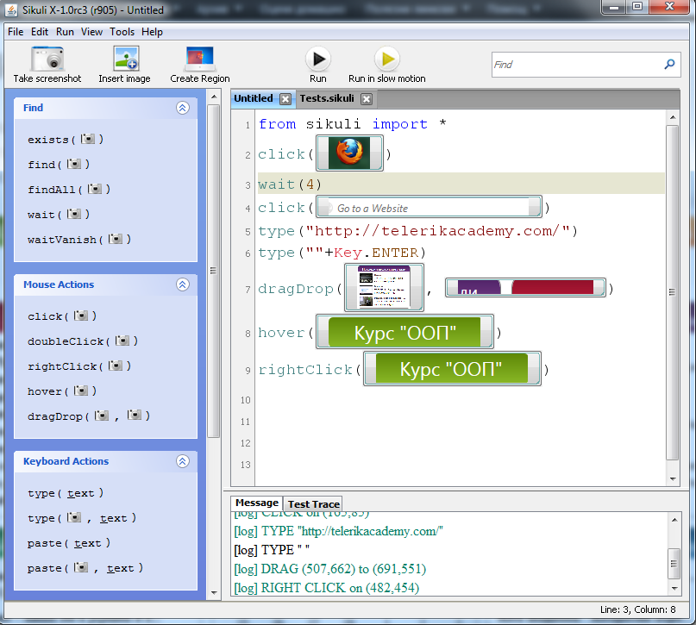
Using Sikuli IDE (3)
The buttons activate the screenshot mode

Slide 17
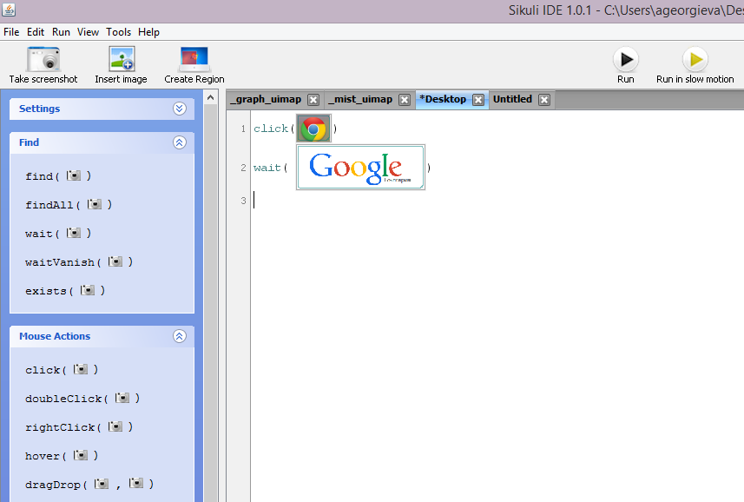
Sikuli IDE
Demo

Slide 18

Advantages
Allow programmer to make visual references instead of using names or keywords
More intuitive and natural approach
Can be used to test hybrid applications – Web, Desktop

Slide 19

Limitation
Sikuli Script operates only in the visible screen space and thus is not applicable to invisible GUI elements
Changes in OS or application themes will affect UI elements

Slide 20
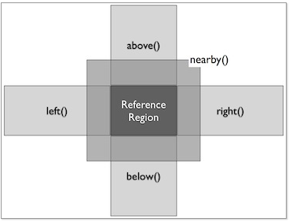
Using Advanced Sikuli Functions
Regions – a rectangular area: Region(x, y, w, h)
Finding Regions:
windowRegion = App.focusedWindow()
buttonRegion = find()
Acting with Regions
region.highlight, click, type, find, etc..
Extending Regions
region.offset(x,y)

Slide 21
Using Advanced Sikuli Functions (2)
Screen – creates a new screen object, that represents the default/primary monitor
Screen([id]), getNumberScreens(), capture(x, y, w, h)
Location – handle single points on the screen directly by its position (x, y)
Location(x, y), setLocation(x, y)
Match – represents the result of a successful find operation
getScore(), getTarget()
Notes:
See: http://doc.sikuli.org/

Slide 22
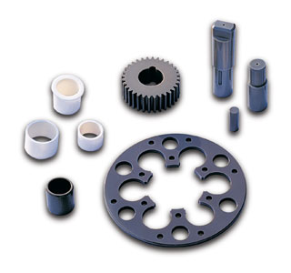
Main parts of Automation Test
Preconditions (set up)
Actions
Click, type, drag and drop
Synchronization points – wait
Verifications & Results
Postconditions (tear down)

Slide 23
Workshop I
Using Sikuli IDE create a script that:
Navigates to https://platform.telerik.com/ (assuming you are logged in)
Create a workspace
Confirm the workspace is created

Slide 24

How do you imagine a test framework?

Slide 25

Testing Framework Definition
Automation testing framework is an overall system in which tests are:
Created
Executed
Analyzed
Maintained

Slide 26

Lets start…
Runing tests from console
Using unit test library
Test case structure

Slide 27

UI Test Framework Architecture
UI Map
Function library
Test cases/Test set
Others: mail notification, video logs, Jenkins

Slide 28
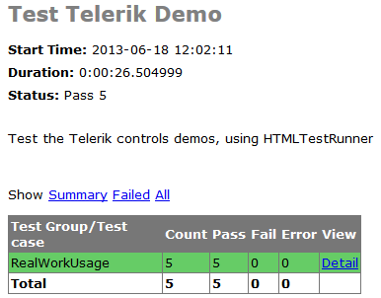
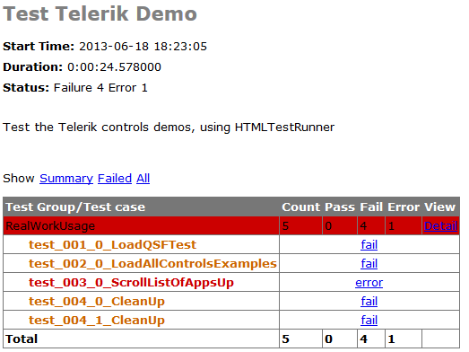
HTMLTestRunner
HTMLTestRunner is an extension to the Python standard library's unittest module
It generates easy to use HTML test reports

Slide 29

Automation Testing
Framework
Demo

Slide 30
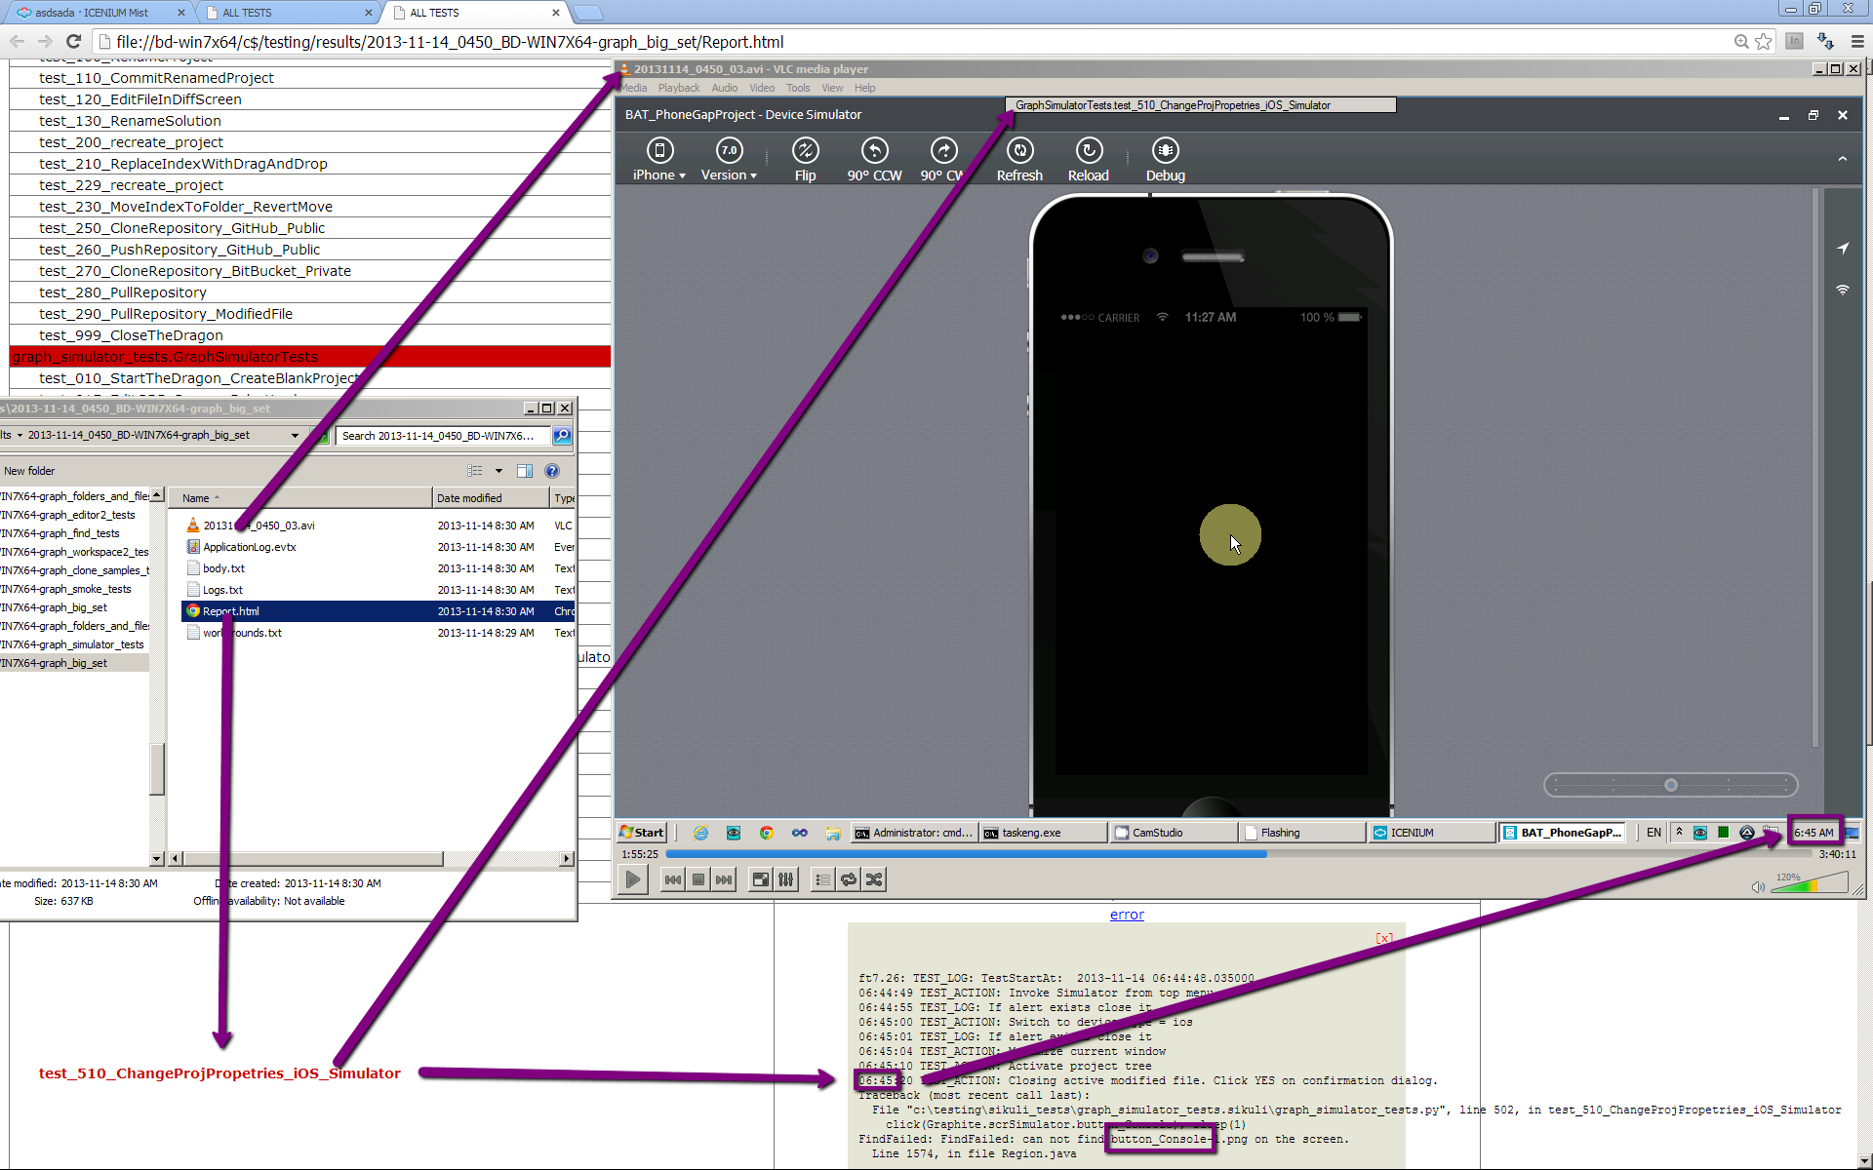
Reading results

Slide 31
Workshop II
Using base framework create a test set that:
Navigates to https://platform.telerik.com/ (assume login is cached)
Create a workspace (you may consider using unique name)
Create an AppBuilder Hybrid project
Bonus exercises
Add New Html file
Do a build

Slide 32
Useful Resources
Sikuli Official site: http://www.sikuli.org/
Sikuli documentation: http://doc.sikuli.org/
Sikuli script help: http://doc.sikuli.org/sikuli-script-index.html
HTMLTestRunner page: http://tungwaiyip.info/software/HTMLTestRunner.html

Slide 33
Sikuli
?
?
?
?
?
Questions?
?
?
?
?
?
?

Slide 34
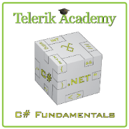



Free Trainings @ Telerik Academy
C# Programming @ Telerik Academy
csharpfundamentals.telerik.com
Telerik Software Academy
academy.telerik.com
Telerik Academy @ Facebook
facebook.com/TelerikAcademy
Telerik Software Academy Forums
forums.academy.telerik.com

