Slide 1
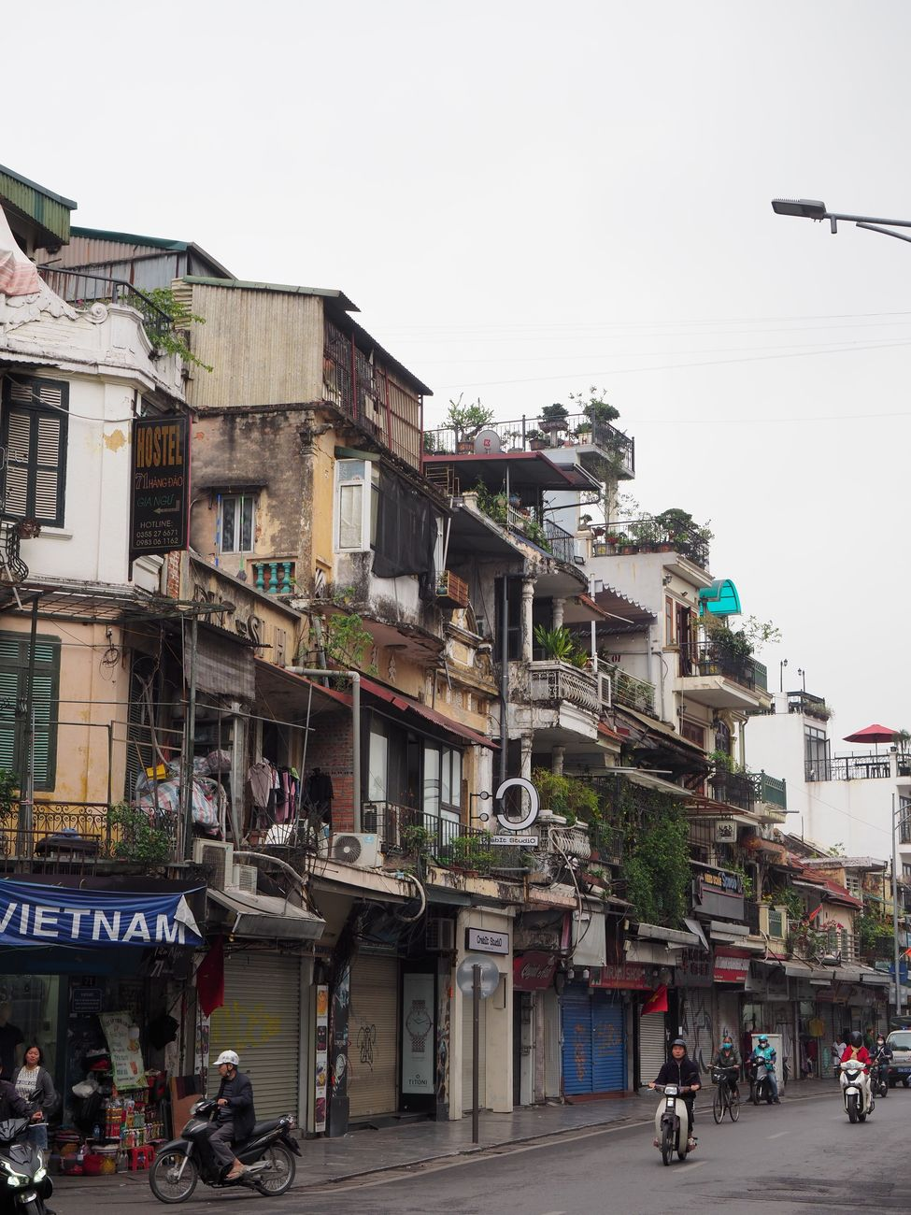
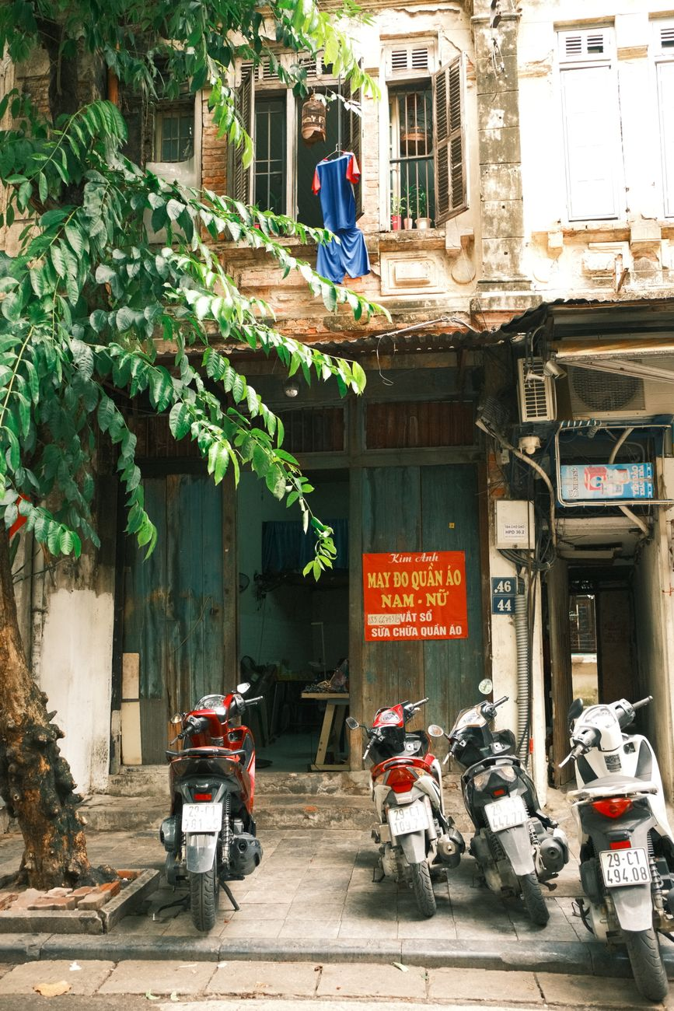
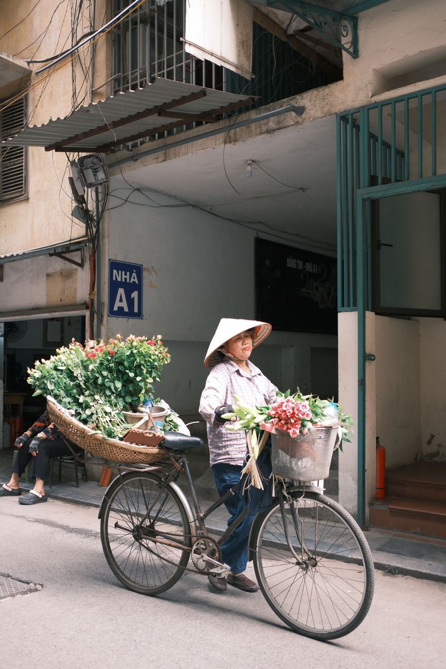
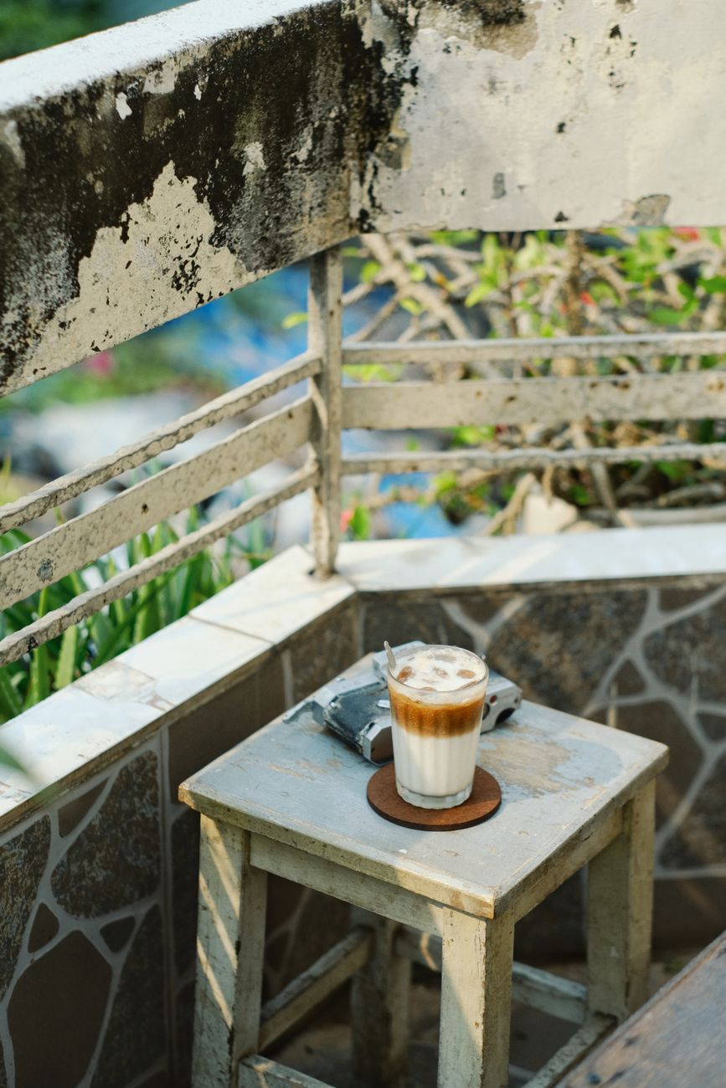
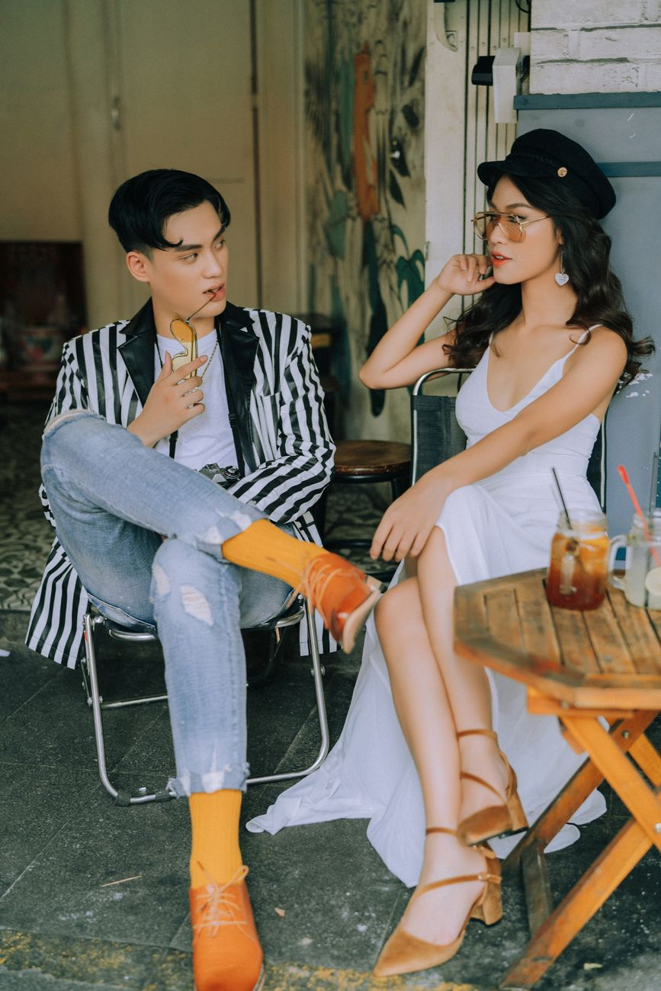
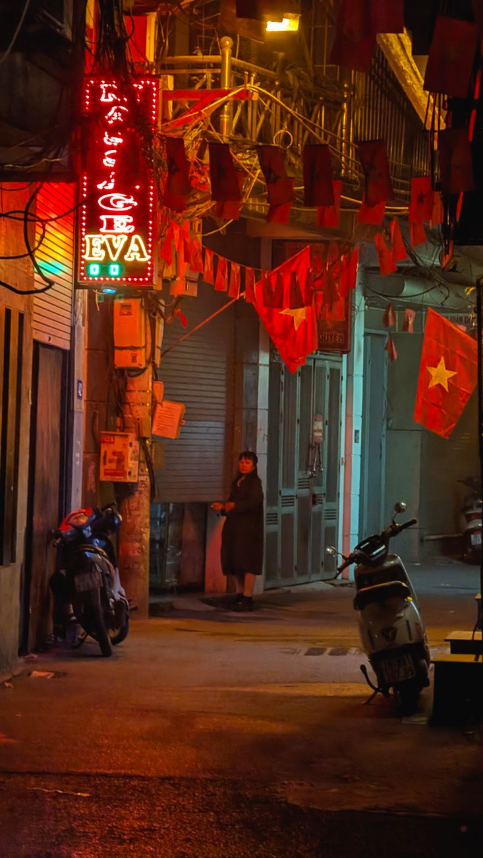
TRAVELFRAME.VN
Your Complete Hanoi Guide
A thoughtful photo and film walk for solo travelers, couples, creators, and small groups who want Hanoi to feel personal.
You arrive beneath faded balconies as motorbikes thread through the Old Quarter. Nothing asks you to rush. A first walk, a camera at your side, and Hanoi begins to feel less like a map than a sequence of small invitations.
DM @travelframe.vn to plan your Hanoi story.
01 / 10
Notes:
Pexels photo 38782292: Dilara Baran (https://www.pexels.com/photo/street-view-of-hanoi-s-historic-old-quarter-38782292/)
Pexels photo 34195917: Thuan Pham (https://www.pexels.com/photo/quaint-hanoi-street-scene-with-motorbikes-34195917/)
Pexels photo 34152682: Thuan Pham (https://www.pexels.com/photo/street-vendor-with-bicycle-selling-flowers-in-hanoi-34152682/)
Pexels photo 15857872: tu nguyen (https://www.pexels.com/photo/coffee-on-chair-near-wall-15857872/)
Pexels photo 1444635: Tizino Academy (https://www.pexels.com/photo/man-sitting-on-folding-chair-beside-woman-sitting-near-table-1444635/)
Pexels photo 36742743: Tripatpal Singh (https://www.pexels.com/photo/nighttime-alley-scene-in-hanoi-vietnam-36742743/)

Slide 2
MEET YOUR HANOI FRIEND
A Walk Shaped Around You
TravelFrame pairs a relaxed local-host experience with natural photo and video support. Solo women are especially welcome, along with couples, creators, and small groups. You set the pace; we help make room for the details you care about.
You notice narrow pavements, open doorways, and motorbikes pausing between turns. Curiosity is enough to begin: share what catches your eye, then let a local friend shape a walk around the details you want to keep.
02 / 10
Notes:
Pexels photo 34195917: Thuan Pham (https://www.pexels.com/photo/quaint-hanoi-street-scene-with-motorbikes-34195917/)

Slide 3
PICK YOUR EXPERIENCE
Choose Your Hanoi Pace
Each experience leaves room to walk, look around, and make the day your own. Delivery timing is confirmed in your written booking confirmation.
Quick Photo Walk
Signature Story Tour
Premium Full-Day
Walking tour
Walking tour
Private full-day experience
WHAT YOU RECEIVE
WHAT YOU RECEIVE
WHAT YOU RECEIVE
10 edited photos
25 edited photos
35 edited photos
One 30-45 second vertical Reel
One 60-90 second short film
GUEST-PAID SEPARATELY
Food
Five selected raw clips
Drinks
GUEST-PAID SEPARATELY
Food
Entrance tickets
Drinks
INCLUDED
Private car
Entrance tickets
Water
One meal per confirmed itinerary
Food, drinks, and entrance tickets are paid separately.
Food, drinks, and entrance tickets are paid separately.
The confirmed itinerary sets the included meal and route.
DM @travelframe.vn to plan your Hanoi story.
03 / 10
Notes:
Pexels photo 34195917: Thuan Pham (https://www.pexels.com/photo/quaint-hanoi-street-scene-with-motorbikes-34195917/)

Slide 4
CHOOSE YOUR HANOI MOOD
Two Moods, One Route
Choose up to two moods and share your priorities. TravelFrame proposes a route around them, then you can swap one or two stops before confirmation. Routes respond to the street and the day, so we do not promise a particular vendor, street activity, Train Street access, or light.
Heritage Hanoi
Old balconies, layered streets, temple edges, and quiet architectural texture.
A basket of flowers leans against a bicycle while the street keeps moving. Your route can connect two moods, not one fixed version of Hanoi, so the places that catch your attention have room to belong together.
Everyday Hanoi
Local cafes, markets, everyday movement, and the small details between destinations.
Hanoi in Style
French Quarter lines, polished portraits, and architecture with a calmer frame.
Hanoi After Dark
Night streets, neon, evening energy, and space for a more cinematic Reel.
04 / 10
Notes:
Pexels photo 34152682: Thuan Pham (https://www.pexels.com/photo/street-vendor-with-bicycle-selling-flowers-in-hanoi-34152682/)

Slide 5
BEFORE YOUR TOUR
Bring What Helps You Feel Free
Keep preparation simple. Comfort and a little battery power go a long way when you are walking and noticing more.
Wear an outfit that feels like you and works for the weather.
Choose comfortable shoes for walking.
Bring a small bag for essentials.
Arrive with a charged phone and a power bank.
Check the weather before you leave.
Confirm the meeting point before the tour.
A cup of coffee waits beside a quiet chair, giving the day a softer rhythm. Before you head out, a few small preparations leave more space for looking around, noticing the street, and taking the day as it comes.
05 / 10
Notes:
Pexels photo 15857872: tu nguyen (https://www.pexels.com/photo/coffee-on-chair-near-wall-15857872/)

Slide 6
ON THE DAY
Easy Guidance, Real Breathing Room
You will meet your local friend, confirm the mood for the day, and ease into the route. Expect gentle posing guidance, a look at sample photos, and time to ask for a different angle or a slower pace.
01
Meet your local friend.
02
Confirm your chosen mood and priorities.
03
Receive gentle posing guidance.
04
Review sample photos together.
05
Take a food or coffee pause if you would like one.
A pause is optional. Food and coffee purchases are paid separately unless they are confirmed in your package itinerary.
A cafe table and folding chairs face the street; a small pause becomes part of the picture. With gentle direction and time to settle in, you can be present in Hanoi rather than only passing through it.
06 / 10
Notes:
Pexels photo 1444635: Tizino Academy (https://www.pexels.com/photo/man-sitting-on-folding-chair-beside-woman-sitting-near-table-1444635/)

Slide 7
CALM PRACTICAL NOTES
Stay Safe & Know the Price
A few calm habits can make everyday transactions and moving around feel clearer.
Paying cash
Train Street
Say the denomination, keep the note visible, and count your change.
Follow barriers, posted restrictions, and railway or security instructions.
Unsolicited shoe repair
Changing money
If you did not ask for it, say “No, thank you” and keep moving.
Prepare small VND notes. At a reputable shop where you are already buying something, politely ask if they can break a 500,000 VND note; they may decline. Exchange foreign cash only at a licensed bank or an authorized exchange counter.
Fruit or photo props
Agree the full price before accepting fruit or photo props.
Getting a ride
Book through Grab or via a verified Mai Linh channel such as the official app or 1055. Match the vehicle and driver before you get in.
Fresh coconut
Ask the price before opening; accept only after you agree.
Indicative prices - checked 6 Sep 2026
Street phở: 40,000-65,000 VND (about USD 1.54-2.50)
Short central-Hanoi GrabBike: 20,000-30,000 VND (about USD 0.77-1.15)
Check the app before booking. Prices vary by location, distance, time, weather and demand.
USD estimates use a rounded planning rate of 1 USD ≈ 26,000 VND, based on Vietcombank's 5 Sep 2026 reference table.
07 / 10
Notes:
Safety, transport and street interactions (checked 2026-09-06): https://www.gov.uk/foreign-travel-advice/vietnam/safety-and-security ; https://www.grab.com/vn/en/transport/bike/ ; https://asiatravellinksdmc.com/travel-guide/hanoi-scams-safety-tips
Train Street (checked 2026-09-06): https://vietnamnet.vn/en/hanoi-s-train-street-keep-it-for-tourism-or-shut-it-down-2381323.html
Exchange and rate references (checked 2026-09-06): https://sbv.hanoi.gov.vn/xem-tat-ca/-/view_content/6660026-nhung-dieu-can-biet-trong-giao-dich-mua-ban-ngoai-te-tien-mat-phong-ngua-ngoai-te-gia.html ; https://www.vietcombank.com.vn/en/Personal/Cong-cu-Tien-ich/Ty-gia
Indicative price references (checked 2026-09-06): https://www.vietnamairlines.com/us/en/plan-book/travel/travel-guide/pho-hanoi ; https://vietnamnet.vn/en/pho-for-vnd30-000-fades-away-as-street-food-prices-climb-in-hanoi-2437708.html ; https://daytripsvietnam.com/guides/vietnam-grab-prices-2026/
All rate and price claims on this slide are indicative planning information only; check the live app fare and current permitted exchange rate before use.

Slide 8
YOUR PHOTOS & FILM
A Simple Delivery Process
Your agreed photos and film follow the package you book. Delivery timing is confirmed only in your written booking confirmation.
01
YOUR BOOKING
Your written booking confirmation records the selected deliverables.
02
GALLERY LINK
Your gallery link is shared through the contact used for your booking. Tell us before the tour how you feel about social sharing; the agreed use is recorded in writing.
03
ONE SMALL REVISION
After delivery, you may send one small revision request with clear notes. We will review what can be adjusted within the agreed deliverables.
08 / 10
Notes:
Pexels photo 1444635: Tizino Academy (https://www.pexels.com/photo/man-sitting-on-folding-chair-beside-woman-sitting-near-table-1444635/)

Slide 9
QUICK FAQ + USEFUL VIETNAMESE
A Few Things You May Want to Know
Keep these phrases close for a small confidence boost while you explore.
FAQ
USEFUL VIETNAMESE
Can I join solo?
Xin chào
Yes. The experience is designed to feel comfortable whether you come alone or with others.
sin chow
Hello
Are couples, creators, and small groups welcome?
Cảm ơn
Yes. Share what you want from the day so the route and pacing can suit your group.
gahm uhn
Thank you
Can I choose more than one mood?
Không, cảm ơn
Choose up to two moods, then review the proposed route before confirmation.
khong, gahm uhn
No, thank you
What should I bring?
Bao nhiêu tiền?
Comfortable shoes, a small bag, a charged phone, and a power bank are a good start.
bao nyew tyen?
How much?
Can we pause for food or coffee?
Tôi đã đặt Grab
Yes, a pause is optional. Purchases are paid separately unless confirmed in your package itinerary.
toy dah dat Grab
I have booked a Grab
How is delivery timing confirmed?
Giúp tôi với
It is confirmed in your written booking confirmation.
zoop toy voy
Please help me
09 / 10
Notes:
Pexels photo 15857872: tu nguyen (https://www.pexels.com/photo/coffee-on-chair-near-wall-15857872/)

Slide 10
READY WHEN YOU ARE
Ready for Your Hanoi Story?
Send the details below and we can begin with a route that feels considered, practical, and yours.
DM @travelframe.vn to plan your Hanoi story.
SEND THESE DETAILS
Preferred date
Number of guests
Package
One or two moods
Hotel or area
Photo, video, or special occasion
Neon gathers along a narrow alley after dark, and the last frames hold a different kind of quiet. Later, when the city is no longer outside your window, those colors can bring back the feeling of being there.
Pexels photos: Dilara Baran; Thuan Pham; tu nguyen; Tizino Academy; Tripatpal Singh.
10 / 10
Notes:
Pexels photo 38782292: Dilara Baran (https://www.pexels.com/photo/street-view-of-hanoi-s-historic-old-quarter-38782292/)
Pexels photo 34195917: Thuan Pham (https://www.pexels.com/photo/quaint-hanoi-street-scene-with-motorbikes-34195917/)
Pexels photo 34152682: Thuan Pham (https://www.pexels.com/photo/street-vendor-with-bicycle-selling-flowers-in-hanoi-34152682/)
Pexels photo 15857872: tu nguyen (https://www.pexels.com/photo/coffee-on-chair-near-wall-15857872/)
Pexels photo 1444635: Tizino Academy (https://www.pexels.com/photo/man-sitting-on-folding-chair-beside-woman-sitting-near-table-1444635/)
Pexels photo 36742743: Tripatpal Singh (https://www.pexels.com/photo/nighttime-alley-scene-in-hanoi-vietnam-36742743/)

