Slide 1
Classification and Clustering Analysis on 'vowel' Data Set
Stats 780 Project Presentation
Yusang Hu
400177333

Slide 2
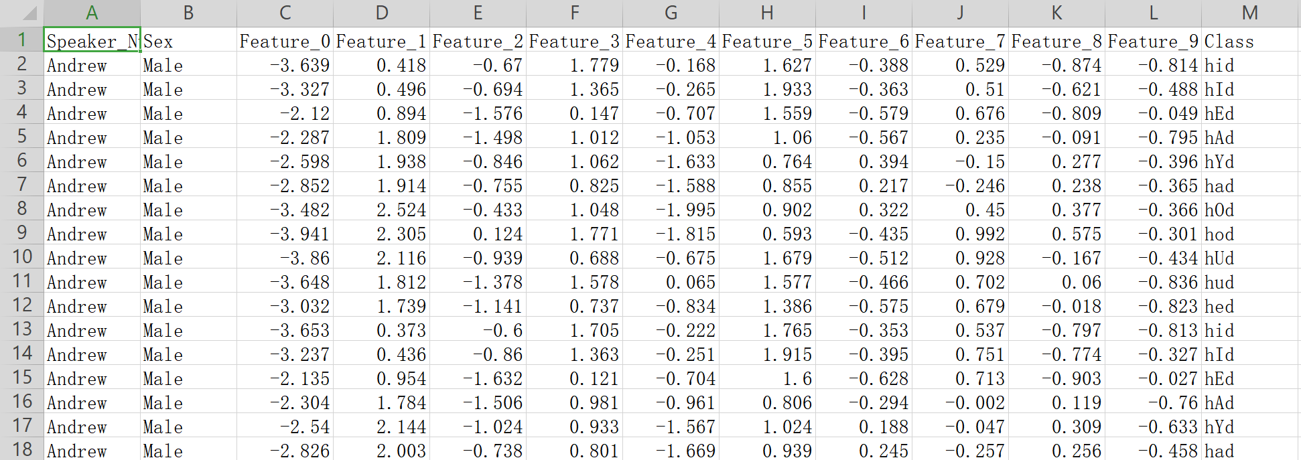
'vowel' Data Set
It is a data set consists of the steady-state portion of 11 vowels in British English
'a', 'A', 'e', 'E', 'i', 'I', 'o', 'O', 'u', 'U', 'Y'
15 individual speakers, each saying each vowel 6 times, in the context of 'h*d'
i.e. had, hAd, hed, hEd, etc..
contains 11 classes (i.e. vowels), and 990 utterances in total, each row represents one utterance.
for each utterance, there are 10 floating-point input values.
i.e. Feature_0, Feature_1, etc..

Slide 3
Problem
Assume labels are known, we want to predict which vowel does an utterance belongs to based on each utterance's 10 floating point input value.
Classification
Assume labels are unknown, we want to group 990 utterances into several clusters based on each utterance's 10 floating point input value.
Clustering

Slide 4
Classification
split the data set into two parts:
75% training set, 25% test set
multinomial logistic regression
classification tree, bagging, random forest, boosting
mixture discriminant analysis

Slide 5
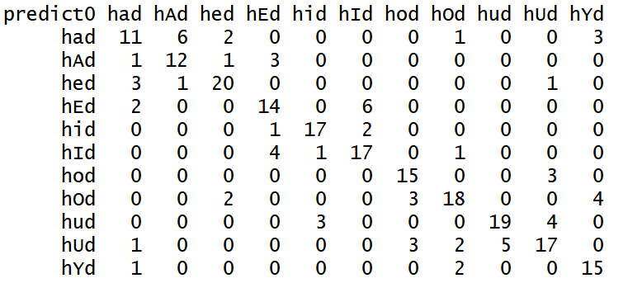

Classification
Multinomial Logistic Regression
fit multinomial logistic regression on the training set
use the result of regression to predict on the test set
Conclusion:
misclassification rate is high, ARI is low -> multinomial logistic regression is not a good method to classify our data set
improve model to avoid bad results

Slide 6
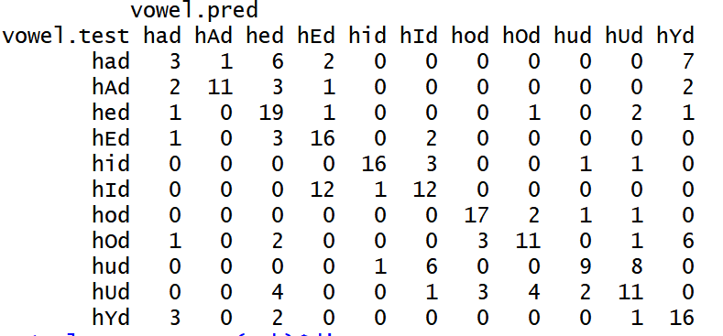
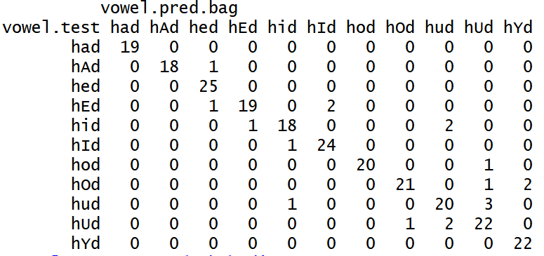
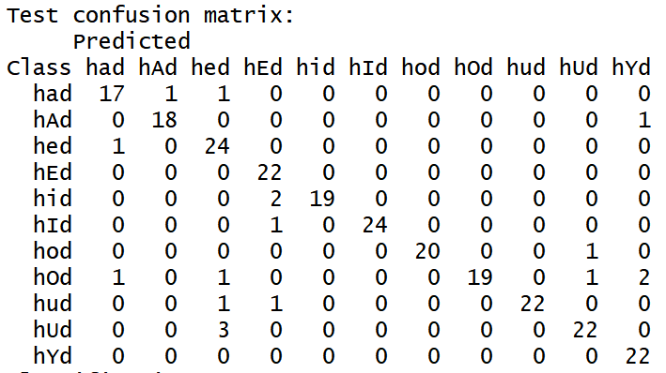


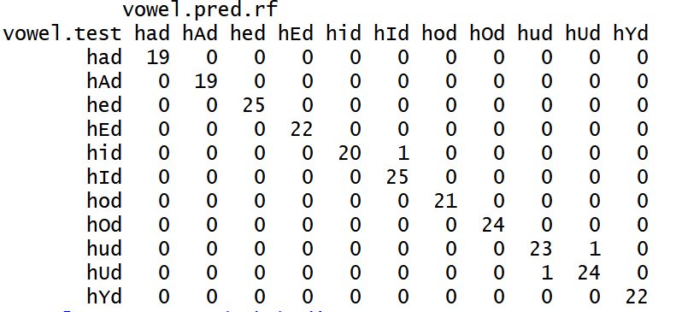
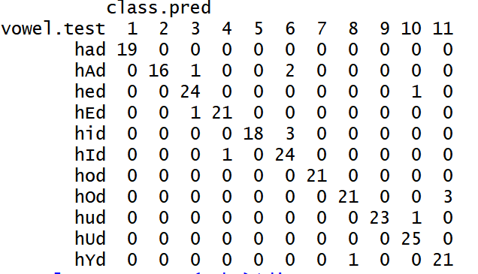



Classification
Classification tree
bagging (mtry=10)
mixture discriminant analysis
random forest (mtry=3)
boosting

Slide 7
Classification
Conclusion
multinomial logistic regression:
classification tree:
bagging:
random forest：
boosting:
mixture discriminant analysis:
random forest > boosting > mixture discriminant analysis bagging > multinomial logistic regression > classification tree

Slide 8
Clustering
Agglomerative hierarchical clustering
k-means clustering
model-based clustering

Slide 9
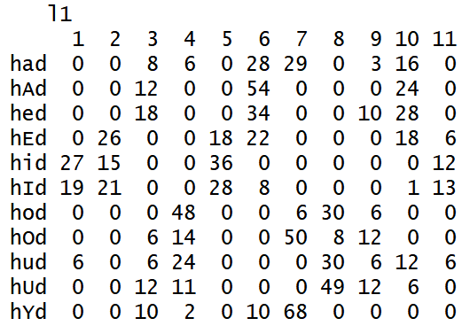
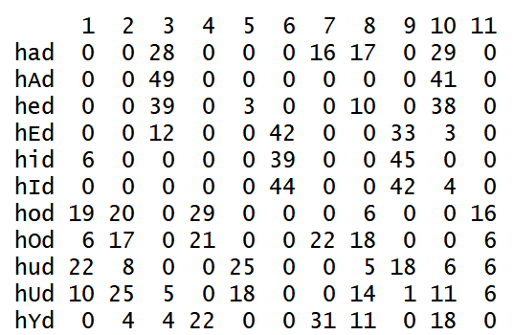
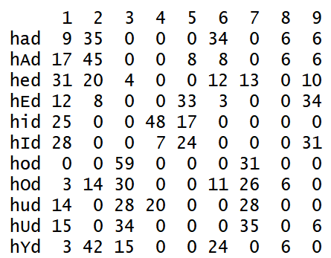
Clustering
agglomerative hierarchical clustering
k-means clustering
model-based clustering
Conclusion:
interested at true classes -> bad results
might because the data set does not have any obvious features that can distinguish one class from the other.

Slide 10
References
Deterding, D.H. (1989). University of Cambridge, "Speaker Normalisation for Automatic Speech Recognition", submitted for PhD.
Robinson, A.J. and Niranjan, M. (1988). Cambridge University Engineering Department, "Generalising the Nodes of the Error Propagation Network", CUED/F-INFENG/TR.25.
Vanschoren, J. (n.d.). vowel. Retrieved November 7, 2019, from https://www.openml.org/d/307.

