Slide 1


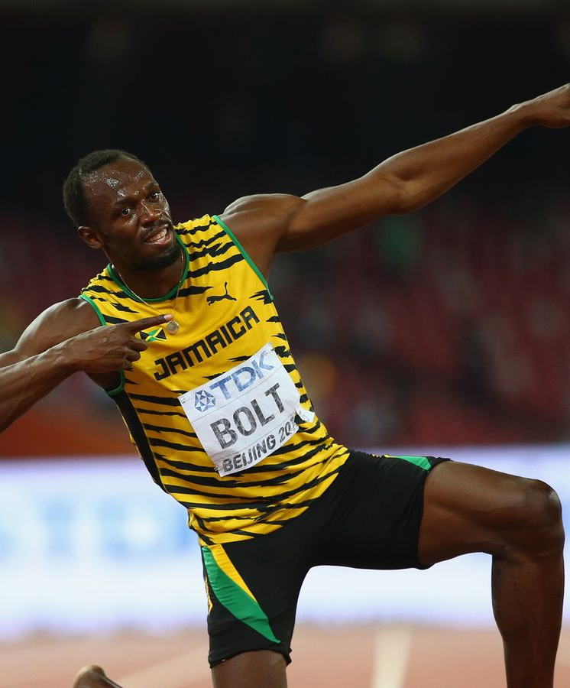
OLYMPICS ANALYSIS

Slide 2

OUTLINE
1. Executive Summary
2. Introduction
3. Methodology
4. Result
4.1. Charts
4.2. Dashboard

Slide 3
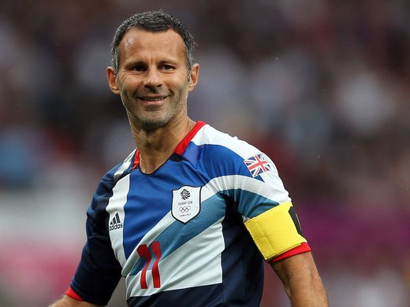
1.EXECUTIVE SUMMARY
Overview about Summer Olympics Games (1896-2016)
Overview about Winter Olympics Games (1924-2014)

Slide 4
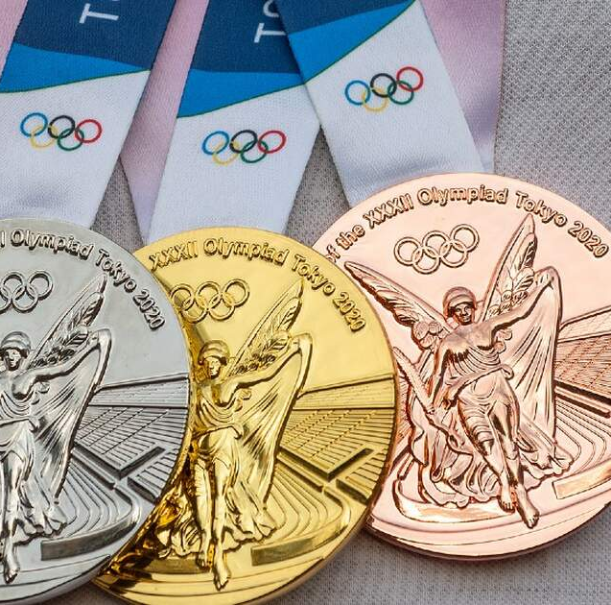
2.INTRODUCTION
Identify top countries by total number of medals.
Identify top athletes.
Total number of Gold, Silver, Bronze medals by year (1896-2016).

Slide 5

3.METHODOLOGY
- Data Collection
+ Collecting Data from github
- Data Wrangling
+ Return values with specified conditions using Case statement (SQL)
+ Breaking out a column into individuals columns
- Exploratory Data Analysis
+ Analyze, explore data (using CTEs, Join…)

Slide 6
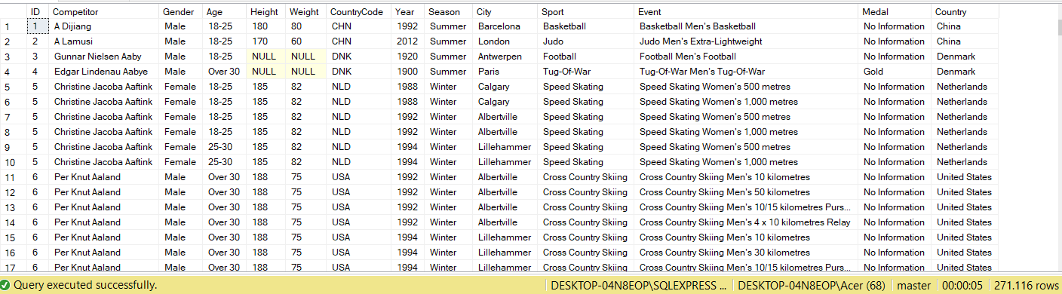
4. RESULT

Slide 7
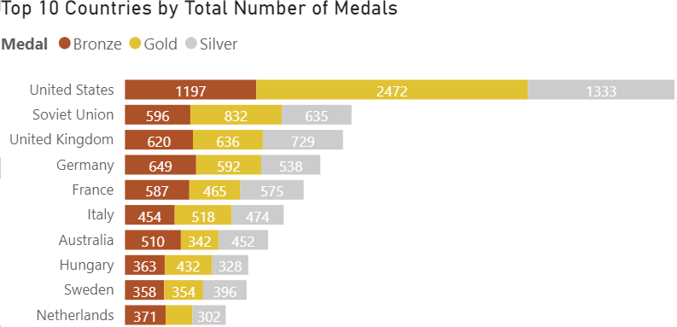
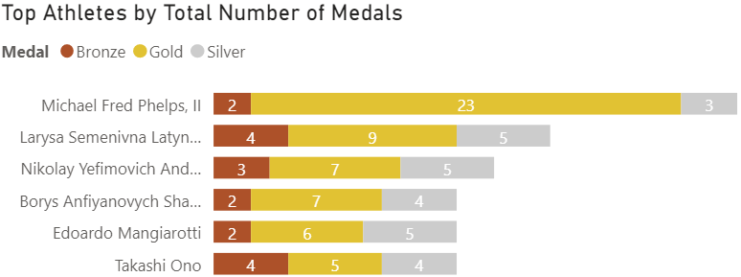
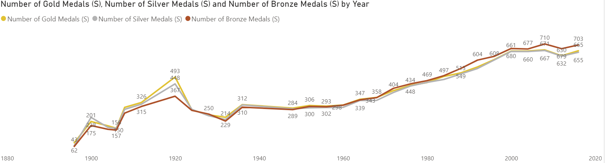
4.1.CHART-SUMMER OLYMPICS

Slide 8
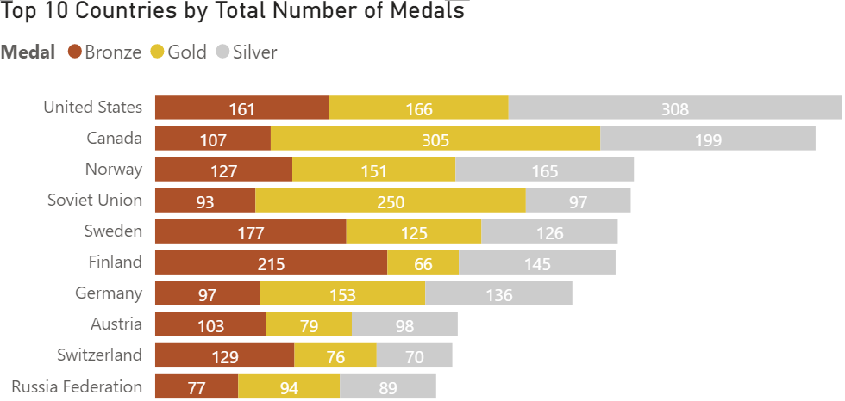
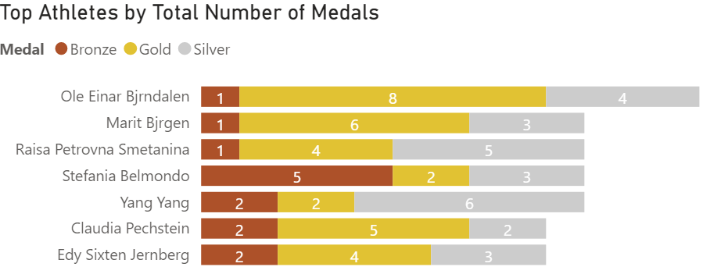
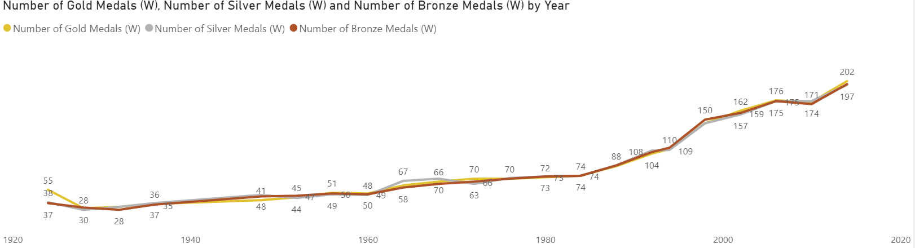
4.1.CHART-WINTER OLYMPICS

Slide 9
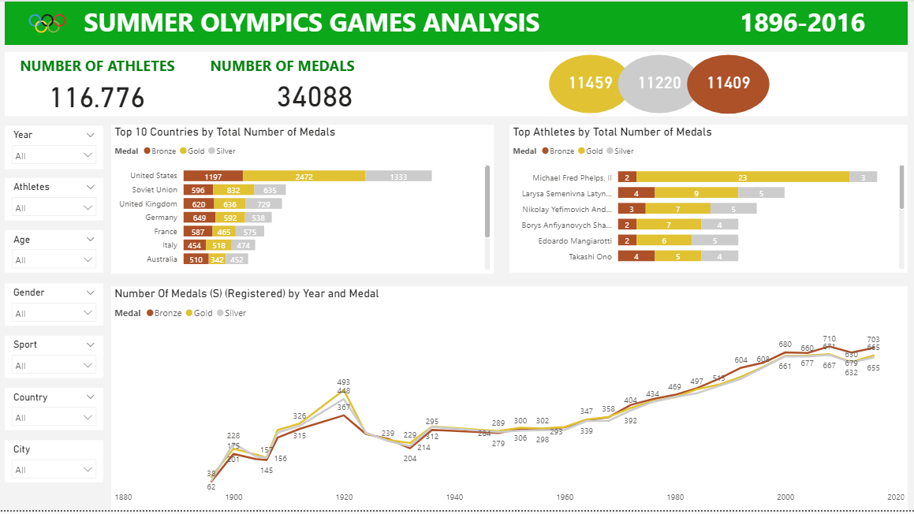
4.2.DASHBOARD

Slide 10
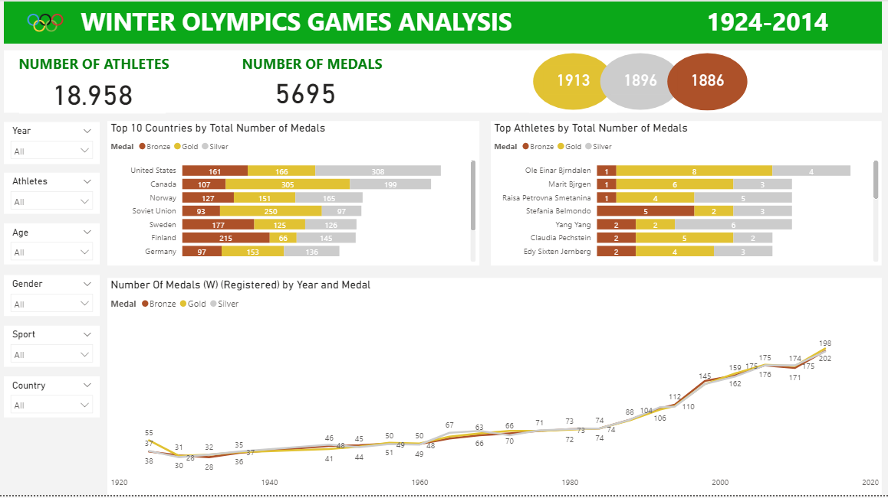
4.2.DASHBOARD

