Slide 1
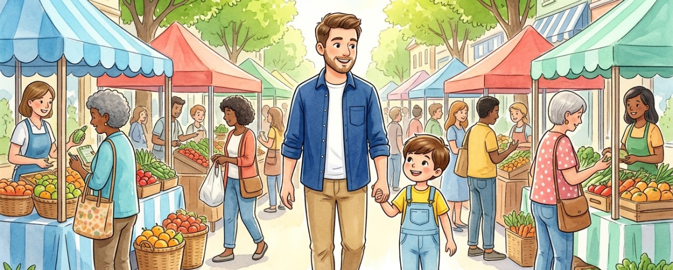
MATH IN DAILY LIFE
Sets at the Market
Tập hợp trong đời sống

Slide 2
VOCABULARY ROADMAP
1. Set
2. Element / Member
3. Belongs to (∈)
Collection of distinct items.
Single object inside a set.
Item is inside the group.
4. Does not belong to (∉)
5. Empty set (∅)
6. Natural numbers (ℕ)
Item is outside the group.
Basket with zero elements.
Counting numbers 1, 2, 3...

Slide 3
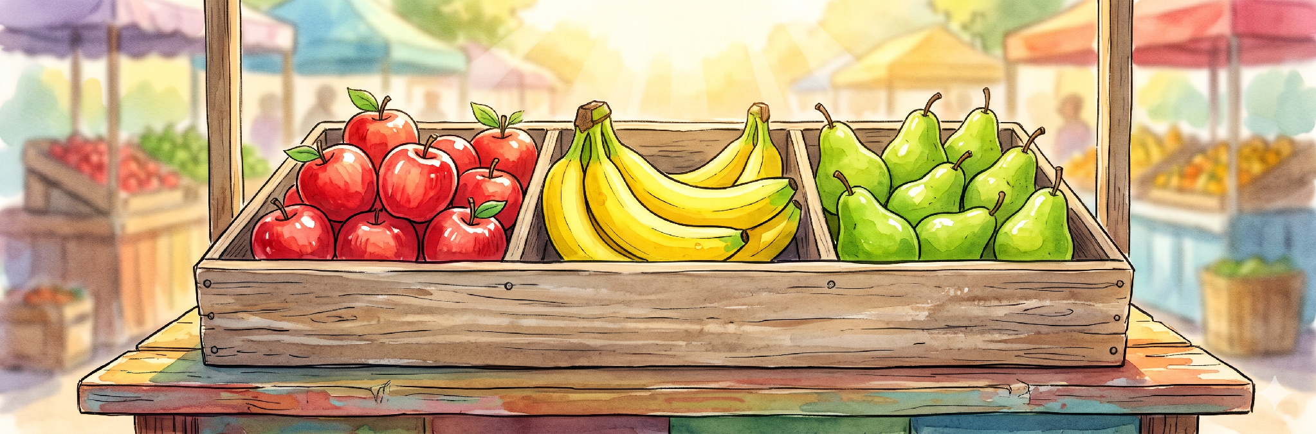
Set /set/
Tập hợp
F = { apple, banana, pear }
“This is a set of fruits.”
All fresh fruits are grouped together in one wooden crate.

Slide 4
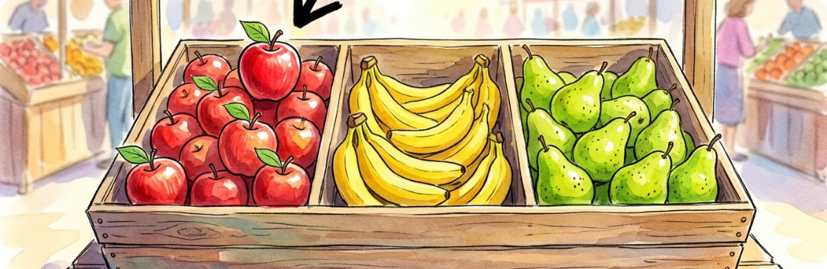

Element / Member /ˈel.ɪ.mənt/
Phần tử
Apple → Element of F
“An apple is an element (or member) of the fruit set.”
Each individual fruit in the stall is one member of the set.

Slide 5

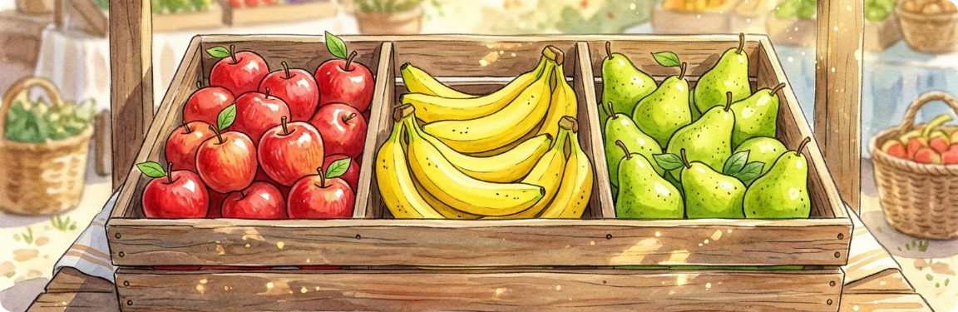
Belongs to /bɪˈlɒŋz tuː/
Thuộc về (∈)
Apple ∈ F
“The red apple belongs to the set of fruits.”
Use belongs to (symbol ∈) when an item is inside the set.

Slide 6
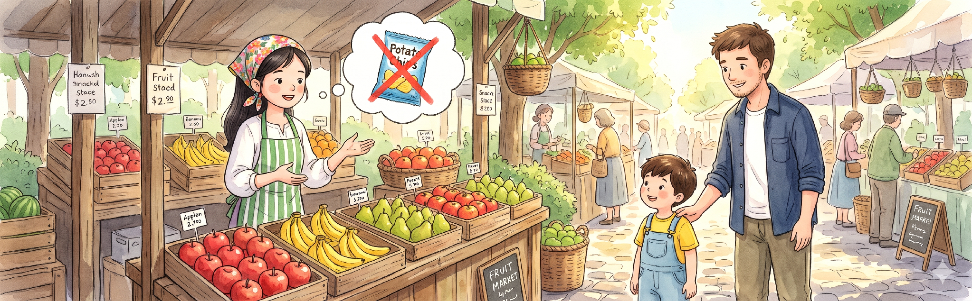
Does not belong to
Không thuộc về (∉)
Snack ∉ F
“Snack does not belong to the set of fruits.”
A bag of chips is a snack, so it is not a member of the fruit set.

Slide 7
QUICK CONTRAST
Belongs to (∈) vs. Does not belong to (∉)
∈ Belongs to
∉ Does not belong to
Banana ∈ Set of Fruits
Chips ∉ Set of Fruits
•
Meaning: Inside the group.
•
Meaning: Outside the group.
•
Example: Pear belongs to fruits.
•
Example: Candy does not belong
to fruits.

Slide 8
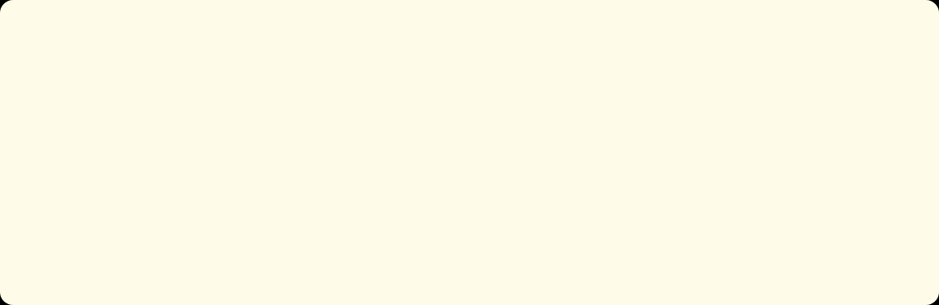
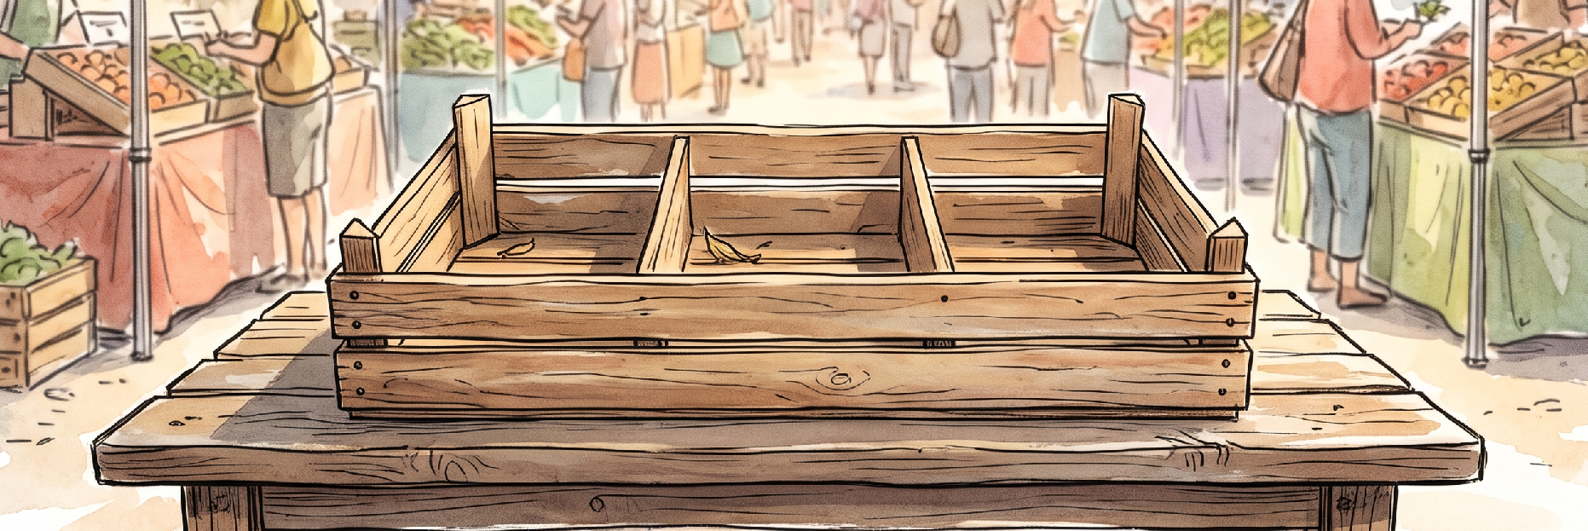
Empty set /ˈemp.ti set/
Tập hợp rỗng (∅)
B = { } = ∅
“All the fruits are sold out. This basket is an empty set.”
A set with zero elements is written as { } or ∅.

Slide 9
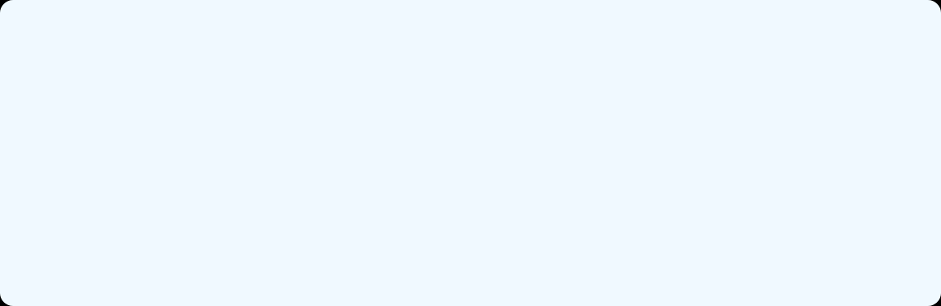

Set of natural numbers
Tập hợp số tự nhiên (ℕ)
ℕ = { 1, 2, 3, 4, ... }
“We count 1 apple, 2 oranges, and 3 bananas using the set of natural numbers.”
Counting numbers (1, 2, 3...) belong to the set of natural numbers (ℕ).

Slide 10
Exercise 1:
FILL IN THE GAP EXERCISE
WORD BANK
Set • Element / Member • Belongs to • Does not belong to • Empty set • Set of natural numbers
A collection of elements is called a __________.
Symbol ∈ means an element __________ a set.
The __________ contains no elements.
5 __________ the set {1, 2, 3, 4, 5}.
A = {x | x ∈ ℕ and x < 1} is an __________.
The set ℕ is the __________.
An element is also called a __________.

Slide 11
GREAT JOB!
Ready for Math in the market!
Set • Element • Belongs to (∈) • Does not belong to (∉) • Empty set (∅) • Natural numbers (ℕ)

