Slide 1
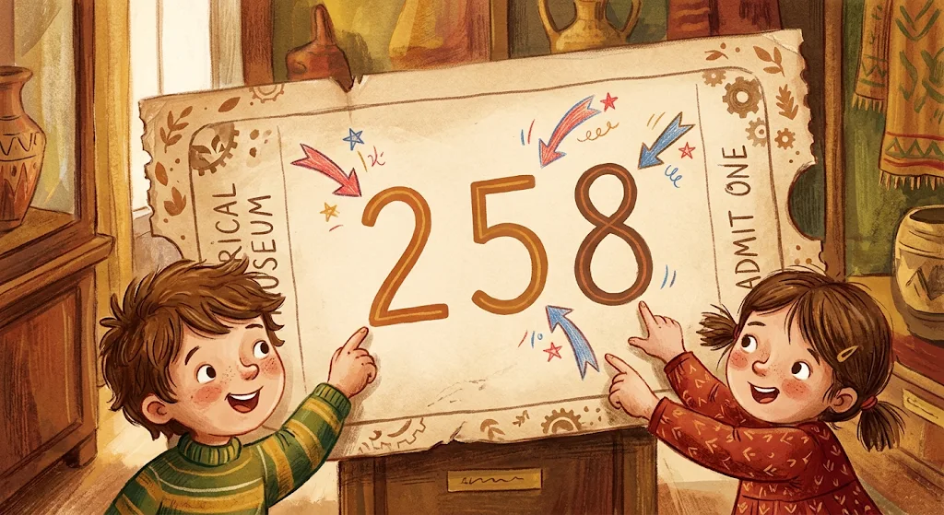
LESSON 2 • MATH IN DAILY LIFE
Numbers & Numerals at the Museum

Slide 2
VOCABULARY OVERVIEW
Eight Key Math Terms
1. Natural number
2. Decimal system
3. Digit
4. Place value
Counting numbers like 258.
Base-10 number system.
Single symbol from 0 to 9.
Value based on position.
5. Hundreds place
6. Tens place
7. Ones place
8. Roman numeral
Third digit from right (200).
Second digit from right (50).
Rightmost single digit (8).
Ancient symbols I, V, X.

Slide 3

At the History Museum Gate
Natural number • Decimal system • Digit
Minh: "Our ticket number is 258—a natural number!"
Lan: "In the decimal system, it uses three digits: 2, 5, and 8."

Slide 4
Inspecting Ticket #258
Hundreds • Tens • Ones place • Place value
Minh: "2 is in the hundreds place, 5 is in the tens place, and 8 is in the ones place."
Lan: "Each digit has a different place value!"

Slide 5
DECIMAL SYSTEM BREAKDOWN
How Place Value Works in 258
Hundreds place
Tens place
Ones place
2
5
8
Place value = 200
Place value = 50
Place value = 8

Slide 6
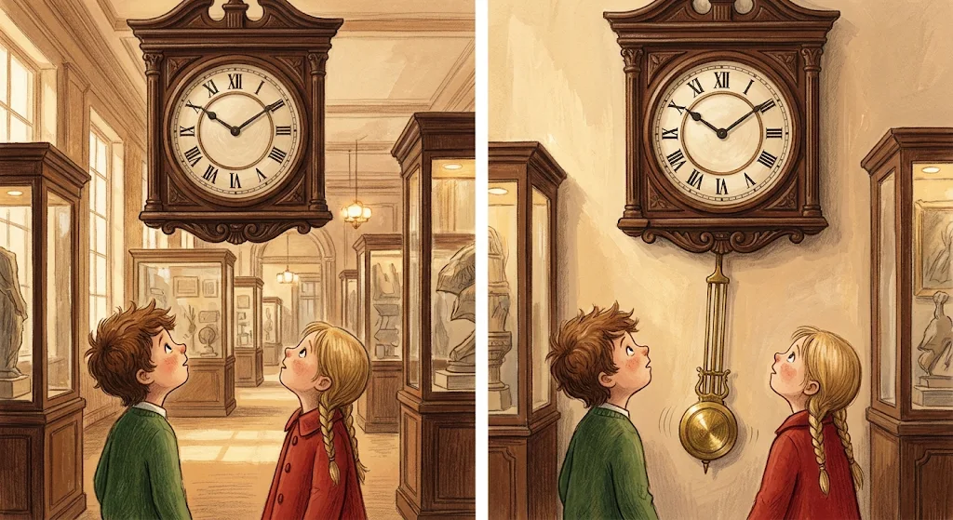
The Giant Antique Clock
Roman numeral • Digit
Lan: "Look at that antique clock! Those are Roman numerals."
Minh: "Cool! They show hours like I, V, X instead of normal digits."

Slide 7
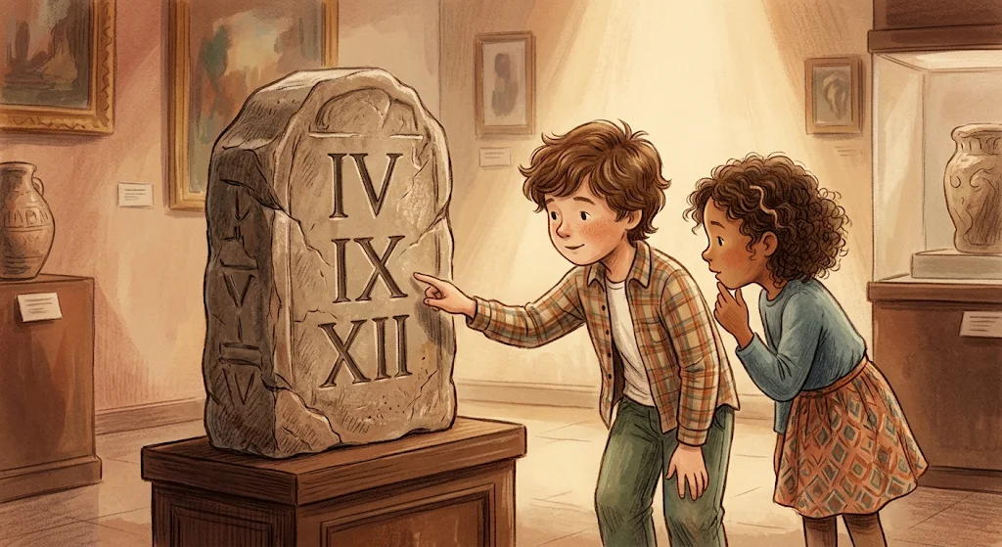
Ancient Stone Inscription
Roman numeral • Natural number
Minh: "This stone tablet carves the Roman numeral XII."
Lan: "In our decimal system, XII equals the natural number 12!"

Slide 8
SYSTEM COMPARISON
Decimal System vs. Roman Numerals
Feature | Decimal System | Roman Numerals
Symbols Used | Ten digits (0–9) | Latin letters (I, V, X, L, C...)
Place Value | Yes (Ones, Tens, Hundreds) | No place value
Museum Example | Ticket number 258 | Antique clock hours I–XII

Slide 9
VOCABULARY PRACTICE
Complete the Museum Sentences
1. In 479, the digit 4 is in the hundreds place.
2. The place value of 7 in 479 is 70 (tens place).
3. On the clock, IX is a Roman numeral for the natural number 9.

Slide 10
Fill the Gap Exercise
VOCABULARY PRACTICE
Natural number • Digit • Ones place • Tens place • Hundreds place • Place value • Roman numeral • Decimal system
1. A is a number used for counting and ordering, starting from zero (0, 1, 2, 3, ...).
5. In the number 428, the digit 8 is in the .
2. In the number 35, both 3 and 5 are each considered a single .
6. In the number 428, the digit 2 is in the .
3. In our standard math system, the value of a digit depends on its within the number.
7. In the number 428, the digit 4 is in the .
4. Natural numbers are typically represented and calculated using the base-10 .
8. Symbols such as I, V, X, IV, and IX are used to form a .

Slide 11
You Mastered Museum Numbers!
Natural number • Digit • Ones, Tens & Hundreds place • Place value • Decimal system • Roman numeral

