Slide 1
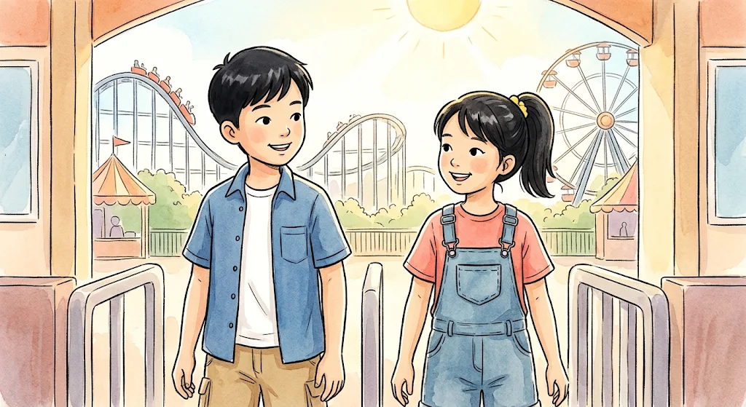
LESSON 3 • MATH IN DAILY LIFE
Comparing Numbers at the Park
Join Minh and Lan at the amusement park to learn math comparison words in context.

Slide 2
VOCABULARY ROADMAP
Seven Key Math Terms
1. Compare
2. Greater than (>)
3. Less than (<)
4. Greater than or equal (≥)
Check which value is larger.
Strictly larger than another number.
Strictly smaller than another number.
At least the minimum value.
5. Less than or equal (≤)
6. Predecessor (n − 1)
7. Successor (n + 1)
At most the maximum value.
Number immediately before another.
Number immediately after another.

Slide 3
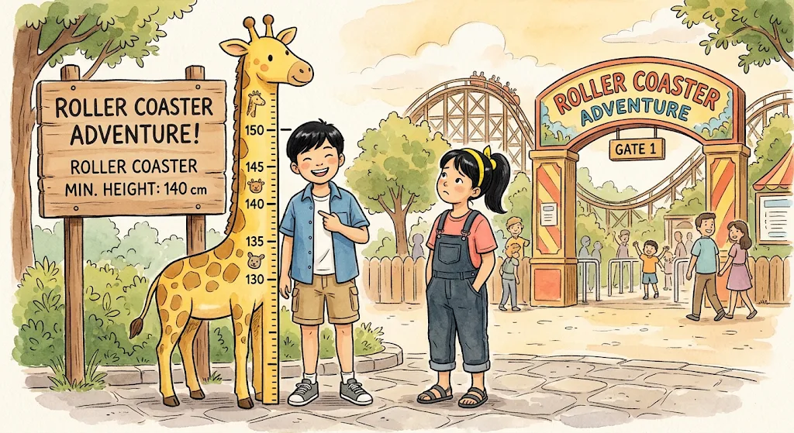
At the Roller Coaster Gate
Compare • Greater than (>) • Less than (<)
Minh: “Let’s compare our heights! 150 is greater than 140, so I can ride.”
Lan: “Aww, 135 is less than 140. I have to wait!”

Slide 4
STRICT INEQUALITIES
Greater Than vs. Less Than
150 > 140
135 < 140
Greater than (>)
Less than (<)
•
Symbol: > opens toward larger value.
•
Symbol: < points toward smaller value.
•
Park Result: Minh passes 140 cm requirement.
•
Park Result: Lan is below 140 cm limit.

Slide 5
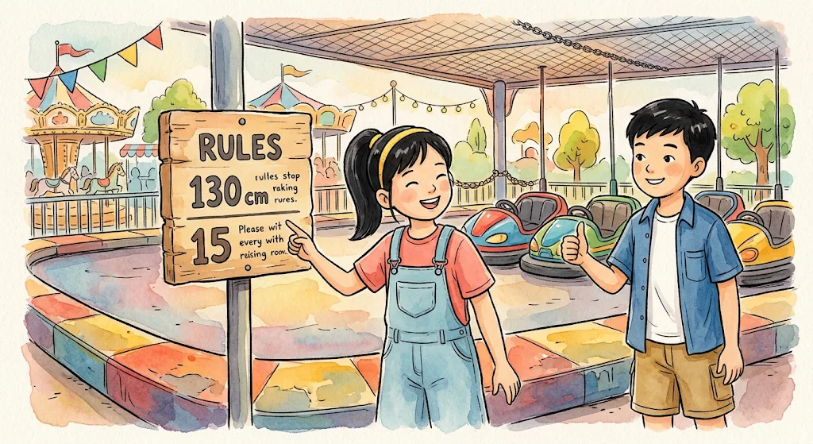
At the Bumper Cars Arena
Greater than or equal to (≥) • Less than or equal to (≤)
Lan: “Look! Height must be greater than or equal to 130 cm. I’m in!”
Minh: “And age must be less than or equal to 15. Both of us qualify!”

Slide 6
INCLUSIVE INEQUALITIES
Boundary Values Count Too
h ≥ 130
a ≤ 15
Greater than or equal to
Less than or equal to
130 cm or taller can enter (135 ≥ 130).
15 years old or younger qualify (12 ≤ 15).

Slide 7
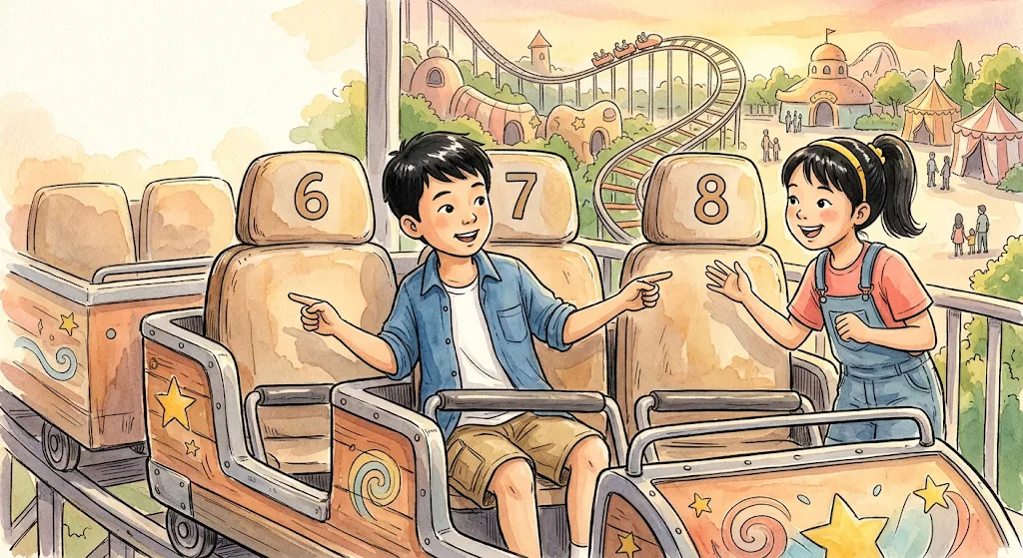
Finding Numbered Ride Seats
Predecessor • Successor
Minh: “I’m in seat 7! Seat 6 is its predecessor.”
Lan: “Then I’ll take seat 8—the successor of 7!”

Slide 8
CONSECUTIVE NUMBERS
Predecessor and Successor of 7
PREDECESSOR (n − 1)
CURRENT SEAT (n)
SUCCESSOR (n + 1)
6
7
8
Comes immediately before 7.
Minh’s seat number.
Comes immediately after 7.

Slide 9
SYSTEM SUMMARY
Park Comparison Quick Reference
Vocabulary Term | Symbol / Form | Park Example
Compare | <, >, = | Compare 150 cm and 135 cm
Greater than | > | 150 > 140 (Minh rides)
Less than | < | 135 < 140 (Lan waits)
Greater than or equal to | ≥ | Height ≥ 130 cm
Less than or equal to | ≤ | Age ≤ 15 years
Predecessor | n − 1 | 6 is predecessor of 7
Successor | n + 1 | 8 is successor of 7

Slide 10
FILL THE GAP EXERCISE
Word Bank: Compare • Less than • Greater than • Less than or equal to • Greater than or equal to • Predecessor • Successor
1. We ____________ two numbers to see
which is bigger.
5. Age ≤ 15 means ____________ 15 years old.
6. Seat 6 comes before 7, so 6 is its ____________.
2. Since 150 > 140, 150 is ____________ 140.
7. Seat 8 comes after 7, so 8 is its ____________.
3. Since 135 < 140, 135 is ____________ 140.
4. Height ≥ 130 cm means ____________ 130 cm.

Slide 11
LESSON 3 COMPLETE
You Mastered Comparing Numbers!
Compare • Greater than (>) • Less than (<) • Greater than or equal to (≥) • Less than or equal to (≤) • Predecessor • Successor

