Slide 1

LESSON 3 • MATH IN DAILY LIFE
Addition & Subtraction at the Bakery

Slide 2
VOCABULARY OVERVIEW
Eight Bakery Math Terms
1. Addition
2. Addend
3. Sum
4. Commutative
Combining amounts together.
Each number being added.
Total result of addition.
Swapping order keeps sum.
6. Identity property
7. Subtraction
8. Difference
5. Associative
Taking an amount away.
Amount left after subtraction.
Grouping keeps sum.
Adding zero keeps total.

Slide 3
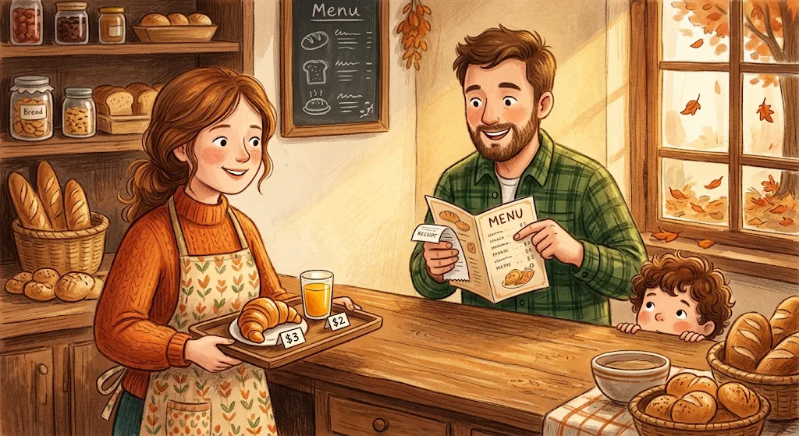
Ordering Lunch at the Counter
Addition • Addends • Sum
Mom: "Let's use addition for our lunch! $3 and $2 are the two addends."
Dad: "And $3 + $2 gives a sum of $5!"

Slide 4
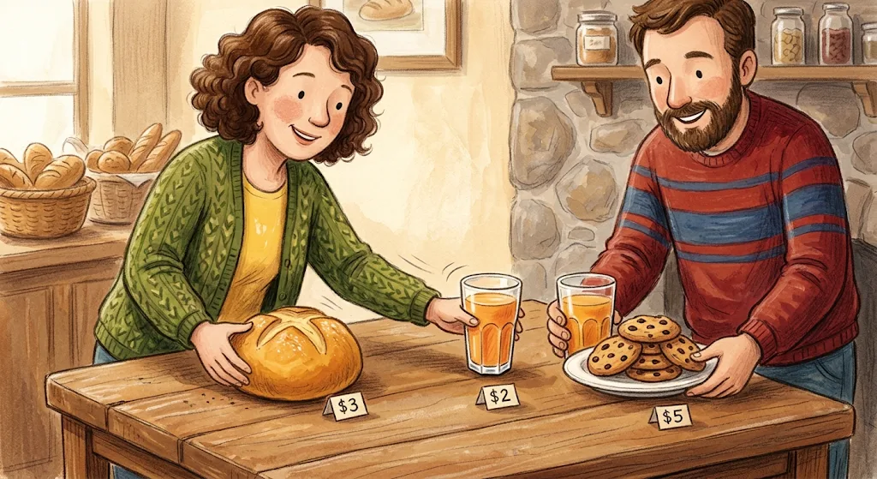
Swapping & Grouping Food
Commutative • Associative
Mom: "Order doesn't matter: $3 + $2 equals $2 + $3. That's the commutative property!"
Dad: "And (3 + 2) + 5 = 3 + (2 + 5) by the associative property!"

Slide 5
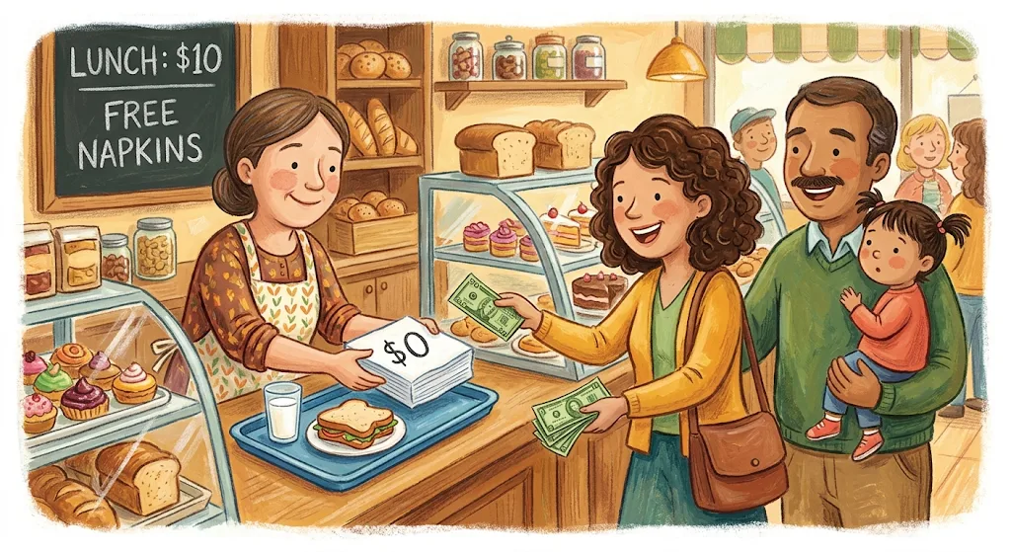
Free Napkins & Getting Change
Zero • Subtraction • Difference
Dad: "Free napkins ($0)! Adding zero keeps our total at $10 (identity property)."
Mom: "We paid $20. By subtraction, $20 − $10 leaves a difference of $10 change!"

Slide 6
KEY RULES
Three Properties of Addition
Associative Property
Commutative Property
Identity Property of 0
(3 + 2) + 5 = 3 + (2 + 5)
3 + 2 = 2 + 3
10 + 0 = 10
Changing addend order keeps the same sum.
Adding zero leaves the sum unchanged.
Changing grouping keeps the same sum.

Slide 7
VOCABULARY CHECK-UP
Bakery Math in Action
Bakery Action | Math Term | Equation
Croissant ($3) and juice ($2) | Addends & Sum | $3 + $2 = $5
Swapping bread & juice | Commutative property | $3 + $2 = $2 + $3
Free napkins ($0) added | Identity property of 0 | $10 + $0 = $10
Paying $20 for $10 bill | Subtraction & Difference | $20 − $10 = $10

Slide 8
Fill the Gap Exercise
VOCABULARY PRACTICE
Word Bank: Addition, Sum, Addend, Subtraction, Difference, Commutative property, Associative property, Adding zero
  The result of a subtraction operation (such as 25) is called the ___________.
  The ___________ allows us to change the order of addends in a sum without changing the final result.
  The ___________ allows us to group addends differently when calculating a sum.
  The property where adding 0 to any number leaves the number unchanged is known as ___________.
  The operation of combining numbers together to find a total is called ___________.
  In an addition expression, each of the numbers being added (such as 25 and 11) is called an ___________.
  The result of an addition operation (such as 36) is called the ___________.
  The operation of taking one number away from another is called ___________.

Slide 9
GREAT JOB!
You Mastered Bakery Math!
Addition • Addend • Sum • Commutative • Associative • Identity property • Subtraction • Difference

