Slide 1
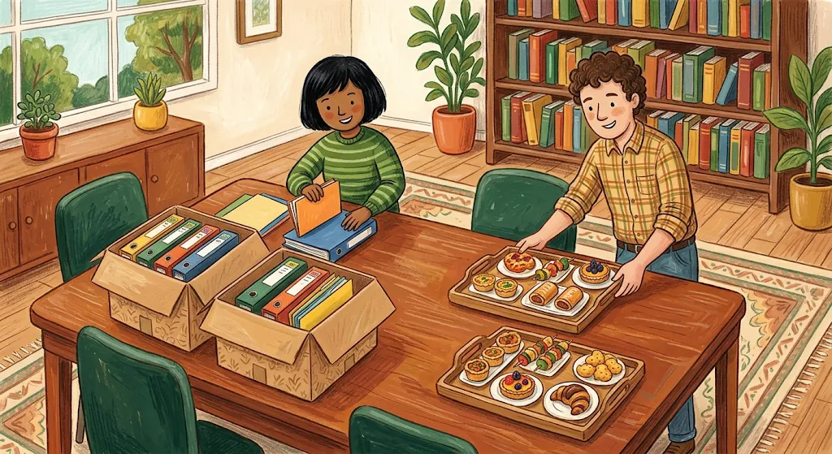
LESSON 5 • MATH IN DAILY LIFE
Multiplication
& Division
at the Kindergarten

Slide 2
VOCABULARY PART 1
Multiplication Terms & Properties
1. Multiplication
2. Factor
3. Product
Repeated addition of equal groups.
Number multiplied to get product.
Result of multiplying factors.
4. Commutative property
5. Associative property
6. Distributive property
Grouping factors keeps product.
Multiplying across a sum.
Swapping factor order keeps product.

Slide 3
VOCABULARY PART 2
Division & Remainder Terms
7. Division
8. Dividend
9. Divisor
10. Quotient
Splitting into equal parts.
Total number being divided.
Number dividing the total.
Answer from division.
12. Division with remainder
11. Divisible
13. Remainder
Divides cleanly with zero left.
Extra amount left undivided.
Division with items left over.

Slide 4

Arranging Workshop Chairs
Multiplication • Factors • Product • Commutative
David: "By multiplication, 3 and 4 are factors, giving a product of 12 seats!"
Sarah: "Arrange them as 4 × 3 and it's still 12—the commutative property of multiplication!"

Slide 5
Folders & Teabreak Trays
Division • Dividend • Divisor • Quotient • Divisible
David: "For folders, (2x3)x4=2x(3x4) by the associative property of multiplication!"
Sarah: "And 2 trays of (4+2) pastries equal 2x4+2x2—the distributive property!"

Slide 6

Handing Out Workshop Notebooks
Division • Dividend • Divisor • Quotient • Divisible
David: "Let's use division! 12 is the dividend, 4 teams are the divisor, and the quotient is 3!"
Sarah: "Clean split! 12 is divisible by 4."

Slide 7
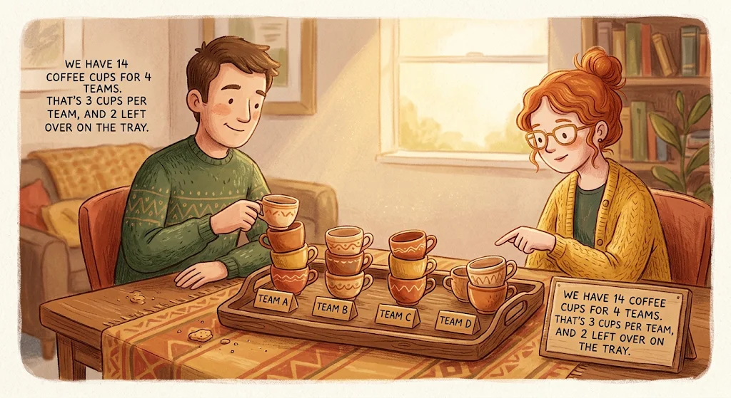
Teabreak Coffee Cups
Division with remainder • Remainder
David: "14 cups for 4 teams requires division with remainder: 14 ÷ 4 = 3 with 2 left over."
Sarah: "14 is not divisible by 4, so the remainder of 2 cups is for us!"

Slide 8
KEY RULES
Three Properties of Multiplication
Associative Property
Commutative Property
Distributive Property
(2 × 3) × 4 = 2 × (3 × 4)
3 × 4 = 4 × 3
2(4 + 2) = 2×4 + 2×2
Swapping factors gives the same product.
Regrouping factors gives the same product.
Multiply each addend inside parentheses.

Slide 9
DIVISION COMPARISON
Divisible vs. Division with Remainder
Workshop Case | Dividend ÷ Divisor | Quotient & Remainder
12 notebooks for 4 teams | 12 ÷ 4 | Quotient = 3 (Divisible)
14 coffee cups for 4 teams | 14 ÷ 4 | Quotient = 3, Remainder = 2

Slide 10
Fill the Gap Exercise
VOCABULARY PRACTICE
Word Bank: Multiplication, Product, Factor, Division, Quotient, Dividend, Divisor, Divisible, Division with remainder, Remainder, Commutative property of multiplication, Associative property of multiplication, Distributive property
  To quickly calculate the total number of items arranged in rows and columns (e.g., finding the area or total items), we use the operation of ___________.
  In the expression 252=50, the numbers 25 and 2 play the role of a ___________, while 50 is called the ___________.
  When applying the ___________, we can change the order or group numbers differently when multiplying multiple terms together without altering the final outcome.
  To calculate 12(10+3) efficiently by expanding it as (1210)+(123), we rely on the ___________.
  ___________, and it must always be strictly less than the divisor.
  In a standard division setup like 36:12=3, the number 36 being shared is the ___________, and 12 is the ___________.

Slide 11
Fill the Gap Exercise
VOCABULARY PRACTICE
Word Bank: Multiplication, Product, Factor, Division, Quotient, Dividend, Divisor, Divisible, Division with remainder, Remainder, Commutative property of multiplication, Associative property of multiplication, Distributive property
  When a natural number can be divided by another with no left-over amount, we say that the first number is ___________ by the second.
  If we distribute 36 items among 15 people and find that some are left over, we are performing a ___________.
  In the division statement 36:15=2(rem.6), the amount left over (6) is specifically called the ___________, and it must always be strictly less than the divisor.

Slide 12
WORKSHOP READY!
You Mastered Kindergarten Math!
Multiplication • Product • Factor • Division • Quotient • Dividend • Divisor • Divisible • Remainder • Commutative • Associative • Distributive

