Slide 1
Cyclistic bike-share analysis
Google Data Analytics Capstone Challenge 1
Presented by: Quang Huy Vu
Data: from September 2021 to August 2022

Slide 2
Table of Contents
Cyclistic bike-share analysis
Executive summary
Analytics goals
The story about bike-share service usage behavior
Recommendations

Slide 3
Executive Summary
The analytics goal is to identify (1) differences in bike-share usage behavior between casual users and members to (2) convert casual users to member users and (3) utilize digital media to leverage the conversion.
Key recommendations:
Loyalty programs leveraging shopping behavior while traveling allow users to turn ride time into shopping rewards.
Promotional season for casual users is considered to be May – October, promoting special fee discounts focusing on docked/electric bikes.
Utilizing digital review sites like Yelp or ticketing sites to promote our campaign. Plus, partnership with these sites helps to control relationship management and send promotional events during the peak season.
Key insights:
Casual users use docked/electric bikes to travel to attraction sites and shopping places nearby, while member users use traditional/electric bikes to travel to or from work. Plus, casual users spend more time using bike-share services than members do.
Attraction sites have multiple sources of information for users to get information and buy tickets in advance online.
Service fees for electric bikes are charged by the time used and unlock fees for docked bikes
Peak season of bike-share service for both user types usage is May – October which is the summer season.

Slide 4
Analytics goals

Slide 5
1
2
3
Define the differences in bike-share ride behavior between casual users and member users
Identify leverage to convert casual users to member users
Identify digital media opportunities to influence to conversion of casual users to member users

Slide 6
The story about bike-share service usage behavior

Slide 7
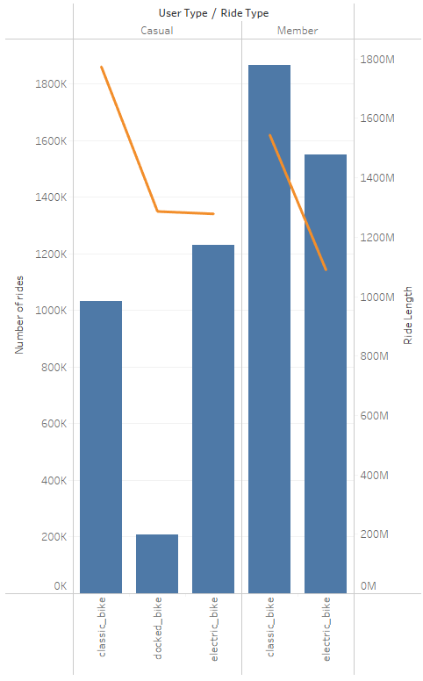

Casual vs member users
About types of bike
Casual users spend approximately the same amount of time on docked bike compared to electric bike.
Casual users like electric bikes better than classic bikes while member users like and spend lots of time on classic bikes.
Average ride time of casual users are higher than member users due to higher total ride time and lower number of rides.

Slide 8
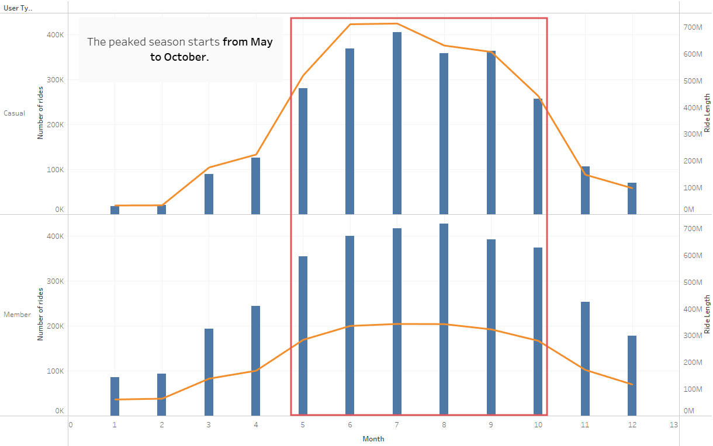
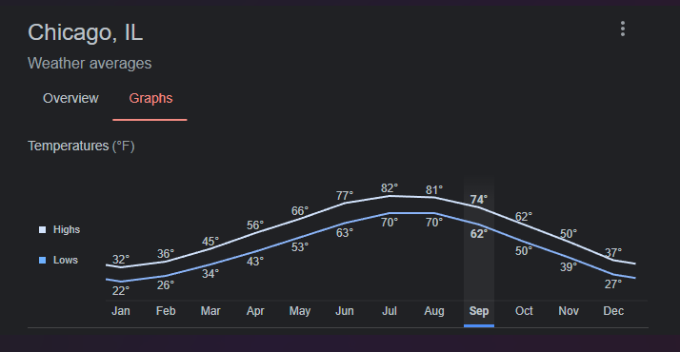
Casual vs member users
About month of the year
Casual users and member users peak seasons are the same. They starts from May to October and peaked in July for casual users and August for member users.
The peak seasons match with the summer period in Chicago which the temperature increases.

Slide 9
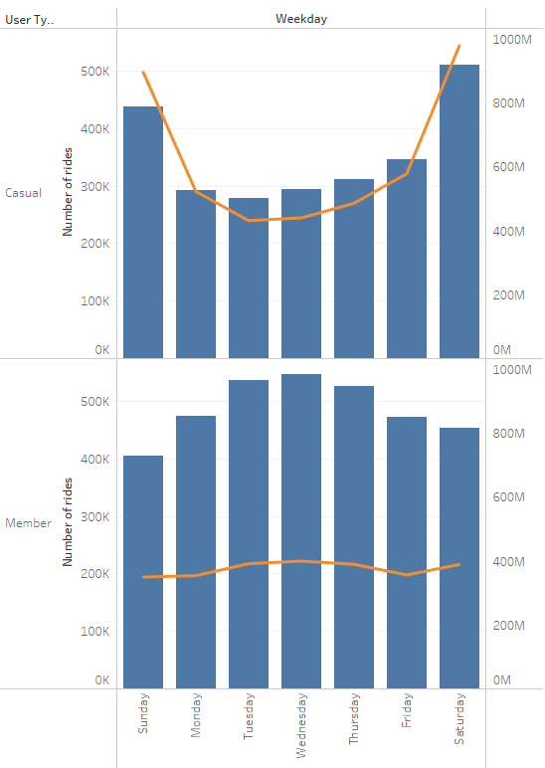
Casual vs member users
About weekday
Casual users have more number of rides and ride time during the weekend (Saturday & Sunday).
Member users spend more time and make more number of rides during weekdays (Monday to Friday).

Slide 10
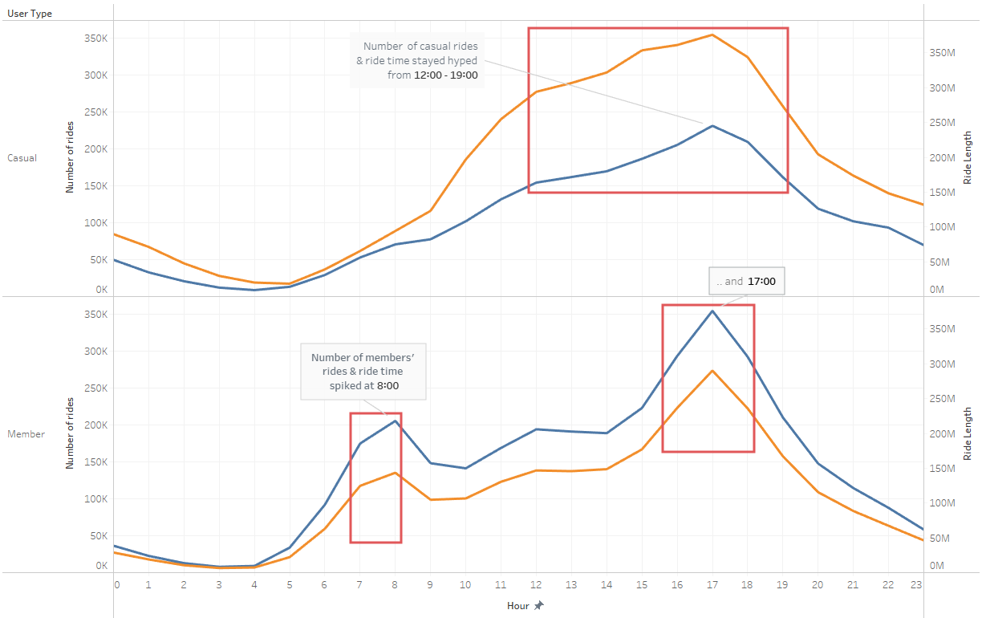
Casual vs member users
About hour of the day
Casual users make rides from 12 PM (time they leave from home/lunch) to 7 PM (time they leave for home/dinner)
Member users peak ride time is 8 AM (time they leave for work) and 5 PM (time they leave from work).

Slide 11
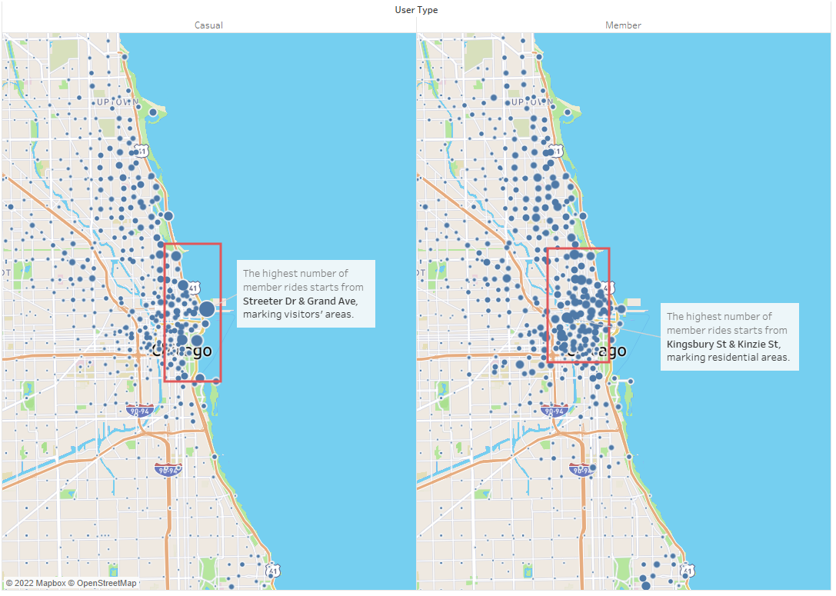
Casual vs member users
About start station locations
Casual users start their rides mostly from areas of entertainment/leisure: parks, museums, harbors, and aquariums.
Member users start their rides mostly from residential areas.

Slide 12
From the differences, some insights are:
Docked and electric bikes are favorite for casual users. They tend to use bike-share services to commute between popular city attractions or home to city attractions and vice versa. And since destinations are city attractions, shopping partnerships or ride-rewarding loyalty programs for shopping can be considered.
Attraction sites receive traffic from review sites like Yelp or ticketing portals to increase sales.
Casual users spend more time riding. As service fees for electric bikes are charged by the time used and unlock fees for docked bikes, fee structure adjustments should be considered.
Peak season is from May to October - a great season to promote and convert casual users to annual members as both the number of rides and total ride time peaked, especially for entertaining activities like visiting harbor, parks, museums, and aquariums. As bike-share service does not require long periods of advanced booking, lagged time planning might not be necessary.

Slide 13
Recommendations

Slide 14
Based on the above insights, recommendations are:
The promotion campaign can be run from May to October with promotional incentives for casual riders during this time of the year. Seasonal passes might be an option, yet this can result in annual members churn to seasonal users. My recommendation is to revamp the fee structure for annual membership regarding electric and docked bikes, intentionally focusing on the benefits for casual users to pursue leisure purposes.
Loyalty reward programs for leisure-focused members give points to users with total ride time and points can be exchanged for rewards. Rewards include shopping discounts, free tickets to city attractions, discounts in local restaurants, etc. This requires partnerships with local shops, city attractions, local restaurants, etc.
Partnership with digital review sites like Yelp or other ticketing portals is key to leveraging digital media to reach casual users. Plus, based on these partnerships, we can make use of booking information to leverage CRM solutions to follow up with special logistical discounts during the travel in peak season.

Slide 15
Thank you.

Slide 16
Cyclistic bike-share

