Slide 1
Bellabeat health-focused behavior analysis
Google Data Analytics Capstone Challenge 2
Presented by: Quang Huy Vu
Data: from April 12th 2021 to May 12th 2021

Slide 2
Table of Contents
Bellabeat health-focused behavior analysis
Executive summary
Analytics goals
The story about bike-share service usage behavior
Recommendations

Slide 3
Executive Summary
The analytics goal is to identify (1) trends in the health-tracking devices market, (2) lever the trends to help Bellabeat’s customers/products, and (3) formulate marketing strategies based on these trends.
Key recommendations:
“Daily Challenge” campaign or feature (long-term) helps engage all users to wear the devices and keep track of their health, especially to encourage the importance of health tracking to low-use users (wear devices less than 30% of the days in a month).
“Sleep notification” CRM message/function keeps track of the sleep time of users. This message reminds users to analyze detailed activities during the day and gives valuable insights into adjusting them to spend more time on sleep.
Partnership with fashion brands to promote a healthy and fashionable lifestyle.
Key insights:
50% of the sample responses use more than 70% of the sample month (high-use users), while 38% use less than 30% of that (low-use users).
All users sleep less than the standard amount of 8 hours (480 minutes).
Most users once use the devices keep them on for more than half of the day (12 hours)
Users wearing the devices more than 70% of the month (high-use) have more steps taken per day, while users wearing the devices less than 30% of the month (low-use) have higher calories burnt and less sleep time compared to average figures.
Key proposition of Bellabeat’s products is that are both health-conscious and fashionable for women.

Slide 4
Analytics goals

Slide 5
Analytics goals
1
2
3
Identify trends in the smart device usage market.
Identify how these trends apply to Bellabeat's customers/
products.
Identify how these trends help influence Bellabeat’s marketing strategy.

Slide 6
Health tracker device trends

Slide 7
Metrics when considered health tracker devices
Area
Metrics
Description
Health-related metrics
- Steps taken/ distance traveled
- Calories burnt
- Sleep time
- The amount of steps/distance taken per day/hour
- The amount of calories burn per day/hour
- The time amount of sleep taken per day
Usage metrics
- Percentage of days worn
- The number of days which device tracker is worn over the total number of days in the dataset.
- The percentage total number of minutes tracker worn over 1440 minutes of day.
- Percentage of minutes worn per day
*Data source: public dataset of “FitBit Fitness Tracker Data” from Mobius

Slide 8
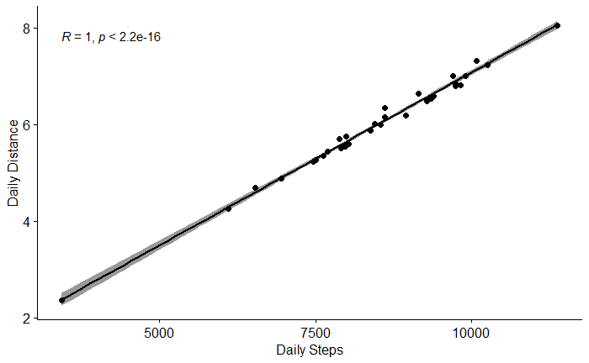
Daily steps and daily distance
Daily steps taken correlates perfectly to daily distance travelled.
*Data source: public dataset of “FitBit Fitness Tracker Data” from Mobius

Slide 9
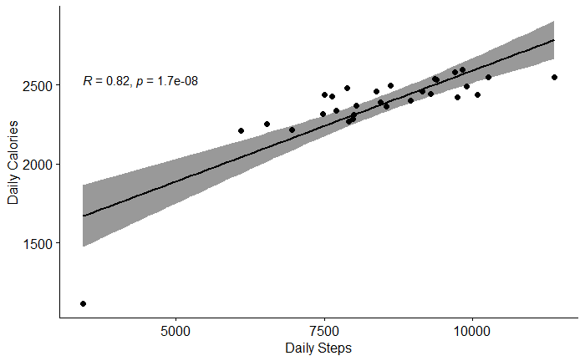
Daily steps and daily calories
Daily steps taken and daily calories are strongly correlated.
*Data source: public dataset of “FitBit Fitness Tracker Data” from Mobius

Slide 10
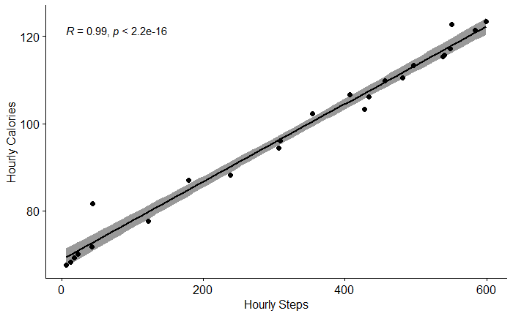
Hourly steps and hourly calories
When considered on an hourly basis, steps taken and calories burnt are almost perfectly correlated.
*Data source: public dataset of “FitBit Fitness Tracker Data” from Mobius

Slide 11
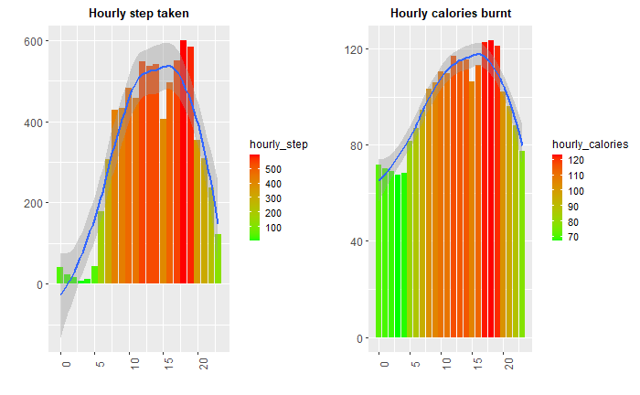
Hourly steps and hourly calories burnt throughout the day
Step count peaks at:
12 PM to 2 PM which is lunch time and refreshment for afternoon shift.
5 PM - 7 PM which is after-work exercise sessions.
During 12 AM to 5 AM, calories burnt peaks during the sleep with barely any amount of steps taken. This is due to the calories burnt by the organs of the body while people sleep.
*Data source: public dataset of “FitBit Fitness Tracker Data” from Mobius

Slide 12
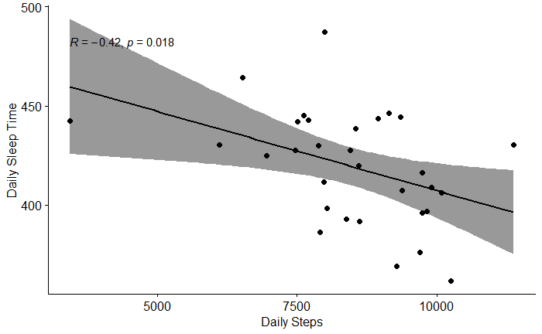
Daily steps and daily sleep time
Daily steps metric have a relatively low negative correlation to daily sleep time.
The more steps taken, the less time users have to sleep.
*Data source: public dataset of “FitBit Fitness Tracker Data” from Mobius

Slide 13
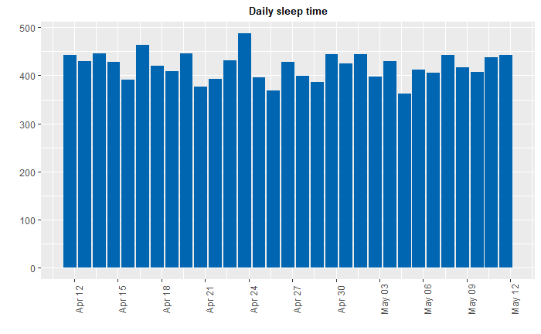
Average sleep time
Most users have less sleep time than the standard of 8 hours sleep time (480 mins)
*Data source: public dataset of “FitBit Fitness Tracker Data” from Mobius

Slide 14
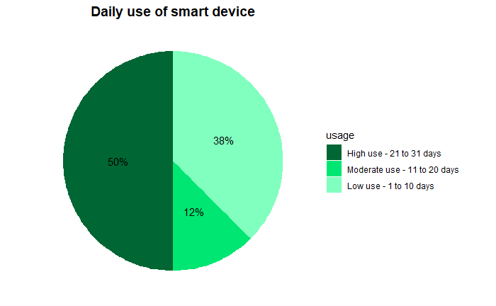
Customer segments
There are 3 customer segments
50% are high-use users: use more than ⅔ of the total days encountered.
12% are medium-use users: use between ⅓ and ⅔ of the total days encountered.
38% are low-use users: use less than ⅓ of the total days encountered.
*Data source: public dataset of “FitBit Fitness Tracker Data” from Mobius

Slide 15
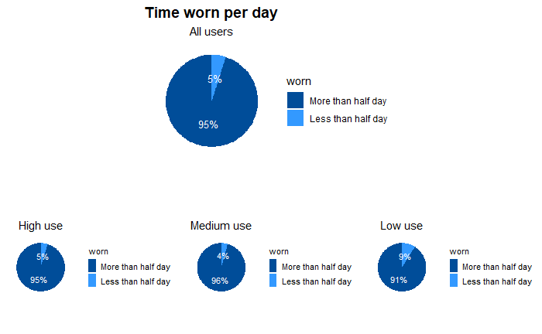
Time worn per day
Overall, all users tend to wear the devices more than half of the day (90-95%).
Low-use users tend to have less tendency to wear the devices more than half of the day compared to the other two user groups.
*Data source: public dataset of “FitBit Fitness Tracker Data” from Mobius

Slide 16
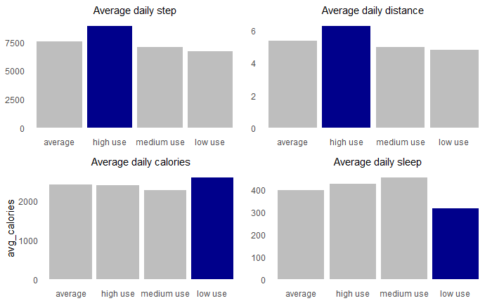
Metrics across all segments
High-use users have higher step counts compared to other groups, plus their calories stays at average amount.
Low-use users have higher calories burnt while getting less sleep time compared to average sleep time of all segments.
*Data source: public dataset of “FitBit Fitness Tracker Data” from Mobius

Slide 17
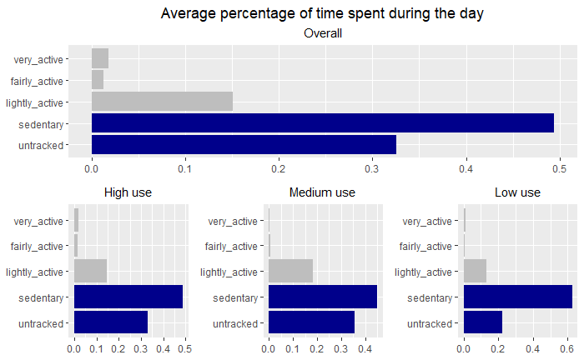
Percentage of usage time per day
Low-use users have more time spent on sedentary activities.
Low-use users have less untracked time compared to the average, which can be used to leverage more usage in this group.
*Data source: public dataset of “FitBit Fitness Tracker Data” from Mobius

Slide 18
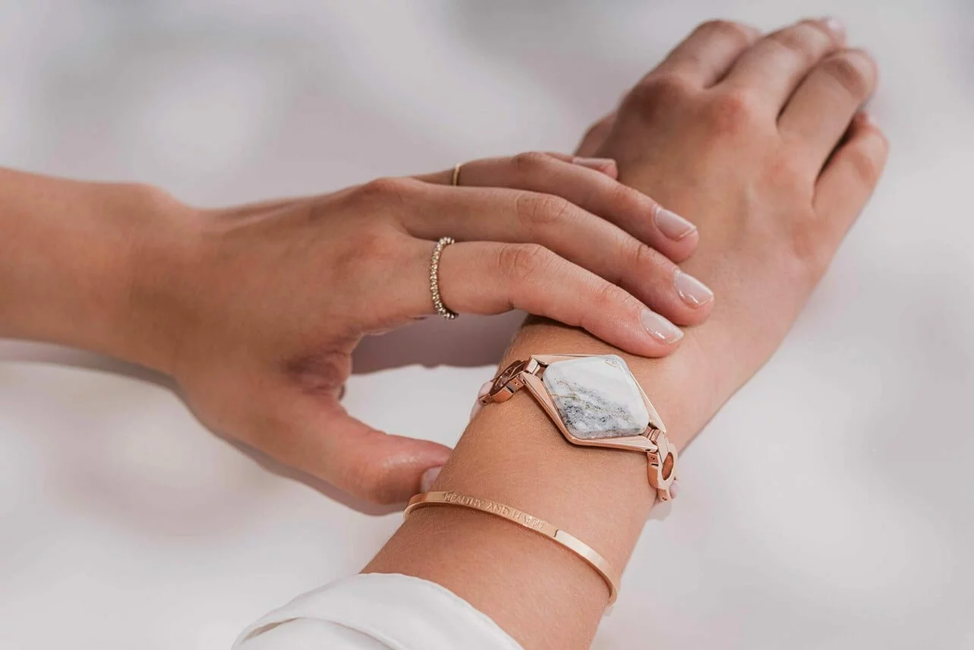

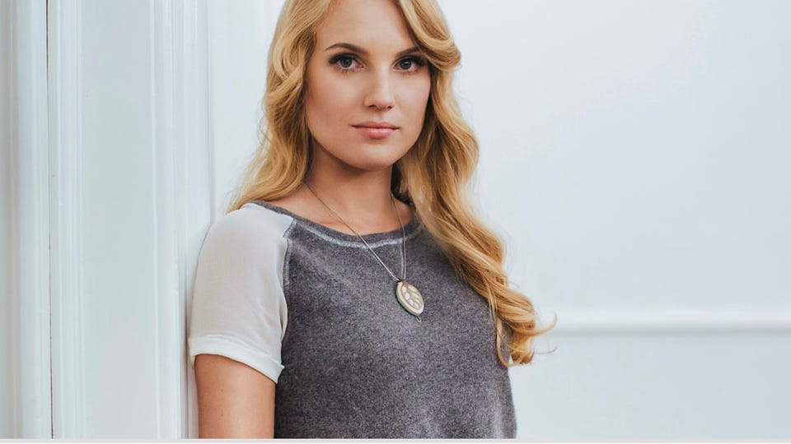
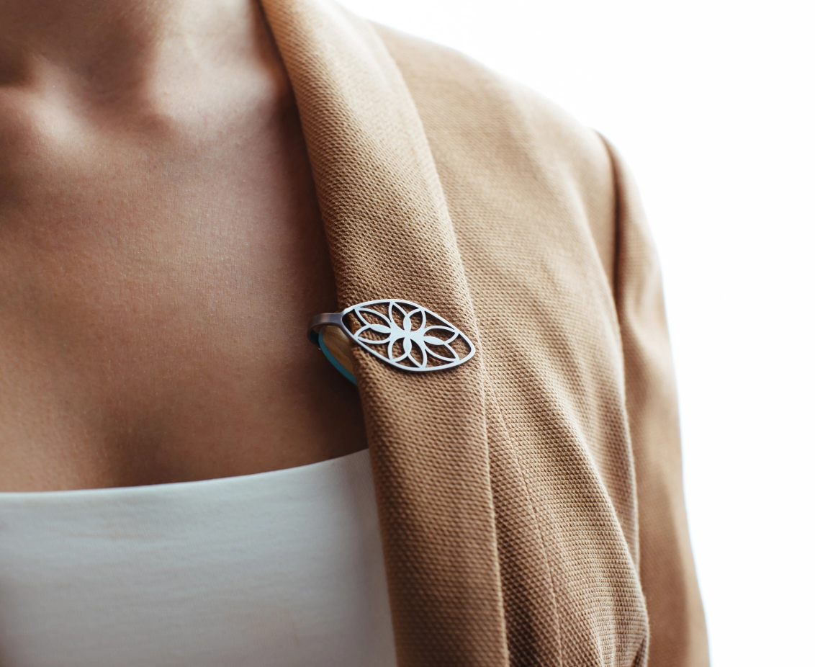
Bellabeat’s key selling point
Positioned as a tech-driven wellness company for women.
Key selling points of Bellabeat is making its tracker devices more fashionable way, such as necklace, jewelry, or clip. This make their products more accessible and stylish to wear.
*Image sources: Bellabeat

Slide 19
Based on the findings, there are pillars for Bellabeat to focus on while developing marketing strategies:
Objectives: (1) increase engagement time during the day of low/medium users and maintain that for high users, (2) encourage users more time to sleep, and (3) increase the daily usage of users.
Pillar
Focus
Proposition
A tech-driven wellness company for women with feminism and fashionably designed trackers.
Place
Focuses on partnership with health-related associations/websites or fashionable brands to increase the connection between having great health (both physical and mental) and keeping track of it.
Product
Focuses on products that are related to the analysis data, such as Leaf, Time, the membership package, and the Bellabeat app.
Price
Focuses on building a fee structure for key products.
Promotion
Focuses on campaigns that increase the usage frequency for low/medium users and retain that of high users.

Slide 20
Recommendations

Slide 21
Based on the above insights, recommendations are:
# | Recommendation | Description
1 | “Daily Challenge” campaign - which encourages users to exercise and engage with the devices more | Objective: engage and maintain exercise activities of users from which their health will benefit. Details: P0 - Daily challenge can be occasional or P1 - designed as a function in the app that sets daily/monthly challenges for users to stay healthy. Possible incentives can be discounts for membership. Target group: P0 - low/medium users, P1 - high users
2 | Sleep notification | Objective: improve sleep time of users Details: P0 - use notification systems to remind users of tracking their sleep habits and P1 – a function that warns users about their sleep time. Target group: P0 - all users, P1 - focuses on low users
3 | Partnership with media outlets/fashion brands to encourage a healthy and fashionable lifestyle using Bellabeat’s accessories | Objective: encourage the usage of tracker devices on a day-to-day basis Details: partnership with media outlets/ fashion brands to highlight mix-and-match recommendations that enhance style and health. Target group: P0 - low/medium users, P1 - all users

Slide 22
Thank you.

