Slide 1
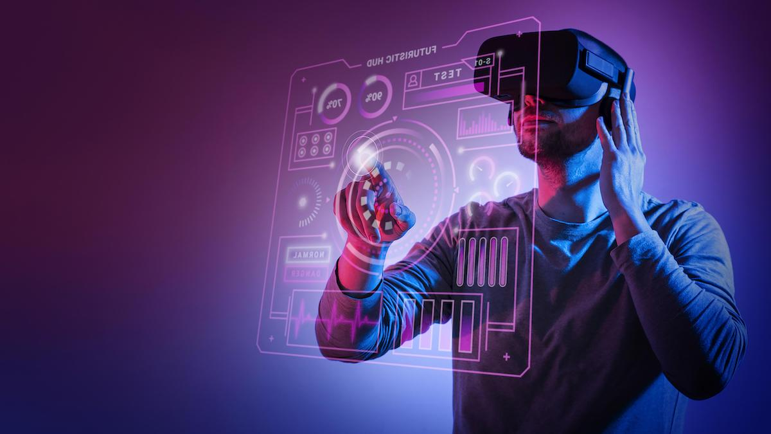
METAVERSE

Slide 2
Metaverse – What it is?
The metaverse is a concept of a persistent, online, 3D universe that combines multiple different virtual spaces. The metaverse will allow users to work, meet, game, and socialize together in these 3D spaces.
In the metaverse, people use avatars to represent themselves, communicate with each other and virtually build out the community.
In short, a metaverse is a network of 3D virtual worlds focused on social connection.

Slide 3
Metaverse – Revolution
Metaverse is a promise that makes the world of fantasies come to reality. Similar to the Web 2.0 on smartphones and laptops, Metaverse is the next-generation technology, a comprehensive world on Web 3.0, that offers absolute immersion in a digital world where all industries and businesses play a pivotal role.

Slide 4
Metaverse – Industries
Financial Industry.
Real Estate Industry.
Education Industry.
Healthcare Industry.
eCommerce and Retail Industry.
Gaming Industry.
Metaverse is for everything and everyone

Slide 5
Metaverse – Financial Industry
South Korea’s one of the largest FI, KB Kookmin Bank, has developed KB Metaverse VR Branch Testbed that allows customers to access banking services in a metaverse wearing a VR device.
“The purpose is to pre-emptively respond to financial changes in the coming metaverse era and to internalise new financial service experiments and technological capabilities”, Jinsoo Yoon, Vice President of Tech Group, KB Koomin Bank.

Slide 6
Metaverse – Real Estate
Metaverse is being speculated to be used as an immersive tool for prescreening a property. With features like offering a 360-degree view and a virtual tour of the property, the virtual world has so much to offer.

Slide 7
Metaverse – Education Industry
Tools like AR and VR became popular methods for spreading the wealth of knowledge. The metaverse offers unique opportunities like the creation of comfortable digital space for classes, experiments, projects, and research. Real-time activities and hands-on experiences foster innovation and creativity in learning spaces.

Slide 8
Metaverse – Healthcare Industry
3D visualisation of the human body, carrying out virtual surgical procedures before carrying out a real surgery is one of the areas where Metaverse proves its worth. A project, Veyond Metaverse is a commitment to bringing the first Metaverse hospital and creating an ecosystem for both patients, healthcare workers, and doctors.

Slide 9
Metaverse – eCommerce
Avatars (digital twin of the consumers) are being increasingly utilised to make informed choices and enhance the shopping experience. With advantages that include a decline in product returns and higher conversions, the industry is making an accelerated transition toward the Metaverse.

Slide 10
Metaverse – Gaming
Uniting the global community across a plethora of devices, gaming has been, so far, the most extensively ruled kingdom by the Metaverse. Fortnite, Roblox, and Minecraft are popular games where players have been interacting with each other as avatars.

