Slide 1
Designing and development of an innovative extrusion machine
FOR RECYCLABLE FILAMENT
SUPERVISOR: DR. MUHAMMAD SAJID
Presented By:
Muhammad Huzaifa (21-IE-27)
Arslan Ahmad Hussain (21-IE-56)

Slide 2
CONTENTS
Introduction | Briefing about project, Problem Statement, Aim and Objectives.
Literature Review | Previous work done by the researchers.
Methodology | The working and making of project.
Machine Hardware | These can be used in the template, and their size and color can be edited
Timeline | The management of time for project.

Slide 3
INTRODUCTION
01
BRIEFING ABOUT PROJECT

Slide 4
INTRODUCTION
01
PROBLEM STATEMENT
With the rise of 3D printing, plastic waste is becoming a growing issue, especially from failed prints, unused parts, and discarded filament. Currently, most filament is made from new, virgin plastics, which not only drives up costs but also adds to environmental pollution. Unfortunately, options for recycling these plastics back into high-quality filament are limited, as affordable and efficient machines for this purpose are scarce. This project seeks to fill that gap by designing an innovative extrusion machine that can transform waste materials from 3D printing into reusable filament, promoting sustainable recycling and helping to reduce both costs and plastic waste for circular economy.

Slide 5
INTRODUCTION
01
EXTRUSION MACHINE
Equipment designed to melt and shape materials, here specifically for producing 3D printer filament from recycled plastics.
RECYCLABLE FILAMENT
Filament made from waste plastic, suitable for reuse in 3D printing, supporting a circular economy.
3D PRINTING
Additive manufacturing process that builds objects layer by layer using filaments, typically plastic, as material.
SUSTAINABLE MANUFACTURING
Production process that minimizes environmental impact by reducing waste and reusing resources.

Slide 6
INTRODUCTION
01
Temperature Control
Precise regulation of heat within the extrusion machine is to ensure consistent melting and filament quality.
Filament Consistency
Uniformity in filament thickness and strength, is essential for reliable 3D printing.
Eco-Friendly Production
Manufacturing approach that reduces carbon footprint and waste, aligning with environmental sustainability goals.
Material Optimization
Process of selecting and treating recycled plastics for maximum performance and quality in filament output

Slide 7
INTRODUCTION
01
AIM
To design and develop an innovative extrusion machine for recyclable filaments.
Objectives
    To design a low-cost extrusion machine that provides an affordable solution without compromising on quality or efficiency.
    To develop an innovative and portable design for the machine, ensuring ease of use and mobility for various applications.
    To recycle waste filament generated from 3D printing, allowing for the reuse of materials and promoting sustainability in the 3D printing process.

Slide 8
INTRODUCTION
01
SDGs
GOAL ID | SUSTAINABLE DEVELOPMENT GOAL | DESCRIPTION
Goal 9 | Industry, Innovation, and Infrastructure | The design of an extrusion machine for recyclable filament promotes innovative manufacturing techniques that enhance the efficiency of the 3D printing industry by using sustainable, recyclable materials. The project helps advance infrastructure in the additive manufacturing industry by reducing reliance on non-recycled filaments and contributing to efficient, cost-effective material production.
Goal 12 | Responsible Consumption and Production | The development of this extrusion machine for recyclable filament production directly aligns with SDG 12 by promoting responsible consumption and production. By focusing on recycling plastics and converting waste

Slide 9
LITERATURE REVIEW
02
PREVIOUS WORK DONE BY RESEARCHERS

Slide 10
LITERATURE REVIEW
02
Paper # | Title | Author | Published Year | Remarks
1 | Design And Fabrication Of Extrusion Machine For Recycling Plastics | S Kumar, R Sooraj, MVV Kumar | 2021 | The extruder is designed to produce 3D printer filament with a diameter range of 2-2.5 mm. The screw extrusion process is used to achieve a fixed cross-section for the filament. PET pellets are heated to temperatures between 230°C and 250°C and extruded through a nozzle. The process ensures a continuous filament free of air bubbles and roughness, meeting the specified quality requirements
2 | Design and development of 3D printer filament extruder | M Aris, S Mat, MS Sam, FR Ramli, MR Alkahari, SIA Kudus | 2020 | The project aims to recycle 3D printing waste into usable filament using an extruder machine, focusing on recycled Acrylonitrile Butadiene Styrene (ABS). The recycled filament is utilized in an open-source 3D printer to create a specimen. Mechanical properties, including tensile strength, tensile strain, maximum load, and Young's modulus, are compared between recycled and pure ABS. Results indicate that the original ABS specimen can withstand a maximum load of 724N, while the recycled ABS specimen can handle 713N.

Slide 11
LITERATURE REVIEW
02
Paper # | Title | Author | Published Year | Remarks
3 | Developing Filament Extruder and Characterization of Recycled High-Density Polyethylene for 3D Printing Filament Material | M Shiferaw, H Gebremedhen, A Mengistie | 2023 | The study developed a desktop-sized filament extruder machine to create 1.75 mm diameter recycled HDPE filament for 3D printing, achieving a smooth, round shape suitable for prototyping. Mechanical and thermal tests showed that the recycled HDPE filament had an ultimate tensile strength of 19.02 MPa, comparable to virgin HDPE, along with high thermal stability (degradation onset at 430°C). FTIR analysis confirmed that the recycled HDPE retained the same functional groups as virgin HDPE, and it also displayed excellent water-repellent properties. The study suggests that recycled HDPE filament could be a sustainable alternative for 3D printing, but further research is needed to enhance filament quality, optimize extrusion parameters, and improve product performance.
4 | Development of filament extruder using recycled plastic material for 3D printer | Jen Aldwayne M., Banaag | 2016 | Developed an extruder machine to recycle waste plastic bottles into 1.00-1.75 mm diameter 3D printer filament. Controlled heating (220-260°C) and Arduino automation ensured consistent output. Motor speed and cooling fan were key to achieving stable filament for successful 3D printing

Slide 12
LITERATURE REVIEW
02
Paper # | Title | Author | Published Year | Remarks
5 | Temperature-induced pressure gradient in the clearance between screw flight and barrel of a single screw extruder | Winter, Horst Henning. | 1980 | Examines temperature-induced pressure gradients in drag flow with a viscosity gradient due to temperature changes. Focuses on clearance flow in single screw extruders, where a polymer layer prevents metal-to-metal contact. Concludes that failure of this layer, leading to dry friction, is caused by temperature-induced pressure flow.
6 | Design and Manufacture of the Cooling and Collection System of a Single Screw Extruder | Opeyemi Osideko, Favour Eboh, and Modupe Onitiri | 5 April 2022 | Focuses on designing and constructing a lightweight, cost-effective filament collection system to improve cooling efficiency in a single screw extruder. Implements a filament winding machine with a circumferential winding pattern, integrating a motor, gear system, and additional cooling fan, leading to a 35% increase in cooling rate. Highlights the benefits of an automated collection system in reducing filament waste, contamination, and enhancing productivity.

Slide 13
METHODOLOGY
03
MAKING AND WORKING OF PROJECT

Slide 14
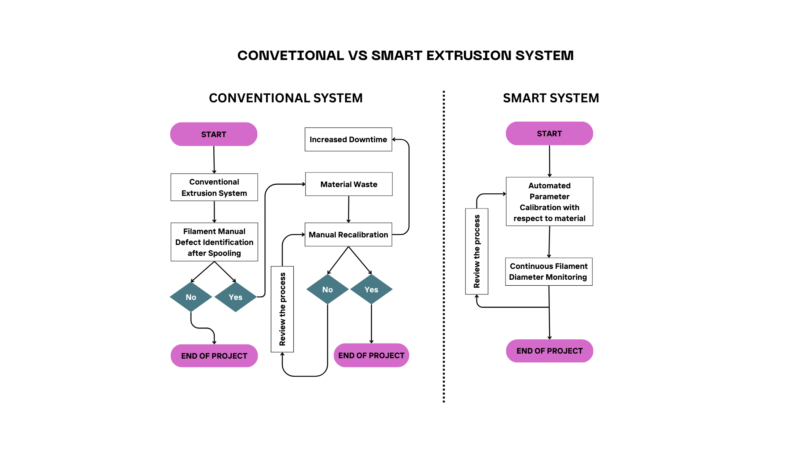
METHODOLOGY
03
SCHEMATIC DIAGRAM
Figure 1: Conventional vs Smart Extrusion System

Slide 15
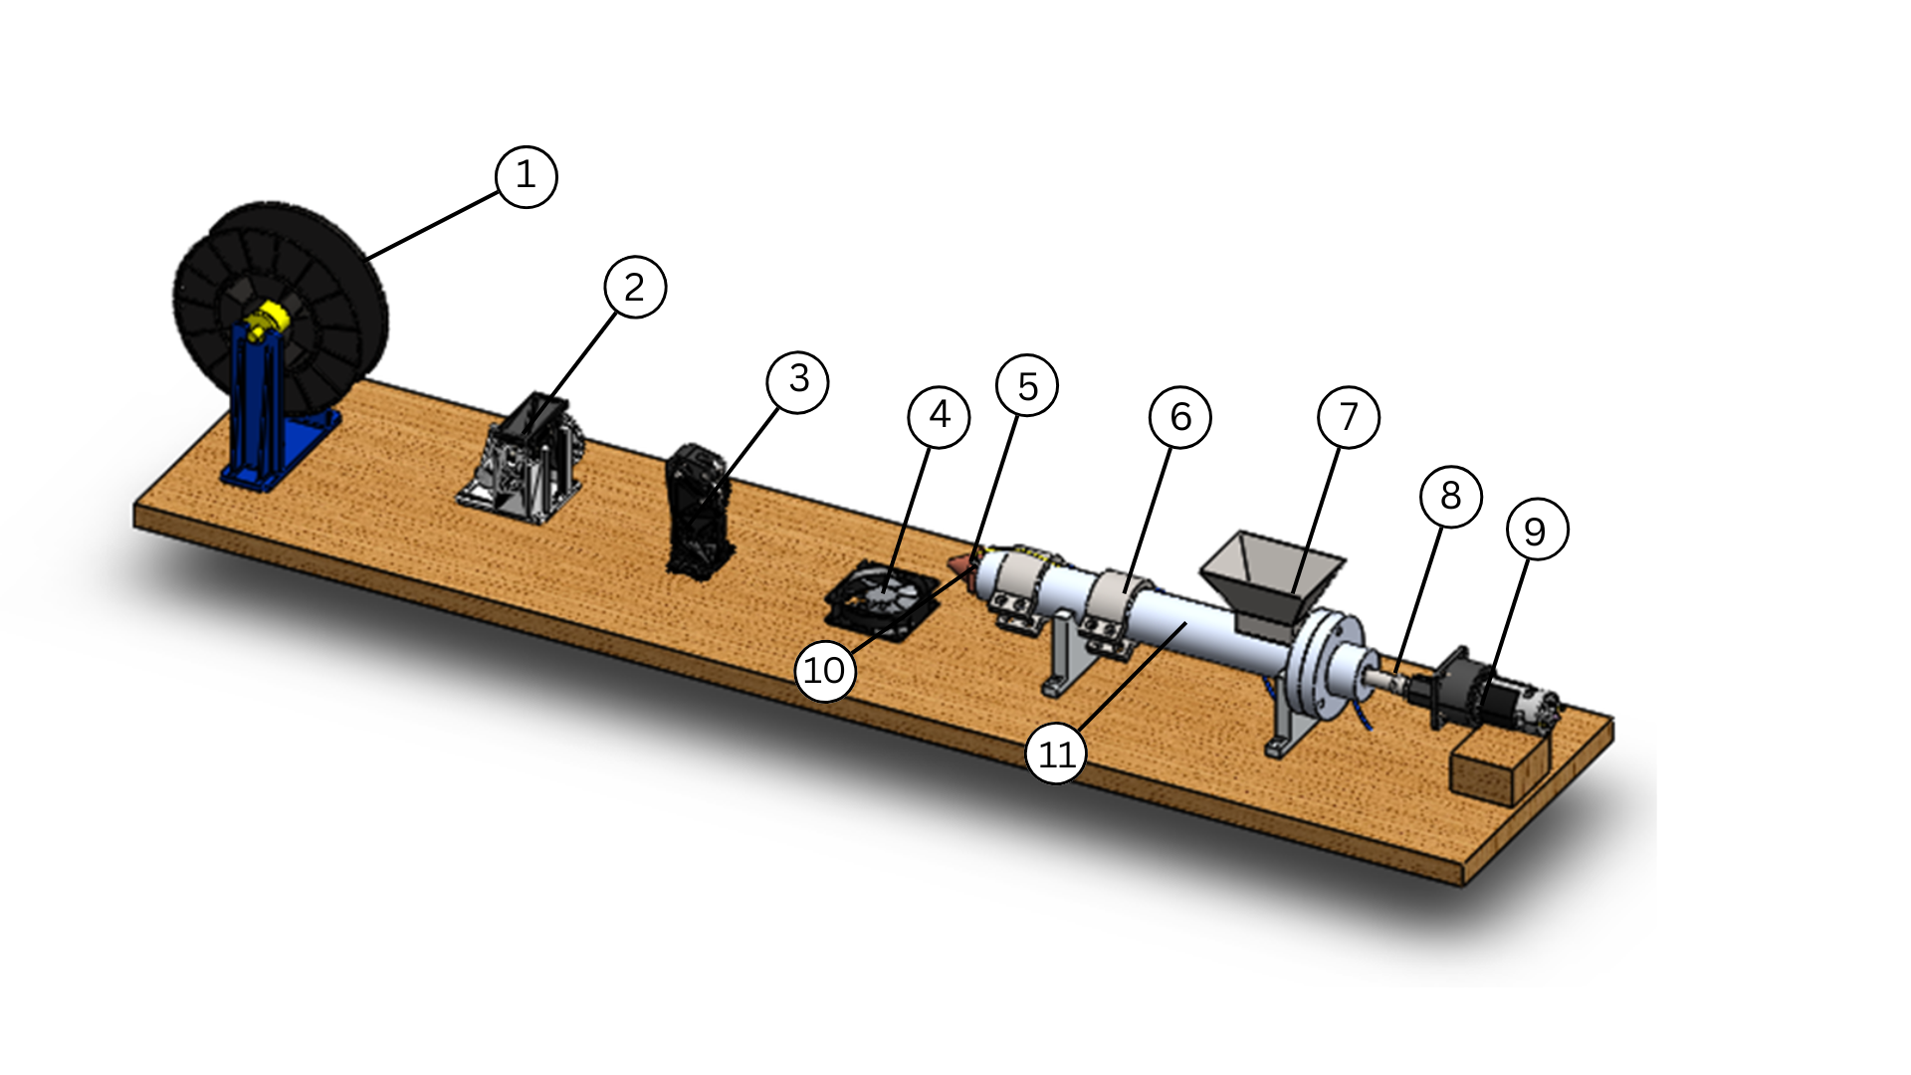
METHODOLOGY
03
3D Model
Winding Spool
Puller Assembly
Filament Diameter Sensor
Cooling Fan
Thermocouple
Heaters
Funnel
Coupling
DC Motor
Nozzle
Barrel

Slide 16
METHODOLOGY
03
Cost estimation
Sr. No. | Product | Price (PKR)
1 | Cooling Fan | 840
2 | Thermocouple | 842
3 | Bread Board | 250
4 | LCD Display | 400
5 | Jumping Wires | 360
6 | Relay 5 v | 130
7 | Auger drill bit | 3706
8 | Barrel | 325
9 | Clamp | 30
10 | Nozzle | 275
11 | Amplifier MAX 6675 | 350
12 | Motor | 4000
13 | Motor Adapter Wire | 450
14 | Commercial Board | 1300
15 | Bearing | 750
16 | Machining | 5500
17 | Heater | 3200
18 | 8 Bearing | 800
19 | Puller Motor | 600
20 | Magnet | 70
21 | I2c | 250
22 | Hall Effect | 150
23 | L298 Controller | 450
Total |  | 25478

Slide 17
METHODOLOGY
03
Major Design considerations
Sr. No. | Part Name | Design Consideration | Abbreviations | Dimensions
1 | Barrel | Outer Diameter | B_{o} | 32 mm
 |  | Inner Diameter | B_{i} | 28 mm
 |  | Barrel Length | L | 460 mm
2 | Nozzel | Internal Diameter | N_{i} | 32 mm
 |  | External Diameter | N_{o} | 36 mm
 |  | Hole | N_{r} | 1.7 mm
3 | Heater | Radius | H_{r} | 36 mm
 |  | Length | H_{l} | 100 mm
4 | Extrusion Bit | Outer Diameter | E_{o} | 28 mm
 |  | Shaft Diameter | E_{s} | 10 mm

Slide 18
METHODOLOGY
03
Main Calculations
Volumetric Flow Rate
Q=A⋅v=4πd^{2​⋅}v
d = diameter of extruded filament [m]
v = linear extrusion speed [m/s]
Q = volumetric flow rate [m³/s]
Q= 3.14(2)²(10)/4
Q= 31.4 m³/s
γ˙​=4Q/πR³
γ˙ ​ = Shear rate [s⁻¹]
Q= Volumetric flow rate [m³/s]
R = Radius of nozzle [m]
γ˙=4(31.4)/ (3.14) (1)3
γ˙=40 s-1
Shear Rate (γ̇) at the Nozzle

Slide 19
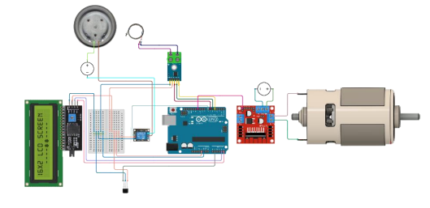
METHODOLOGY
03
Circuit diagram

Slide 20
METHODOLOGY
03
Arduino code
// Include necessary libraries
#include <Wire.h> // Required for I2C communication
#include <LiquidCrystal_I2C.h> // For the I2C LCD
#include <max6675.h> // For the thermocouple
// --- I2C LCD Setup ---
// Set the LCD address (common addresses are 0x27 or 0x3F)
// If unsure, use an I2C Scanner sketch to find the correct address
LiquidCrystal_I2C lcd(0x27, 16, 2); // Address 0x27, 16 columns, 2 rows
// --- Thermocouple Pins ---
int thermoDO = 4;
int thermoCS = 5;
int thermoCLK = 6;
MAX6675 thermocouple(thermoCLK, thermoCS, thermoDO);
// --- Heater Relay ---
int heaterRelay = 7;

Slide 21
METHODOLOGY
03
Arduino code
// --- L298 Motor Pins ---
int enA = 9; int in1 = 8; int in2 = 10; // Screw Motor
int enB = 11; int in3 = 12; int in4 = 13; // Puller Motor
// --- Filament Sensor ---
#define NUMTEMPS 4
#define smooth 50
#define sensIn A1
// Lookup Table for filament diameter calibration
// * IMPORTANT: Check if these values match your sensor readings! *
static float lut3[NUMTEMPS][2] = {
{494, 0},
{495.1, 0.5},
{498.0, 1},
{512.8, 2.5}
};
float sensbuf = lut3[0][0]; // Initialize smoothed buffer

Slide 22
METHODOLOGY
03
Arduino code
// --- Target Control Variables ---
float targetTemp = 190;
float targetDiameter = 1.75;
int baseSpeed = 150;
int pullerSpeed = baseSpeed;
// --- Variables for LCD display timing & state ---
unsigned long lastLcdUpdateTime = 0;
// * Adjust LCD Update Speed Here (milliseconds) *
const unsigned long lcdUpdateInterval = 1500; // Update LCD every 1.5 seconds (change as needed)
String lastStatusMessage = "";
bool showStatusOnLcd = false; // Flag to alternate LCD line 2
void setup() {
Serial.begin(9600);
// Serial.println("Smart Extrusion System Initializing..."); // Optional: Keep or remove
// Serial.println("Initialization Complete."); // Optional: Keep or remove

Slide 23
METHODOLOGY
03
Arduino code
// Initialize LCD
lcd.init(); // Initialize the LCD
lcd.backlight(); // Turn on the backlight
lcd.setCursor(0, 0);
lcd.print("Initializing...");
// Initialize Pins
pinMode(heaterRelay, OUTPUT);
pinMode(in1, OUTPUT); pinMode(in2, OUTPUT);
pinMode(in3, OUTPUT); pinMode(in4, OUTPUT);
// Set motors to forward initially
digitalWrite(in1, HIGH); digitalWrite(in2, LOW);
digitalWrite(in3, HIGH); digitalWrite(in4, LOW);
delay(1000); // Wait a bit for sensors to stabilize
lcd.clear();
}

Slide 24
METHODOLOGY
03
Arduino code
void loop() {
// Read current temperature
float currentTemp = thermocouple.readCelsius();
// Heater ON/OFF Control (Bang-Bang)
if (currentTemp < targetTemp - 5) {
digitalWrite(heaterRelay, HIGH);
} else if (currentTemp > targetTemp + 5) {
digitalWrite(heaterRelay, LOW);
}
bool heaterState = digitalRead(heaterRelay);
// --- Read filament diameter ---
int rawSensor = analogRead(sensIn);
sensbuf += (rawSensor - sensbuf) / smooth;
float diameter = lookup(sensbuf, lut3);
// --- Adaptive Adjustment Logic ---
float error = diameter - targetDiameter;
String currentStatus = ""; // Status for this loop iteration
bool printStatusLine = false; // Flag to print status on a new line

Slide 25
METHODOLOGY
03
Arduino code
if (diameter > 0 && error > 0.05) { // Only adjust if diameter reading is valid
// Too thick -> pull faster
pullerSpeed += 10;
pullerSpeed = constrain(pullerSpeed, 100, 255);
currentStatus = "Filament too thick ➜ Increasing puller speed";
printStatusLine = true;
} else if (diameter > 0 && error < -0.05) { // Only adjust if diameter reading is valid
// Too thin -> increase temp (original logic)
} else if (diameter > 0 && error < -0.05) {
// Too thin → pull slower
pullerSpeed -= 10;
pullerSpeed = constrain(pullerSpeed, 100, 255); // You can allow down to 80 or lower if needed
currentStatus = "Filament too thin ➜ Decreasing puller speed";
printStatusLine = true;
} else if (diameter <= 0) {
currentStatus = "Sensor Error?"; // Keep this for LCD
// Don't print a specific status line for sensor error in the requested format
} else {
currentStatus = "Diameter OK"; // Keep this for LCD
// Don't print a status line if diameter is OK
}

Slide 26
METHODOLOGY
03
Arduino code
// Update the status message for LCD if it changed
if (currentStatus != lastStatusMessage) {
lastStatusMessage = currentStatus;
}
// Set Motor Speeds
analogWrite(enA, baseSpeed); // Screw motor
analogWrite(enB, pullerSpeed); // Puller motor
// --- Serial Monitoring (Formatted as requested) ---
Serial.print("Temp: "); Serial.print(currentTemp, 2); // Use 2 decimal places like original example
Serial.print(" °C | Heater: "); Serial.print(heaterState ? "ON" : "OFF");
Serial.print(" | Diameter: "); Serial.print(diameter, 3);
Serial.print(" mm | Puller Speed: "); Serial.println(pullerSpeed);
// Print status message on a new line if needed
if (printStatusLine) {
Serial.println(currentStatus);
}

Slide 27
METHODOLOGY
03
Arduino code
// --- LCD Update Logic (Unchanged) ---
unsigned long currentTime = millis();
if (currentTime - lastLcdUpdateTime >= lcdUpdateInterval) {
lastLcdUpdateTime = currentTime;
showStatusOnLcd = !showStatusOnLcd; // Toggle flag each update
// Line 0: Temperature and Heater Status (Always shown)
lcd.setCursor(0, 0);
String line0 = "T:" + String(currentTemp, 1) + " H:" + (heaterState ? "ON " : "OFF");
lcd.print(line0);
// Pad with spaces to clear rest of line
for (int i = line0.length(); i < 16; i++) { lcd.print(" "); }
// Line 1: Alternate between Diameter/Puller and Status Message
lcd.setCursor(0, 1);
String line1 = "";

Slide 28
METHODOLOGY
03
Arduino code
if (showStatusOnLcd && lastStatusMessage != "") {
// Display the status message (use the internal status, e.g., "Thin->Inc Temp")
if (lastStatusMessage == "Filament too thick ➜ Increasing puller speed") line1 = "Thick->Pull Faster";
else if (lastStatusMessage == "Filament too thin ➜ Increasing temp slightly") line1 = "Thin->Inc Temp";
else line1 = lastStatusMessage; // Display other statuses like "Sensor Error?" or "Diameter OK"
} else {
// Display Diameter and Puller Speed
line1 = "D:" + String(diameter, 2) + " P:" + String(pullerSpeed);
}
lcd.print(line1);
// Pad with spaces to clear rest of line
for (int i = line1.length(); i < 16; i++) { lcd.print(" "); }
}
// Short delay - adjust if needed, but LCD updates control the main timing
delay(1000);
}

Slide 29
METHODOLOGY
03
Arduino code
// --- Lookup Table Interpolation Function (Unchanged) ---
float lookup(float inval, float lut[][2]) {
byte i;
// Check if below the first entry
if (inval <= lut[0][0]) {
return lut[0][1]; // Return the diameter associated with the lowest raw value (0 in this case)
}
// Check if above the last entry
if (inval >= lut[NUMTEMPS - 1][0]) {
return lut[NUMTEMPS - 1][1]; // Return max diameter
}
// Find the interval and interpolate
for (i = 1; i < NUMTEMPS; i++) {
if (lut[i][0] >= inval) { // Find the first raw value in the table >= input value
// Interpolate within the interval [i-1, i]
float val1 = lut[i-1][0]; // Lower raw value
float val2 = lut[i][0]; // Upper raw value
float out1 = lut[i-1][1]; // Lower diameter
float out2 = lut[i][1]; // Upper diameter

Slide 30
METHODOLOGY
03
Arduino code
// Perform linear interpolation
return out1 + (inval - val1) * (out2 - out1) / (val2 - val1);
}
}
// Should not be reached due to checks above, but return max as fallback
return lut[NUMTEMPS - 1][1];
}

Slide 31
HARDWARE
04
ACTUAL WORKING MACHINE MADE

Slide 32
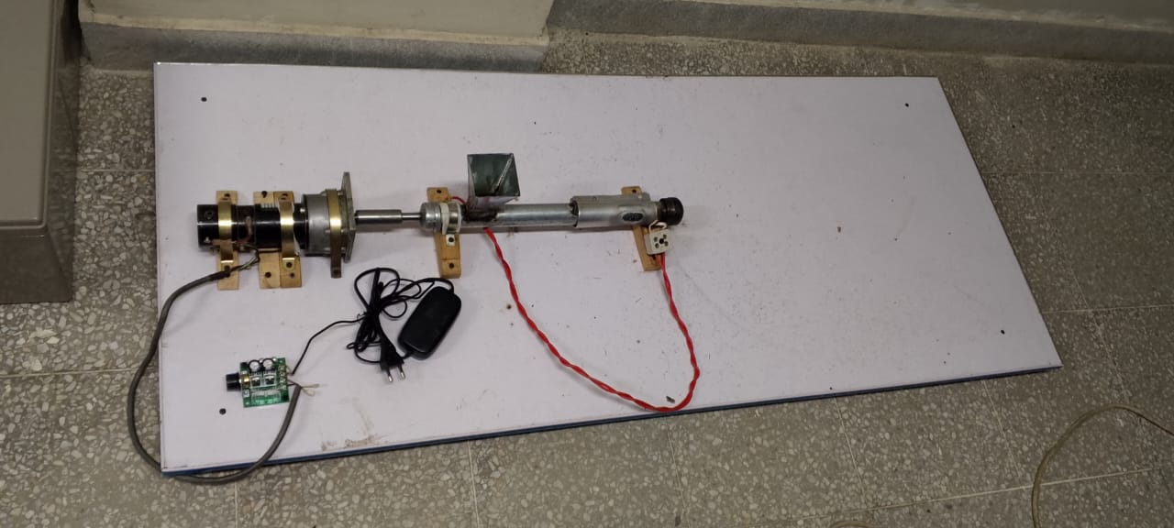
HARDWARE
04

Slide 33
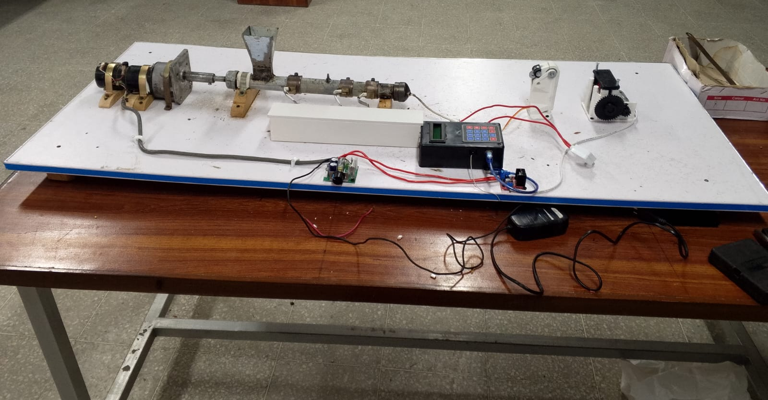
HARDWARE
04

Slide 34
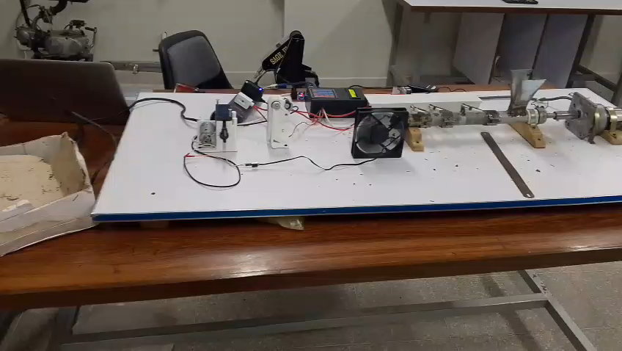
HARDWARE
04

Slide 35
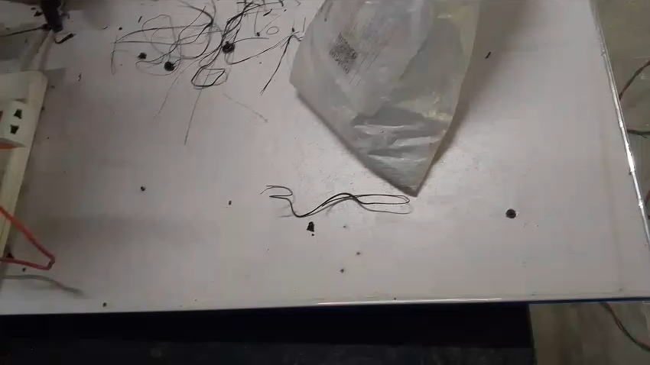
HARDWARE
04

Slide 36
TIMELINE
05
TIME MANAGEMENT FOR PROJECT

Slide 37
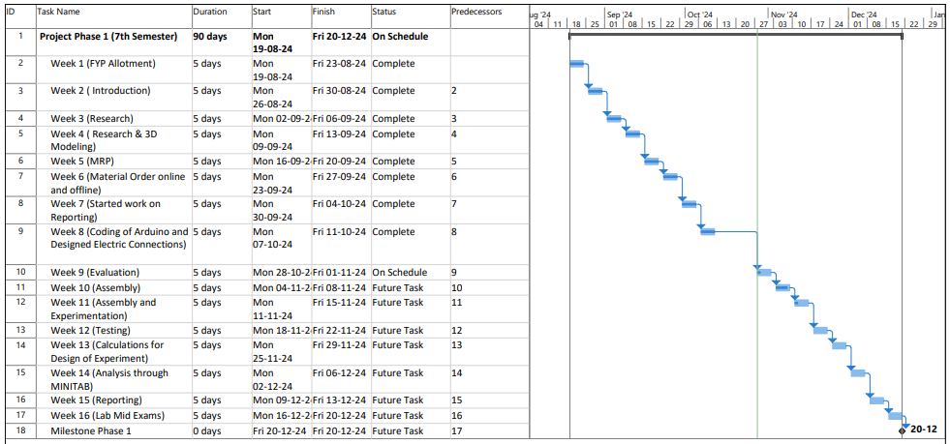

Slide 38
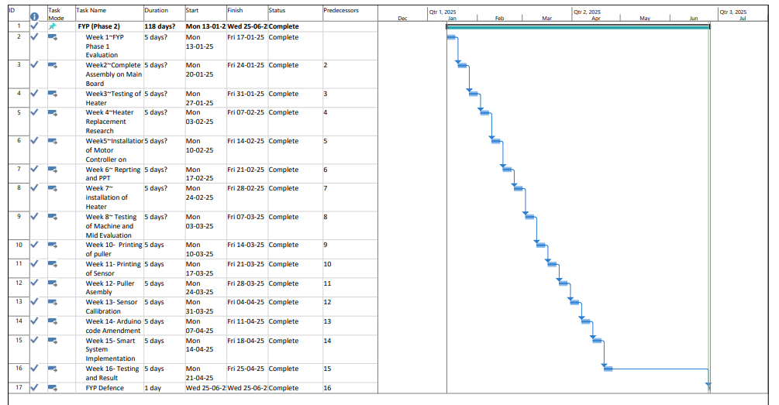

Slide 39
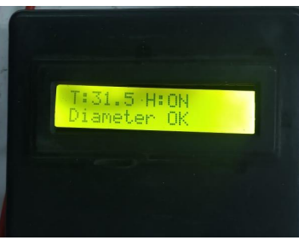
RESULTS & ANALYSIS
06
DIAMETER SENSOR VALIDATION

Slide 40
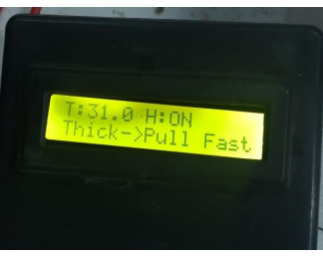
RESULTS & ANALYSIS
06
PULLER CONTROL LOGIC TESTING
When the filament is thick counted by diameter sensor then signal is sent to L298 through Arduino to increase the puller speed.
When the filament is thin counted by diameter sensor then signal is sent to L298 through Arduino to decrease the puller speed

Slide 41
RESULTS & ANALYSIS
06
CFD ANALYSIS
Objective: To understand material flow inside the extrusion barrel using CFD analysis.
Challenge: Internal flow is unobservable due to barrel confinement and material opacity.
Solution: CFD provides a non-invasive method to visualize and analyze flow dynamics.
Benefit: Helps verify design validity and mechanical soundness of the extrusion system.
Focus: Simulated thermal and flow behavior of molten PLA through the screw and nozzle.

Slide 42
RESULTS & ANALYSIS
06
GEOMETRY PREPARATION AND MESHING
Tool Used: ANSYS Meshing with CFD physics preference and Fluent solver
Mesh Strategy: Linear element order selected for faster computation under laminar flow
Element Size: Default size 25.102 mm with defeaturing to simplify minor geometry
Mesh Refinement: Curvature and proximity capturing enabled for complex shapes
Key Parameters:
  Curvature min: 2.0 mm
  Proximity: 1.0 mm
  Defeature size: 0.12551 mm
  Mesh growth rate: 1.2 (for stability)
Element Details:
  Max element size: 50.204 mm
  Avg surface area: 1262.1 mm²
  Min edge length: 0.88942 mm
Focus Areas: Enhanced resolution near screw surfaces and nozzle for accurate flow prediction
Efficiency: Balanced mesh quality with low computational load

Slide 43
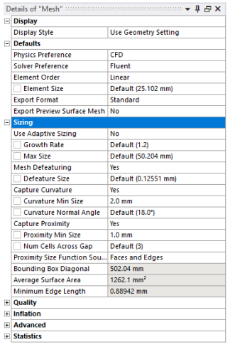
RESULTS & ANALYSIS
06
DETAILS OF MESH

Slide 44
RESULTS & ANALYSIS
06
BOUNDARY CONDITION & SOLVER SETUP
Boundary Conditions: Set to reflect realistic operating environment
Material Model: Molten PLA treated as incompressible, non-Newtonian, high-viscosity fluid
Flow Type: Laminar flow assumption due to low Reynolds number
Inlet Condition: Mass flow inlet based on experimental extrusion rate
Outlet Condition: Pressure outlet set to atmospheric pressure (open-end discharge)
Thermal Setup: Barrel walls maintained at constant 175 °C (heater environment)
Wall Condition: No-slip condition assumed for full fluid-wall adherence
Solver Used: Steady-state, pressure-based solver suitable for high-viscosity laminar flow.

Slide 45
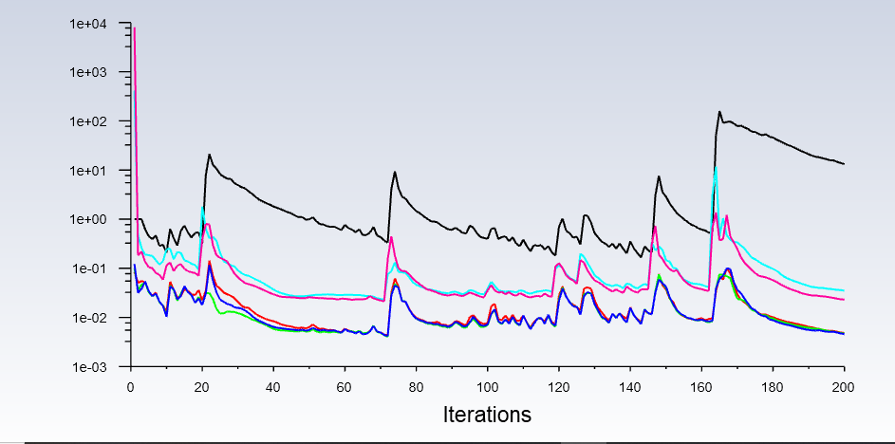
RESULTS & ANALYSIS
06
ITERATIONS VS VELOCITY

Slide 46
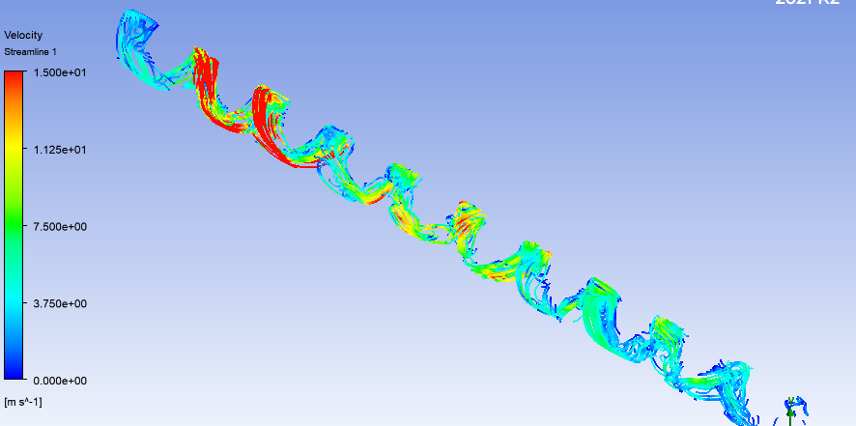
RESULTS & ANALYSIS
06
CFD FLOW ANALYSIS
Red (~15 m/s)
Blue (~0 m/s)

Slide 47
CONCLUSIONS
06
The system integrates key components with an Arduino Uno-based control unit.
Sensor-based automation was achieved using real-time feedback from a K-type thermocouple and diameter sensor, enabling thermal regulation and filament sizing through closed-loop control.
The CAD-based mechanical design ensured compactness and ease of fabrication using accessible materials.
CFD and thermal-structural simulations validated the system’s flow behaviour, heat distribution, and mechanical stability, reducing reliance on physical trials.
The project confirms the feasibility of a self-regulating, sustainable filament extrusion unit for eco-friendly 3D printing applications.

Slide 48
ENDING
06
THANK
YOU

