Slide 1
FairLoad
A working decision tool for sharing donated food fairly
Problem statement DN-SI-01: Food Bank Resource Allocation Optimization
Track: Healthcare & Social Impact | DataNova 2026 Global Data-thon
Team: 404 Error Found
Live demo: https://huzaifaguru.github.io/fairload/
Notes:
FairLoad helps a food bank decide where limited food should go each week, and shows the trade-offs behind each decision. The dots are real Delaware ZIP codes from the public data we used. Yellow diamonds mark the two Food Bank of Delaware facility areas.

Slide 2



Every shipment trades off speed, reach and fairness
Food banks receive donations they cannot fully predict, then must place them across many communities with limited trucks, storage and time.
Food has a clock
Capacity is limited
Fair is not simple
Fresh produce can spoil while it waits, so holding stock for a better plan has a real cost.
Trucks, cold storage and pantry intake restrict what can move, even when food is available.
Delivering the most pounds can favor easy-to-reach sites over the communities with the greatest need.
Who it is for: food bank operations managers and allocation planners who must make and defend these decisions every week.
Why it matters: a poor allocation can mean wasted food and unmet need at the same time.
Notes:
Research on food bank distribution, including Orgut et al. in IIE Transactions 2016, treats equity and effectiveness as competing goals under capacity limits. That is the decision we are supporting.

Slide 3
Real data shows pounds and local need can diverge sharply
181×
gap between the highest and lowest ZIP (159 vs 0.9 lb)
14%
of Delaware's people in poverty live in ZIPs with no mobile pantry record
Read with care: this covers mobile pantries only. Urban ZIPs may rely on fixed pantries, so a gap is a question to investigate, not proof of unfairness.
Sources: Food Bank of Delaware Mobile Pantries, Q1–Q2 FY25 (FirstMap Delaware); ACS 2020–2024 5-year, table B17001 (via Census Reporter). 1,484,579 lb across 31 ZIPs after cleaning; ZIP codes matched to ZCTAs.
Notes:
We joined public pantry records to Census poverty counts. We removed 5 records: a one-off mass event, two implausible values, one missing value and one exact duplicate. We excluded one ZIP with no measured poverty. The field name suggests pounds and boxes may be mixed. We checked: the smallest value kept is 2,251, which would be an implausible 45,000 pounds even at 20 pounds per box, so we read the field as pounds. Only the data owner can confirm this.

Slide 4
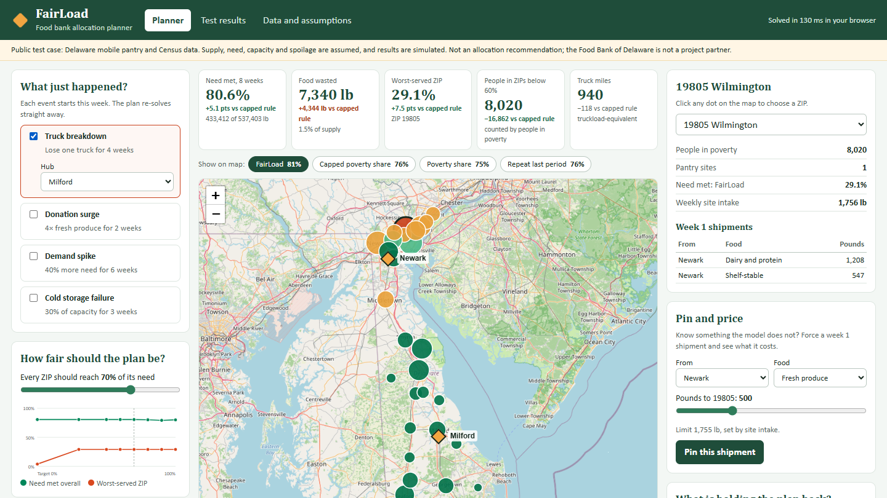




FairLoad turns a weekly allocation into a decision you can test
Recommend
Generates a shipping plan across hubs and pantries for each food type.
Stress-test
Re-solves live for a truck failure, donation surge or demand spike.
Balance
A fairness slider shows pounds delivered against the worst-served area.
Pin and price
A manager forces a shipment and sees exactly what that choice costs.
The working planner, shown with a truck breakdown at Milford. Dots are real ZIP locations sized by people in poverty, colored by share of need met. Supply, need and capacity are assumed. Base map: OpenStreetMap contributors.
Notes:
This is the real app, not a concept. The pin and price feature is the core of the idea. Real managers know things a model does not. FairLoad lets them overrule the model and shows the cost in food delivered, waste and which ZIPs give up the most. The model advises and the human decides.

Slide 5

The optimizer re-solves each week under capacity limits
Public data
Need estimate
Optimizer
Scenario tests
Human decision
Pantry records and poverty counts by ZIP
People in need and pounds required, by ZIP
Multi-week linear program solved with HiGHS
Plans tested on 30 simulated runs per scenario
Review, pin, re-solve and export
It decides
It minimizes
It respects
Pounds per route, week and food type
Stock to hold, by shelf-life bucket
Food wasted
Need left unmet
Falling short of an equity target, with a rising penalty
Truck time and hub stock
Pantry intake and cold storage
Spoilage over time
No server required. React, Leaflet and HiGHS compiled to WebAssembly run on free static hosting, so the demo stays available and food data can stay on the user's device.
Notes:
A linear program gives an exact optimum and full traceability, which suits a decision people must be able to explain. Each week it reads actual stock and orders, plans four weeks ahead on average forecasts, carries out week one and repeats. Testing found a flaw in our first equity penalty: a flat penalty let high fairness targets starve a far ZIP. We changed to a penalty that rises with the gap and added a regression test.

Slide 6
Our first pilot: a simple rule matched the optimizer
Measure | Current | Simple rule ±50% | Optimizer ±50%
Average shortfall (lb per person) | 5.17 | 3.50 | 3.50
People in low-coverage ZIPs | 27,426 | 15,312 | 15,312
Worst-served ZIP (lb per person) | 0.88 | 1.32 | 1.32
Pounds moved | 0 | 167,178 | 273,256
Estimated truck miles vs current | 100% | 96% | 100%
−32%
average shortfall for both plans, using the same total pounds
What this tells us
Truck miles did not limit this simple case, so the optimizer added no benefit. So the full model had to beat rules once spoilage, truck time and disruptions apply.
Pilot on historical mobile pantry data; a feasibility test, not an allocation recommendation. Simple rule: split by share of people in poverty, with each ZIP limited to ±50% of its current pounds. Low coverage: below half the average pounds per person in poverty. Assumes 1.3× road circuity, 20,000 lb per truckload and approximate hub locations; this pilot did not model demand or spoilage.
Notes:
Average shortfall is how far each ZIP falls below the average pounds per person in poverty, weighted by people in poverty. Both plans cut it by 32 percent. The number of people in low-coverage ZIPs also falls by 44 percent, but that measure is sensitive to ZIPs crossing the threshold, and the worst-served ZIP barely moves. In this simple case truck miles do not limit the plan, so a simple rule matches the optimizer while moving less food. This set the bar for the full model, which comes next. We do not recommend moving food away from rural sites on this evidence, because fixed pantries are missing from the data.

Slide 7
Research provides the models; FairLoad makes them usable
 | Published food bank models | FairLoad
Form | Mathematical models and numerical studies | Interactive tool that runs in any browser
Overrides | Not the focus of the work we reviewed | Pin any shipment and see its cost
Disruption | Studied as uncertainty within a model | Trigger an event and re-solve on the spot
Fairness | A set bound or parameter | A slider that shows the trade-off
Evidence | Studies based on specific food bank data | Public data, open assumptions, repeatable tests
We credit this research directly: our contribution is the decision experience around it, not new optimization theory.
Research reviewed at abstract level: Orgut, Ivy, Uzsoy & Wilson, IIE Transactions (2016); Orgut, Ivy, Uzsoy & Hale, European Journal of Operational Research (2018).
Notes:
We are honest about where the originality lies. The research community has already established strong equity models, including stochastic and robust versions. The new part is putting those ideas in the hands of a manager, with overrides priced by the model.

Slide 8
We tested FairLoad against five baselines and a best case
Compare against
Measure
Poverty share
Split by people in poverty, with and without a ±50% limit
% of estimated need met
Pounds of food wasted
Worst-served ZIP and people in low-coverage ZIPs
Truck miles
Solve time in the browser
Last period
Repeat the previous allocation
Truck-aware rule
Shortest routes first, every ZIP up to a 70% floor
How we kept it honest
One-forecast plan
Optimize once and do not re-solve
Reported 30 random runs per scenario, kept apart from the runs we tuned on
Varied 16 settings, including truck time, spoilage and need
Sent every policy through the same simulator and limits
Perfect hindsight
Knows the future; used as an upper bound
All results are simulated. They are not real-world savings.
Notes:
The rules are not strawmen. They re-offer leftovers to ZIPs that can still take food, and the truck-aware rule was added because hand rules ignore truck time. The weights and default equity target were set before reported runs. One disclosure: we fixed the equity penalty after a first test run, because the flaw appeared in the planner. The headline gain barely changed.

Slide 9
In all 6 scenarios, FairLoad met more need than any rule tested
Scenario | Strongest rule | Rule | FairLoad | Gain (points) | 95% interval | Waste change (lb)
Normal weeks | Shortest routes + floor | 82.6% | 85.4% | +2.8 | 2.5 to 3.1 | +36
Truck breakdown | Shortest routes + floor | 79.1% | 82.5% | +3.4 | 3.0 to 3.7 | +2,203
Produce donation surge | Shortest routes + floor | 83.6% | 86.2% | +2.7 | 2.4 to 3.0 | −876
Demand spike in one county | Shortest routes + floor | 77.2% | 80.0% | +2.8 | 2.5 to 3.1 | +46
Cold storage failure | Shortest routes + floor | 81.9% | 85.0% | +3.0 | 2.7 to 3.4 | +376
Truck breakdown and demand spike | Shortest routes + floor | 74.1% | 77.5% | +3.4 | 3.0 to 3.8 | +987
Close to the limit: FairLoad came within 0.4 points of perfect hindsight on normal weeks, and solved in about 34 ms per week.
Simulated: 30 paired 12-week runs per scenario. Need met is pounds delivered as a share of estimated need. The strongest rule is chosen after the fact in each scenario, which favors the rules. Waste change is FairLoad minus that rule over 12 weeks.
Notes:
The gain ranges from 2.7 to 3.4 percentage points. The strongest rule was chosen after seeing the results, so this comparison leans in favor of the rules. On normal weeks the gain is about 22,292 pounds over 12 weeks. FairLoad won every one of the 30 paired runs against the truck-aware rule in each scenario.

Slide 10
The gain depends on truck time, and waste did not reliably fall
Check truck time first
We have no real fleet data. If trucks are plentiful, a simple rule is nearly as good, as our pilot suggested.
Waste is not the win
Against the strongest rule, waste moved −876 to +2,203 lb. A produce surge wastes about 48,010 lb under every plan.
Allocation cannot fix a site gap
ZIP 19805 stays below 30% of need under every plan. One more site lifts it to 58% in the model. Check fixed pantries first.
A fairness target cost little
Moving the target from 0% to 70% cut people in ZIPs below 60% from 21,107 to 10,937, for 0.4 points of need met.
Simulated, 15 runs per setting, normal weeks unless noted. The fairness figures use a truck breakdown plus a demand spike. Every sensitivity setting and interval is in the app and in docs/RESULTS.md.
Notes:
This is the most important slide for anyone who wants to use the tool. Most of the gain comes from using limited truck time better. The first thing a food bank should check is whether its trucks actually limit delivery. If they do not, our own results say a simple rule is close. FairLoad did not consistently reduce waste. The tool also showed that some gaps are about sites, not allocation.

Slide 11



We state what is real, what is assumed and who stays in charge
Real data
Assumed and disclosed
Responsible use
Pantry pounds, locations and site counts
People in poverty and population by ZIP
Weekly need and donation flows
Food mix and spoilage rates
Truck, storage and site capacity
Road distances
Aggregate data only; no personal records
People make the final decision
Every override is visible
Attribution to data owners
Known limits: mobile pantry records only, two quarters of data, poverty used as a proxy for need, and most sites observed only once. Delaware is a public test case; the Food Bank of Delaware is not a project partner.
Notes:
A fairness tool that hides its assumptions would be a contradiction. Poverty is an imperfect proxy for food insecurity, and we did not add county food-insecurity estimates as first planned. We tested a blend of poverty and population instead. We have not worked with the Food Bank of Delaware, and we do not claim they endorse this work.

Slide 12




Cheap to run, easy to adapt, and ready to try
Impact and feasibility
Status and next steps
Low cost
Free static hosting, with no license or server fees
Built
Full model, browser app, tests, scenario analysis and documentation
Adaptable
Another food bank can upload its own CSV; it stays in the browser
Check
Replace assumptions with real fleet, storage and need data
Beyond food
The approach could extend to medical and disaster supply allocation
Add
Fixed pantries, and ZIPs with no mobile pantry record
Actionable
Prices extra resources: one more Milford truck, +2.0 points of need met in the model
Pilot
Run alongside a planner's real weekly decisions before relying on it
Notes:
We delivered the code, documentation, scenario analysis and presentation that the problem statement asks for. Before anyone relies on this, it needs real fleet, storage and need data, and a trial alongside real planning decisions.

Slide 13
404 Error Found
Better decisions about who gets food, with the reasoning in plain sight.
Team: Syed Mohammad Huzaifa, Shaikh Muhammad Zain, Muhammad Maaz Ur Rehman
Live demo: https://huzaifaguru.github.io/fairload/
Notes:
Thank you. We would welcome your questions about the model, the data or the assumptions.

