Slide 1
PhD Forum: Evaluating and Designing Routing Protocols for Reliable Distributed Quantum Systems
Huzaifah Nadeem
Department of Computer Science
University of Pittsburgh

Slide 2
Background & Motivation

Slide 3
Distributed Quantum Systems
Applications:
Leadership elections without communication [DP2008]
Clock Synchronization [Kómár+2014]
Quantum Key Distribution (a cryptographic protocol) [BB2014]
Distributed Quantum Algorithms [DP2008]
etc
Prerequisites:
Quantum Computers
Reliable Quantum Networks
[DP2008] Vasil S. Denchev and Gopal Pandurangan. “Distributed quantum computing: a new frontier in distributed systems or science fiction?” In: SIGACT News 39.3 (Sept. 2008), pp. 77–95.
[Kómár+2014] P. Kómár, E. M. Kessler, M. Bishof, L. Jiang, A. S. Sørensen, J. Ye and M. D. Lukin “A quantum network of clocks”. In: Nature Physics 10.8 (Aug. 2014), pp. 582–587
[BB2014] Charles H. Bennett and Gilles Brassard. “Quantum cryptography: Public key distribution and coin tossing”. In: Theoretical Computer Science 560 (2014). Theoretical Aspects of Quantum Cryptography – celebrating 30 years of BB84, pp. 7–11

Slide 4
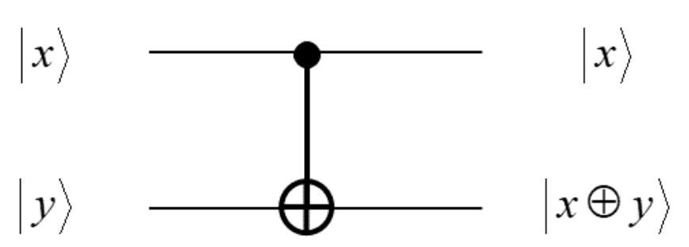
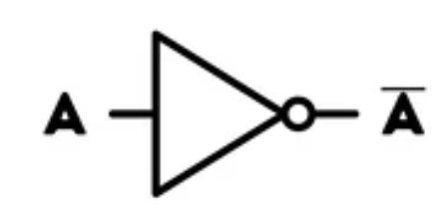
Quantum Computing
Quantum Bits aka “Qubits”
vs. Digital Bits
|ψ⟩ = α |0⟩ + β |1⟩
Logical qubits and Physical Realization
Quantum Gates
Mathematically: Matrices with certain properties
Actual gates are noisy
NOT Gate
(Digital Gate)
CNOT Gate
(Quantum Gate)
Notes:
TODO: make sure the pictures are free to use (rights stuff)

Slide 5
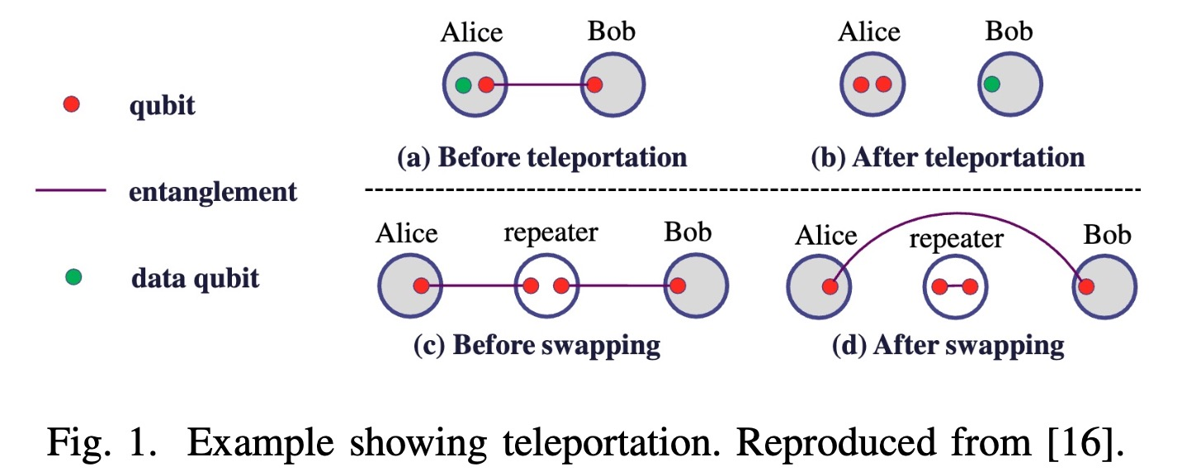
Quantum Networking
Transmitting Qubits:
“Tell-n-go” approach
Exponential loss over length
State Teleportation
EPR Pairs
Swap operation
End-to-end EPR pairs
Application will use them to teleport the data qubit
Some applications use them directly
Example showing teleportation.
Reproduced from [SQ2020]
[SQ2020] Shi, S., & Qian, C. (2020). Concurrent Entanglement Routing for Quantum Networks. SIGCOMM ’20. https://doi.org/10.1145/3387514.3405853
Notes:
TODO: cite for fig properly

Slide 6
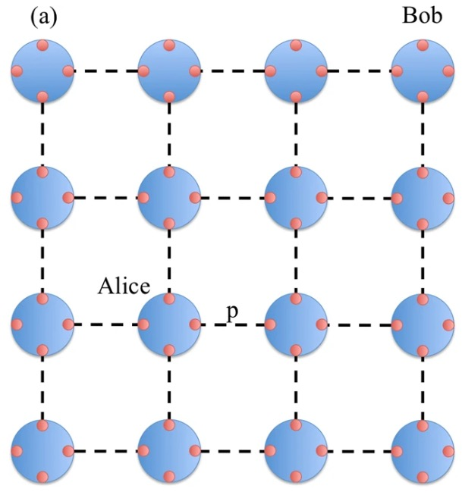
Example
Figure adapted from [Pant+2019]
[Pant+2019] Pant, M., Krovi, H., Towsley, D., Tassiulas, L., Jiang, L., Basu, P., Englund, D., & Guha, S. (2019). Routing entanglement in the quantum internet. Npj Quantum Information, 5(1). https://doi.org/10.1038/s41534-019-0139-x
Notes:
TODO fix citation

Slide 7

Example
Figure adapted from [Pant+2019]
[Pant+2019] Pant, M., Krovi, H., Towsley, D., Tassiulas, L., Jiang, L., Basu, P., Englund, D., & Guha, S. (2019). Routing entanglement in the quantum internet. Npj Quantum Information, 5(1). https://doi.org/10.1038/s41534-019-0139-x
Notes:
TODO fix citation

Slide 8
Example
Figure adapted from [Pant+2019]
[Pant+2019] Pant, M., Krovi, H., Towsley, D., Tassiulas, L., Jiang, L., Basu, P., Englund, D., & Guha, S. (2019). Routing entanglement in the quantum internet. Npj Quantum Information, 5(1). https://doi.org/10.1038/s41534-019-0139-x
Notes:
TODO fix citation

Slide 9
Example
Figure adapted from [Pant+2019]
[Pant+2019] Pant, M., Krovi, H., Towsley, D., Tassiulas, L., Jiang, L., Basu, P., Englund, D., & Guha, S. (2019). Routing entanglement in the quantum internet. Npj Quantum Information, 5(1). https://doi.org/10.1038/s41534-019-0139-x
Notes:
TODO fix citation

Slide 10
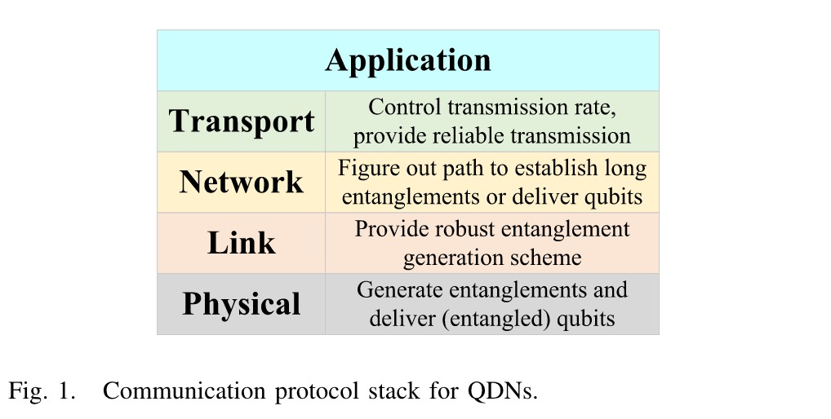
Quantum Networking
Quantum Network Stack:
Figure reproduced from [ZQ2023]
[ZQ2023] Yangming Zhao and Chunming Qiao. “Distributed Transport Protocols for Quantum Data Networks”. In: IEEE/ACM Transactions on Networking 31.6 (2023), pp. 2777–2792. DOI: 10.1109/TNET.2023.3262547.
Notes:
Mostly focus on network layer as that is our focus + link/physical where relevant since we want those details through netsquid etc

Slide 11
Quantum Routing Algorithms

Slide 12
Quantum Routing Algorithms
Quite a few, but we will focus on (initially):
SLMP (and variants) [Pant+2019]
QPASS [SQ2020]
Differences:
Heuristics
Calculating routes over the q. link subgraph or the overall network graph
Global link state knowledge, local link state knowledge, etc.
[Pant+2019] Pant, M., Krovi, H., Towsley, D., Tassiulas, L., Jiang, L., Basu, P., Englund, D., & Guha, S. (2019). Routing entanglement in the quantum internet. Npj Quantum Information, 5(1). https://doi.org/10.1038/s41534-019-0139-x
[SQ2020] Shi, S., & Qian, C. (2020). Concurrent Entanglement Routing for Quantum Networks. SIGCOMM ’20. https://doi.org/10.1145/3387514.3405853

Slide 13
This Work

Slide 14
Quantum Network Simulators
Each routing algorithm has its own
Problems & challenges:
Tightly bound to the routing algorithms’ structure and working
Limited lower-level models and functionality
Unfair to compare algorithms using their own simulators
NetSquid [Coopmans+2021]
A quantum network simulator for physical and link layer protocols
Simulates quantum hardware operations on qubits (in detail)
Well-supported in the Physics community
[Coopmans+2021] Tim Coopmans et al. “NetSquid, a NETwork Simulator for QUantum Information using Discrete events”. In: Communications Physics 4.1 (July 2021), p. 164. ISSN: 2399-3650. DOI: 10.1038/s42005-021-00647-8.

Slide 15
Plan
NetSquid as a base
Quantum Information package [Cubitt2013]
Target: Higher level abstractions
[Cubitt2013] Toby Cubitt. Quantum Information Package. (28 December 2013). URL: https://www.dr-qubit.org/matlab.html

Slide 16
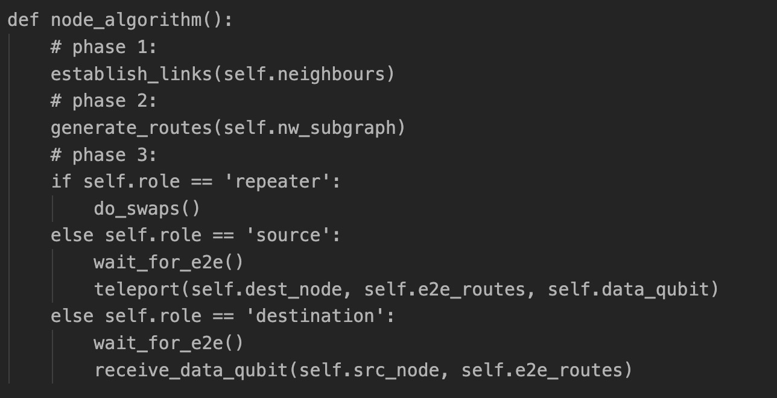
Pseudocode Example
What we want:
Notes:
Simplified example

Slide 17
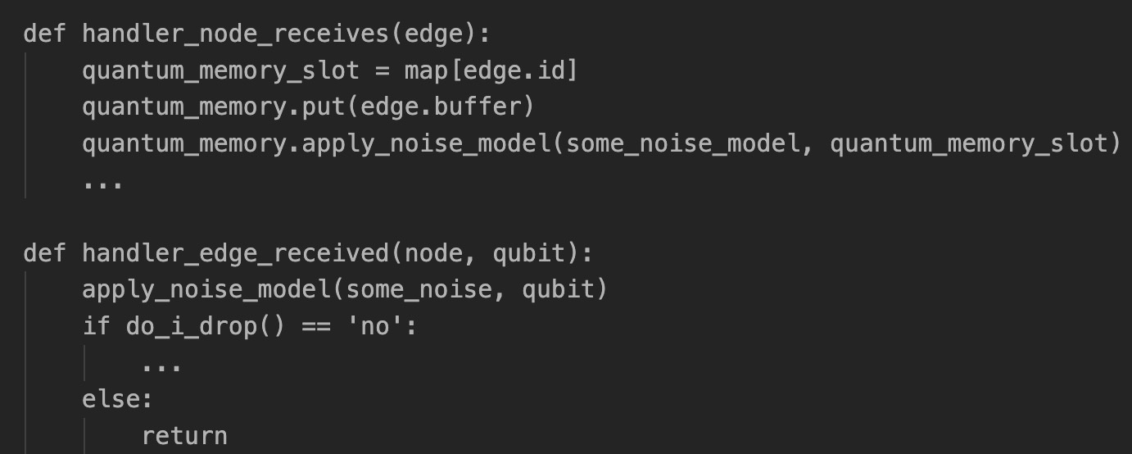
Pseudocode Example
What NetSquid provides:
Notes:
Simplified example

Slide 18
How would such a tool help?
Understand how different routing algorithms work on realistic quantum networks
Realistic network topologies
Realistic hardware modelling (e.g. quantum memories, channels)
Get insights into tradeoffs between routing algorithms
How do different design choices affect our performance (by various metrics: E2E pair generation rate, some cost metric, fidelity, etc)
Basically,
Help us really understand, through experimentation, how they work
Help us better design and evaluate these algorithms
Notes:
This is the big picture here. Next specific questions

Slide 19
What we hope to answer
What is the effect of the average degree of a node for the QPASS algorithm?
The algorithm uses a heuristic based approach to route qubits
What if you have nodes with high degree but less reliable (in terms on noise introduced by them)
Might make the algorithm’s performance worse
Notes:
- What is the effect of the average degree of a node for the
QPASS algorithm in [QP paper]? The algorithm uses a heuristic
based approach to route qubits and having nodes with
high degree but less reliability, in terms of the noise
they introduce, might make the algorithm’s performance
worse.

Slide 20
What we hope to answer
What is average consumption of EPR pairs for SLMP and QPASS?
There would likely be some ‘cost’ associated with generating an EPR pair
Cost can be time, processing, monetary, etc.
For certain cost-effective quantum networks and systems, this might be important.
Notes:
- What is average consumption of EPR pairs for [SLMP]
and [QPASS]. There should be some cost associated with
generating EPR pairs and taking that into account would
be important for cost-effective quantum networks and
systems.

Slide 21
What we hope to answer
What is the average fidelity of paths that SLMP and QPASS are routing over?
Fidelity requirements can vary for different applications, and they do not take that into account.
Should we be taking that into account? Or do these algorithms perform ‘good enough’ for most applications.
Notes:
- What is the average fidelity of paths that [16] and [13] are
routing over? Fidelity requirements can vary for different
applications and they do not take that into account.

Slide 22
What we hope to answer
How does SLMP work on non-grid topologies?
Their (numerical) analysis limited to grids
They claim that it works on all topologies
It ignores edge lengths
OK for a grid but not so much for others
Exponential loss over length
Notes:
- How does [SLMP] work on non-grid topologies? This is
important to understand since it does claim that the algo-
rithm should work on any topology. However, it has only
been evaluated on a grid. Moreover, the algorithm seems
to be made specifically for grid with same edge lengths.
We would like to test it with different assumptions.

Slide 23
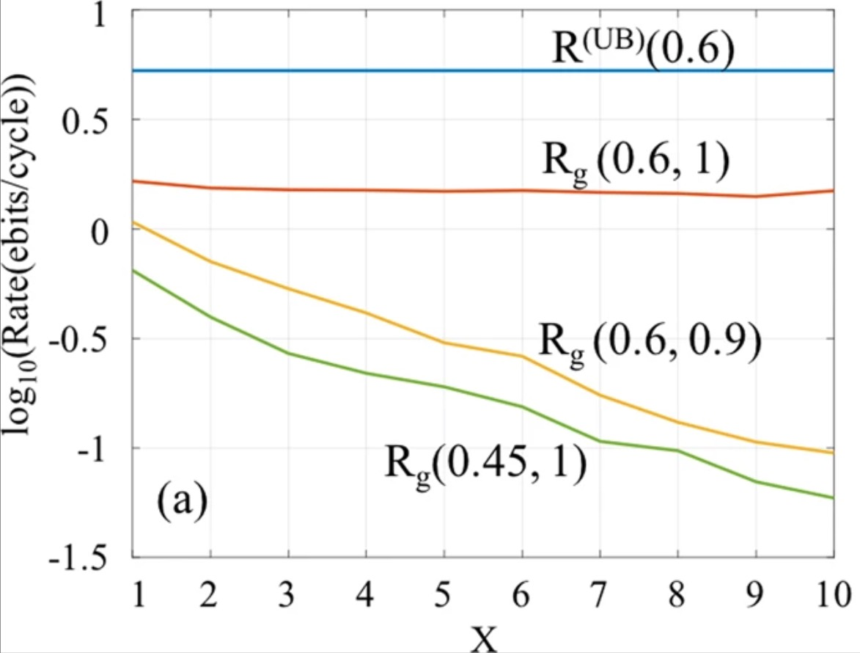
Preliminary Results
Log₁₀(Rate(ebits/cycle))
x-distance on the grid (# of hops)
Results from an early version of the tool
Figure 1(a) from [Pant+2019]
[Pant+2019] Pant, M., Krovi, H., Towsley, D., Tassiulas, L., Jiang, L., Basu, P., Englund, D., & Guha, S. (2019). Routing entanglement in the quantum internet. Npj Quantum Information, 5(1). https://doi.org/10.1038/s41534-019-0139-x
Notes:
Essentially throughput on y axis

Slide 24
Conclusion
To support the various Distributed Quantum Systems Applications, we need reliable Quantum Networks and Routing Algorithms.
A high-level simulator, that supports abstractions for lower-level details, will help us really understand, through experimentation, how these algorithms work and help us better design and evaluate them on realistic networks

Slide 25
Questions?
h.nadeem@pitt.edu
sites.pitt.edu/~hun13

Slide 26
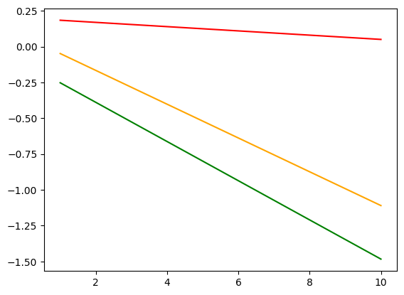
mine
From the paper
Notes:
TODO: neat figures (would need to reproduce paper’s figure properly (how? Excel?)

Slide 27
mine
From the paper
Notes:
TODO: neat figures (would need to reproduce paper’s figure properly (how? Excel?)

