Slide 1
WELCOME

Slide 2
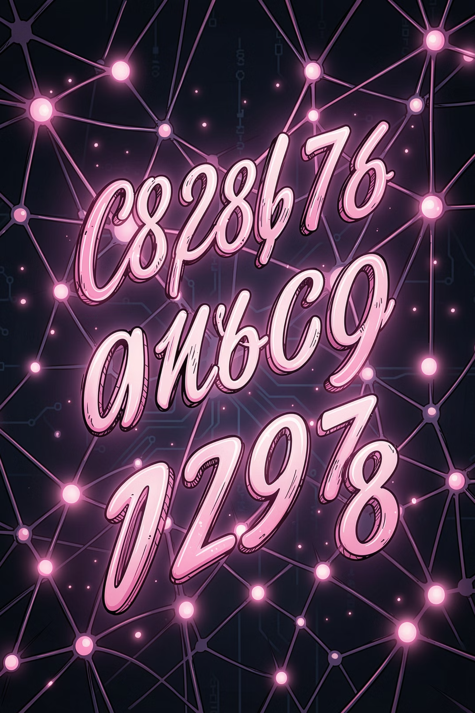
HANDWRITTEN DIGIT RECOGNITION SYSTEM USING CNN AND STREAMLIT
AI TRAINING PROGRAM · NSTI SRINAGAR · 2025–2026
Theme: Sustainability
Submitted By
HUZAIFA NAZIR
Furkan
Sheeba
Department of Artificial Intelligence
NATIONAL SKILL TRAINING INSTITUTE (NSTI)
SRINAGAR, JAMMU & KASHMIR
Academic Session
2025 – 2026

Slide 3
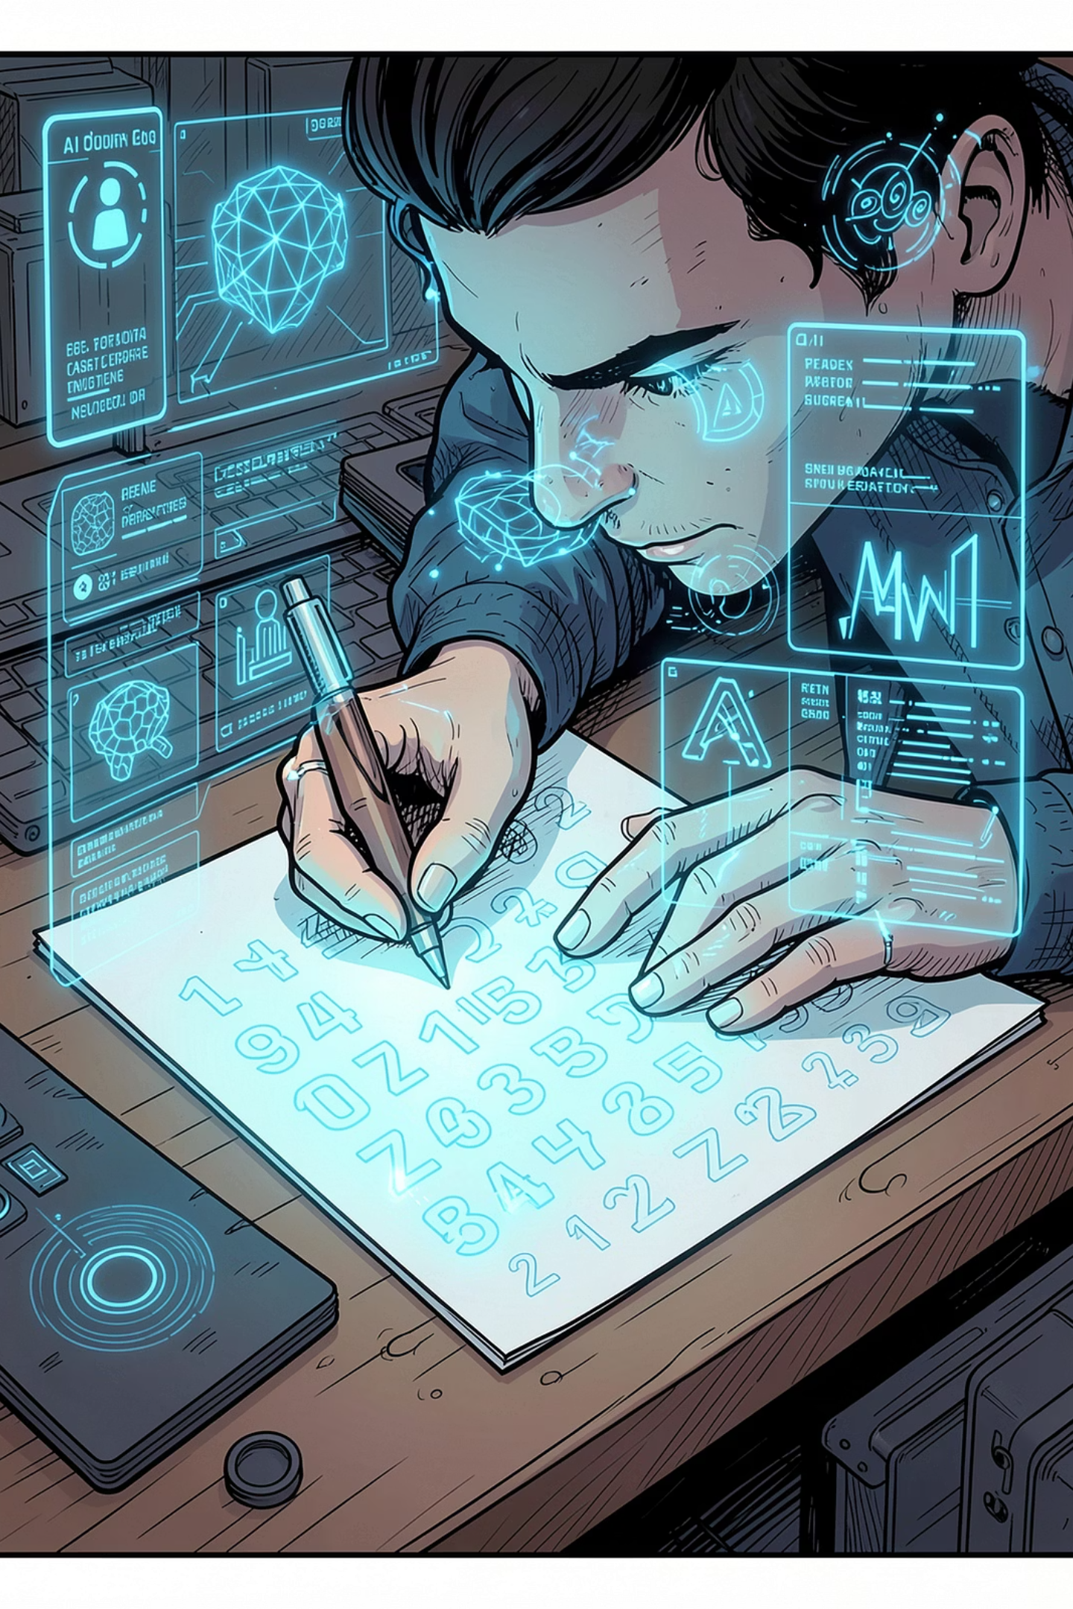
Abstract
The Handwritten Digit Recognition System is a machine learning project that identifies handwritten digits from 0 to 9. The system uses a Convolutional Neural Network (CNN) model trained on the MNIST dataset. Users can upload an image of a handwritten digit through a Streamlit web application, and the system predicts the digit automatically. This project demonstrates the practical use of Artificial Intelligence and Deep Learning in image recognition.

Slide 4

Aim of the project
To develop a web-based application that recognizes and predicts handwritten digits (0–9) using a CNN model deployed via Streamlit.

Slide 5
Objectives
• To collect and use the MNIST handwritten digit dataset.
• To train a CNN model for digit recognition.
• To build a user-friendly web interface using Streamlit.
• To allow users to upload digit images.
• To predict and display the recognized digit accurately.

Slide 6
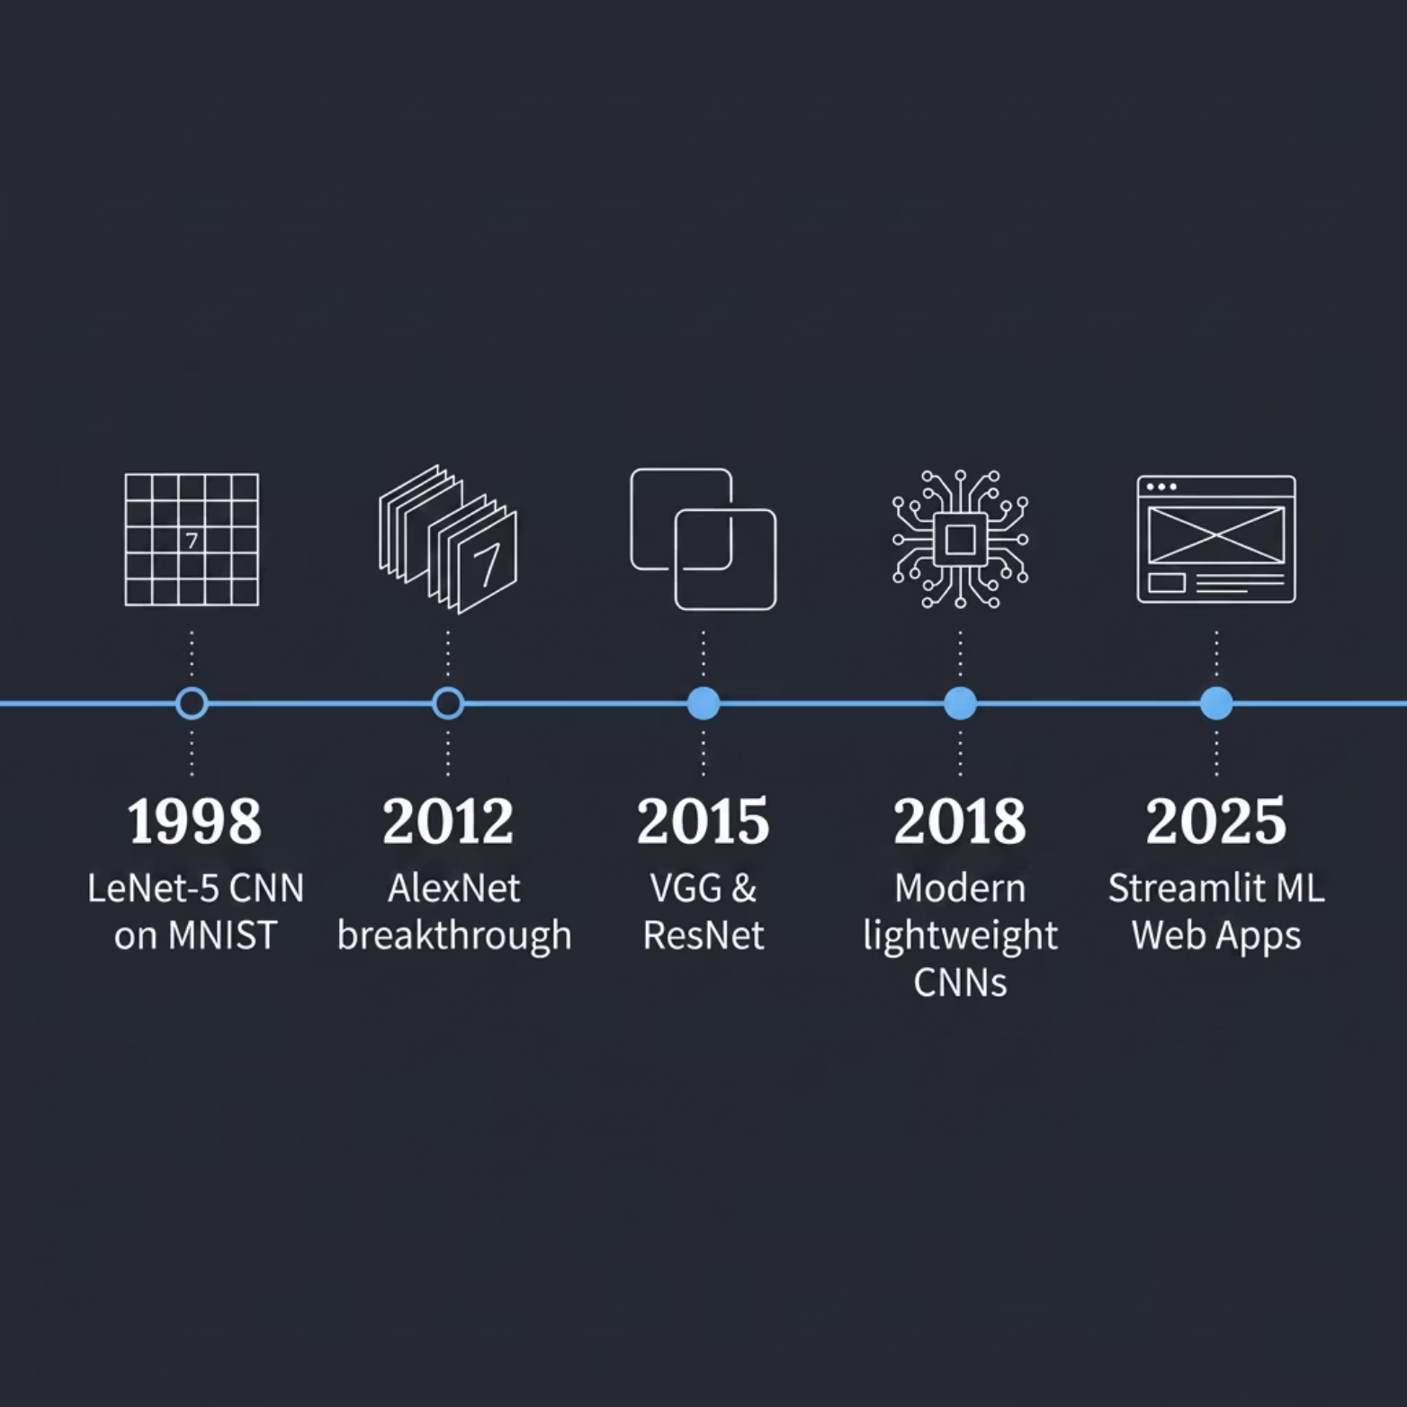
Project Theory
Handwritten Digit Recognition is an application of Artificial Intelligence and Deep Learning. In this project, a CNN model is used to learn patterns from handwritten digit images. The MNIST dataset contains thousands of images of digits from 0 to 9. After training, the model can identify unknown handwritten digits and predict the correct number.

Slide 7

Methodology
Collect the MNIST dataset.
Preprocess the Images
Design CNN
Train model Develop a Streamlit web application.

Slide 8

Dataset & Tools
The MNIST Dataset
Technology Stack
The MNIST dataset is the gold standard for digit recognition research, comprising 70,000 grayscale images of handwritten digits (0–9), each 28×28 pixels.
Python
Core programming language
TensorFlow / Keras
CNN model building & training
Streamlit
Interactive web application
NumPy · Pandas · Matplotlib
Data handling & visualization
60K
10K
10
Training samples
Test samples
Digit classes

Slide 9
Flow Chart
Start
↓
Load MNIST Dataset
↓
Train CNN Model
↓
Save Model
↓
Launch Streamlit App
↓
Upload Digit Image
↓
Preprocess Image
↓
Predict Digit
↓
Display Result
↓
End

Slide 10

Streamlit Web Application
How It Works
The Streamlit app provides a zero-setup, browser-based interface for real-time digit recognition. Users upload an image, and the CNN returns a prediction instantly.

Slide 11
Conclusion
The Handwritten Digit Recognition System successfully recognizes handwritten digits using a CNN model. The project uses the MNIST dataset and provides predictions through a Streamlit web application. The system is accurate, efficient, and demonstrates the practical application of Deep Learning in image recognition.

Slide 12
THANK YOU

