Slide 1

Do you like CAFFEINE
KING OF MODERN CACHE

Slide 2
BACKGROUND

Slide 3
Guava cache performance

Slide 4
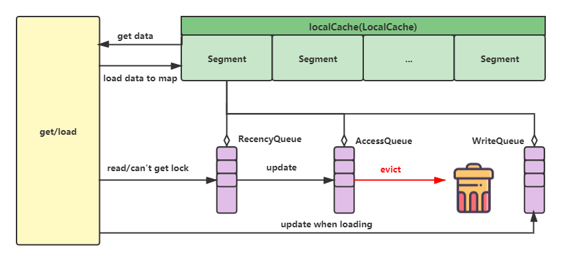
Guava cache
Algorithm: LRU
Implementation
AccessQueue
WriteQueue
RecencyQueue

Slide 5
COMMON CACHE
ALGORITHM AND IMPLEMENTAION

Slide 6
LRU
Advantage:
Simple
Small memory consumption
Good at handling sparse burst
Disadvantage:
Lack of statistics and can evict popular data

Slide 7
LFU
Advantage:
Keep popular data with frequency statistics
Disadvantage:
Large memory consumption
Hard to evict expired high-frequency cache node
Hard to handle sparse burst as low-frequency data will not be cached

Slide 8
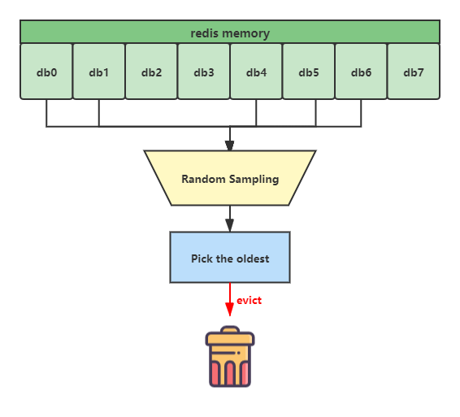
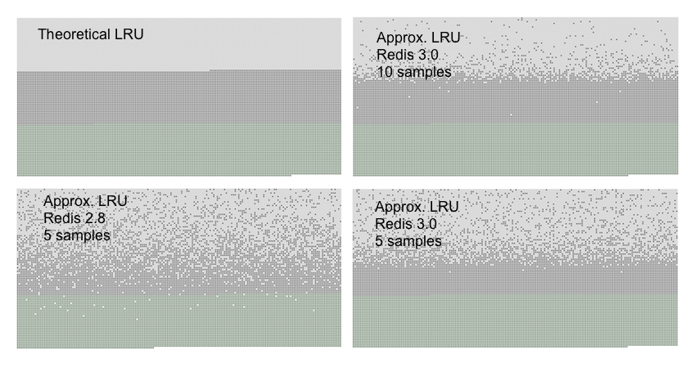
Redis LRU
Algorithm
Approx. LRU
Implementation
Sampling
LRU

Slide 9
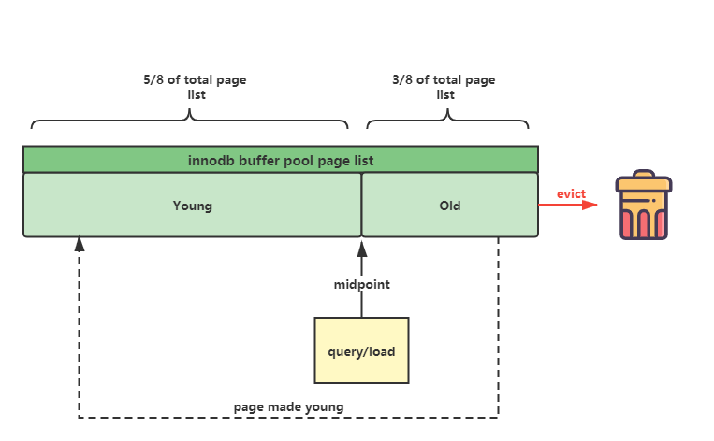
Mysql innodb page cache
Algorithm
Segmented LRU
Implementation
Old generation
Young generation
Page made young

Slide 10
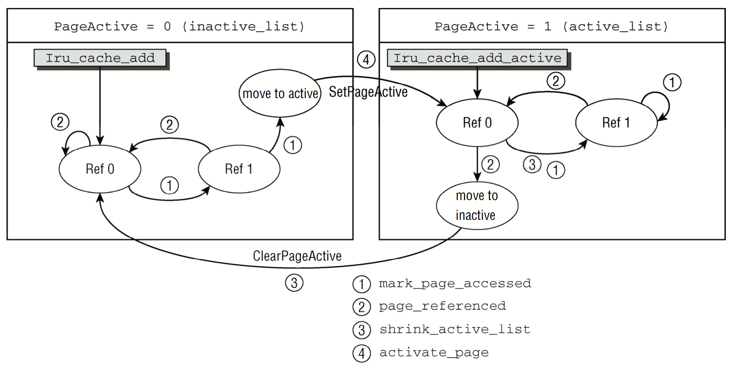
Linux page cache
Algorithm
Segmented LRU
Implementation
Active list
Inactive list
Make active
Make inactive

Slide 11
HOW TO COME UP WITH CAFFEINE
Combine Lru with lfu

Slide 12
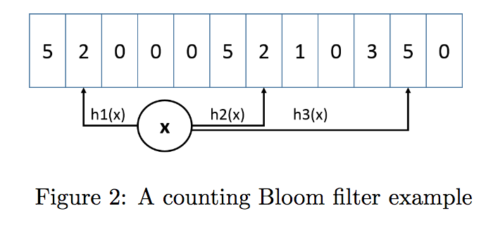
Reduce LFU memory consumption
Algorithm
Bloomfilter
Implementation
Count-min sketch

Slide 13
Make LFU cache expired
Algorithm
Reset
Implementation
Every time we add an item to the approximation sketch, we increment a counter. Once this counter reaches the sample size (W), we divide it and all other counters in the approximation sketch by 2
Proof
Mathematical induction

Slide 14
Handle spart burst
Algorithm
LRU
Implementation
Window cache

Slide 15
Reduce space
Implementation
Small counter: If a sketch takes W as reset sample size, it is required to allow counters to count until W. The sketch size is C. So if the node is moved to the main cache, the counter should be larger than W/C. We don’t need to count until W.
Doorkeeper: The Doorkeeper is a regular Bloom filter placed in front of the approximate counting scheme. Upon item arrival, we first check if the item is contained in the Doorkeeper. If it is not contained in the Doorkeeper (as is expected with first timers and tail items), the item is inserted to the Doorkeeper and otherwise, it is inserted to the main structure.

Slide 16
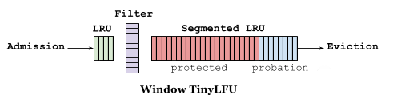
Window TinyLFU schema
Algorithm
LRU with count-min sketch

Slide 17
CAFFEINE IMPLEMETAION

Slide 18
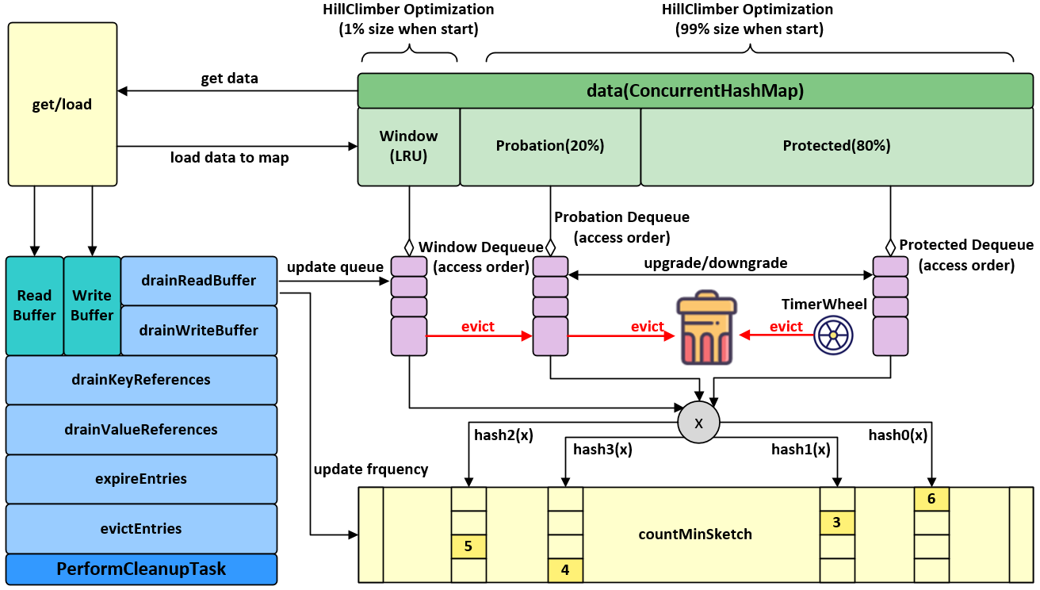
Schema
Component
data
AccessOrderDeque
Eden Dequeue
Probation Dequeue
Protected Dequeue
countMinSketch
PerformCleanupTask

Slide 19
PerformCleanupTask
Algorithm
WAL or innodb insert buffer
Implementation
drainReadBuffer()
drainWriteBuffer()
drainKeyReferences()
drainValueReferences()
expireEntries()
evictEntries()

Slide 20
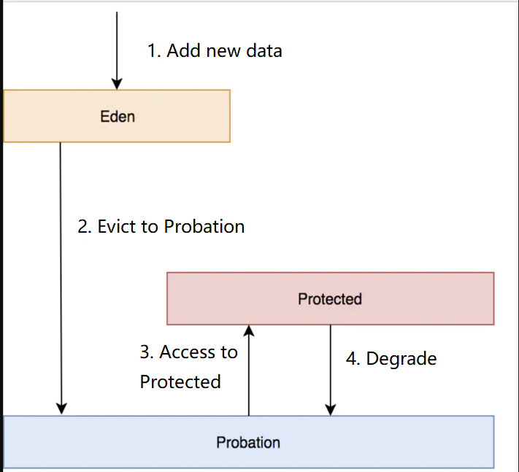
Eviction
Implementation
The head of probation is the oldest node and the tail is the newest. So we will decide which on shall be evicted based on tinyLFU：
If the frequency of the tail node is larger than that of the head node, the head one will be evicted.
Otherwise if the frequency of the tail node < 5, then the tail one will be evicted.
If the frequency of the tail node >= 5, the tail and the head node will be randomly eviced.

Slide 21
Usage

Slide 22
Performance

Slide 23
FURTHER THOUGHTS

Slide 24
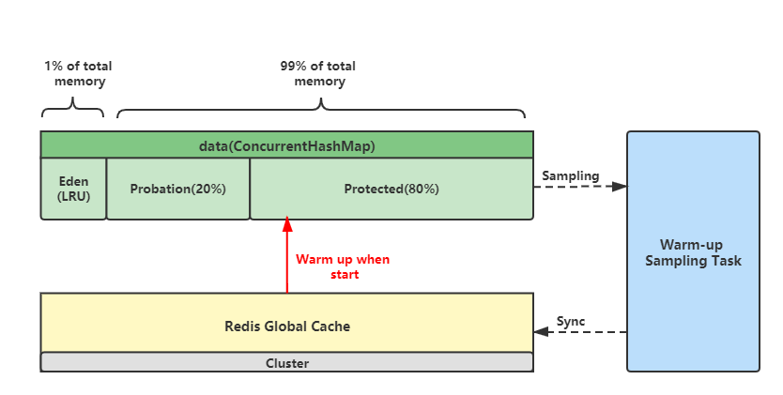
Cache warm up
Implementation
Warm-up task will sample cache in protected list to sync them into redis global cache
When the service with local cache starts, the warm-up cache in redis will be loaded first

Slide 25
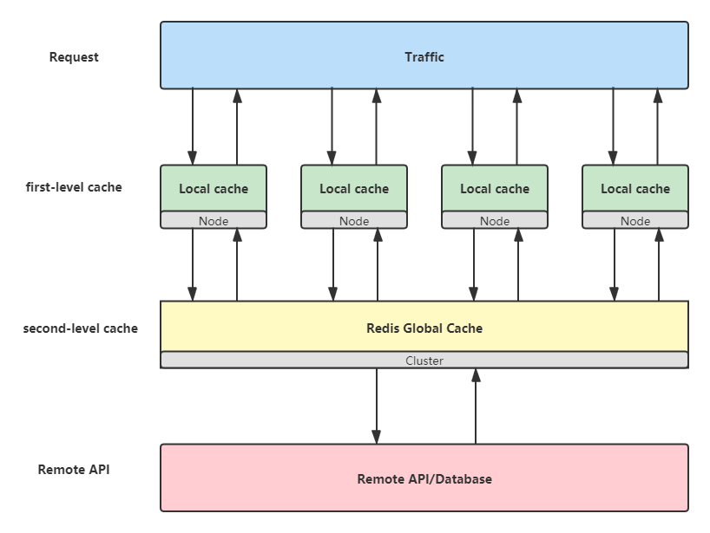
Multiple-level cache
Implementation
We’ll sync all the local cache in every node to the redis global cache
The request will first come to local cache. If it’s not hit, the request will go to the redis global cache. If the redis cache is also missed, the request will then go to the remote API or database

Slide 26
REFERENCE [1] https://github.com/ben-manes/caffeine.git [2] Gil Einziger, Roy Friedman, Ben Manes. TinyLFU: A Highly Efficient Cache Admission Policy. ACM Transactions on storage, 2015 [3] Gil Einziger, Ohad Eytan, Roy Friedman, Ben Manes. Adaptive Software Cache Management. Proceedings of the 19th International Middleware Conference, 2018
Thanks!

