Slide 1
Local Or International Restaurant In Istanbul
CAPSTONE PROJECT

Slide 2
Introduction/Business Problem
In this project, if a person or company want to open a restaurant in Istanbul,Turkey.I will give a thought about the Local or International restaurant.Istanbul is a very big metropoll and big city.In this project a person or company who wanna open new restaurant will find the good opinion.The problem is confusing the opening new restaurant ın Istanbul becasue of the big area.We will give a result about the solving this problem.While solving this problem, ı will use sections at the below.

Slide 3
Introduction/Business Problem
1. Using multiple datasets from different sources (i.e. Web, Geocode, CSV files, Foursquare API)

Slide 4
Introduction/Business Problem
2. Python Webscraping using Beautifulsoup

Slide 5
Introduction/Business Problem
3. Data Preprocessing

Slide 6
Introduction/Business Problem
4. Data Analysis

Slide 7
Introduction/Business Problem
5. Result and Discussions

Slide 8
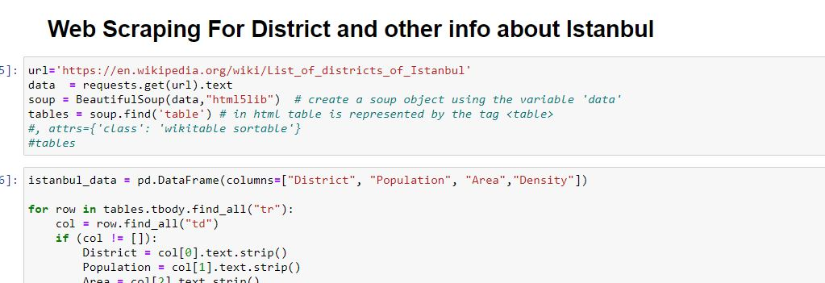
DATA SECTION
In this section, we will prepare the data for the getting true or logical result after the applying the algorithms

Slide 9
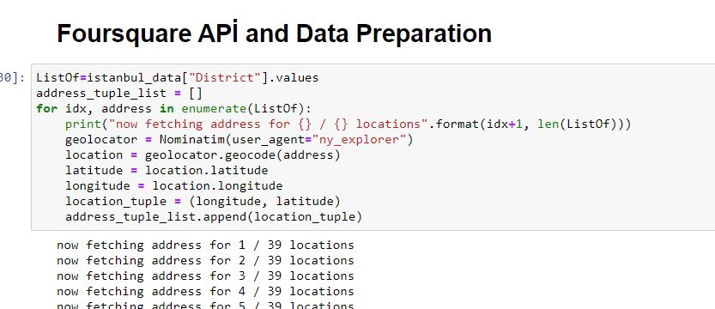
DATA SECTION

Slide 10
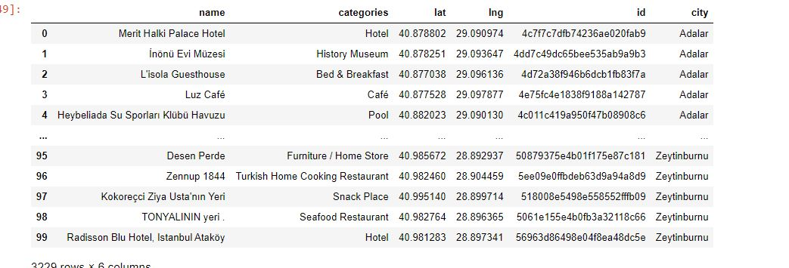
DATA SECTION

Slide 11
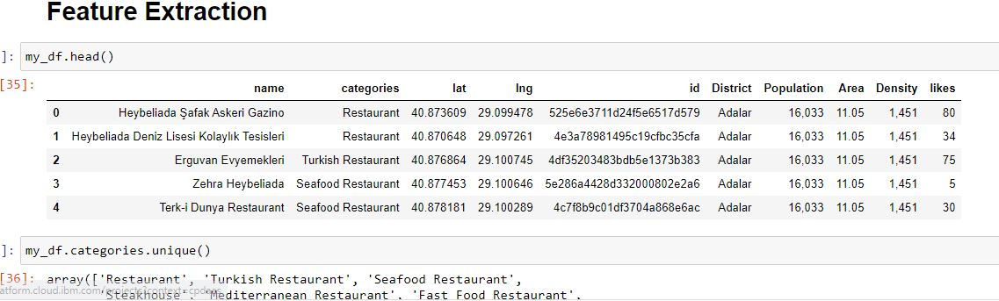
DATA SECTION

Slide 12
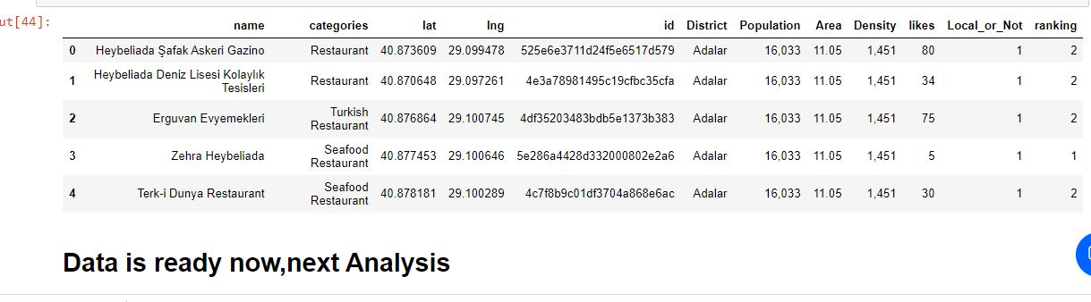
Data is Ready

Slide 13
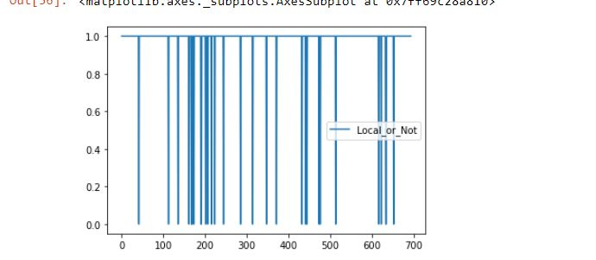
Decision Tree Algorithm

Slide 14
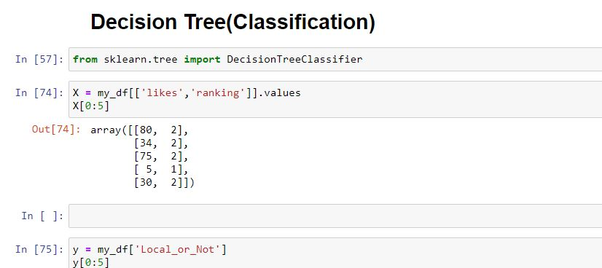
Decision Tree Algorithm

Slide 15
Result And Discussion
Built useful models to predict whether and how a person or company will choose.
Accuracy of the models has room for improvement.
Capture more of places.
Local or Not with the decision tree algorithm we can decide.

