Slide 1
Asynchronous Distributed Data Collection Approach for Mobile Group Consumption
Weiran Chen, Zuoyou Li, Yue Liang, Jiaojiao Chen and Weiping Zhu
Wuhan University
October 2015

Slide 2
Outline
Introduction
System Model
Solution
Simulation Results
Conclusion

Slide 3
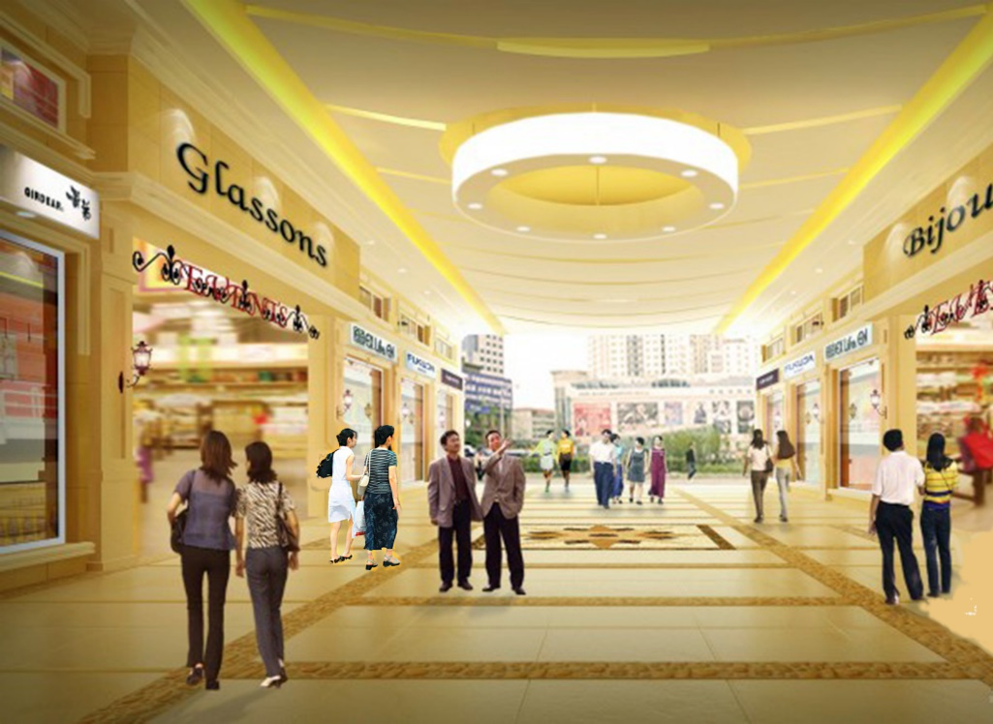
Introduction
Mobile Group Consumption
  Group consumption happens among a group of people such as couples, families, colleagues, friends, etc.
  Recent group consumption is increasingly based on mobile devices such as smartphones, pads, laptops, etc.

Slide 4
Existing Data Collection System
Centralized
  Difficult to find a proper powerful server
  Suffers from serious one-point failure and computation bottleneck
Synchronized clock needed
  High overhead when the consumers is in a large number and constantly moving
  Sometimes impossible due to hardware constrains of devices or privacy concerns from people.
It is highly demanded to design an asynchronous distributed data collection approach for mobile group consuming

Slide 5
Our Contributions
Propose asynchronous distributed system model
  Data collection is not based on centralized server or synchronized clock
Propose a three-layer data collection approach
  Data collection is firstly handled locally, and then coordinated in convective regions or more regions if the data collection spans a wide area
  Analyze the causality of two marketing events based on pure message exchange

Slide 6
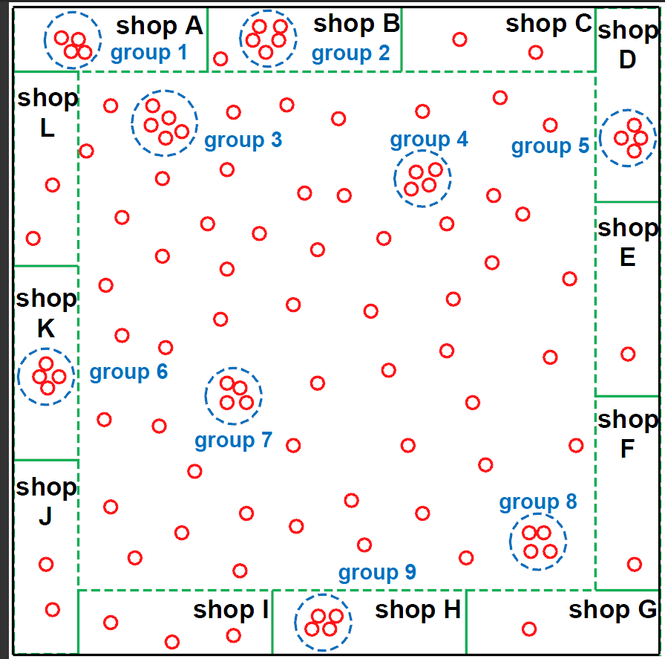
System Model
Shopping mall, shops, groups

Slide 7
System Model (cont)
Gathering event
  N person is gathered in a shop during its promotion time
  Each gathering event exists in a time interval which is delimited by the start time of the gathering event
No central server or synchronized clock

Slide 8
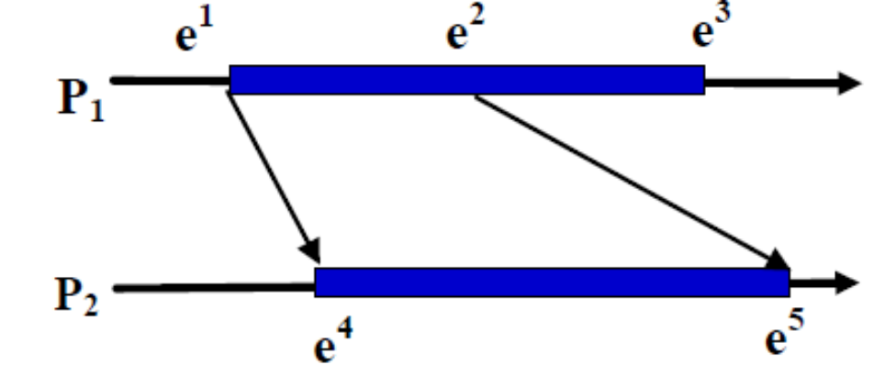
System Model (cont)
Temporal Relations
  happen before
  concurrent

Slide 9
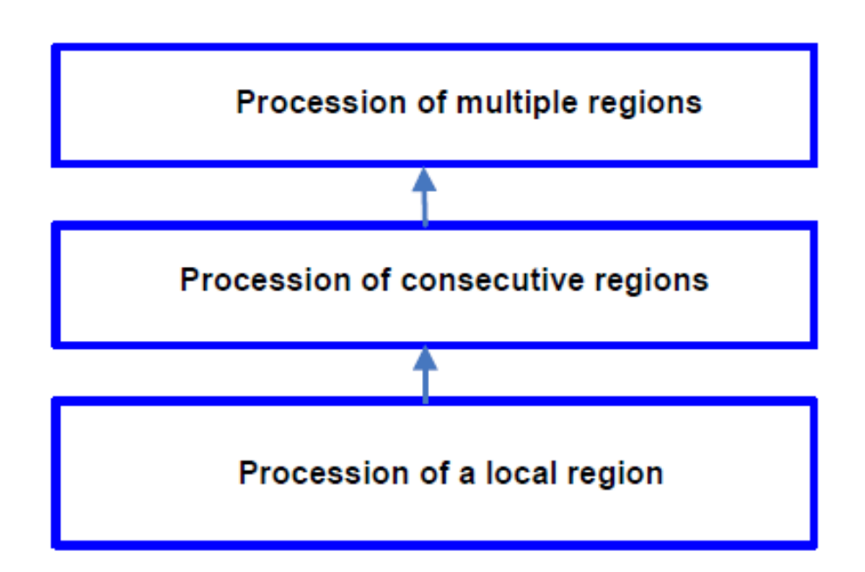
Solution
  A three-layer Framework
  An example
    Analyze the causality of two marketing events

Slide 10
Solution
  Basic Idea
  Build the happen before relation through the message forward among persons and shops, and the walking of the persons
  The happen before relation is implemented by vector clock
  Each shop monitoring the gathering event by monitoring its start event and end event
  The causality relation is built by the before relation between two gathering events
  Routing tree is built among shops in a distributed way
  The routing tree is adjusted adaptively to control the depth

Slide 11
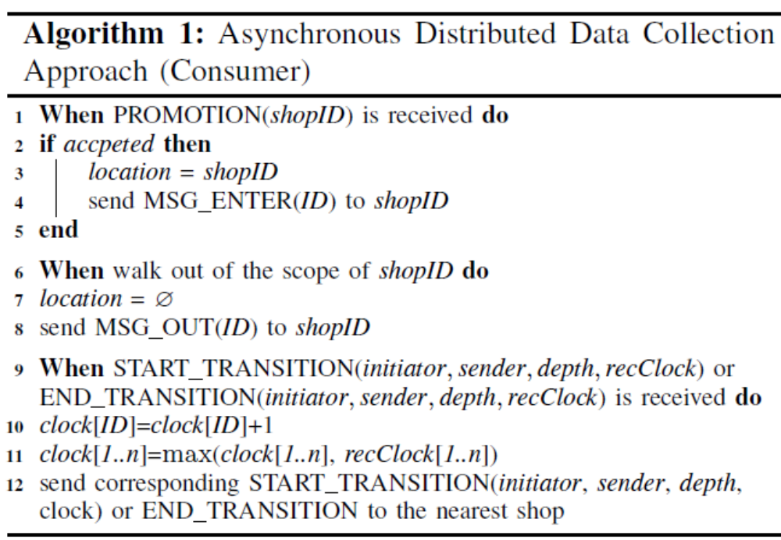

ADDC

Slide 12
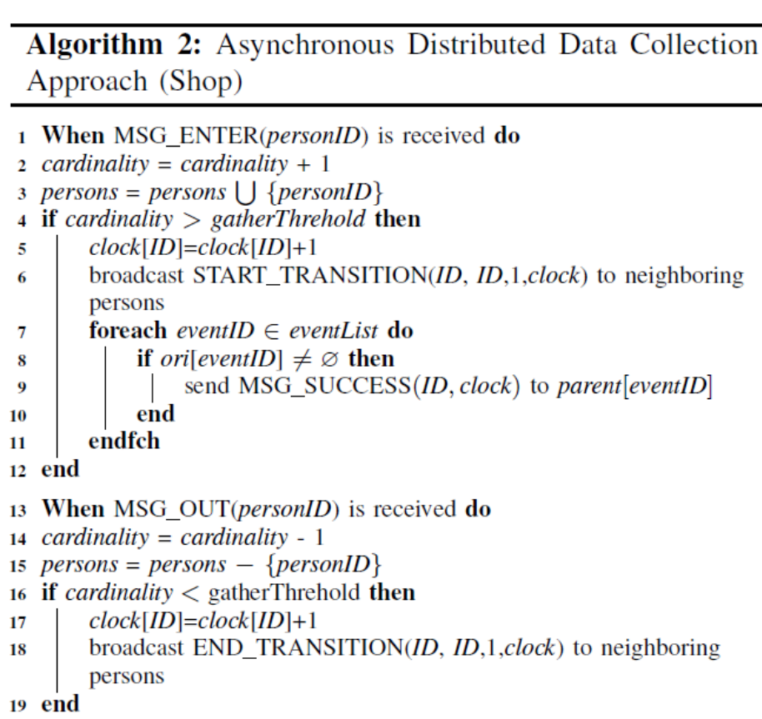
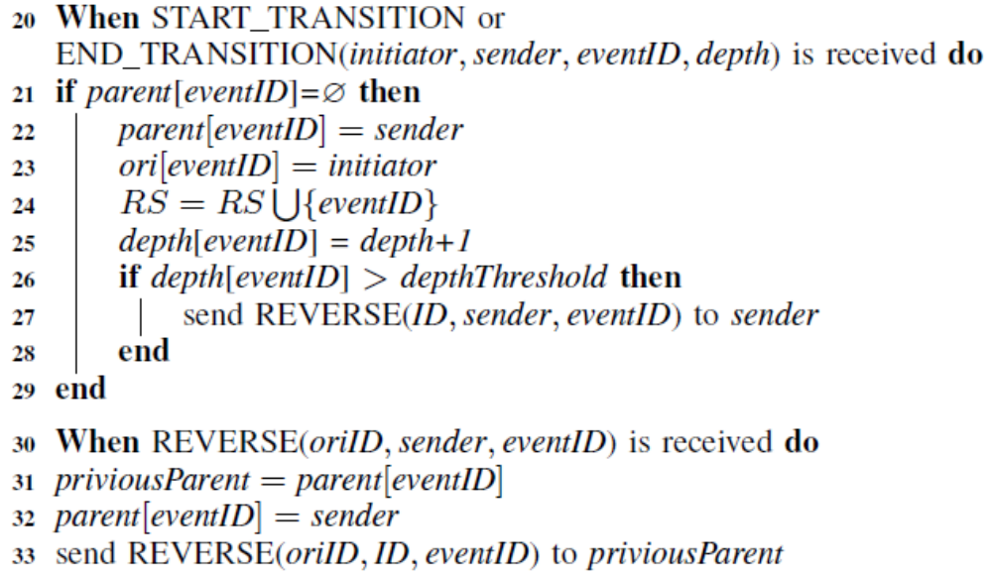
ADDC

Slide 13
Discussion
  Time duration
  Generally is impossible since no synchronized clock exist
  If the exchange of messages are frequent, the number of messages from one event to another event can be used to estimate the time duration between them
  Temporal relations
  29 kinds of relations between two time intervals (dense time mode)
  Occurrence probability for specifying the uncertainty
1.A.D. Kshemkalyani, “A fine-grained modality classification for global predicates,” IEEE Trans. on Parallel and Distributed Systems, vol. 14,no. 8, pp.807-816, 2003. Z
2.W. Zhu, J. Cao, and M. Raynal, “Predicate detection in asynchronous distributed systems: A probabilistic approach,”IEEE Transactions on Computers, vol. pp, no. 99, pp. 1-1, 2015.

Slide 14


Evaluation Results
Simulation Setup
  People wander in a room of 10m × 10m including 12 shops
  In each second, each shop conducts marketing activities in a probability of p = 0.00307 and each lasts a duration of s.
  Each marketing activity affects the people d < 15m
  Each person has a probability of p_{m} = 0.49 to be attracted
  We compare the results of our approach ADDC with those under physical clock
  The number of event patterns satisfying the causality of two events and three events, denoted by and , respectively. T is set to be 500 seconds

Slide 15
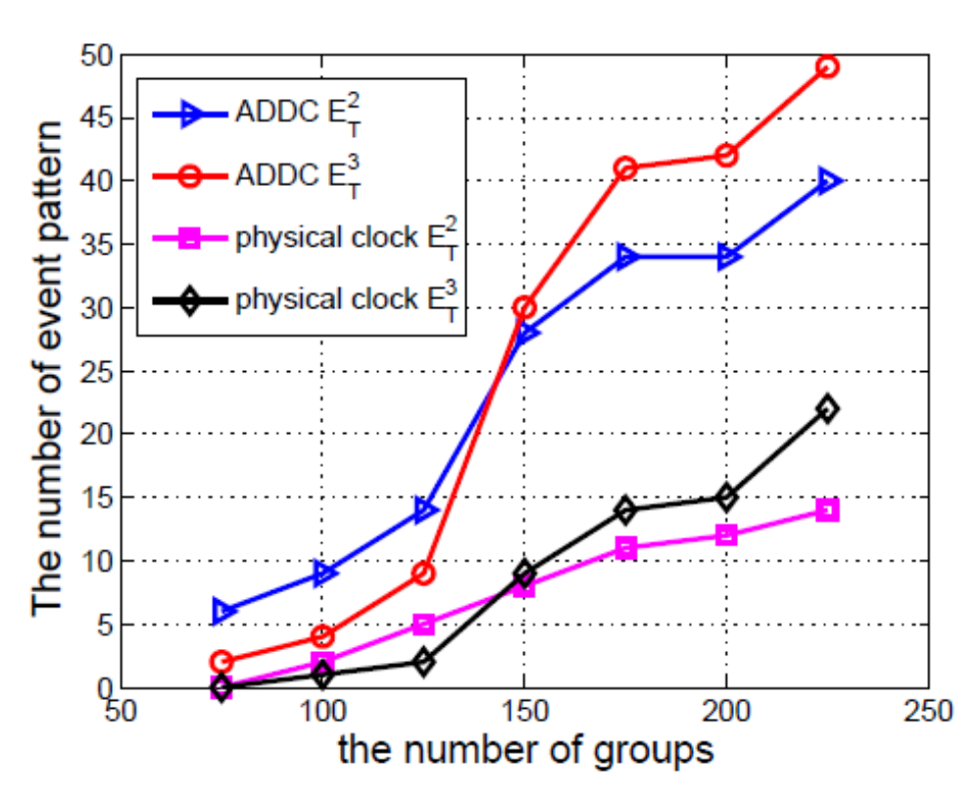
Evaluation Results
Adjust the number of groups

Slide 16
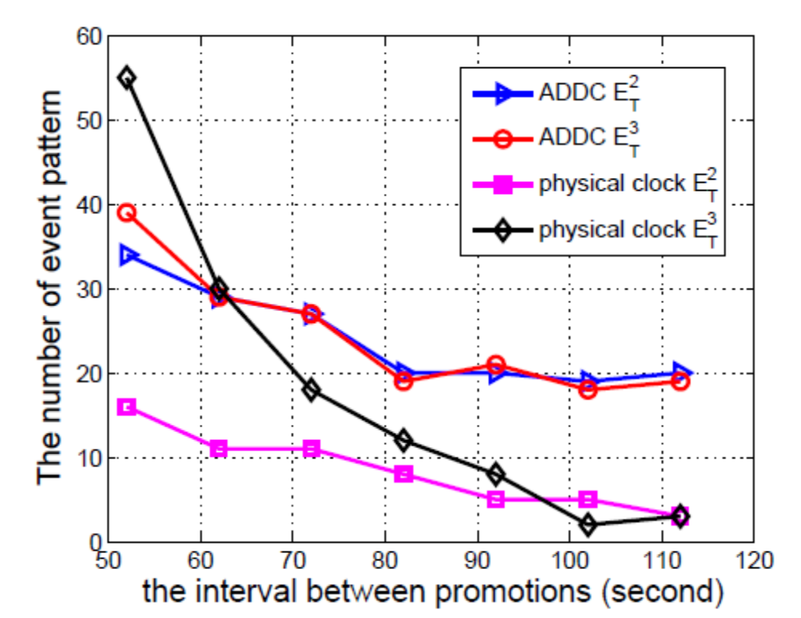
Evaluation Results
Adjust interval between promotions

Slide 17
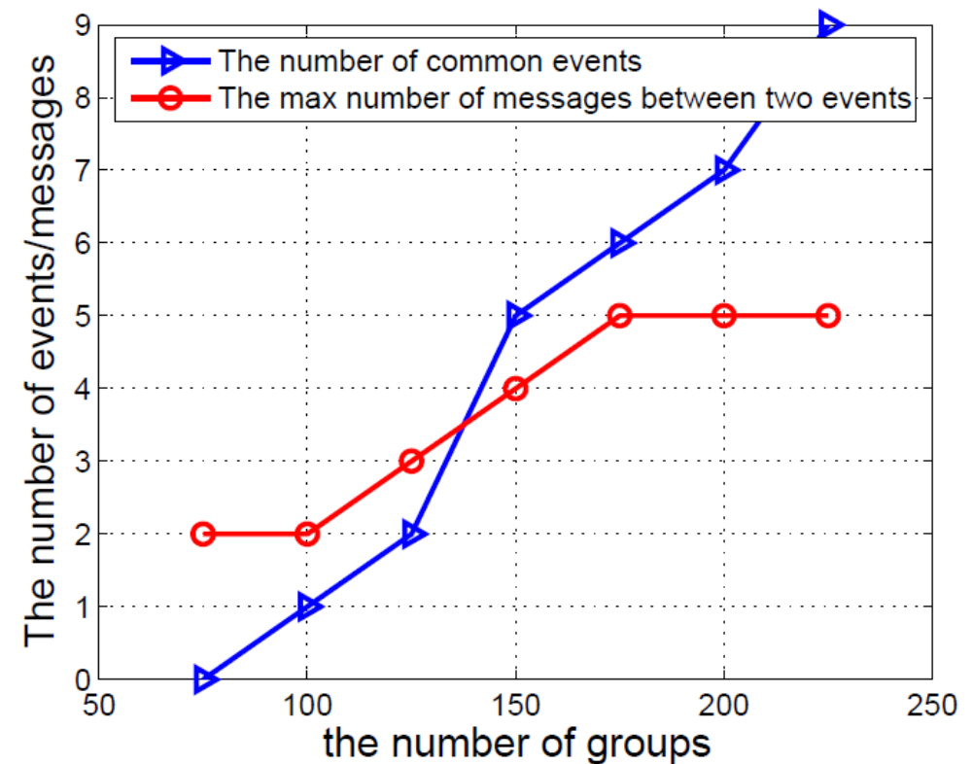
Evaluation Results
Common event patterns and messages

Slide 18
Conclusion
We investigated asynchronous distributed data collection problem for mobile group consumption
A effective system model and a three-layer solution framework are proposed, without central server or synchronized clock.
We proposed detailed algorithms to analyze the causality of two events happened in the system based on message exchange.
Simulation results shown that the proposed approach has good performance.

Slide 19
Thank You!
Q&A
Weiping Zhu
wpzhu@whu.edu.cn

