Slide 1
Resource Management in Kubernetes

Slide 2
Talk Outline
Namespace and cgroups
Namespace
Cgroups
Example in practice
systemd
Resource manage
System
Pod
Evict
Practice in Escontainer

Slide 3
Namespace
Isolation
Enable a process(or serveral processes) to have different views of the system than other processes.
namespaces in kernel-side
NS | PARM
mnt(mount points, filesystems) | CLONE_NEWNS
pid(processes) | CLONE_NEWPID
net(network stack) | CLONE_NEWNET
ipc(system V IPC) | CLONE_NEWIPC
uts(hostname) | CLONE_NEWUTS
user(UIDs) | CLONE_NEWUSER
Notes:
not implementd
security namespace,
security keys namespace,
device namespace,
time namespace

Slide 4
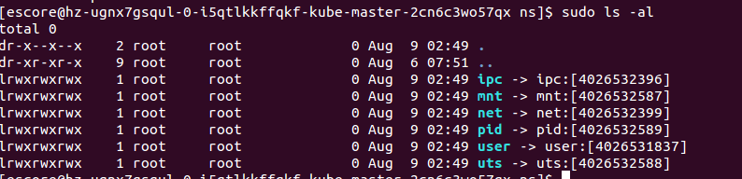
Namespace
Three system calls for management
clone()--- new process, new namespace, attach process to ns
unshare()--- new namespace, attach current process to it
setns(int fd, int nstype)--- join an existing namespace

Slide 5
Namespace
没中ns如果做隔离的作用是什么,不同type之间ns之间能看到的内容是否是不一样的.

Slide 6
cgroup
cgroups
manage resources for groups of processes
definitions
task (Userspace or kernel process)
cgroup (One or more tasks)
subsystem (Module to modify the behavior of the tasks in a cgroup)
hierarchy (Serveral cgroups in a tree)

Slide 7
cgroup
cgroup hierarchy
a or more tree, tasks in the leave of tree.
subsystem
subsystem | description
cpuset,cpu,cpuacct
memory hugetbl
device blkio net_cls net_prio
freezer perf

Slide 8
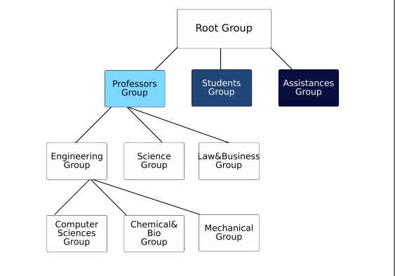
cgroup

Slide 9
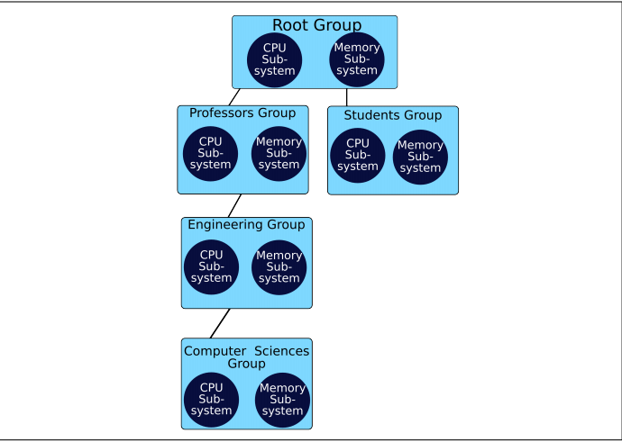
cgroup
The Same Set of Subsystems is inherited by all children

Slide 10
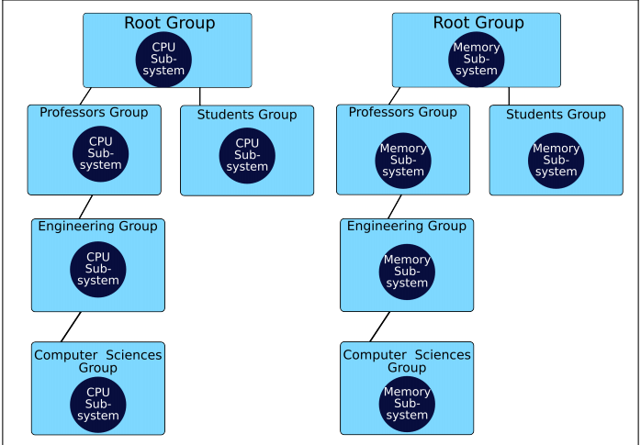
cgroup

Slide 11
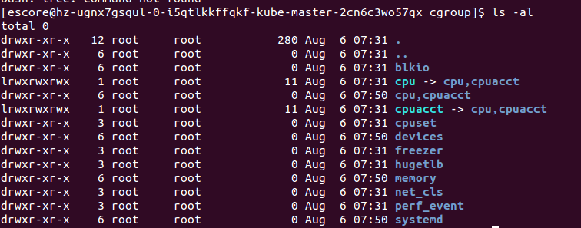
cgroup
virtual cgroup filesystem
手动挂载cgroup+subsystem
demo

Slide 12
cgroup
cgroup tools
FileSystem
libcgroup
cgroupspy
systemd
docker

Slide 13
systemd
Resource control in unit files
pre-configured slices
system
machine
user
https://www.freedesktop.org/software/systemd/man/systemd.resource-control.html

Slide 14
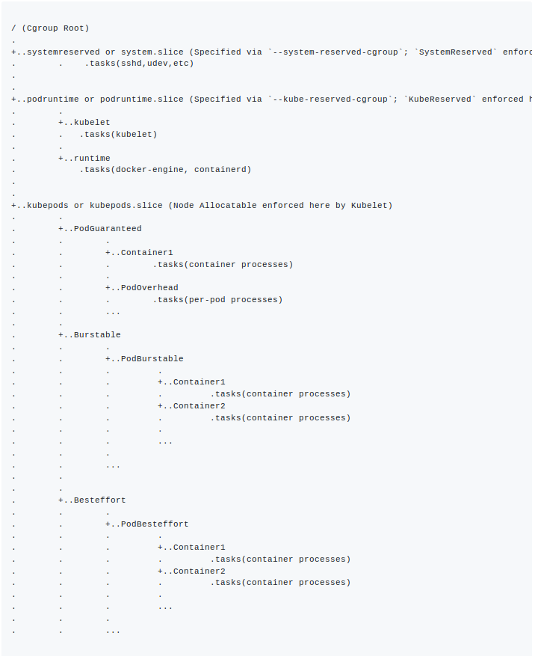
Resource manage

Slide 15
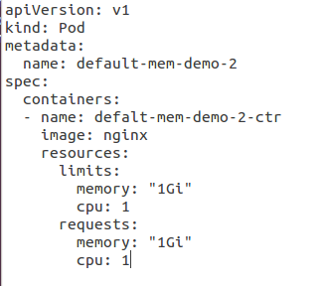
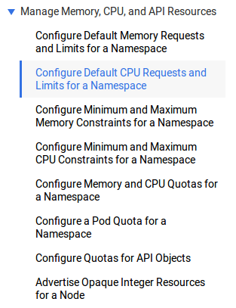
Resource manage
how to set pod request/limit resource.
-->example
pod qos
Best-Effort pods -> Burstable pods -> Guaranteed pods
Node资源（CPU, Memory）资源不足对不同QoS类型pod的处理
可压缩资源CPU：在压缩资源部分已经提到CPU属于可压缩资源，当pod使用超过设置的 limits 值,pod中进程使用cpu会被限制，但不会被kill。
不可压缩资源内存
当Node 内存资源不足时，那么就会有进程因OOM会被kernel kill掉，3种QoS pods被kill掉的顺序与场景如下：
Best-Effort 类型的pods：系统用完了全部内存时，该类型pods会最先被kill掉。
Burstable类型pods：系统用完了全部内存，且没有Best-Effort container可以被kill时，该类型pods会被kill掉。
Guaranteed pods：系统用完了全部内存、且没有Burstable与Best-Effort container可以被kill，该类型的pods会被kill掉。
more can do
-->example

Slide 16
Resource manage
kubelet
kube Reserved
--kube-reserved=[cpu=100m][,][memory=100Mi][,][storage=1Gi]
--kube-reserved-cgroup=
system Reserved
--system-reserved=[cpu=100mi][,][memory=100Mi][,][storage=1Gi]
--system-reserved-cgroup=
eviction thresholds
--eviction-hard=[memory.available<500Mi]
[Allocatable] = [Node Capacity] - [Kube-Reserved] - [System-Reserved] - [Hard-Eviction-Threshold]

