Slide 1
Resource Management in Kubernetes

Slide 2
Talk Outline
Namespace and cgroups
Namespace
Cgroups
Example in practice
systemd
Resource manage
System
Pod
Evict
Practice in Escontainer

Slide 3
Namespace
Isolation
Enable a process(or serveral processes) to have different views of the system than other processes.
namespaces in kernel-side
NS | PARM
mnt(mount points, filesystems) | CLONE_NEWNS
pid(processes) | CLONE_NEWPID
net(network stack) | CLONE_NEWNET
ipc(system V IPC) | CLONE_NEWIPC
uts(hostname) | CLONE_NEWUTS
user(UIDs) | CLONE_NEWUSER
Notes:
not implementd
security namespace,
security keys namespace,
device namespace,
time namespace

Slide 4
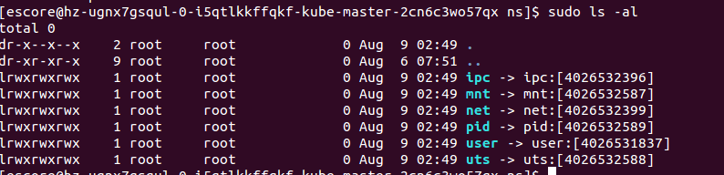
Namespace
Three system calls for management
clone()--- new process, new namespace, attach process to ns
unshare()--- new namespace, attach current process to it
setns(int fd, int nstype)--- join an existing namespace

Slide 5
Namespace
没中ns如果做隔离的作用是什么,不同type之间ns之间能看到的内容是否是不一样的.

Slide 6
cgroup
cgroups
manage resources for groups of processes
definitions
task (Userspace or kernel process)
cgroup (One or more tasks)
subsystem (Module to modify the behavior of the tasks in a cgroup)
hierarchy (Serveral cgroups in a tree)

Slide 7
cgroup
cgroup hierarchy
a or more tree, tasks in the leave of tree.
subsystem
subsystem | description
cpuset,cpu,cpuacct
memory hugetbl
device blkio net_cls net_prio
freezer perf

Slide 8
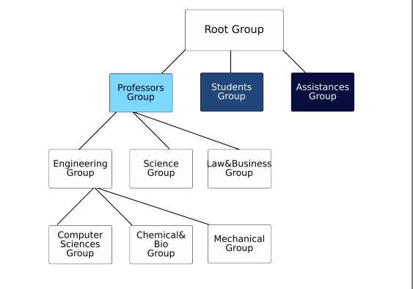
cgroup

Slide 9
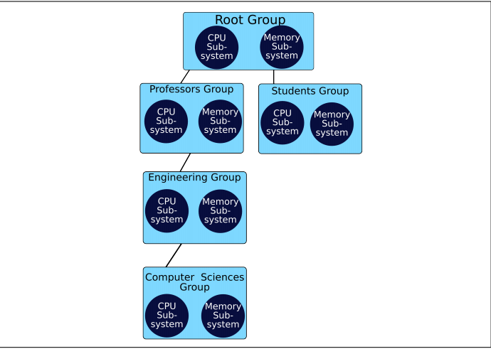
cgroup
The Same Set of Subsystems is inherited by all children

Slide 10
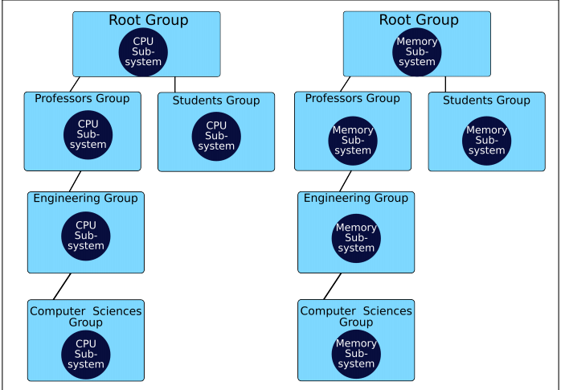
cgroup

Slide 11
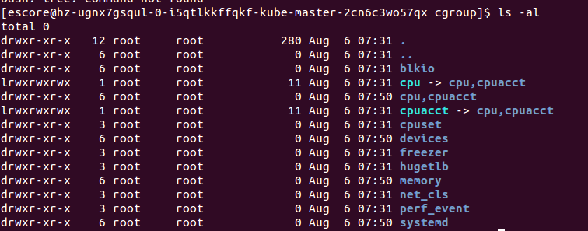
cgroup
手动挂载cgroup+subsystem

Slide 12
cgroup
每种cgroup类型主要参数罗列以及example例子

Slide 13
cgroup
cgroup tools
FileSystem
libcgroup
cgroupspy
systemd
docker

Slide 14
systemd
Resource control in unit files
pre-configured slices
system
machine
user
https://www.freedesktop.org/software/systemd/man/systemd.resource-control.html

