Slide 1
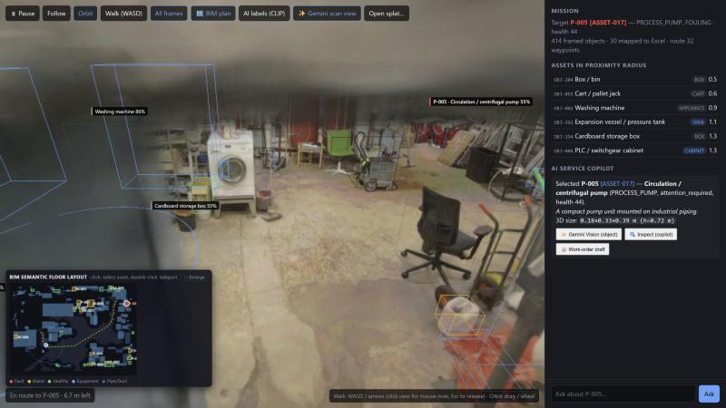
Semantic digital twin and field-service copilot
theMOLFARS · Valmet × Since AI 2026 · Industrial Metaverse challenge
414
30 / 30
8.9 m
49 / 50
3D-framed objects, no overlaps
Excel assets mapped
collision-free A* route
vision benchmark crops
Notes:
We turn Valmet's raw Gaussian-splat scan into a digital twin: every object framed, Excel assets mapped onto real boxes, an avatar that walks a collision-free route to the faulty pump, and a copilot that diagnoses it with evidence IDs.

Slide 2



From blind scan to navigable twin
1
2
3
4
5
6
Sanitize
Floor + grid
Segment
Recognise
Map Excel
Route
1.68 M splats read; corrupted tails cut
Floor/ceiling peaks, 10 cm occupancy grid
Colour-aware voxel graph + 3D NMS
CLIP + video photo match + Gemini
Fit score: class, size, vision
A* with clearance → scene.json
pipeline/ (Python)
web/ (three.js + Spark)
server.py (FastAPI)
build_scene.py runs offline in ~5 s and writes scene.json, the clean splat and a floor plan
Renders the splat, frames, avatar, proximity list and copilot chat; CLIP runs on WebGPU
PostgreSQL evidence, Gemini answers, vision labels, work-order drafts
Notes:
Heavy work happens once, offline and deterministic. The browser only renders and runs the mission; the server answers questions from the Excel data.

Slide 3



414 non-overlapping, named 3D frames
Colour-aware segmentation
4 cm voxels join only if their colours match, so a red pump splits from its white pipe
One frame per object
3D NMS, 129 touching parts grouped into 49 objects, 88 frames rotated by PCA; isolate any of them
17 classes, honest names
Pumps, valves, gauges, motors — and the washing machine, boxes and ladder
49/50 is an upper bound for this room: part of the rules were written for this scan.
Notes:
Criterion 1, 30%. 414 objects, never overlapping. Vision went from 30% to 66% with CLIP alone and to 49 of 50 with Gemini on top. We say openly that the last number is tuned to this room.

Slide 4
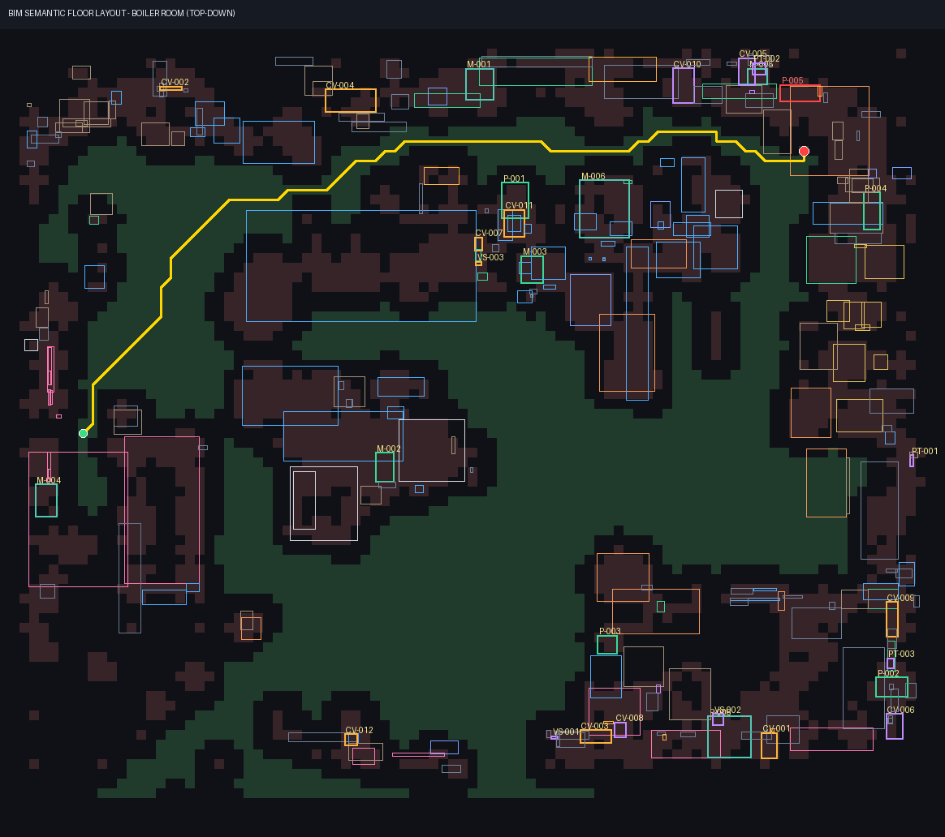




A route that never clips through equipment
Occupancy grid, 10 cm
Floor = splats within ±12 cm; obstacles 0.2–1.7 m high; every cell 0.22 m from the nearest obstacle splat
A* with clearance cost
Middle of aisles, line-of-sight smoothing; Walk mode collides with the same grid
Proximity radius 1.3 m
Frames and Excel status appear as the avatar passes: 14 assets plus the target on this route
Inspection tour (Q‑04)
13 non-healthy assets, urgent first, then the shortest walk: 57 m
Notes:
Criterion 2, 25%. The grid comes from the splat itself. The route is 8.9 m with 11 waypoints, along the equipment wall, never closer than 0.224 m to a splat and is checked cell by cell. Along it, 14 Excel assets enter the 1.3 m radius before the target.

Slide 5



Excel data lands on boxes that fit
Worst health is the target
Some of the 14 assets the avatar passes within 1.3 m
ASSET-017 / P-005, process pump, fouling, health 44, on box OBJ-115 that vision reads as a pump
Tag | Class | State | Health
P-005 | Process pump | attention required | 44
M-006 | Electric motor | attention required | 45
P-001 | Process pump | degraded | 69
M-001 | Electric motor | watch | 77
CV-010 | Control valve | healthy | 96
PT-002 | Pressure transmitter | healthy | 96
Fit score per asset
Exact class +4, compatible class +1.5, seen by vision +2, size check per class
Never on walls or clutter
Boxes read as wall, pipe, box, chair or appliance are excluded; a test fails if that breaks
Statuses are the Excel values as they are: the route also passes degraded and watch-listed devices.
Notes:
The brief allows random mapping; we do better. Assets go worst-health first to the box that fits their class and size, and never to a wall or a washing machine.

Slide 6




Cited diagnosis, honest confidence
Confidence for P-005 (Q‑06)
0.91
model confidence from the pack
Arrival at P-005
SQL over 8 Excel tables
Gemini or offline template
4-section cited report
0.43
after 9 open data-quality flags
Comments on every asset the avatar passes, with evidence IDs
Every cited ID is checked against the retrieved data (Q‑03)
Own telemetry detector: AUC 0.91 vs the pack's labels (Q‑02)
Work-order draft, never submitted (Q‑05)
0.55
3D identity of the mapped box
0.43
overall: the weakest link
Notes:
Criterion 3, 20%. Retrieval is deterministic SQL over eight tables, so nothing is invented. Gemini writes the answer; without a key the same evidence is templated. Confidence drops with each data-quality flag and with a weak 3D identity, as Builder Question Q‑06 asks.

Slide 7

Modular backend that is safe to demo
Pipeline
API (pack's API_Contract)
Trust and reliability
build_scene.py: splat → scene.json
extract_frames.py: video frames
fetch_data.py: splat from Google Drive
video_lift.py: COLMAP + CLIP-L + OWLv2 on GPU
Every API_Contract route of the pack
POST /api/telemetry + MQTT bridge (Q‑07)
OpenUSD export of the scene (Q‑09)
/api/priorities, /anomalies, /brief
docker compose up runs everything
CI: 21 unit tests on every push
JSON-only POSTs, escaped labels
SQLite fallback when Docker is off
Notes:
Criterion 4, 15%. Three modules with one job each. The server implements every route from the pack's API_Contract sheet, plus the vision endpoints, and was hardened after an audit.

Slide 8
Five-minute demo, and what comes next
1
Orbit overview: frames over the splat
Next
Run video_lift.py on the GPU PC for multi-view labels
Re-run Gemini labels without the old score floor
Connect a real OPC UA / MQTT source
Open the OpenUSD export in Omniverse
2
Floor plan: grid, obstacles, A* route
3
Mission: frames + comments within 1.3 m
4
P-005: cited diagnosis, isolated pump
5
Inspection tour (🎬 Demo runs all of it)
github.com/huziichuk/theMOLFARS
Notes:
Close with the live demo order. Next steps are the builder questions we did not finish: live data feeds and OpenUSD export.

