Slide 1
分布式、微服务之
成都数字天空科技有限公司
唯一ID发号器
主讲人：胡祖兴
主讲日期：2018.9.27

Slide 2
为什么需要
从我们公司当前开发的所有系统来看，对于唯一主键ID的策略只有2种，数据库自增ID、UUID。
  对于较小的系统，数据量不大，并发性不高的单体系统，采用数据库自增ID或者UUID策略应该是满足需求，但对于游戏，大数据量，高并发访问的应用来说以及分布式系统等来说，以上两者将带来诸多问题.

Slide 3
UUID局限
1
不满足时间粗略有序性
2
不可反解
3
完全时间数据，长度长，占用空间大
4
无序性，底层是B+树，随机写

Slide 4
数据库自增局限
1
完全依赖数据库
2
数据库移植性差
3
分库分表
4
扩容、洗数据

Slide 5
高性能唯一ID发号器应运而生
ID发号器
1、全局唯一
2、粗略有序
…
指标
3、可反解
4、高性能

Slide 6
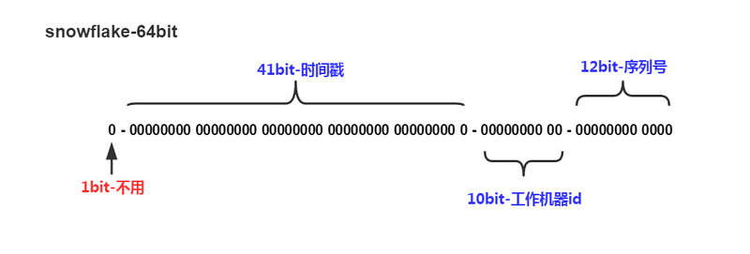
ID发号器—算法原理
此次ID发号器采用的是Twitter的SnowFlake(雪花算法)。算法描述如下（下图来自网上）：
雪花算法生成的ID是64bit的整数，一般我们习惯是正整数
高位1bit：表示正数，所以固定为0，不会使用它
41bit ： 中间41位记录时间戳，表示的范围为0 到 2^41 – 1 毫秒，可以用69年
10bit ： 工作机器ID，用10位记录工作机器ID，可以表示2^10个机器，即支持2^10（1024）个机器同时工作
12bit：序列号，同一毫秒产生的不同ID，那么同一机器，同一毫秒最多将产生2^12 – 1 (4095)个ID

Slide 7
雪花算法结果
保证
所有生成ID按时间趋势增加
整个分布式系统不会出现重复ID（10位的机器ID是不重复的）

Slide 8
实战-Java开发
这里只讲解关键代码部分，完整的项目地址：
https://github.com/huzuxing/distributed-guid-gen.git

Slide 9
Diagram
Text
Add Your
Title Text
Text 1
Text 2
Text 3
Text 4
Text 5
Add Your
Title Text
Text 1
Text 2
Text 3
Text 4
Text 5
Text
Text
Text
Text
LOGO
www.themegallery.com

Slide 10
Diagram
Text
Text
Concept
Text
Text
Text
Text
Add Your Text
LOGO
www.themegallery.com

Slide 11
Diagram
Add Your Text
Add Your Text
Add Your Text
Add Your Text
Add Your Text
Add Your Text
Add Your Text
Add Your Text
LOGO
www.themegallery.com

Slide 12
Diagram
Add Your Title
Add Your Title
ThemeGallery is a Design Digital Content & Contents mall developed by Guild Design Inc.
Add Your Title
ThemeGallery is a Design Digital Content & Contents mall developed by Guild Design Inc.
ThemeGallery is a Design Digital Content & Contents mall developed by Guild Design Inc.
LOGO
www.themegallery.com

Slide 13
Diagram
Text
Text
Text
ThemeGallery is a Design Digital Content & Contents mall developed by Guild Design Inc.
ThemeGallery is a Design Digital Content & Contents mall developed by Guild Design Inc.
ThemeGallery is a Design Digital Content & Contents mall developed by Guild Design Inc.
LOGO
www.themegallery.com

Slide 14
Marketing Diagram
Concept
Concept
concept
Concept
LOGO
www.themegallery.com

Slide 15
Diagram
Add Your Text
Add Your Text
Add Your Text
Title
Add Your Text
Add Your Text
Add Your Text
LOGO
www.themegallery.com

Slide 16
Diagram
1
2
3
ThemeGallery is a Design Digital Content & Contents mall developed by Guild Design Inc.
ThemeGallery is a Design Digital Content & Contents mall developed by Guild Design Inc.
ThemeGallery is a Design Digital Content & Contents mall developed by Guild Design Inc.
LOGO
www.themegallery.com

Slide 17
Diagram
2001
2002
2003
2004
Your Text
Your Text
Your Text
Your Text
Your Text
Your Text
Your Text
Your Text
LOGO
www.themegallery.com

Slide 18
Diagram
ThemeGallery is a Design Digital Content & Contents mall developed by Guild Design Inc.
Title
ThemeGallery is a Design Digital Content & Contents mall developed by Guild Design Inc.
Title
ThemeGallery is a Design Digital Content & Contents mall developed by Guild Design Inc.
Title
LOGO
www.themegallery.com

Slide 19
Block Diagram
TEXT
TEXT
TEXT
TEXT
TEXT
TEXT
TEXT
TEXT
LOGO

Slide 20
Table
 | Title | Title | Title | Title | Title
Title | O | O | O | O | O
Title | O | O | O | O | O
Title | O | O | O | O | O
Title | O | O | O | O | O
Title | O | O | O | O | O
Title | O | X | O | X | O
LOGO
www.themegallery.com

Slide 21
3-d Pie Chart
Text2
Text3
Text1
Text4
Text5
LOGO
www.themegallery.com

Slide 22
Block Diagram
Add Your Text
Add Your Text
concept
Concept
Concept
Concept
LOGO
www.themegallery.com

Slide 23
Thank You !
www.themegallery.com

