Slide 1
AI Introduction
Nov 2022

Slide 2


Agenda
What is AI
AI in Daily Life
AI Development History
AI, Machine Learning & Deep Learning
How to Let Machine to Learn
Discriminative and Generative Model
An Example to Predict Dog / Cat
The Concern about AI

Slide 3
What is AI
What is Intelligence?
Given some environment(inputs), according knowledge, can do some predictions / actions to finish some assigned task.
What is AI (Artificial Intelligence)?
Teach/build machine to have some intelligence, like human.

Slide 4
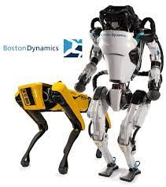
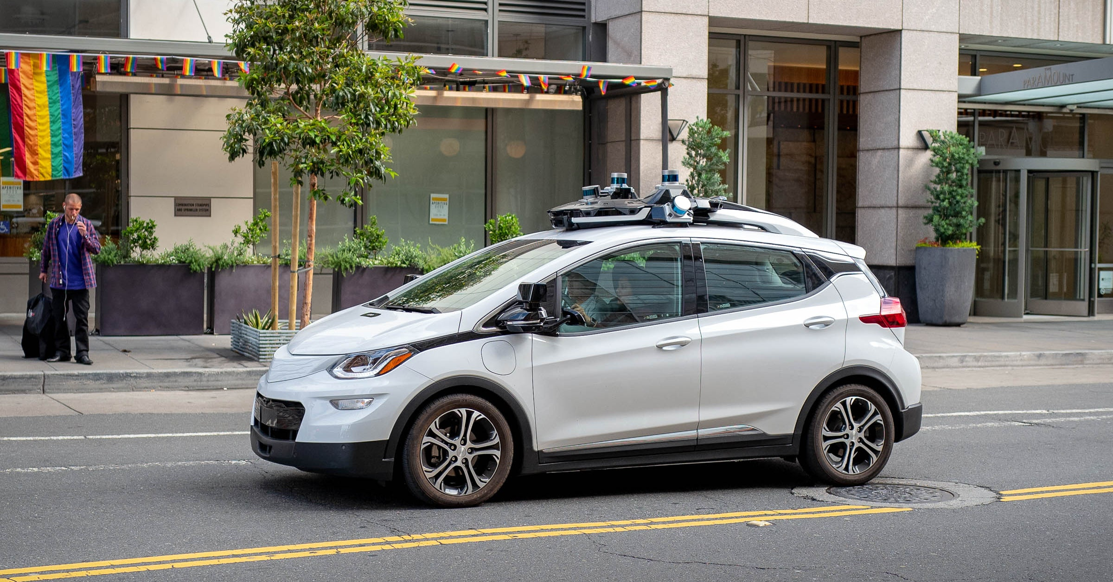
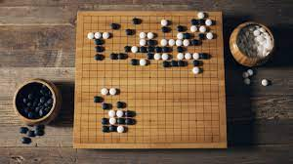

AI in Daily Life
E-Commerce
Chatbots
Amusement
Gaming
Healthcare
Marketing
…
Notes:
https://quickdraw.withgoogle.com/

Slide 5

AI Development History
How to teach / build AI
Phase 1 (1950 ~ 1960): Symbolic AI
Let computer think like people
(Even people doesn’t know how people thinking … )
Phase 2 (1980 ~ 1990): Expert System
Write down expert knowledge and put it into Computer
(Too many rules to write it out and hard to describe … )
Phase 3 (2010 ~ Now): Machine Learning
Put the data that human see, let computer to learn knowledge

Slide 6
AI, Machine Learning & Deep Learning
AI
Machine Learning
Deep Learning

Slide 7
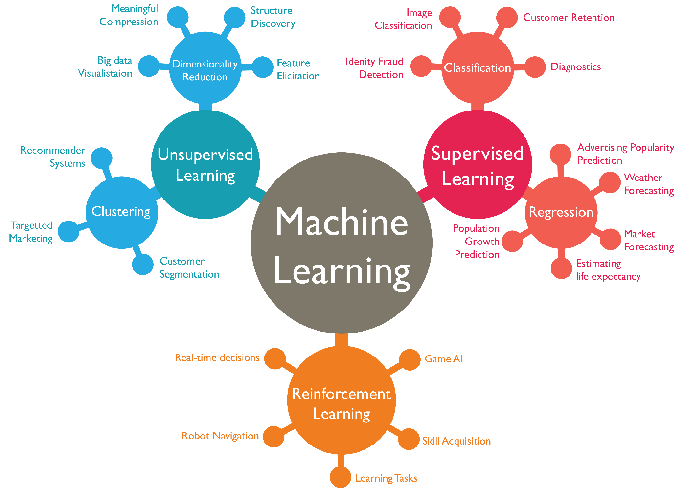
How to Let Machine to Learn

Slide 8
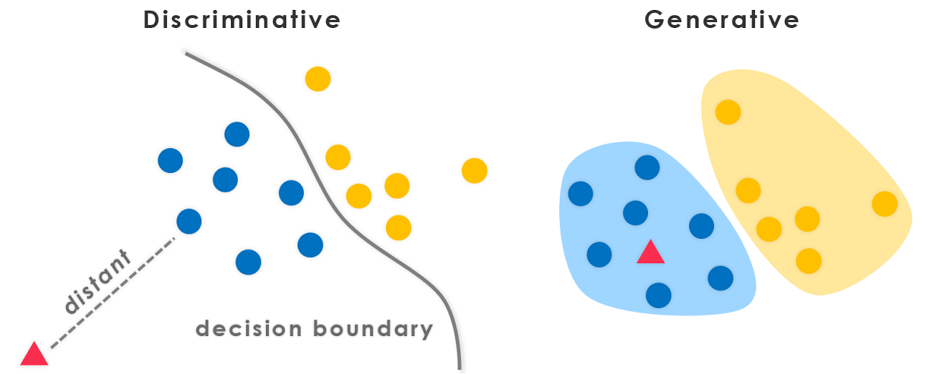
Discriminative and Generative Model
In General, A Discriminative model ‌models the decision boundary between the classes.
A Generative Model ‌explicitly models the actual distribution of each class
Refer: https://medium.com/@mlengineer/generative-and-discriminative-models-af5637a66a3

Slide 9

Discriminative and Generative Model
Discriminative Model Use Cases
Yes / No (or probability )
Email
Spam or not
Ads
User will click or not
Illness
User will click or not
Image
Detect object
Recommendation
User will buy or not
Transaction
Safe or not

Slide 10
Discriminative and Generative Model
Generative Model Demos
https://transformer.huggingface.co/
https://deepai.org/machine-learning-model/text2img
https://www.aichpoem.net/#/shisanbai/poem

Slide 11

An Example to Predict Dog / Cat
Training Data
Training
Validation Data
Model Spec
(Knowledge)
Real Data
Prediction
Result

Slide 12
An Example to Predict Dog / Cat
https://github.com/huzza2/AI_Fundation

Slide 13


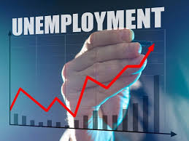

The Concern about AI
Privacy
Security
Job Loss
Out of control

Slide 14

Thank You

