Slide 1
P2P Communication between NodeMCUs
GROUP ID:
Group Members:
ABHAY GOYAL (202211034)
HARSH VARSHNEY (202211001)

Slide 2
Motivation
The problem of communication exists -
In mountains, hilly areas (within an area and to other areas),
Between the outside and inside areas of tunnels, and
Remote, rural and forest areas.
So, we got a motivation to develop a technology to solve this problem and improve connectivity in such areas.

Slide 3
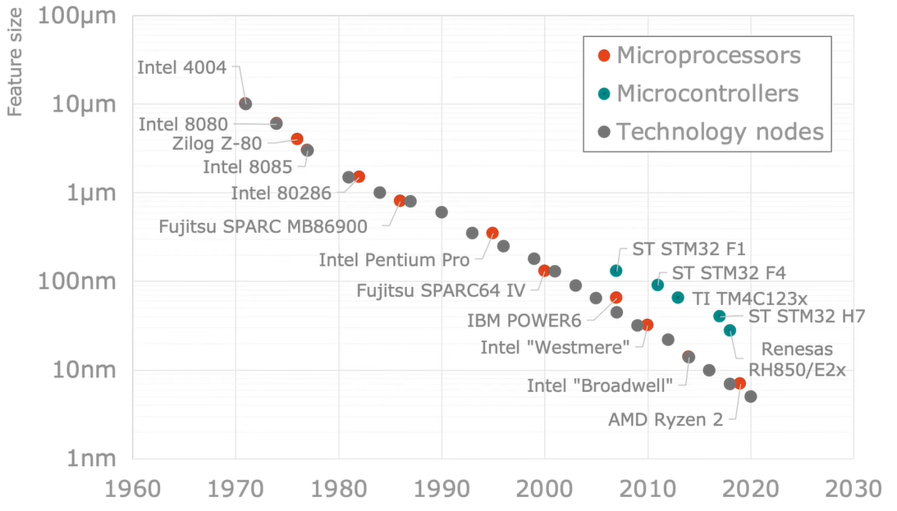
State of the Art Technology
Image Source- https://bit.ly/3MhRN6W

Slide 4
Project Objective
2-way P2P communication between 2 NodeMCUs.
2-way P2P communication between multiple NodeMCUs for increasing connectivity.

Slide 5
Components Required
Frontend (Hardware)
NodeMCU Modules
USB Cable
Connecting wires
Breadboard (in development phase)
Custom PCB (in implementation phase)
Backend (Software)
Arduino IDE

Slide 6
NodeMCU
An open-source firmware and development kit that helps us to prototype our IoT product within a few Lua script lines.
The name "NodeMCU" combines "node" and "MCU" (micro-controller unit).
NodeMCU Development board features Wi-Fi capability, analog pins, digital pins, and serial communication protocols.
It uses many open-source projects, such as lua-cjson and SPIFFS.

Slide 7
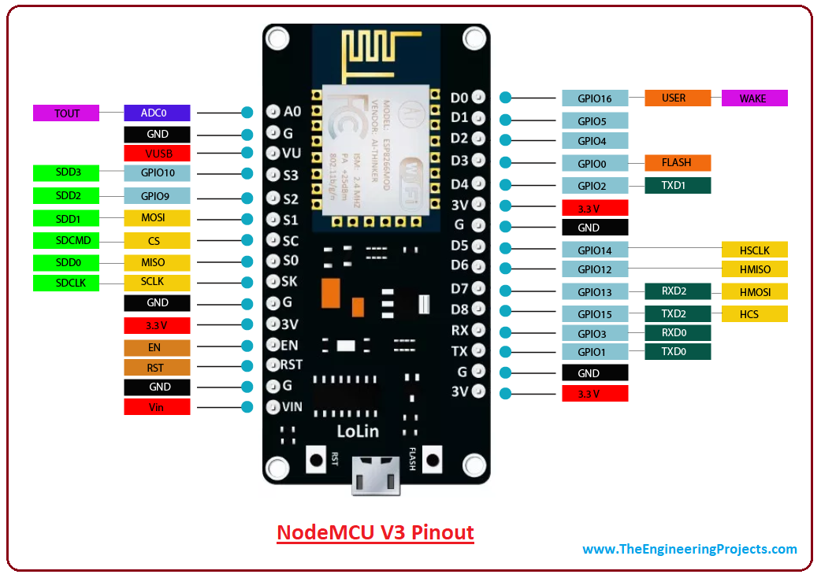
NodeMCU V3 Pin Diagram

Slide 8
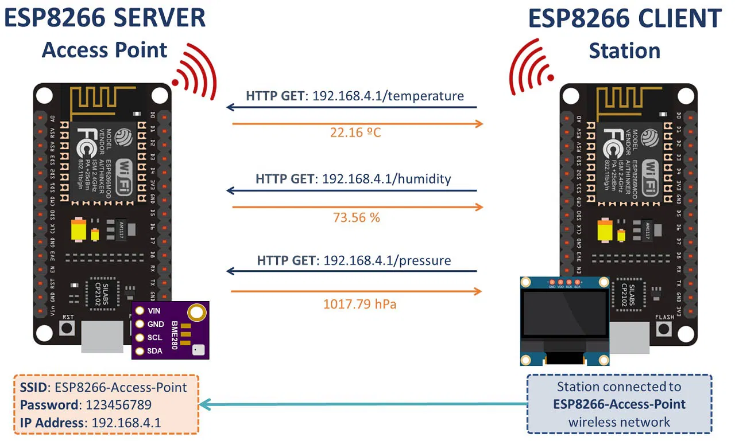
One-way Communication Between Two NodeMCUs
Image Source- https://bit.ly/3ywa1fp

Slide 9
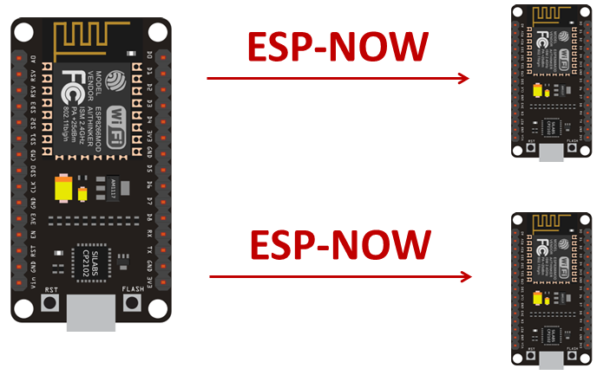
One-to-many Communication of NodeMCUs
Image Source- https://bit.ly/3CLA6cM

Slide 10
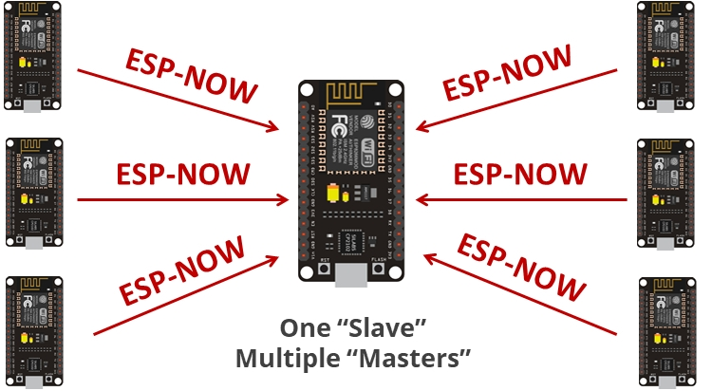
Many-to-one Communication of NodeMCUs
Image Source- https://bit.ly/3MiOOva

Slide 11
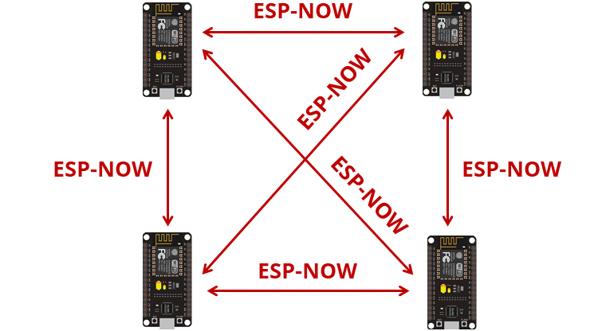
Mesh Communication of NodeMCUs
Image Source- https://bit.ly/3CkdRJJ

Slide 12
Conclusion
There will be communication between two devices at subsequent positions without the internet.
It will help solve the connection dropout problem in tunnels or affected areas.

Slide 13
Future Work
We will go for more communication modes to make communication more effective and create a network of devices.
A local network of devices can be used in communication for emergency, relief and for disaster management purposes.

Slide 14
References
Parihar, Yogendra Singh. (2019). Internet of Things and NodeMCU A review of use of NodeMCU ESP8266 in IoT products. 6. 1085. © 2019 JETIR June 2019, Volume 6, Issue 6
P2P (Bilateral) Communication Between NodeMCU Esp8266 Boards Using Arduino IDE (doi:10.24193/subbphys.2020.08)

